Slide 1
Algorithm Analysis
More Examples
COMP171

Slide 2
Problem 1: Recursive Algorithm Analysis
Derive the tightest possible bound for the Big-Oh time complexity of the following C code fragment in terms of the value of the input size n. Variables are all of type integer.
1. sum = 0;
2. for (i = 0; i < n; i += 4) {
3. for (j = n * n * n; j > 4; j--) {
4. sum++;
5. }
6. }

Slide 3
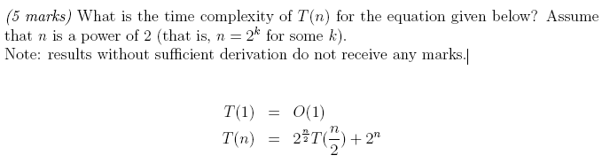
Problem 2

Slide 4
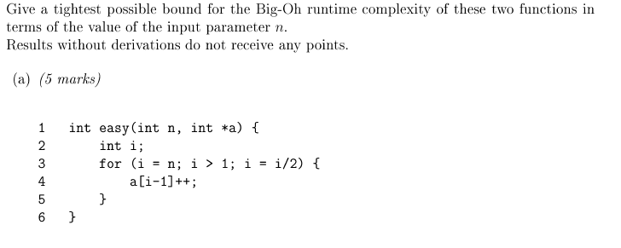
Problem 3

Slide 5
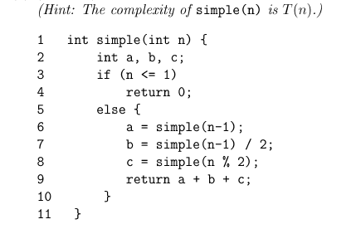
Problem 4
Give the tightest possible bound in big-Oh notation to the running time:

