Slide 1
AVL-Trees (Part 1: Single Rotations)
COMP171
Fall 2006
Lecture 17-18

Slide 2
Balance Binary Search Tree
Worst case height of binary search tree: N-1
  Insertion, deletion can be O(N) in the worst case
We want a tree with small height
Height of a binary tree with N node is at least Θ(log N)
Goal: keep the height of a binary search tree O(log N)
Balanced binary search trees
  Examples: AVL tree, red-black tree

Slide 3
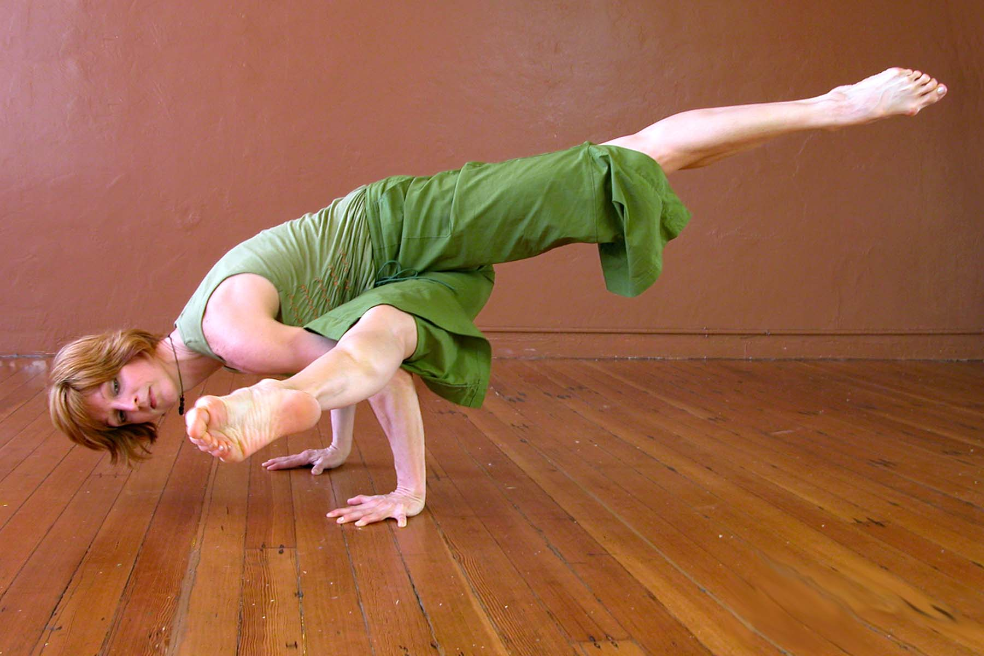
Balanced Tree?
Suggestion 1: the left and right subtrees of root have the same height
  But the left and right subtrees may be linear lists!
Suggestion 2: every node must have left and right subtrees of the same height
  Only complete binary trees satisfy
  Too rigid to be useful
Our choice: for each node, the height of the left and right subtrees can differ at most 1

Slide 4
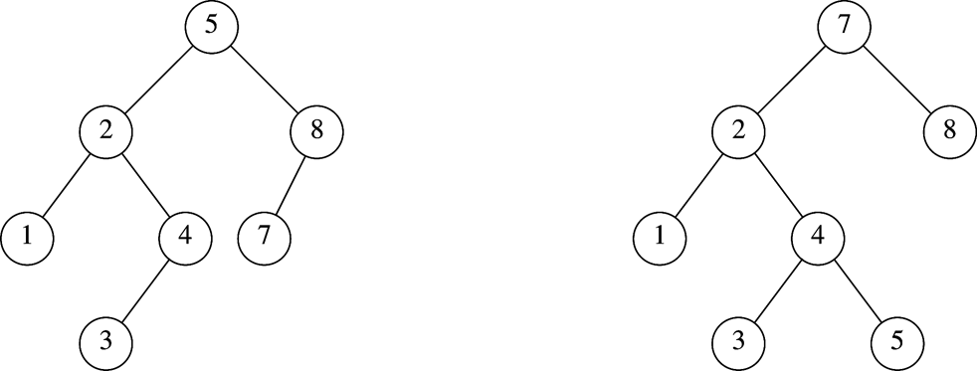
AVL Tree
An AVL tree is a binary search tree in which
  for every node in the tree, the height of the left and right subtrees differ by at most 1.
Height of subtree: Max # of edges to a leaf
Height of an empty subtree: -1
  Height of one node: 0
AVL tree
AVL property violated here

Slide 5
AVL Tree with
Minimum Number of Nodes
N₀ = 1
N₁ = 2
N₂ =4
N₃ = N₁+N₂+1=7
height of left=?
Height right=?

Slide 6
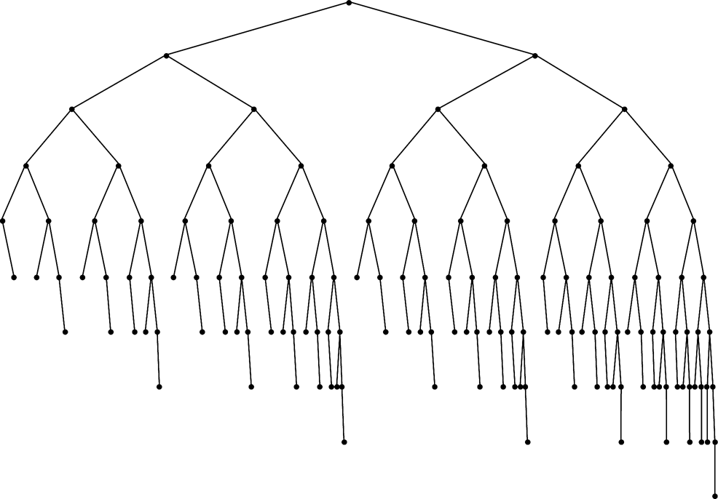
Smallest AVL tree
of height 7
Smallest AVL tree
of height 8
Smallest AVL tree of height 9

Slide 7
Height of AVL Tree
Denote N_{h} the minimum number of nodes in an AVL tree of height h
N₀=0, N₁ =2 (base)
N_{h}= N_{h-1} + N_{h-2} +1 (recursive relation)
N > N_{h}= N_{h-1} + N_{h-2} +1
>2 N_{h-2} >4 N_{h-4} >…>2^{i} N_{h-2i}
If h is even, let i=h/2–1. The equation becomes N>2^{h/2-1}N₂ ⇒ N>2^{h/2-1}x4 ⇒ h=O(logN)
If h is odd, let i=(h-1)/2. The equation becomes N>2^{(h-1)/2}N₁ ⇒ N>2^{(h-1)/2}x2 ⇒ h=O(logN)
Thus, many operations (i.e. searching) on an AVL tree will take O(log N) time

Slide 8
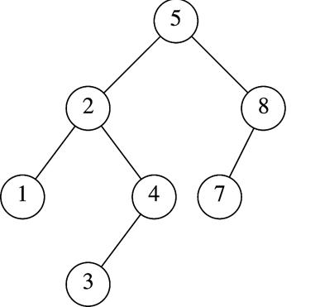
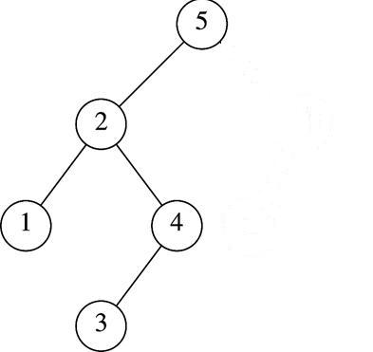
Insertion in AVL Tree
Basically follows insertion strategy of binary search tree
  But may cause violation of AVL tree property
Restore the destroyed balance condition if needed
7
6
8
6
Insert 6
Property violated
Original AVL tree
Restore AVL property

Slide 9

Some Observations
After an insertion, only nodes that are on the path from the insertion point to the root might have their balance altered
  Because only those nodes have their subtrees altered
Rebalance the tree at the deepest such node guarantees that the entire tree satisfies the AVL property
7
6
8
6
Node 5,8,7 might
have balance altered
Rebalance node 7
guarantees the whole tree be AVL

Slide 10

Different Cases for Rebalance
Denote the node that must be rebalanced α
  Case 1: an insertion into the left subtree of the left child of α
  Case 2: an insertion into the right subtree of the left child of α
  Case 3: an insertion into the left subtree of the right child of α
  Case 4: an insertion into the right subtree of the right child of α
Cases 1&4 are mirror image symmetries
with respect to α, as are cases 2&3

Slide 11

Rotations
Rebalance of AVL tree are done with simple modification to tree, known as rotation
Insertion occurs on the “outside” (i.e., left-left or right-right) is fixed by single rotation of the tree
Insertion occurs on the “inside” (i.e., left-right or right-left) is fixed by double rotation of the tree

Slide 12
Insertion Algorithm
First, insert the new key as a new leaf just as in ordinary binary search tree
Then trace the path from the new leaf towards the root. For each node x encountered, check if heights of left(x) and right(x) differ by at most 1
  If yes, proceed to parent(x)
  If not, restructure by doing either a single rotation or a double rotation
Note: once we perform a rotation at a node x, we won’t need to perform any rotation at any ancestor of x.

Slide 13
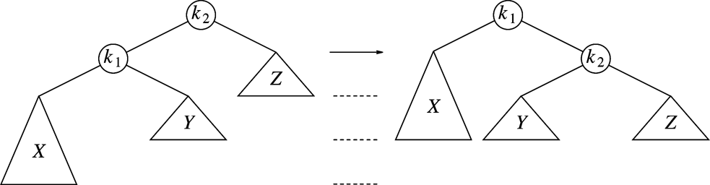
Single Rotation to Fix Case 1(left-left)
k2 violates
An insertion in subtree X,
AVL property violated at node k2
Solution: single rotation
AVL-property quiz:
Can Y have the same height as the new X?
Can Y have the same height as Z?

Slide 14
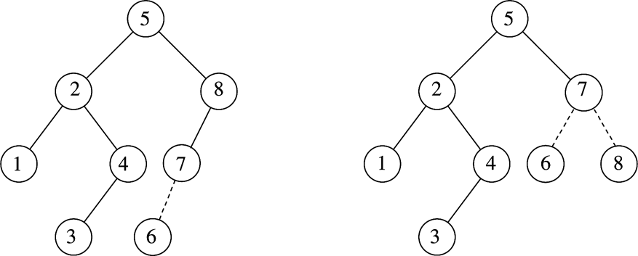
Single Rotation Case 1 Example
k2
k1
k1
X
k2
X

Slide 15
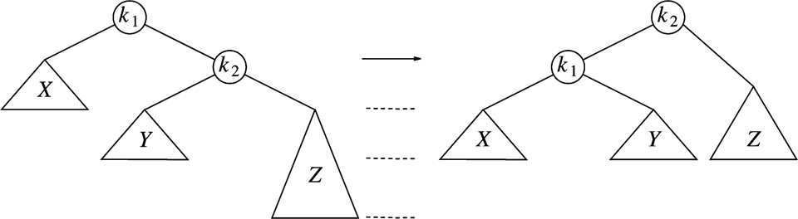
Single Rotation to Fix Case 4 (right-right)
k1 violates
An insertion in subtree Z
Case 4 is a symmetric case to case 1
Insertion takes O(Height of AVL Tree) time, Single rotation takes O(1) time

Slide 16
Single Rotation Example
Sequentially insert 3, 2, 1, 4, 5, 6 to an AVL Tree
3
3
2
2
2
2
2
1
3
1
3
1
3
Insert 3, 2
1
Single rotation
Insert 4
4
Insert 5,
violation at node 3
4
Insert 1
violation at node 3
2
2
5
4
1
4
1
4
2
5
3
5
3
5
1
3
6
Single rotation
Insert 6,
violation at node 2
6
Single rotation

Slide 17
If we continue to insert 7, 16, 15, 14, 13, 12, 11, 10, 8, 9
4
4
2
5
2
6
1
3
6
1
3
5
7
Insert 7,
violation at node 5
7
Single rotation
4
4
6
2
6
2
1
3
5
What is the result?
1
3
5
7
Single rotation
But….
Violation remains
Insert 16, fine
Insert 15
violation at node 7
16
15

Slide 18
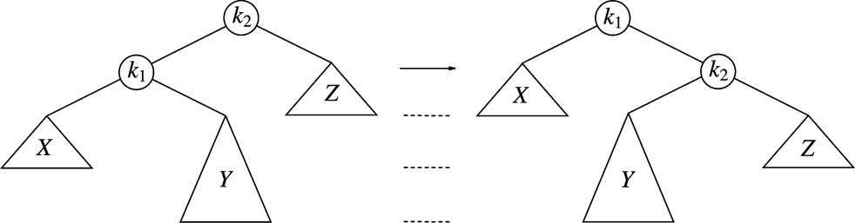
Single Rotation Fails to fix Case 2&3
Case 2: violation in k2 because of
insertion in subtree Y
Single rotation result
Single rotation fails to fix case 2&3
Take case 2 as an example (case 3 is a symmetry to it )
  The problem is subtree Y is too deep
  Single rotation doesn’t make it any less deep

Slide 19
Single Rotation Fails
What shall we do?
We need to rotate twice
  Double Rotation

