Slide 1
B⁺-Trees (Part 1)
COMP171
Fall 2006
Lecture 20

Slide 2

Contents
Why B⁺ Tree?
B⁺ Tree Introduction
Searching and Insertion in B⁺ Tree

Slide 3
Motivation
AVL tree with N nodes is an excellent data structure for searching, indexing, etc.
  The Big-Oh analysis shows most operations finishes within O(logN) time
The theoretical conclusion works as long as the entire structure can fit into the main memory
When the data size is too large and has to reside on disk, the performance of AVL tree may deteriorate rapidly

Slide 4


A Practical Example
A 500-MIPS machine, with 7200 RPM hard disk
  500 million instruction executions, and approximately 120 disk accesses each second
The machine is shared by 20 users
  Thus for each user, can handle 120/20=6 disk access/sec
A database with 10,000,000 items,
  256 bytes/item (assume it doesn’t fit in main memory)
  The typical searching time for one user
    A successful search need log_{base 2} 10,000,000 = 24 disk access,
    Takes around 24/6=4 sec.
    This is way too slow!!
We want to reduce the number of disk access to a very small constant

Slide 5

From Binary to M-ary
Idea: allow a node in a tree to have many children
  Less disk access = smaller tree height = more branching
As branching increases, the depth decreases
An M-ary tree allows M-way branching
  Each internal node has at most M children
A complete M-ary tree has height that is roughly log_{M}N instead of log₂N
  if M = 20, then log₂₀ 2²⁰ < 5
  Thus, we can speedup the search significantly

Slide 6
M-ary Search Tree
Binary search tree has one key to decide which of the two branches to take
M-ary search tree needs M-1 keys to decide which branch to take
M-ary search tree should be balanced in some way too
  We don’t want an M-ary search tree to degenerate to a linked list, or even a binary search tree
    Thus, require that each node is at least ½ full!

Slide 7
B⁺ Tree
A B⁺-tree of order M (M>3) is an M-ary tree with the following properties:
  The data items are stored in leaves
  The root is either a leaf or has between two and M children
  The non-leaf nodes store up to M-1 keys to guide the searching; key i represents the smallest key in subtree i+1
  All non-leaf nodes (except the root) have between ⎡M/2⎤ and M children
  All leaves are at the same depth and have between ⎡L/2⎤ and L data items, for some L (usually L << M, but we will assume M=L in most examples)
Note there are vairous defintions of B-trees, but mostly in minor ways.
The above definsion is one of the popular forms.

Slide 8
Keys in Internal Nodes
Which keys are stored at the internal nodes?
  There are several ways to do it. Different books adopt different conventions.
We will adopt the following convention:
  key i in an internal node is the smallest key in its i+1 subtree (i.e. right subtree of key i)
Even following this convention, there is no unique B⁺-tree for the same set of records.

Slide 9
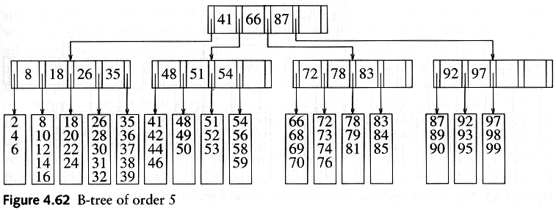
B⁺ Tree Example 1 (M=L=5)
Records are stored at the leaves (we only show the keys here)
Since L=5, each leaf has between 3 and 5 data items
Since M=5, each nonleaf nodes has between 3 to 5 children
Requiring nodes to be half full guarantees that the B+ tree does not degenerate into a simple binary tree

Slide 10
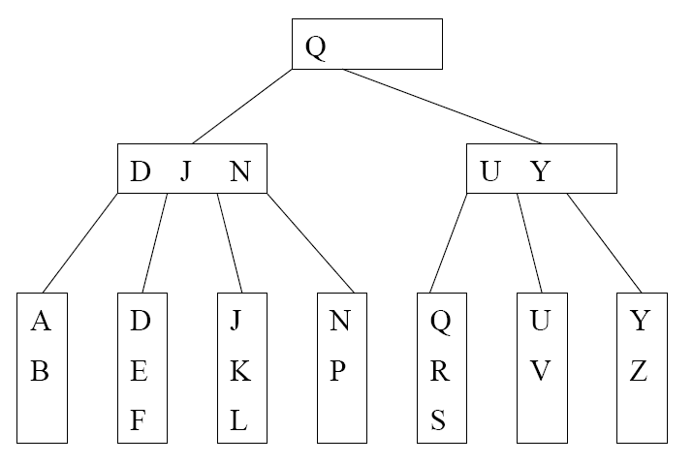
B⁺ Tree Example 2 (M=L=4)
We can still talk about left and right child pointers
E.g. the left child pointer of N is the same as the right child pointer of J
We can also talk about the left subtree and right subtree of a key in internal nodes

Slide 11

B+ Tree in Practical Usage
Each internal node/leaf is designed to fit into one I/O block of data. An I/O block usually can hold quite a lot of data. Hence, an internal node can keep a lot of keys, i.e., large M. This implies that the tree has only a few levels and only a few disk accesses can accomplish a search, insertion, or deletion.
B⁺-tree is a popular structure used in commercial databases. To further speed up the search, the first one or two levels of the B⁺-tree are usually kept in main memory.
The disadvantage of B⁺-tree is that most nodes will have less than M-1 keys most of the time. This could lead to severe space wastage. Thus, it is not a good dictionary structure for data in main memory.
The textbook calls the tree B-tree instead of B⁺-tree. In some other textbooks, B-tree refers to the variant where the actual records are kept at internal nodes as well as the leaves. Such a scheme is not practical. Keeping actual records at the internal nodes will limit the number of keys stored there, and thus increasing the number of tree levels.

Slide 12
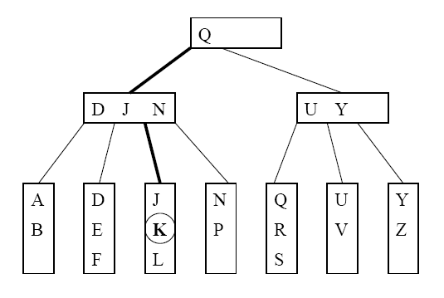
Searching Example
Suppose that we want to search for the key K. The path traversed is shown in bold.

Slide 13

Searching Algorithm
Let x be the input search key.
Start the searching at the root
If we encounter an internal node v, search (linear search or binary search) for x among the keys stored at v
  If x < K_{min} at v, follow the left child pointer of K_{min}
  If K_{i} ≤ x < K_{i+1} for two consecutive keys K_{i} and K_{i+1} at v, follow the left child pointer of K_{i+1}
  If x ≥ K_{max} at v, follow the right child pointer of K_{max}
If we encounter a leaf v, we search (linear search or binary search) for x among the keys stored at v. If found, we return the entire record; otherwise, report not found.

Slide 14
Insertion Procedure
Suppose that we want to insert a key K and its associated record.
Search for the key K using the search procedure
This will bring us to a leaf x
Insert K into x
  Splitting (instead of rotations in AVL trees) of nodes is used to maintain properties of B⁺-trees [next slide]

Slide 15

Insertion into a Leaf
If leaf x contains < L keys, then insert K into x (at the correct position in node x)
If x is already full (i.e. containing L keys). Split x
  Cut x off from its parent
  Insert K into x, pretending x has space for K. Now x has L+1 keys.
  After inserting K, split x into 2 new leaves x_{L} and x_{R}, with x_{L} containing the ⎣(L+1)/2⎦ smallest keys, and x_{R} containing the remaining ⎡(L+1)/2⎤ keys. Let J be the minimum key in x_{R}
  Make a copy of J to be the parent of x_{L} and x_{R}, and insert the copy together with its child pointers into the old parent of x.

Slide 16
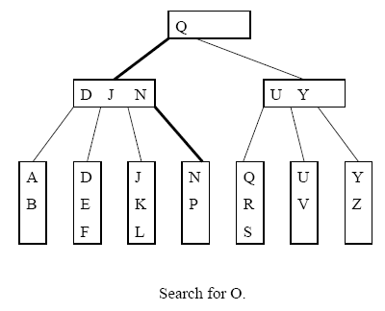
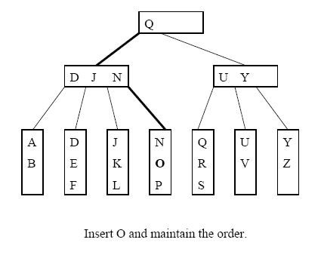
Inserting into a Non-full Leaf (L=3)

Slide 17
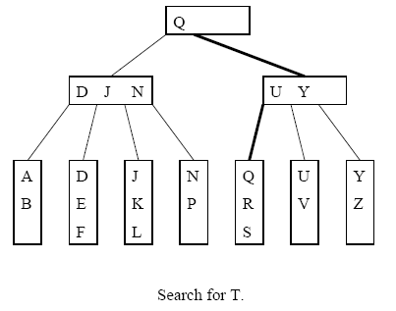
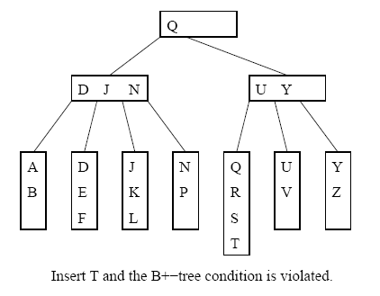
Splitting a Leaf: Inserting T

Slide 18
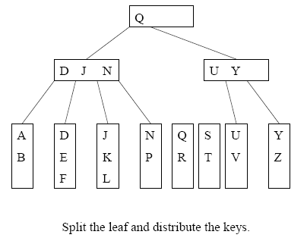
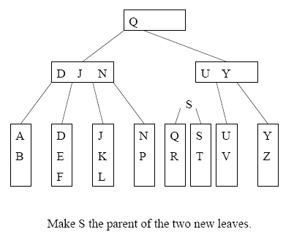
Splitting Example 1

Slide 19
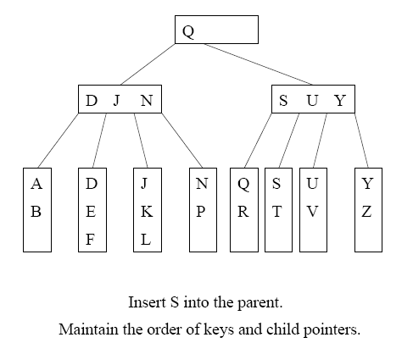
Two disk accesses to write the two leaves, one disk access to update the parent
For L=32, two leaves with 16 and 17 items are created. We can perform 15 more insertions without another split

Slide 20
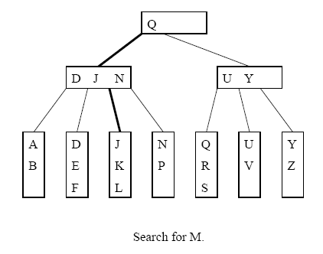
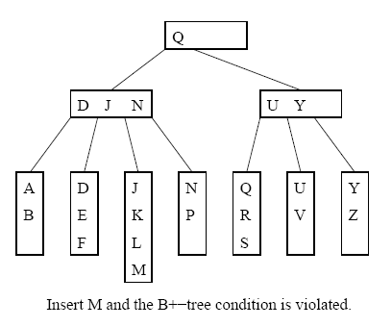
Splitting Example 2

Slide 21
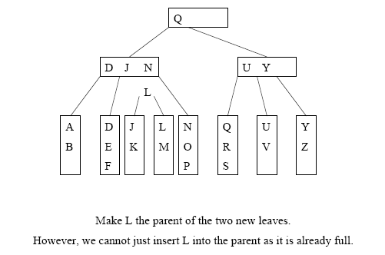
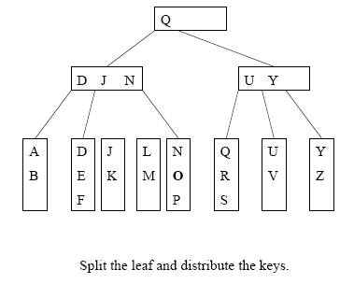
Cont’d
=> Need to split the internal node

Slide 22
Splitting an Internal Node
To insert a key K into a full internal node x:
Cut x off from its parent
Insert K and its left and right child pointers into x, pretending there is space. Now x has M keys.
Split x into 2 new internal nodes x_{L} and x_{R}, with x_{L} containing the ( ⎡M/2⎤ - 1 ) smallest keys, and x_{R} containing the ⎣M/2⎦ largest keys. Note that the (⎡M/2⎤)th key J is not placed in x_{L} or x_{R}
Make J the parent of x_{L} and x_{R}, and insert J together with its child pointers into the old parent of x.

Slide 23
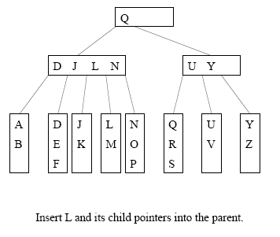
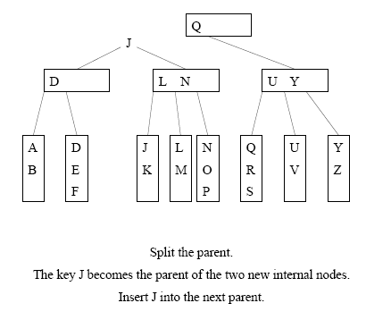
Example: Splitting Internal Node (M=4)

Slide 24
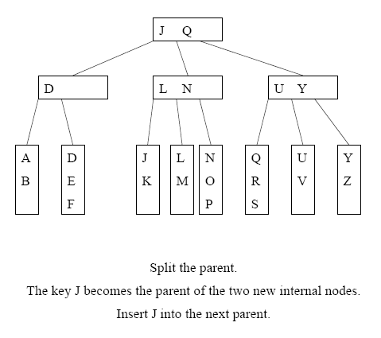
Cont’d

Slide 25

Termination
Splitting will continue as long as we encounter full internal nodes
If the split internal node x does not have a parent (i.e. x is a root), then create a new root containing the key J and its two children

