Slide 1
Connected Components,
Directed Graphs,
Topological Sort
COMP171
Fall 2006
Lecture 25

Slide 2
Graph Application: Connectivity
G =
P
Q
N
L
R
O
M
D
s
E
C
How do we tell if two vertices
are connected?
A
F
A connected to F?
A connected to L?
B
K
G
H

Slide 3
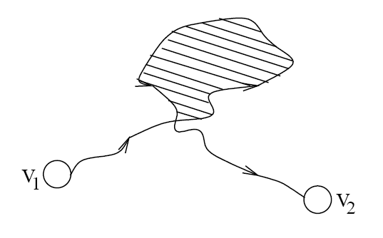
Connectivity
A graph is connected if and only if there exists a path between every pair of distinct vertices.
A graph is connected if and only if there exists a simple path between every pair of distinct vertices
  since every non-simple path contains a cycle, which can be bypassed
How to check for connectivity?
  Run BFS or DFS (using an arbitrary vertex as the source)
  If all vertices have been visited, the graph is connected.
  Running time? O(n + m)

Slide 4
Connected Components

Slide 5

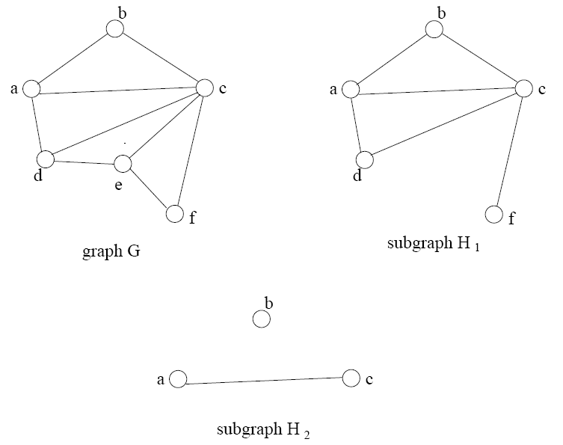
Subgraphs

Slide 6
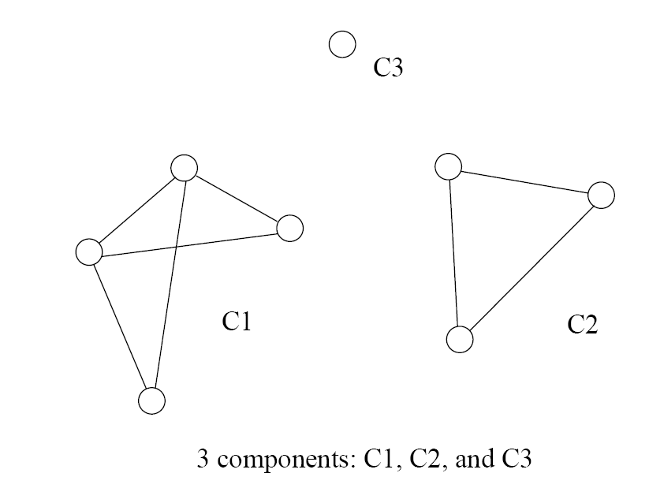
Connected Components
Formal definition
  A connected component is a maximal connected subgraph of a graph
The set of connected components is unique for a given graph

Slide 7
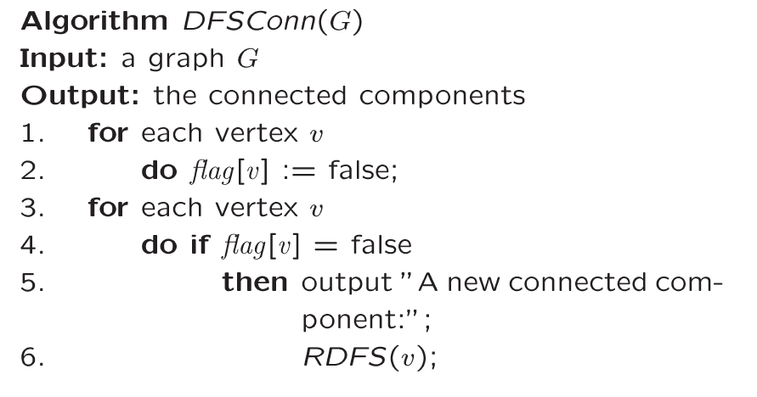
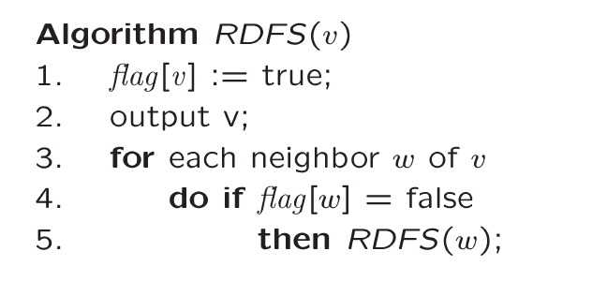
Finding Connected Components
For each vertex
If not visited
This will find all vertices connected to “v” => one
connected component
Call DFS
Basic DFS algorithm

Slide 8
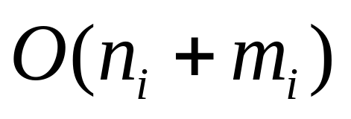
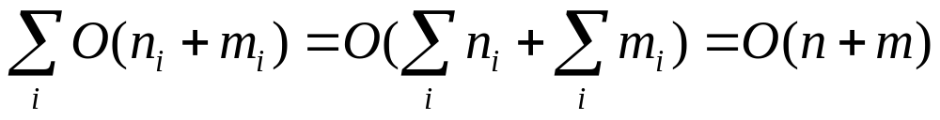
Time Complexity
Running time for each i connected component
Running time for the graph G
Reason: Can two connected components share
  the same edge?
  the same vertex?

Slide 9

Trees
Tree arises in many computer science applications
A graph G is a tree if and only if it is connected and acyclic
  (Acyclic means it does not contain any simple cycles)
The following statements are equivalent
  G is a tree
  G is acyclic and has exactly n-1 edges
  G is connected and has exactly n-1 edges

Slide 10
Tree Example
6
3
8
0
7
2
9
1
5
4
Is it a graph?
Does it contain cycles? In other words, is it acyclic?
How many vertices?
How many edges?

Slide 11

Directed Graph
A graph is directed if direction is assigned to each edge.
Directed edges are denoted as arcs.
  Arc is an ordered pair (u, v)
Recall: for an undirected graph
  An edge is denoted {u,v}, which actually corresponds to two arcs (u,v) and (v,u)

Slide 12
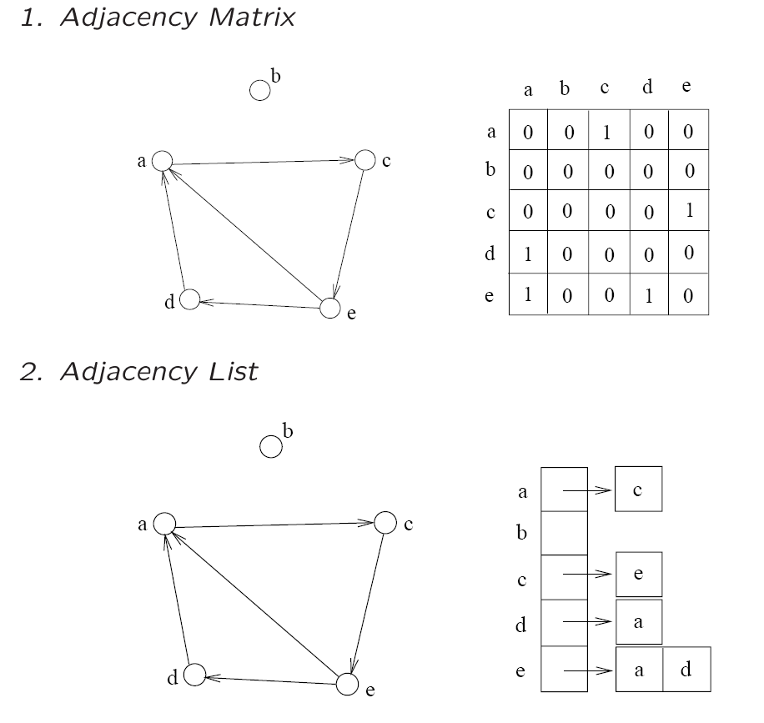
Representations
The adjacency matrix and adjacency list can be used

Slide 13

Directed Acyclic Graph
A directed path is a sequence of vertices
(v₀, v₁, . . . , v_{k})
  Such that (v_{i}, v_{i+1}) is an arc
A directed cycle is a directed path such that the first and last vertices are the same.
A directed graph is acyclic if it does not contain any directed cycles

Slide 14
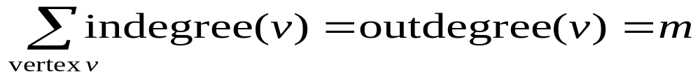
Indegree and Outdegree
Since the edges are directed
  We can’t simply talk about Deg(v)
Instead, we need to consider the arcs coming “in” and going “out”
  Thus, we define terms Indegree(v), and Outdegree(v)
Each arc(u,v) contributes count 1 to the outdegree of u and the indegree of v

Slide 15
Calculate Indegree and Outdegree
Outdegree is simple to compute
  Scan through list Adj[v] and count the arcs
Indegree caculation
  First, initialize indegree[v]=0 for each vertex v
  Scan through adj[v] list for each v
    For each vertex w seen, indegree[w]++;
    Running time: O(n+m)

Slide 16
Example
3
Indeg(2)?
Indeg(8)?
Outdeg(0)?
Num of Edges?
Total OutDeg?
Total Indeg?
6
8
0
7
2
9
1
5
4

Slide 17
Directed Graphs Usage
Directed graphs are often used to represent order-dependent tasks
  That is we cannot start a task before another task finishes
We can model this task dependent constraint using arcs
An arc (i,j) means task j cannot start until task i is finished
Clearly, for the system not to hang, the graph must be acyclic
i
j
Task j cannot start
until task i is finished

Slide 18
University Example
CS departments course structure
₁₀₄
₁₅₁
₁₇₁
₁₈₀
₃₄₂
₂₂₁
₂₀₁
₂₁₁
₂₅₁
₂₇₁
_{M111}
_{M132}
₂₅₂
₂₃₁
₃₀₃
₃₄₃
₂₇₂
₃₆₁
₃₈₁
₃₂₇
₃₄₁
₃₃₆
₃₃₄
₃₆₂
Any directed cycles?
₃₃₂
How many indeg(171)?
How many outdeg(171)?

Slide 19
Topological Sort
Topological sort is an algorithm for a directed acyclic graph
Linearly order the vertices so that the linear order respects the ordering relations implied by the arcs
3
For example:
0, 1, 2, 5, 9
0, 4, 5, 9
0, 6, 3, 7 ?
6
8
0
2
7
9
1
5
4

Slide 20
Topological Sort Algorithm
Observations
  Starting point must have zero indegree
  If it doesn’t exist, the graph would not be acyclic
Algorithm
A vertex with zero indegree is a task that can start right away. So we can output it first in the linear order
If a vertex i is output, then its outgoing arcs (i, j) are no longer useful, since tasks j does not need to wait for i anymore- so remove all i’s outgoing arcs
With vertex i removed, the new graph is still a directed acyclic graph. So, repeat step 1-2 until no vertex is left.

Slide 21
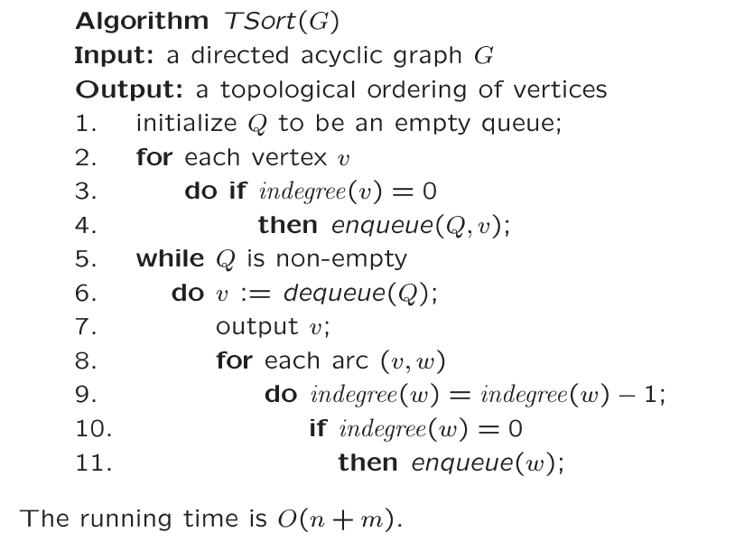
Topological Sort
Find all starting points
Reduce indegree(w)
Place new start
vertices on the Q

Slide 22
Example
Indegree
0
1
2
3
4
5
6
7
8
9
6 | 1 | 4
0
1
2
3
4
5
6
7
8
9
0
1
2
1
1
2
1
1
2
2
2
start
6
3
7 | 5
8
8
5
0
2
7
9
1
9
3 | 2
5
8
4
9
Q = { 0 }
OUTPUT: 0

Slide 23
Indegree
0
1
2
3
4
5
6
7
8
9
6 | 1 | 4
0
1
2
3
4
5
6
7
8
9
0
1
2
1
1
2
1
1
2
2
2
-1
6
3
7 | 5
8
8
5
-1
0
2
7
9
1
9
3 | 2
-1
5
8
4
9
Dequeue 0 Q = { }
-> remove 0’s arcs – adjust
indegrees of neighbors
Decrement 0’s
neighbors
OUTPUT: 0

Slide 24
Indegree
0
1
2
3
4
5
6
7
8
9
6 | 1 | 4
0
1
2
3
4
5
6
7
8
9
0
0
2
1
0
2
0
1
2
2
2
6
3
7 | 5
8
8
5
0
2
7
9
1
9
3 | 2
5
8
4
9
Q = { 6, 1, 4 }
Enqueue all starting points
Enqueue all
new start points
OUTPUT: 0

Slide 25
Indegree
0
1
2
3
4
5
6
7
8
9
6 | 1 | 4
0
1
2
3
4
5
6
7
8
9
0
0
2
1
0
2
0
1
2
2
2
6
3
7 | 5
-1
8
8
-1
5
2
7
9
1
9
3 | 2
5
8
4
9
Dequeue 6 Q = { 1, 4 }
Remove arcs .. Adjust indegrees
of neighbors
Adjust neighbors
indegree
OUTPUT: 0 6

Slide 26
Indegree
0
1
2
3
4
5
6
7
8
9
6 | 1 | 4
0
1
2
3
4
5
6
7
8
9
0
0
1
0
0
2
0
1
2
2
2
3
7 | 5
8
8
5
2
7
9
1
9
3 | 2
5
8
4
9
Q = { 1, 4, 3 }
Enqueue 3
Enqueue new
start
OUTPUT: 0 6

Slide 27
Indegree
0
1
2
3
4
5
6
7
8
9
6 | 1 | 4
0
1
2
3
4
5
6
7
8
9
0
0
1
0
0
2
0
1
2
2
2
3
7 | 5
-1
8
8
5
2
7
9
1
9
3 | 2
5
8
4
9
Dequeue 1 Q = { 4, 3 }
Adjust indegrees of neighbors
Adjust neighbors
of 1
OUTPUT: 0 6 1

Slide 28
Indegree
0
1
2
3
4
5
6
7
8
9
6 | 1 | 4
0
1
2
3
4
5
6
7
8
9
0
0
0
0
0
2
0
1
2
2
2
3
7 | 5
8
8
5
2
7
9
9
3 | 2
5
8
4
9
Dequeue 1 Q = { 4, 3, 2 }
Enqueue 2
Enqueue new
starting points
OUTPUT: 0 6 1

Slide 29
Indegree
0
1
2
3
4
5
6
7
8
9
6 | 1 | 4
0
1
2
3
4
5
6
7
8
9
0
0
0
0
0
2
0
1
2
2
2
3
7 | 5
8
8
5
2
7
9
9
-1
3 | 2
5
8
4
9
Dequeue 4 Q = { 3, 2 }
Adjust indegrees of neighbors
Adjust 4’s
neighbors
OUTPUT: 0 6 1 4

Slide 30
Indegree
0
1
2
3
4
5
6
7
8
9
6 | 1 | 4
0
1
2
3
4
5
6
7
8
9
0
0
0
0
0
1
0
1
2
2
2
3
7 | 5
8
8
5
2
7
9
9
3 | 2
5
8
9
Dequeue 4 Q = { 3, 2 }
No new start points found
NO new start
points
OUTPUT: 0 6 1 4

Slide 31
Indegree
0
1
2
3
4
5
6
7
8
9
6 | 1 | 4
0
1
2
3
4
5
6
7
8
9
0
0
0
0
0
1
0
1
2
2
2
3
7 | 5
8
8
5
2
7
9
9
3 | 2
5
8
9
-1
Dequeue 3 Q = { 2 }
Adjust 3’s neighbors
OUTPUT: 0 6 1 4 3

Slide 32
Indegree
0
1
2
3
4
5
6
7
8
9
6 | 1 | 4
0
1
2
3
4
5
6
7
8
9
0
0
0
0
0
1
0
1
1
2
2
7 | 5
8
8
5
2
7
9
9
3 | 2
5
8
9
Dequeue 3 Q = { 2 }
No new start points found
OUTPUT: 0 6 1 4 3

Slide 33
Indegree
0
1
2
3
4
5
6
7
8
9
6 | 1 | 4
0
1
2
3
4
5
6
7
8
9
0
0
0
0
0
1
0
1
1
2
2
7 | 5
8
8
5
2
7
9
9
-1
3 | 2
5
8
-1
9
Dequeue 2 Q = { }
Adjust 2’s neighbors
OUTPUT: 0 6 1 4 3 2

Slide 34
Indegree
0
1
2
3
4
5
6
7
8
9
6 | 1 | 4
0
1
2
3
4
5
6
7
8
9
0
0
0
0
0
0
0
0
1
2
2
7 | 5
8
8
5
7
9
9
3 | 2
5
8
9
Dequeue 2 Q = { 5, 7 }
Enqueue 5, 7
OUTPUT: 0 6 1 4 3 2

Slide 35
Indegree
0
1
2
3
4
5
6
7
8
9
6 | 1 | 4
0
1
2
3
4
5
6
7
8
9
0
0
0
0
0
0
0
0
1
2
2
7 | 5
8
8
5
7
9
9
3 | 2
5
8
9
-1
Dequeue 5 Q = { 7 }
Adjust neighbors
OUTPUT: 0 6 1 4 3 2 5

Slide 36
Indegree
0
1
2
3
4
5
6
7
8
9
6 | 1 | 4
0
1
2
3
4
5
6
7
8
9
0
0
0
0
0
0
0
0
1
1
2
7 | 5
8
8
5
7
9
9
3 | 2
8
9
Dequeue 5 Q = { 7 }
No new starts
OUTPUT: 0 6 1 4 3 2 5

Slide 37
Indegree
0
1
2
3
4
5
6
7
8
9
6 | 1 | 4
0
1
2
3
4
5
6
7
8
9
0
0
0
0
0
0
0
0
1
1
2
7 | 5
8
8
5
7
9
9
3 | 2
8
9
-1
Dequeue 7 Q = { }
Adjust neighbors
OUTPUT: 0 6 1 4 3 2 5 7

Slide 38
Indegree
0
1
2
3
4
5
6
7
8
9
6 | 1 | 4
0
1
2
3
4
5
6
7
8
9
0
0
0
0
0
0
0
0
0
1
2
7 | 5
8
8
5
9
9
3 | 2
8
9
Dequeue 7 Q = { 8 }
Enqueue 8
OUTPUT: 0 6 1 4 3 2 5 7

Slide 39
Indegree
0
1
2
3
4
5
6
7
8
9
6 | 1 | 4
0
1
2
3
4
5
6
7
8
9
0
0
0
0
0
0
0
0
0
1
2
7 | 5
8
8
5
9
9
3 | 2
8
9
-1
Dequeue 8 Q = { }
Adjust indegrees of neighbors
OUTPUT: 0 6 1 4 3 2 5 7 8

Slide 40
Indegree
0
1
2
3
4
5
6
7
8
9
6 | 1 | 4
0
1
2
3
4
5
6
7
8
9
0
0
0
0
0
0
0
0
0
0
2
7 | 5
8
5
9
9
3 | 2
8
9
Dequeue 8 Q = { 9 }
Enqueue 9
Dequeue 9 Q = { }
STOP – no neighbors
OUTPUT: 0 6 1 4 3 2 5 7 8 9

Slide 41
6
3
8
0
2
7
9
1
5
4
OUTPUT: 0 6 1 4 3 2 5 7 8 9
Is output topologically correct?

Slide 42
Topological Sort: Complexity
We never visited a vertex more than one time
For each vertex, we had to examine all outgoing edges
  Σ outdegree(v) = m
  This is summed over all vertices, not per vertex
So, our running time is exactly
  O(n + m)

