Slide 1

Counting Example 1
Page <number>
Page <number>
Exco Members: Year 1: 4; Year 2: 5; Year 3: 3
Total number of members: 12
Choose 6 from 12

Slide 2
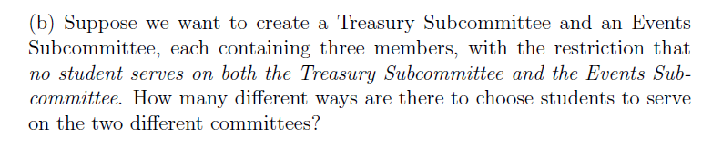



Example 1
Page <number>
Page <number>
Exco Members: Year 1: 4; Year 2: 5; Year 3: 3
Number of ways to choose Treasury Subcommittee
  12 choose 3
Number of ways to choose Events Subcommittee
  9 choose 3
So

Slide 3



Example 1
Page <number>
Page <number>
Exco Members: Year 1: 4; Year 2: 5; Year 3: 3
Number of ways to choose Treasury Subcommittee
Number of ways to choose Events Subcommittee
  9 choose 3
Answer

Slide 4

Example 1
Page <number>
Page <number>
Exco Members: Year 1: 4; Year 2: 5; Year 3: 3
“At least” makes things complex.

Slide 5
Wrong Answer
Page <number>
First choose 1 from each year
Then pick 3 from remaining 9 members
Answer

Slide 6
One way to make up committee
Page <number>
First choose 1 from each year
  Anthony (Y1), Mike (Y2), William (Y3)
Then pick 3 from remaining 9 members
  Billy (Y1), Calvin(Y1), David (Y1),
Committee
  Anthony (Y1), Billy (Y1), Calvin(Y1), David (Y1), Mike (Y2), William (Y3)

Slide 7
Another way to make up committee
Page <number>
First choose 1 from each year
  Billy (Y1), Mike (Y2), William (Y3)
Then pick 3 from remaining 9 members
  Anthony (Y1), Calvin(Y1), David (Y1),
Same Committee as before
  Anthony (Y1), Billy (Y1), Calvin(Y1), David (Y1), Mike (Y2), William (Y3)
Double counting
  We count: X = {All the different ways to build the committee using our algorithm}
  We want: Y = {All the different committees}
  The mapping from X to Y is not one-to-one

Slide 8
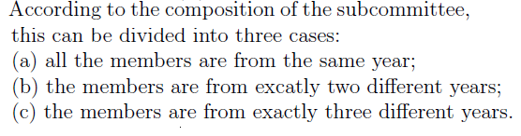
Example 1
Page <number>
Page <number>
Exco Members: Year 1: 4; Year 2: 5; Year 3: 3
“At least” makes things complex.

Slide 9


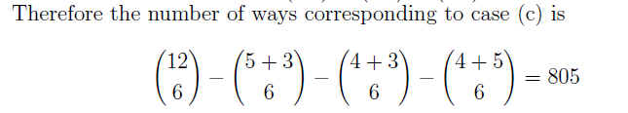
Page <number>

Slide 10

Counting Example 2
Page <number>
A function from Sn to S2 can be defined in two steps:
  Partition Sn into two subsets A and B:
  Map A to 1 and B to 2.
The number of partitions (A, B) equals the number of ways to choose A. It is 2^n.
For the function to be onto, A cannot be the empty set or the whole set.
So, the answer is: 2^n-2.

Slide 11

Counting Example 2
Page <number>
A function from S6 to S4 can be defined in two steps:
  Partition Sn into four subsets A, B, C, D:
  Map A to 1, B to 2, C to 3, and D to 4.
For the function to be onto, none of the subsets can be empty.
There are two scenarios:
  One subset with 3 elements, the other free subsets each contains 1 element.
  Two subsets each contains 2 elements, the other two subsets contains 1 element.

Slide 12
Counting Example 2
Page <number>
Scenario 1: One subset with 3 elements, the other three subsets each contains 1 element
  Number of ways to choose 3-element subset: (6 choose 3)
  After the subset is chosen, we have 4 subsets: one 3-subset, and three 1-subset.
  Number of ways to label the subsets A, B, C, or D: 4!
  So, the total number for this scenario is: 4! (6 choose 3)
Scenario 2: Two subsets with 2 elements, the other two subsets each contains 1 element
  Number of ways to choose two 2-element subsets: (6 choose 2)(4 choose 2)/2
  Number of ways to label the four subsets A, B, C, or D: 4!
  So, the total number for this scenario is: 4! (6 choose 2)(4 choose 2)/2
  The final answer: 4! (6 choose 3) + 4! (6 choose 2)(4 choose 2)/2

Slide 13
Example 3
Page <number>
Let U and V be two finite sets consisting of |U| = m > 0 and |V| = n > 0 elements, respectively. How many different one-to-one (or injective) functions f : U → V can be defined?
Answer
  0, if n < m
  n(n-1)..(n-m+1), if n >= m

Slide 14
Example 4
Page <number>
In a computer system, each user has a password of eight characters long where each character is an uppercase letter or a digit. Each password must contain at least one digit. How many possible passwords are there?
Answer:
  All passwords: 36^8
  Passwords with no digit: 26^8
  Passwords containing at least one digit: 36^8 – 26^8

Slide 15
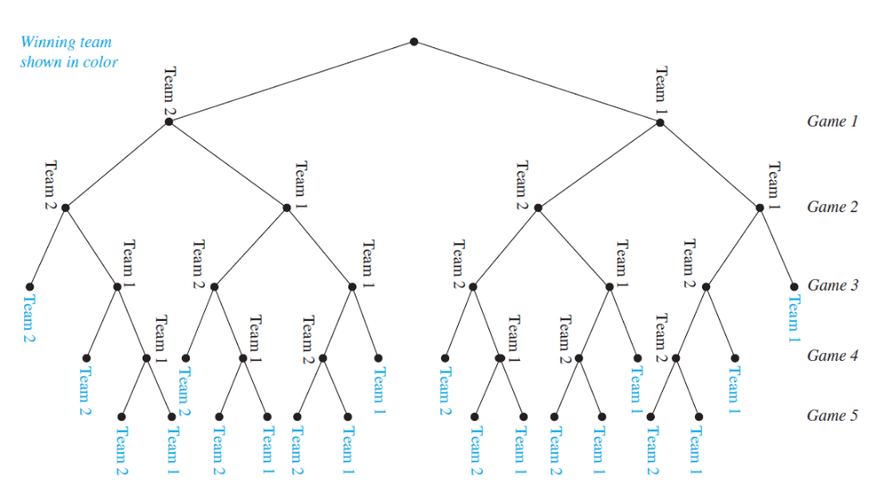
Example 5: Tree Diagram
Page <number>
A playoff between two teams consists of at most five games. The first team that wins three games wins the playoff. In how many different ways can the playoff occur?
Answer: Draw a tree diagram for all possible scenarios, count. 20

Slide 16
Example 6
Page <number>
How many permutations of the letters ABCDEFGH contain the string ABC?
Answer: 6!
How many bit strings of length n contain exactly k 1s?
Answer: C(n, k)

Slide 17
Example 7
Page <number>
Twelve people sit down at a round table. We consider two seating charts equivalent if each person has the same person to the right in both seating charts. How many different seating charts are there?
Answer: 12!/12

