Slide 1

Part I
L01 Propositional Logic
L02 Predicate Logic
L03 Inference Rules and Proof Techniques
Reading: Rosen, Chapter 1.

Slide 2
L01: Propositional Logic
Objectives
Propositions
Compound Propositions
Propositional Equivalences

Slide 3
Propositional Logic
Logic is the basis of all mathematical reasoning.
The rules of logic give precise meaning to mathematical statements.

Slide 4
Proposition
Definition
A proposition is a declarative statement (i.e., a sentence that declares a fact) that is either true or false, but not both
Remark
Propositions are the basic building blocks of logic. The area of logic that deals with propositions is called propositional logic.
Definition
The truth value of a proposition is true, denoted by T, if it is a true proposition and false, denoted by F, if it is a false proposition.

Slide 5
Examples
Example
Each of the following declarative statements is a proposition:
(a) Hong Kong is a city in China.
(b) COMP 2711 or COMP 2711H is an elective course for the COMP program.
(c) 2 + 2 = 2²
(d) 1 + 1 = 3
Propositions (a) and (c) are true but (b) and (d) are false.

Slide 6
Examples
Example
Each of the following is not a proposition:
(a) No parking
(b) Who has an iPad?
(c) y = log(x+1)
(d) x² – 3x + 1 = 0

Slide 7
Outline
Introduction to Propositions
Compound Propositions
Propositional Equivalence

Slide 8
Logical Operator and Truth Table
Logical operators or logical connectives can be used to turn existing propositions into new propositions.
The definition of a logical operator can be given in the form of a truth table by enumerating all possible truth values of the proposition(s) involved.

Slide 9
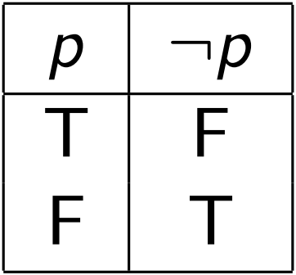
Negation
Definition
Let p be a proposition. The negation of p, denoted by ¬p or and read as “not p”, is the statement “it is not the case that p”. The truth value of ¬p is the opposite of the truth value of p.
The truth table has a row for each of the two possible truth values of the proposition p and the corresponding truth value of ¬p.

Slide 10
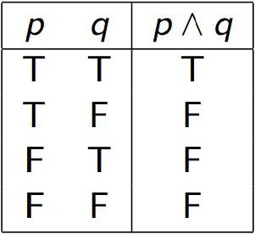
Conjunction
Definition
Let p and q be propositions. The conjunction of p and q, denoted by p^q, is the proposition “p and q”.
The conjunction p ^ q is true when both p and q are true and is false otherwise.

Slide 11
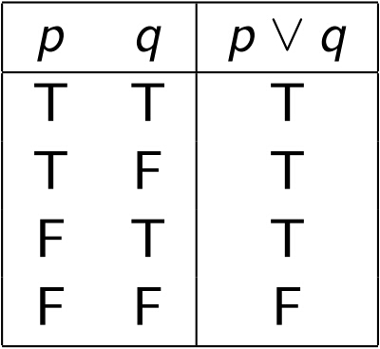
Disjunction
Definition
The disjunction of p and q, denoted by p∨q, is the proposition “p or q”.
The disjunction p ∨ q is false when both p and q are false and is true otherwise.

Slide 12
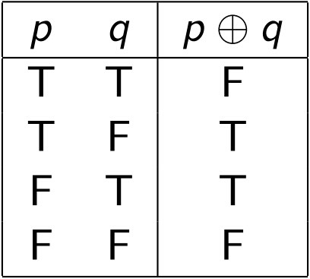
Exclusive Or
Definition
The exclusive or of p and q, denoted by p⊕q, is the proposition that is true when exactly one of p and q is true and is false otherwise.

Slide 13
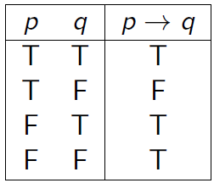
Conditional Statement
Definition
The conditional statement p→q is the proposition “if p, then q”.
The statement p→q is false when p is true and q is false, and true otherwise.
p is called the hypothesis (or premise) and q is called the conclusion (or consequence).

Slide 14
Conditional Statement (cont'd)
Equivalent ways of expressing p → q:
if p, then q
q if p
p implies q
p only if q (which says that “p cannot be true unless q is true”)
q follows from p
p is a sufficient condition for q (i.e., p being true is enough to make q true)
q is a necessary condition for p (i.e., p cannot be true unless q is true)

Slide 15
Necessary and sufficient conditions
Steering well is a necessary condition for driving well
Driving well → steering well
Steering well is not a sufficient condition for driving well since someone who steers well may still be a bad driver
Boiling potato is a sufficient condition for cooking potato
Boiling potato → cooking potato
Boiling potato is not a necessary condition for cooking potato as there is other way to cook it

Slide 16
Examples
Example
Consider the following statement that a professor makes:
“If you get 100% on the final exam, then you will get an A.”

Slide 17
Examples
Example (cont’d)
If a student manages to get 100% on the final exam, then she would expect to receive an A.
If the student does not get 100%, she may or may not receive an A depending on other factors.
However, if she does get 100% but the professor does not give her an A, she will feel cheated.
Principle of excluded middle
A statement is true exactly when it is not false.

Slide 18
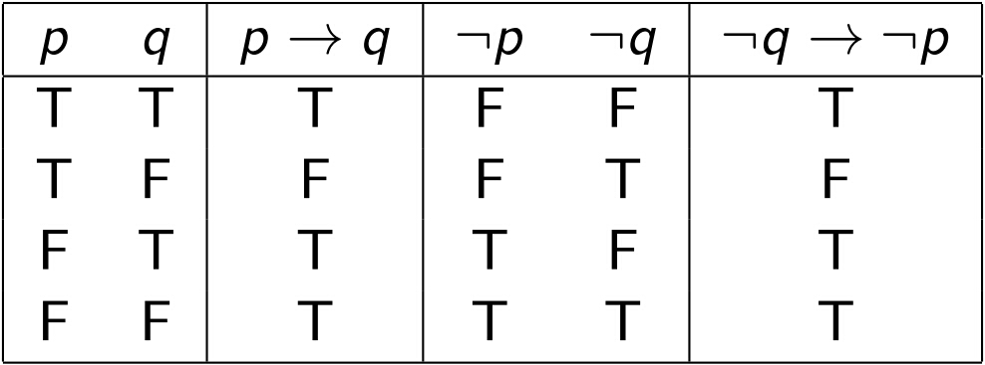
Converse, Contrapositive
Definition
The converse of p→q is q→p.
The contrapositive of p→q is ¬q→¬p.
The contrapositive and p→q are equivalent.

Slide 19
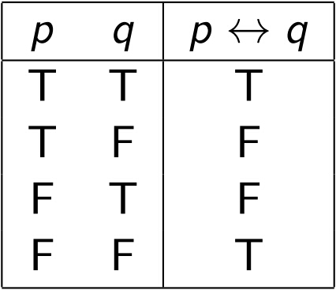
Biconditional Statement
Definition
The biconditional statement p↔q is the proposition “p if and only if q”.
The statement is true when p and q have the same truth value and is false otherwise.

Slide 20
Biconditional Statement (cont'd)
The proposition p ↔ q has exactly the same truth value as (p → q) ^ (q → p)
Equivalent ways of expressing p ↔ q:
p if and only if q
p iff q
p is necessary and sufficient for q
if p then q, and conversely

Slide 21
Outline
Introduction to Propositions
Compound Propositions
Propositional Equivalence

Slide 22
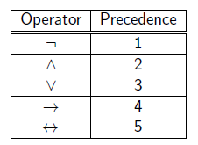
Precedence of Logical Operators
Multiple logical operators can be used to construct compound propositions.
Parentheses can be used for clarity
p ∨ ¬q → p ^ q,
may be written more clearly as
(p ∨ ¬q) → (p ^ q).

Slide 23
Examples
Example
Express the system specification “the automated reply cannot be sent when the file system is full” using logical operators.

Slide 24
Examples
Example
Find the bitwise AND (^), bitwise OR (∨), and bitwise XOR (⊕) of the bit strings
01101 10110 and 11000 11101.
Remark
Computer bit operations correspond to the logical operators. In particular, the bit operations AND, OR, and XOR correspond to the operators ^, ∨, ⊕, respectively. The bits 1 and 0 correspond to the truth values true and false, respectively.

Slide 25
Outline
Introduction to Propositions
Compound Propositions
Propositional Equivalence

Slide 26
Tautology and Contradiction
Definition
A tautology is a compound proposition that is always true, no matter what the truth values of the propositions that occur in it.
A contradiction is a compound proposition that is always false.
A contingency is a compound proposition that is neither a tautology nor a contradiction.

Slide 27
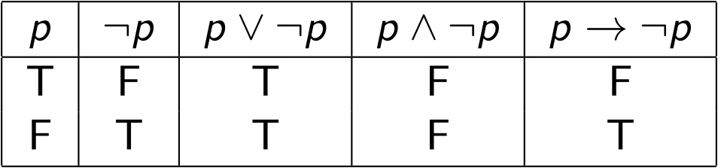
Tautology and Contradiction
Example
p∨¬p is a tautology
p^¬p is a contradiction
p→¬p is a contingency

Slide 28
Logical Equivalence
Compound propositions that always have the same truth values are called logically equivalent
Definition
The compound propositions p and q are called logically equivalent if p ↔ q is a tautology.
The notation is p ≡ q (or p ⇔ q).
Remark
The symbol ≡ is not a logical operator and p≡q is not a compound proposition but rather is the statement that p ↔ q is a tautology.

Slide 29
Logical Equivalence
Example
Show that ¬(p ∨ q) and ¬p ^ ¬q are logically equivalent.
p | q | p ∨ q | ¬(p ∨ q) | ¬p | ¬q | ¬p ^ ¬q | ¬(p ∨ q) ↔ ¬p ^ ¬q
T | T | T | F | F | F | F | T
T | F | T | F | F | T | F | T
F | T | T | F | T | F | F | T
F | F | F | T | T | T | T | T

Slide 30
Logical Equivalence
Example
Show that p → q and ¬p ∨ q are logically equivalent.

Slide 31
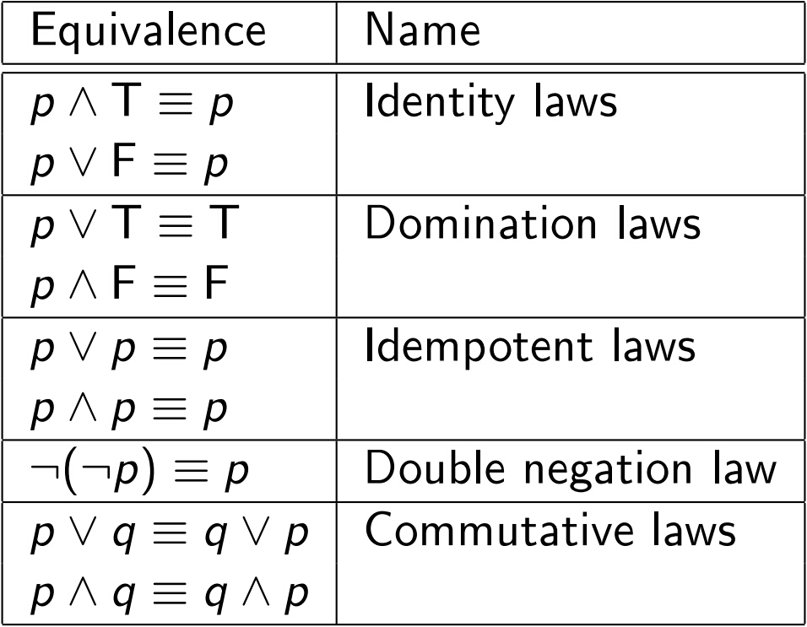
Propositional Equivalences
The following table summarizes the major propositional equivalences:

Slide 32
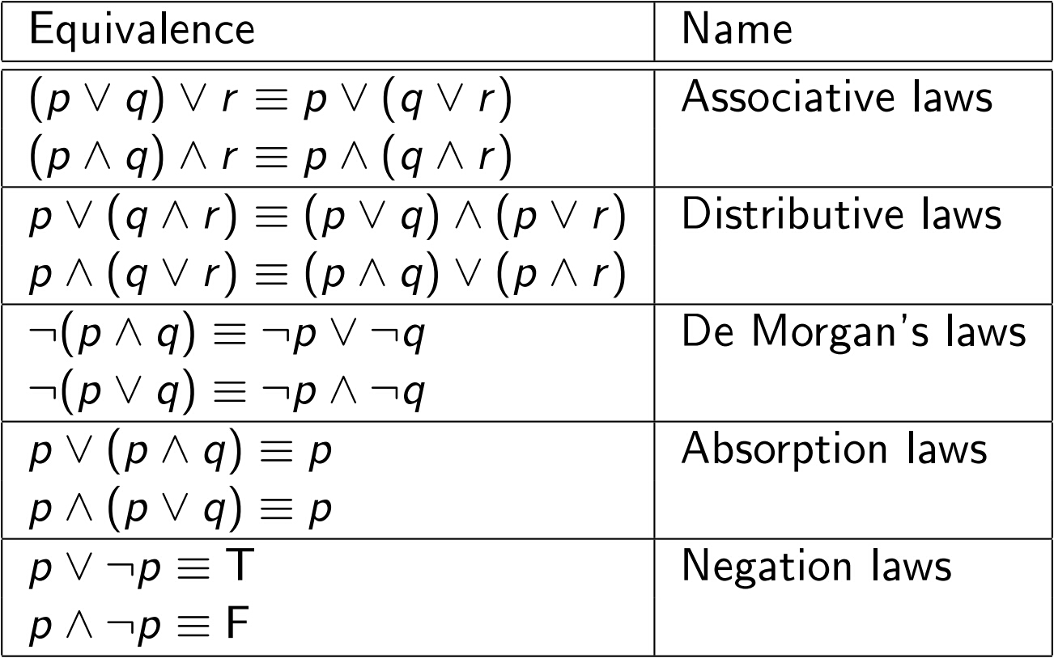
Propositional Equivalences (cont'd)

Slide 33
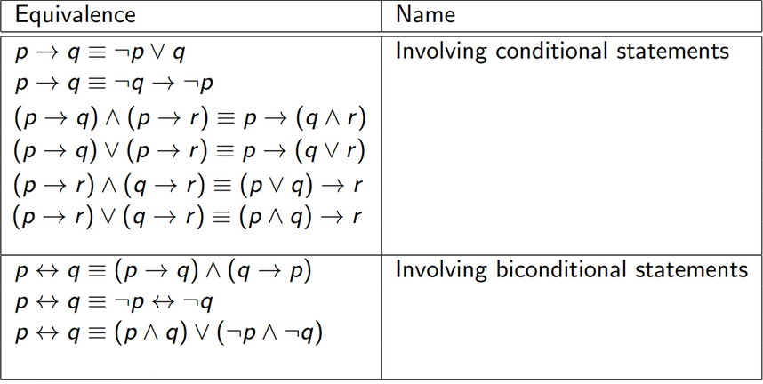
Propositional Equivalences (cont'd)

Slide 34
Examples
Example
Use De Morgan's laws to express the negations of “Alice will send a secret message or Bob will send a secret message” and “today is Friday and today is a holiday”.
Example
Show that ¬(p →q) and p^¬q are logically equivalent by developing a series of logical equivalences.

Slide 35
Examples
Example
Show that ¬(p∨(¬p^q)) and ¬p^¬q are logically equivalent by developing a series of logical equivalences.
Answer
¬(p ∨ (¬p ^ q)) ≡ ¬p ^ (¬(¬p^q))
≡ ¬p ^ (¬(¬p ) ∨ ¬q)
≡ ¬p ^ (p ∨ ¬q)
≡ (¬p ^ p) ∨ (¬p ^ ¬q)
≡ F ∨ (¬p ^ ¬q)
≡ ¬p ^ ¬q

Slide 36
Examples
Example
Show that (p^q)→(p∨q) is a tautology by developing a series of logical equivalences.

