Slide 1
L02: Predicate Logic
Objectives
Predicates
Quantifiers
Quantifiers with Restricted domains
Logical Equivalences involving Quantifiers
Nested Quantifiers

Slide 2
Predicate Logic
Suppose we know that “every COMP student is required to take either COMP 2711 or COMP 2711H”.
No rules of propositional logic allow us to conclude the truth of the statement “Chan Tai Man, a COMP student, is required to take either COMP 2711 or COMP 2711H”.
We now study predicate logic which is more powerful than propositional logic.

Slide 3
Outline
Predicates
Quantifiers
Quantifiers with Restricted Domains
Logical Equivalences involving Quantifiers
Nested Quantifiers

Slide 4
Predicate
Definition
Informally, a predicate is a statement that may be true or false depending on the choice of values of its variables. Each choice of values produces a proposition.
More formally, a statement involving n variables x₁, x₂, … , x_{n}, denoted by P(x₁, x₂, … , x_{n}), is the value of the propositional function P at the n-tuple (x₁, x₂, … , x_{n}) and P is called an n-ary predicate.
Example: P(x) denotes the statement “x is greater than 3”. x is the variable, and P is the predicate “is greater than 3”

Slide 5
Examples
Example
Let P(x) denote the statement “x>3”. What are the truth values of P(4) and P(2)?
Example
Let A(x) denote the statement “HKUST student x is required to take either COMP 2711 or COMP 2711H”. Suppose Alice is a COMP student and Bob is a CHEM student. What are the truth values of A(Alice) and A(Bob)?

Slide 6
Example
Example
Let Q(x, y) denote the statement “x=y+3”. What are the truth values of the propositions Q(1, 2) and Q(3, 0)?

Slide 7
Outline
Predicates
Quantifiers
Quantifiers with Restricted Domains
Logical Equivalences involving Quantifiers
Nested Quantifiers

Slide 8
Universal Quantification
We saw that when the variables in a propositional function are assigned values, the resulting proposition has a certain truth value.
Sometimes we may want to say that a predicate is true over a set of values.

Slide 9
Universal Quantification
Definition
The universal quantification of P(x) is the statement “for all elements x in the domain such that P(x)”.
Denote as ∀x P(x). We read it as “for all x P(x)” or “for every x P(x)”.
Here ∀ is called the universal quantifier.
An element for which P(x) is false is called a counterexample of ∀x P(x).

Slide 10
Domain
The domain or universe is the set of all possible values of a variable.
The domain must always be specified when a universal quantifier is used; without it, the universal quantification of a statement is not well defined.
Generally, an implicit assumption is made that the domain is nonempty. Otherwise ∀x P(x) is true for any propositional function P(x) because there are no elements x in the domain for which P(x) is false.

Slide 11
Examples
Example
Let P(x) be the statement “x + 1 > x”. What is the truth value of the quantification ∀x P(x), where the domain consists of all real numbers?
Example
Let Q(x) be the statement “x < 2”. What is the truth value of the quantification ∀x Q(x), where the domain consists of all real numbers?

Slide 12
Examples
Example
Let P(x) be the statement “x² > 0”. What is the truth value of the quantification ∀x P(x), where the domain consists of all integers?
Example
What is the truth value of “∀x (x² ≥ x)” if the domain consists of all real numbers?
What is its truth value if the domain consists of all integers?

Slide 13
Existential Quantification
Definition
The existential quantification of P(x) is the statement “there exists an element x in the domain such that P(x)”.
The notation ∃x P(x) denotes the existential quantification of P(x).
Here ∃ is called the existential quantifier.

Slide 14
Existential Quantification
Note that ∃x means “there exists at least one x in the domain” but not “there exists one and only one x in the domain” or “there exists a unique x in the domain”.

Slide 15
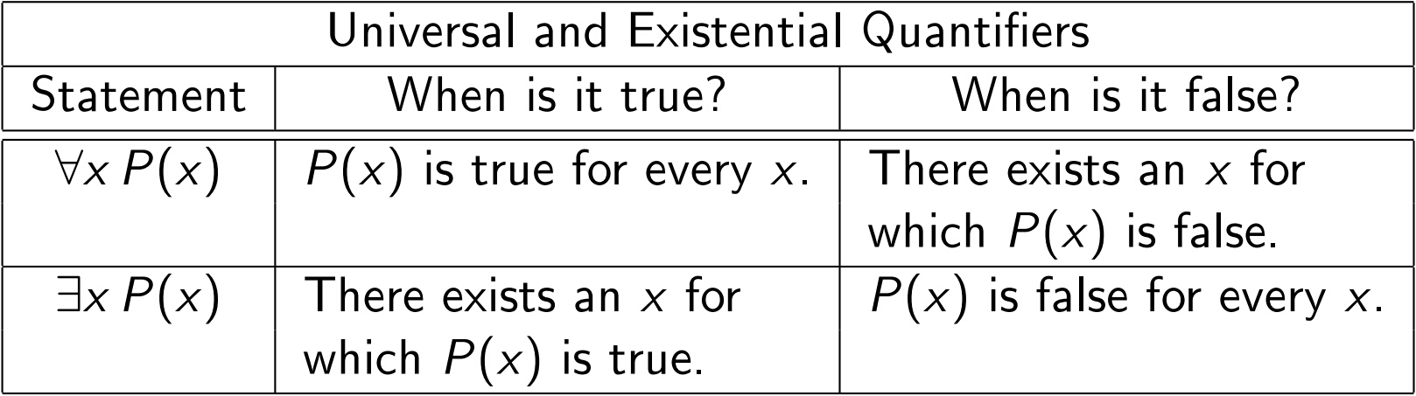
Universal and Existential Quantifiers

Slide 16
Examples
Example
Let P(x) be the statement “x > 3”. What is the truth value of the quantification ∃x P(x), where the domain consists of all real numbers?
Example
Let Q(x) be the statement “x = x + 1”. What is the truth value of the quantification ∃x Q(x), where the domain consists of all real numbers?

Slide 17
Examples
Express the following statements using predicate and quantifiers:
“every student in this class has studied mathematics in secondary school”
“some student in this class has learned C++ programming”
“every student in this class has learned either C++ or Python”

Slide 18
Restricted Domains
Example
What does each of the following statements mean, assuming that the domain in each case consists of all real numbers?
(a) ∀x < 0 (x² > 0)
(b) ∀y ≠ 0 (y³ ≠ 0)
(c) ∃z > 0 (z² = 2)

Slide 19
Outline
Predicates
Quantifiers
Quantifiers with Restricted Domains
Logical Equivalences involving Quantifiers
Nested Quantifiers

Slide 20
Motivation: Quantifier with Restricted Domain
The restriction of a universal quantification is the same as the universal quantification of a conditional statement (see next slide).
The restriction of an existential quantification is the same as the existential quantification of a conjunction (see next slide).

Slide 21

Quantifier with Restricted Domain
Theorem 2.1
Let U₁ and U₂ be two domains with U₁ ⊆ U₂. Suppose U₁ = { x ∈ U₂ | Q(x) is true }.
Then, a statement P(x) about U₂ may also be interpreted as a statement about U₁
(a) ∀x ∈ U₁ (P(x)) is equivalent to
∀x ∈ U₂ (Q(x) → P(x))
(b) ∃x ∈ U₁ (P(x)) is equivalent to
∃x ∈ U₂ (Q(x) ^ P(x))
false

Slide 22





Quantifier with Restricted Domain
Rewrite the following quantified statements

Slide 23
Quantifier with Restricted Domain
∀x ∈ U₁ (P(x)) is equiv. to ∀x ∈ U₂ (Q(x) → P(x))
Proof:
Case 1: Suppose ∀x ∈ U₁ (P(x)) is true.
That is, P(x) is true for all x ∈ U₁.
false
(i) For all x ∈ U₁ , Q(x) and P(x) are both true.
(ii) For all x ∈ U₂ \ U₁, Q(x) is false.
Thus for all x ∈ U₁ , Q(x) → P(x) is true.
Thus for all x ∈ U₂ \ U₁, Q(x) → P(x) is true.
Thus ∀x ∈ U₂ (Q(x) → P(x)) is true.

Slide 24
Quantifier with Restricted Domain
Case 2:
Suppose ∀x ∈ U₁ (P(x)) is false.
That is, there exists an x’ in U₁ for which P(x’ ) is false.
Since x’ is in U₁, Q(x’ ) is true.
Since Q(x’ ) and P(x’ ) are both false,
Q(x’ ) → P(x’ ) is false.
Thus ∀x ∈ U₂ (Q(x) → P(x)) is false.
false

Slide 25
Examples
Example
Show that ∃x ∈ U₁ (P(x)) is true implies
∃x ∈ U₂ (Q(x) → P(x)) is true
But ∃x ∈ U₁ (P(x)) is false does not imply
∃x ∈ U₂ (Q(x) → P(x)) is false
For example, ∃x<0 (x + 1 < x) is false but
∃x (x < 0 → (x + 1 < x )) is true.

Slide 26
Examples
Example
Express the statement “every mail message larger than one megabyte will be compressed” using predicates and quantifiers

Slide 27
Example
Example
Consider the following argument:
Premise 1: “All lions are fierce”
Premise 2: “Some lions do not drink coffee”
Conclusion: “Some fierce creatures do not drink coffee”
Let P(x), Q(x), and R(x) be the statements “x is a lion”, “x is fierce”, and “x drinks coffee”, respectively.
Assume that the domain consists of all creatures.
Express the statements using quantifiers and P(x), Q(x), and R(x).

Slide 28
Example, cont
∀x (P(x) → Q(x))
∃x (P(x) ^ ¬ R(x))
∃x (Q(x) ^ ¬ R(x))
Remark
In the next section, we will discuss the issue of determining whether the conclusion is a valid consequence of the premises. In this example, it is.

Slide 29
Outline
Predicates
Quantifiers
Quantifiers with Restricted Domains
Logical Equivalences involving Quantifiers
Nested Quantifiers

Slide 30
Logical Equivalence
Definition
Statements involving predicates and quantifiers are logically equivalent if and only if they have the same truth value no matter which predicates are substituted into these statements and which domain is used for the variables in these propositional functions.
We use the notation S ≡ T to indicate that two statements S and T involving predicates and quantifiers are logically equivalent.

Slide 31
Logical Equivalence
Example
Show that ∀x (Q(x) ^ P(x)) and ∀x P(x) ^ ∀x Q(x) are logically equivalent, where the same domain is used throughout.
Solution
Suppose ∀x (Q(x) ^ P(x)) is true. That is, Q(x) and P(x) are both true for all values of x. Thus, ∀x P(x) is true and so is ∀x Q(x). Thus ∀x P(x) ^ ∀x Q(x) is true.
Suppose ∀x (Q(x) ^ P(x)) is false. Then, there is a value a such that either Q(a) or P(a) is false. Thus, either ∀x P(x) is false or ∀x Q(x) is also false. Thus ∀x P(x) ^ ∀x Q(x) is false.

Slide 32

Logical Equivalence (cont'd)
The previous logical equivalence shows that we can distribute a universal quantifier over a conjunction.
∀x (Q(x) ^ P(x)) ≡ ∀x P(x) ^ ∀x Q(x)
We can also distribute an existential quantifier over a disjunction:
∃x (P(x) ∨ Q(x)) ≡ ∃x P(x) ∨ ∃x Q(x)
However, we cannot distribute a universal quantifier over a disjunction, nor can we distribute an existential quantifier over a conjunction:
∀x (P(x) ∨ Q(x)) ∀x P(x) ∨ ∀x Q(x)
∃x (P(x) ^ Q(x)) ∃x P(x) ^ ∃x Q(x)

Slide 33
Logical Equivalence (cont'd)
∃x (P(x) ^ Q(x)) ∃x P(x) ^ ∃x Q(x)
Example:
P(x): 2x + 1 = 5
Q(x): x² = 9
∃x P(x) ^ ∃x Q(x) is true because P(2) and Q(3) are true, but ∃x (P(x) ^ Q(x)) is false because there is no one integer a such that P(a) and Q(a) are both true.

Slide 34
Motivation: negation
Example
Express the following statement as a universal quantification: “every student in the class has sought the approval of the instructor to take the course”. Then express the negation of the statement using an existential Quantifier.

Slide 35
Motivation: negation
Example
Express the following statement as an existential quantification: “there is a student in the class who has sought the approval of the instructor to take the course”.
Then express the negation of the statement using a universal quantifier.

Slide 36
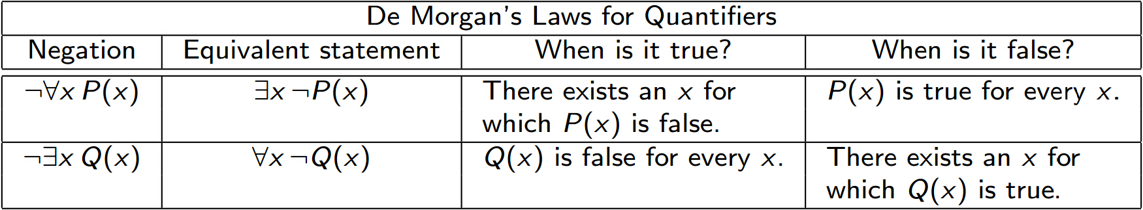
De Morgan's Laws for Quantifiers

Slide 37
De Morgan's Laws for Quantifiers (cont'd)
When the domain has n elements x₁, x₂, … , x_{n}, it follows that
¬∀x P(x) is the same as ¬ (P(x₁) ^ P(x₂) ^ … ^ P(x_{n})),
which is equivalent to ¬P(x₁) ∨ ¬P(x₂) ∨ … ∨ ¬P(x_{n}) by De Morgan's laws,
and this is the same as ∃x ¬P(x).
Similarly, ¬∃x P(x) is the same as ¬ (P(x₁) ∨ P(x₂) ∨ … ∨ P(x_{n})), which by De Morgan's laws is equivalent to ¬P(x₁) ^ ¬P(x₂) ^ … ^ ¬P(x_{n}), and this is the same as ∀x ¬P(x).

Slide 38
Examples
Example
What is the negation of the statement
∀x (x² > x) ?
Example
What is the negation of the statement
∃x (x² = 2) ?

Slide 39
Examples
Example
Show that ¬∀x (P(x)→Q(x)) and ∃x (P(x) ^ ¬Q(x))
are logically equivalent.
Solution
¬∀x (P(x)→Q(x)) ≡ ∃x ¬ (P(x) →Q(x))
≡ ∃x ¬ (¬ P(x) ∨ Q(x))
≡ ∃x (P(x) ^ ¬Q(x))

Slide 40
Outline
Predicates
Quantifiers
Quantifiers with Restricted Domains
Logical Equivalences involving Quantifiers
More Examples
Nested Quantifiers

Slide 41
Nested Quantifiers
Example
Assume that the domain for the variables x and y consists of all real numbers.
The statement
∀x ∀y (x + y = y + x)
says that x + y = y + x for all real numbers x and y.
This is the commutative law for the addition of real numbers.

Slide 42
Nested Quantifiers
Example
The statement
∀x ∃y (x + y = 0)
says that for every real number x , there is a real number y such that x +y = 0.
This states that every real number has an additive inverse.
What is the truth value of the quantification
∃y ∀x (x + y = 0) ?
It is false since there is no value of z that satisfies
the equation x + y = 0 for all values of x.
Remark: This example illustrates that the order in which quantifiers appear makes a difference.

Slide 43
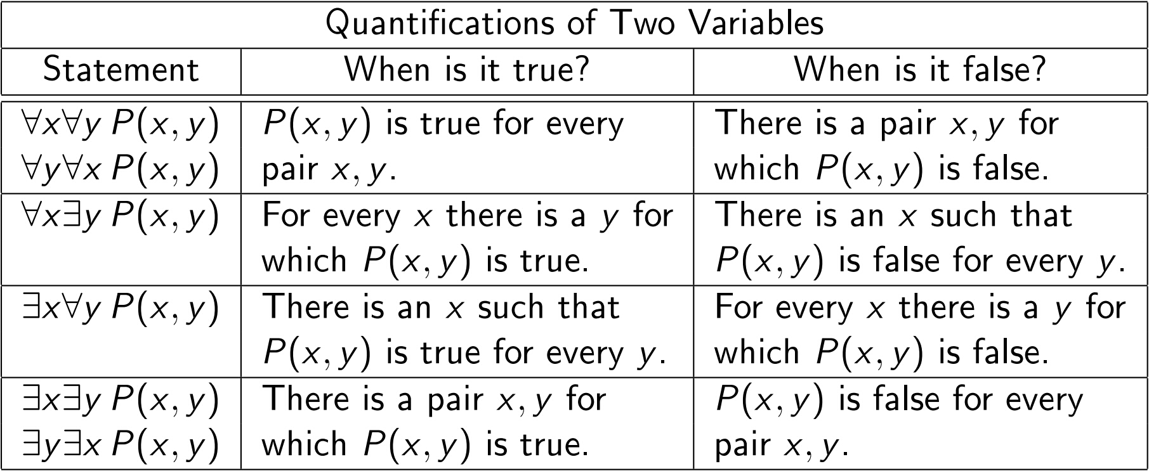
Quantifications of Two Variables
The following table summarizes the meanings of the different possible quantifications involving two variables.

Slide 44
Examples
Example
Let Q(x, y, z) be the statement “x + y = z”. What are the truth values of the statements
∀x ∀y ∃z Q(x, y, z)
∃z ∀x ∀y Q(x, y, z),
where the domain of the variables is all real numbers?
Solution:
Suppose x and y are assigned values. Then there exists a real number z such that x + y = z. Thus the first statement is true.
There is no value of z that satisfies the equation x + y = z for all values of x and y. Thus the second statement is false

Slide 45
Examples
Example
Translate the statement “the sum of two positive integers is always positive” into a logical expression.
Example
Translate the statement “every nonzero real number has a multiplicative inverse”.

Slide 46
Examples
Example
Translate the statement
∀x (C(x) ∨ ∃y (C(y) ^ F(x, y)))
into English, where C(x) is “x has a computer”, F(x, y) is “x and y are friends”, and the domain for both x and y consists of all students in the school.
Example
Translate the statement
∃x∀y∀z ((F(x, y) ^ F(x, z) ^ (y ≠ z)) → ¬F(y, z)
into English, where F(a, b) means a and b are friends and the domain for x, y, and z consists of all students in the school.

Slide 47
Examples
Example
Express the statement “if a person is female and is a parent, then this person is someone’s mother” as a logical expression involving predicates, quantifiers and logical connectives, with a domain consisting of all people.
Example
Express the statement “everyone has exactly one best friend” as a logical expression involving predicates, quantifiers and logical connectives, with a domain consisting of all people.

Slide 48
Examples
Example
Express the negation of the statement ∀x∃y (xy = 1) so that no negation precedes a quantifier.

Slide 49
Examples
Example
Use quantifiers to express the statement “there is a woman who has taken a flight on every airline in the world”.
Solution
Let P(w,f) be “w has taken flight f ”
Let Q(f,a) be “f is a flight on airline a ”
∃w ∀a ∃f ( (P(w, f) ^ Q(f, a) )
Example
Use quantifiers to express the statement “there does not exist a woman who has taken a flight on every airline in the world” so that no negation precedes a quantifier.

