Slide 1
L03: Rules of Inference & Basic Proof Technique
Objectives
Rules of Inference
Rules of Inference for Propositional Logic
Rules of Inference for Predicate Logic
Basic Proof Technique
Some Terminology
Direct Proof
Proof by Contraposition
Proof by Contradiction

Slide 2
Rules of Inference
Proofs in mathematics are valid arguments that establish the truth of mathematical statements.
By an argument, we mean a sequence of statements that end with a conclusion.
By valid, we mean that the conclusion, or final statement of the argument, must follow from the truth of the preceding statements, or premises, of the argument.
That is, an argument is valid if and only if it is impossible for all the premises to be true and the conclusion to be false.
To deduce new statements from statements we already have, we use rules of inference which are templates for constructing valid arguments.
Rules of inference are our basic tools for establishing the truth of statements.

Slide 3
Outline
Rules of Inference
Rules of Inference for Propositional Logic
Rules of Inference for Predicate Logic
Basic Proof Technique
Some Terminology
Direct Proof
Proof by Contraposition
Proof by Contradiction

Slide 4
Argument
Definition
An argument in propositional logic is a sequence of propositions.
All but the final proposition in the argument are called premises or hypotheses and the final proposition is called the conclusion.
Definition
An argument is valid if the truth of all its premises implies that the conclusion is true.

Slide 5
Rules of Inference for Propositional Logic
Remark
An argument with premises p₁, p₂, … , p_{n} and conclusion q is valid when (p₁ ^ p₂ ^ … ^ p_{n}) → q is a tautology.
Using a truth table to show the validity of an argument form can be very tedious.
This process can be simplified significantly by using rules of inference.

Slide 6
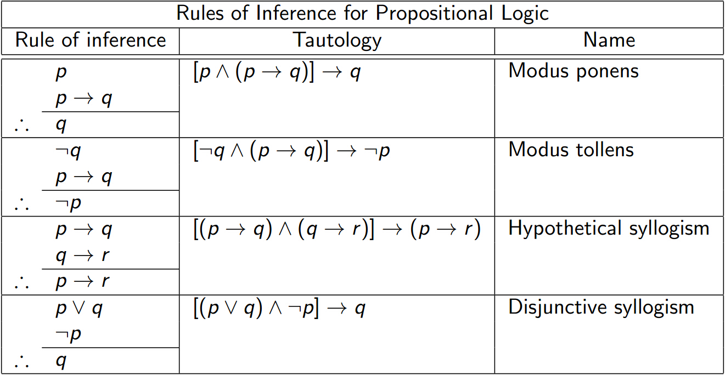
Rules of Inference for Propositional Logic (cont'd)

Slide 7
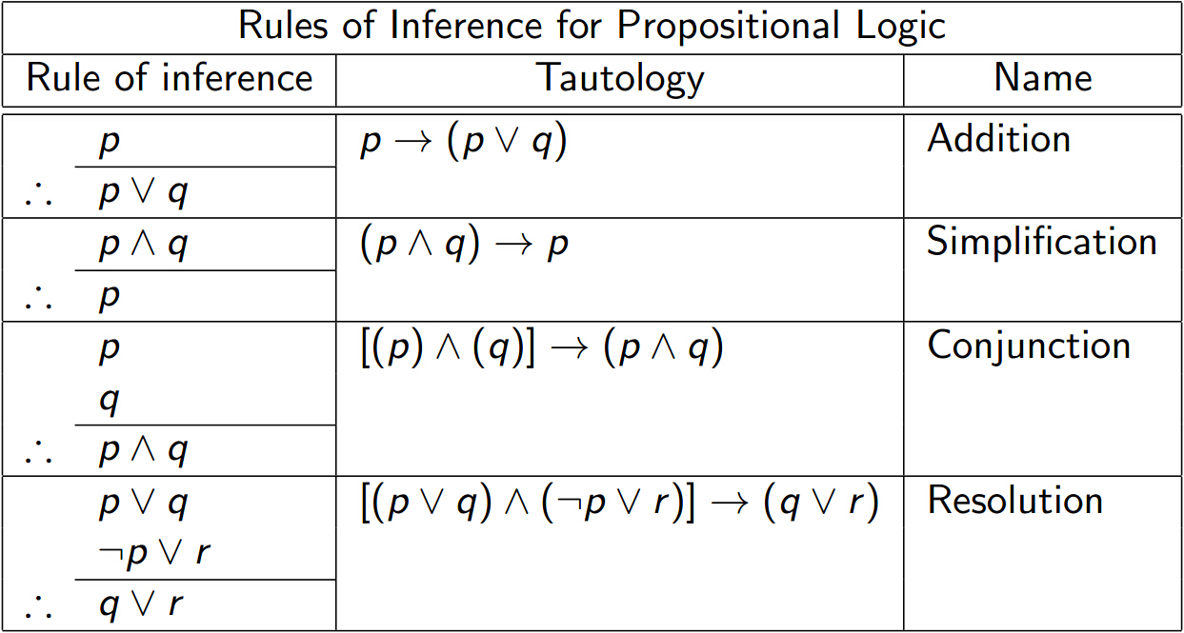
Rules of Inference for Propositional Logic (cont'd)

Slide 8
Examples
Example
Show that the hypotheses “it is not snowing or Jasmine is skiing” and “it is snowing or Bart is playing hockey” imply that “Jasmine is skiing or Bart is playing hockey”.
Solution
¬ s ∨ k
s ∨ h
∴ k ∨ h (using resolution)
Remark
Resolution plays an important role in programming languages based on the rules of logic, such as Prolog. Furthermore, it can be used to build automatic theorem proving systems.

Slide 9
Example
Example
Show that the hypotheses (p ^ q) ∨ r and r→s imply the conclusion p ∨ s.
Solution
1. (p ^ q) ∨ r Premise
2. r → s Premise
3. ¬ r ∨ s 2, equivalence
4. (p ^ q) ∨ s 1,3 resolution
5. (p∨s)^(q∨s) 4, equivalence
6. p ∨ s 5, simplification

Slide 10
Examples
Is the following argument valid?
If you do every problem in the textbook, then you will learn discrete mathematics. You learned discrete mathematics.
Therefore, you did every problem in the textbook.
p → q
q
∴ p invalid
Is the following argument valid?
If you do every problem in the textbook, then you will learn discrete mathematics. You did not do every problem in the textbook.
Therefore, you did not learn discrete mathematics.
p → q
¬ p
∴ ¬ q invalid

Slide 11
Example
Example
Show that the following premises lead to the conclusion.
Premises:
“it is not sunny this afternoon and it is colder than yesterday”
“we will go swimming only if it is sunny”
“if we do not go swimming, then we will take a canoe trip”
“if we take a canoe trip, then we will be home by sunset”
Conclusion: “we will be home by sunset”.
Remark
We could have used a truth table to show that whenever each of the four premises is true, the conclusion is also true. However, because we are working with five propositional variables p, q, r, s, and t, such a truth table would have 2⁵ = 32 rows.

Slide 12
Example (cont)
1. ¬ s ^ c Premise
2. ¬ s 1, Simplification
3. w → s Premise
4. ¬ w 2,3 Modus tollens
5. ¬ w → c Premise
6. c Modus ponens
7. c → h Premise
8. h Modus ponens

Slide 13
Outline
Rules of Inference
Rules of Inference for Propositional Logic
Rules of Inference for Predicate Logic
Basic Proof Technique
Some Terminology
Direct Proof
Proof by Contraposition
Proof by Contradiction

Slide 14
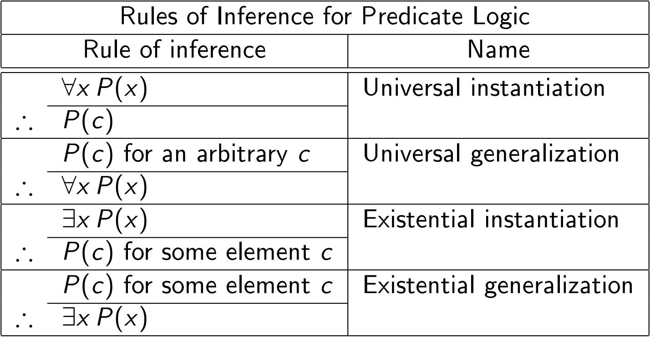
Rules of Inference for Predicate Logic

Slide 15
Examples
Example
Show that the premises “everyone in this discrete mathematics class has taken a course in computer science” and “Joseph is a student in this class” imply the conclusion “Joseph has taken a course in computer science”.
Solution
1. ∀x (P(x) → C(x)) Premise
2. P(Joseph) → C(Joseph) Universal instantiation
3. P(Joseph) Premise
4. C(Joseph) 2,3 Modus ponens
∴

Slide 16
Example
Example
Assume that “for all positive integers n, if n is greater than 4, then n² is less than 2^{n} ” is true. Use universal modus ponens to show that 100² < 2¹⁰⁰

Slide 17
Example
Show that the premises “a student in this class has not read the textbook” and “everyone in this class passed the first unit test” imply the conclusion “someone who passed the first unit test has not read the textbook”.
1. ∃x (P(x) ^ ¬R(x)) Premise
2. P(a) ^ ¬R(a) for some a 1, Existential instantiation
3. P(a) 2, Simplification
4. ¬ R(a) 2, Simplification
5. ∀x (P(x) → U(x)) Premise
6. P(a) → U(a) 5, Universal instantiation
7. U(a) 3,6, Modus ponens
8. U(a) ^ ¬ R(a) 4,7, Conjunction
9. ∃x (U(x) ^ ¬R(x)) 8, Existential generalization

Slide 18
Outline
Rules of Inference
Rules of Inference for Propositional Logic
Rules of Inference for Predicate Logic
Rules of Inference
Some Terminology
Direct Proof
Proof by Contraposition
Proof by Contradiction

Slide 19
Some Terminology
Definition
A theorem is a statement that can be shown to be true.
Remark
In mathematical writing, the term theorem is usually reserved for a statement that is considered at least somewhat important. Less important theorems are sometimes called propositions.
Definition
An axiom is a statement that is assumed to be true.
Definition
A less important theorem that is helpful in the proof of other theorems is called a lemma.

Slide 20
Some Terminology (cont’d)
Definition
A proof is a valid argument that establishes the truth of a theorem. The statements used in a proof can include axioms, premises of the theorem, and previously proved theorems or lemmas.
Using these ingredients and rules of inference, the final step of the proof establishes the truth of the statement being proved.
Remark
Complicated proofs are usually easier to understand when they are proved using a series of lemmas, where each lemma is proved individually.

Slide 21
Some Terminology
Definition
A corollary is a theorem that can be established directly from a theorem that has been proved.
Definition
A conjecture is a statement that is being proposed to be a true statement, usually on the basis of some partial evidence, a heuristic argument, or the intuition of an expert.
Remark
When a proof of a conjecture is found, the conjecture becomes a theorem. However, many conjectures are eventually found to be false.

Slide 22
Outline
Rules of Inference
Rules of Inference for Propositional Logic
Rules of Inference for Predicate Logic
Basic Proof Technique
Some Terminology
Direct Proof
Proof by Contraposition
Proof by Contradiction

Slide 23
Direct Proof
A direct proof of a conditional statement p→q
The first step is the assumption that p is true.
Subsequent steps are constructed using axioms,
definitions, previously proved theorems, and
rules of inference, with the final step showing
that q must also be true.

Slide 24
Direct Proof
Example
Give a direct proof of the theorem “if n is an odd integer, then n² is odd”. (An integer n is odd if there exists an integer k such that n = 2k + 1.)
Solution:
Assume that the hypothesis of this implication is true;
namely, suppose that n is odd.
Then n = 2k + 1, where k is an integer.
It follows that n ² = (2k + 1) ² = 2(2k²+2k)+1.
Therefore, n² is odd.

Slide 25
Examples
Example
Give a direct proof that if m and n are both perfect squares, then mn is also a perfect square. (An integer a is a perfect square if there exists an integer b such that a = b².)
Example
Prove that the sum of two rational numbers is rational. (A real number r is rational if there exist integers p and q with q ≠ 0 such that r = p / q. A real number that is not rational is called irrational.)

Slide 26
Limitation of Direct Proofs
Remark
Direct proofs are useful but attempts at direct proofs sometimes lead to dead ends. There are other proof techniques.
Proofs that are not direct proofs, i.e., that do not start with the hypothesis and end with the conclusion, are called indirect proofs.
We will consider several types of indirect proofs.

Slide 27
Outline
Rules of Inference
Rules of Inference for Propositional Logic
Rules of Inference for Predicate Logic
Basic Proof Technique
Some Terminology
Direct Proof
Proof by Contraposition
Proof by Contradiction

Slide 28
Indirect Proof
A proof by contraposition makes use of the fact that the conditional statement p → q is equivalent to its contrapositive ¬q → ¬p.
This means that the conditional statement p → q can be proved by showing that its contrapositive ¬q → ¬p is true.
To do so, we take ¬q as a hypothesis, and using axioms, definitions, previously proved theorems, and rules of inference, we show that ¬p must follow.

Slide 29
Examples
Example
Prove that if n is an integer and 3n + 2 is odd, then n is odd.
Solution
Assume that the conclusion of this implication is false;
namely, assume that n is even.
Then n = 2k for some integer k.
It follows that 3n + 2 = 3(2k)+2 = 2(3k+1)
Therefore, 3n + 2 is even.

Slide 30
Examples
Example
Prove that if n = ab, where a and b are positive integers, then a ≤ √n or b ≤ √n.

Slide 31
Outline
Rules of Inference
Rules of Inference for Propositional Logic
Rules of Inference for Predicate Logic
Basic Proof Technique
Some Terminology
Direct Proof
Proof by Contraposition
Proof by Contradiction

Slide 32
Proof by Contradiction
Suppose we want to prove that a statement p is true.
Suppose a contradiction F can be found so that ¬p → F is true. For ¬p →F to be true, the proposition ¬p must be false. Consequently, p must be true.
An example of contradiction is r ^ ¬r, where r is a proposition.
This is called a proof by contradiction.

Slide 33
Examples
Example
Prove that √2 is irrational by giving a proof by contradiction.
Solution:
Suppose √2 is rational. We will show that this leads to a contradiction.
There exists integers a and b with √2 = a/b, where a and b have no common factors.
….
We have shown that 2 divides a and b. We obtain a contradiction.

Slide 34
Proof by Contradiction for Conditional Statement
Proofs by contradiction can be used to prove conditional statements p → q is true.
We first assume that the negation of the conclusion is true. We then use the premises of the theorem and the negation of the conclusion to arrive at a contradiction.
That is, (p ^ ¬q) → F.
The validity of such proofs is based on the logical equivalence of p → q and (p ^ ¬q) → F.

Slide 35
Proof by Contradiction for Conditional Statement (cont’d)
We can rewrite a proof by contraposition of a conditional statement p→q as a proof by contradiction.
In a proof by contraposition, we assume that ¬q is true and then show that ¬p must also be true.
To rewrite as a proof by contradiction, we suppose that both p and ¬q are true. Then, we use the steps from the proof of ¬q → ¬p to show that ¬p is true. This leads to the contradiction p ^ ¬p, completing the proof.

Slide 36
Proof by Contradiction for Conditional Statement (cont’d)
Example (compare with proof by contraposition)
Give a proof by contradiction of the theorem “if 3n + 2 is odd, then n is odd”.
Solution:
We assume 3n+2 is odd and n is not odd, i.e., n is even.
Following the same steps as in the solution of proving
this statement by contraposition:
n = 2k for some integer k.
……
then 3n + 2 is even.
This contradicts the assumption that 3n + 2 is odd,
completing the proof.

Slide 37
Proof by Contradiction for Biconditional Statement
To prove a theorem that is a biconditional statement of the form p ↔ q, we show that both p → q and q → p are true.
Example 20
Prove the theorem “if n is a positive integer, then n is odd if and only if n² is odd”.

Slide 38
Example
Example
Show that these statements about the integer n are logically equivalent:
p₁ : n is even
p₂ : n-1 is even
p₃: n² is even
Hint: We will prove that the implications p₁ → p₂ ,
p₂ → p₃, and p₃ → p₁ are true.

Slide 39
Some comments on proofs
Constructing proofs is an art that can be learned only by trying various lines of attack. There is no algorithm for proving theorems.
Many statements that appear to be theorems have resisted the persistent efforts of mathematicians for hundreds of years.
For instance, Goldbach’s conjecture: “every even positive integer greater than 4 is the sum of two primes” has not yet been proved, and no counterexample has been found.

