Slide 1
L05: Lists, Permutations and Subsets
Page <number>
Outline
Use of Sum/Product Principle
  General Product Principle
  Counting lists and functions
The Bijection Principle
  Functions concepts: Injection, surjection, and bijection
  The Bijection Principle
    Increasing triples and 3 elements subsets
  Counting permutations and subsets
    Binomial Coefficients
Reading
  SDB, pp. 40-49

Slide 2

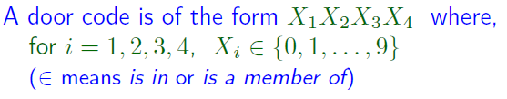



Counting Door Codes
Page <number>

Slide 3
Counting Door Codes: Justification
Page <number>
All codes
Those start with 0
Those start with 1
Those start with 9
|S_{i}| = # of codes with 3 digits
|S|= 10 * |S_{i}|
= 10 * 10³
=10⁴
Repeat argument on S_{i} :
|S_{i}| = 10³
Cumbersome to justify using the simple product principle

Slide 4
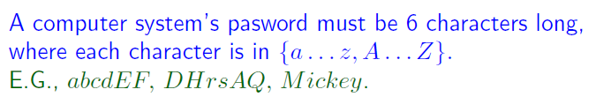

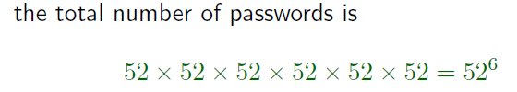
Counting Passwords
Page <number>
Cumbersome to justify using the simple product principle

Slide 5
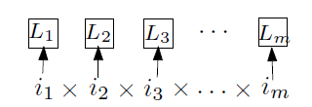
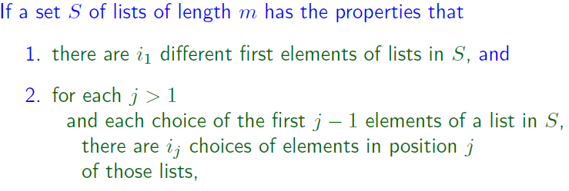

Product Principle, Version 2
Page <number>
Directly applicable to the password examples

Slide 6
Counter Example
Page <number>
Increasing triples
  {X₁X₂X₃ | X_{i} from {0, 1, …, 9}, X₁ < X₂ < X₃}
10 choices for X₁: 10
Choices for X₂:
  When X₁=0, there are 9 choices
  When X₁=1, there are 8 choices
  When X₁=2, there are 7 choices
  ….
Cannot use product principle
Think: How to count?

Slide 7
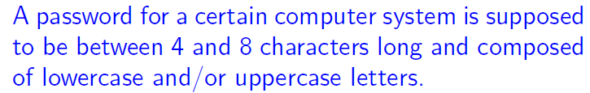

Page <number>

Slide 8

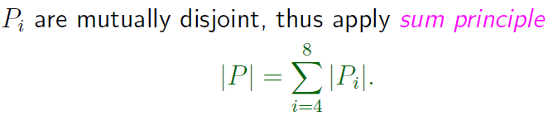


Page <number>

Slide 9
Outline
Page <number>
Use of Sum/Product Principle
  General Product Principle
  Counting lists and functions
The Bijection Principle
  Functions concepts: Injection, surjection, and bijection
  The Bijection Principle
    Increasing triples and 3 elements subsets
  Counting permutations and subsets

Slide 10

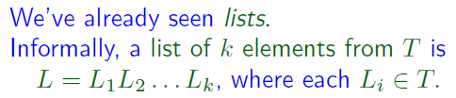


Page <number>

Slide 11
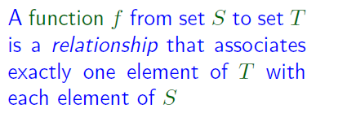
Page <number>
f: S T
1 Sam
2 Mary
3 Sarah
S = {1, 2, 3}: domain of function f
T={Sam, Mary, Sarah}: range of function f

Slide 12

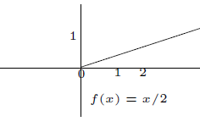

Page <number>
f: S T
1 Sam
2 Mary
3 Sarah

Slide 13
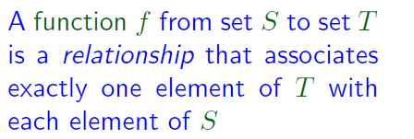
Notes
Page <number>
For each element s of S, f gives one element of T, f(s)
In general NOT:
  For each element t of T, f(s) = t for some s of S
  Only a special kind of function has this property, onto

Slide 14
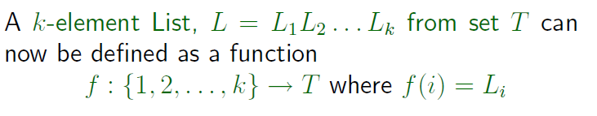

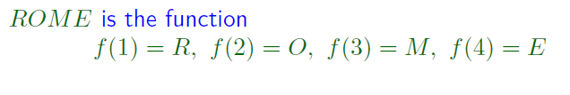
Page <number>

Slide 15
Functions as Lists
Page <number>
Function:
  f: {1, 2, …, k} → T
Same as list of T
  f(1)f(2)…f(k)

Slide 16
Exercise on Function Counting
Page <number>
All functions: {1, 2} ->{a, b}
f(1) f(2)
a a
a b
b a
b b
2-element list from {a,b}
#: 2*2=4

Slide 17
Counting Functions
Page <number>
# of functions : 2-element set → 3-element set
= # of 2-element lists from 3-element set
= 3*3
f(1) f(2)

Slide 18
Counting Functions
Page <number>
# of functions: 3-element set → 2-element set
= # of 3-element lists from 2-element set
= 2*2*2
f(1) f(2) f(3)

Slide 19
Outline
Page <number>
Use of Sum/Product Principle
  General Product Principle
  Counting lists and functions
The Bijection Principle
  Functions concepts: Injection, surjection, and bijection
  The Bijection Principle
    Increasing triples and 3 elements subsets
  Counting permutations and subsets

Slide 20
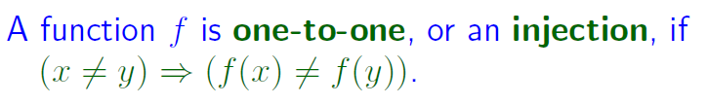
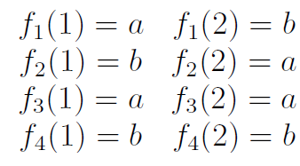


Injection
Page <number>
f: {1, 2} ➔ {a, b}

Slide 21
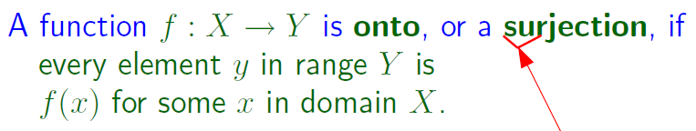

Surjection
Page <number>
f: {1, 2} ➔ {a, b}

Slide 22
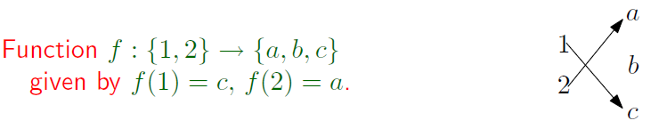

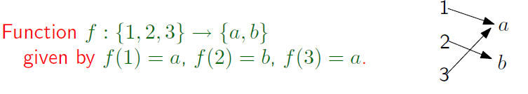

Examples
Page <number>

Slide 23

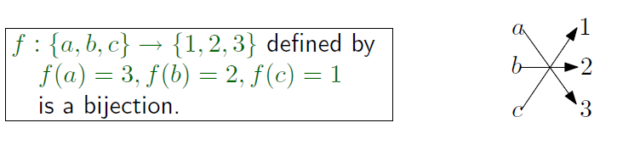
Bijection
Page <number>
Domain and range have same number of elements.

Slide 24
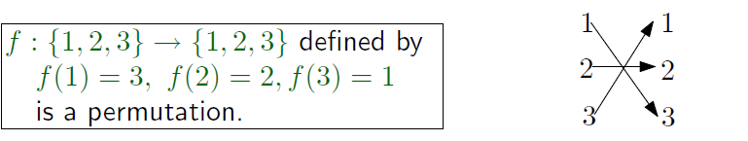
Permutation
Page <number>

Slide 25
Outline
Page <number>
Use of Sum/Product Principle
  General Product Principle
  Counting lists and functions
The Bijection Principle
  Functions concepts: Injection, surjection, and bijection
  The Bijection Principle
    Increasing triples and 3 elements subsets
  Counting permutations and subsets

Slide 26

Bijection Principle
Page <number>
Bijection f: S→T
Counting elements in S
  May be difficult directly
  Find another set T that is easy to count
  Define a function f: S → T
  Prove that f is a bijection
  Count T

Slide 27
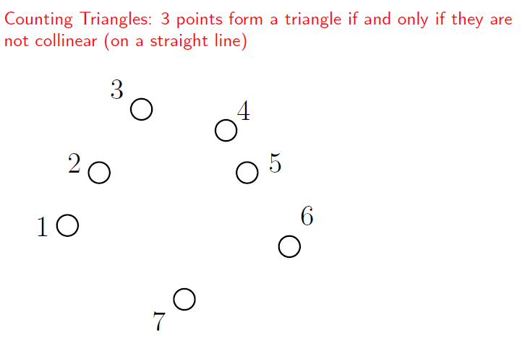
Example
Page <number>

Slide 28
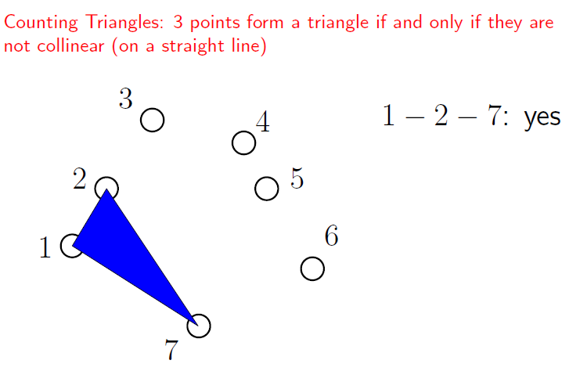
Page <number>

Slide 29
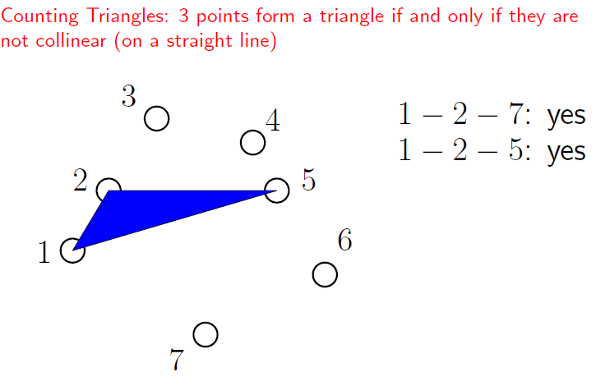
Page <number>

Slide 30
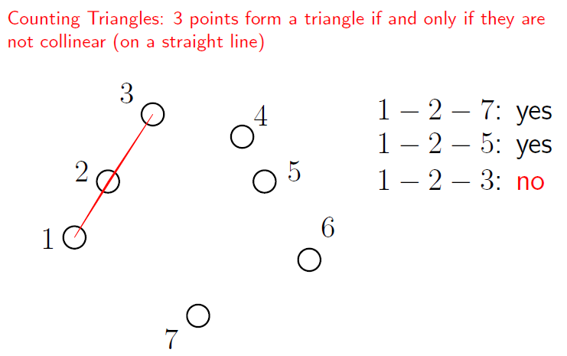
Page <number>

Slide 31
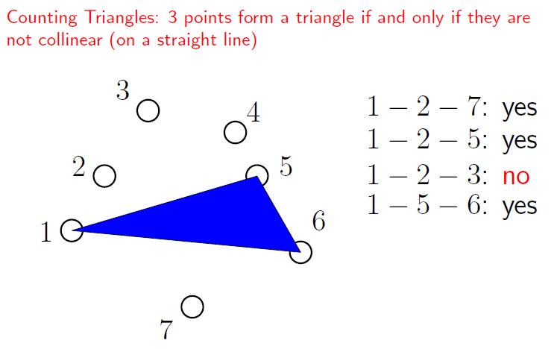
Page <number>

Slide 32
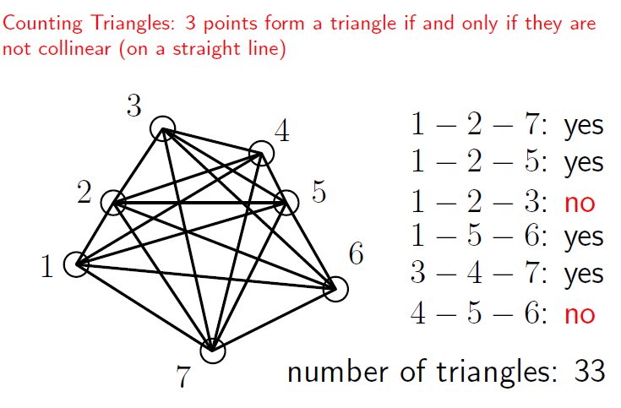
Page <number>

Slide 33
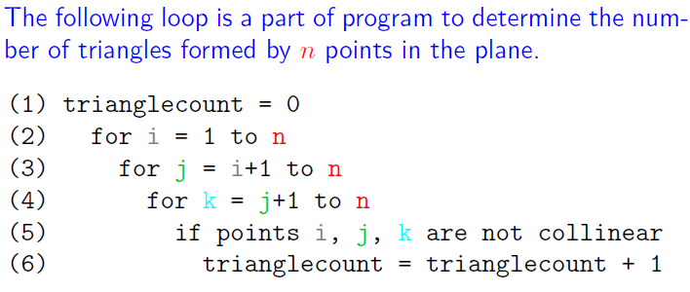
Example
Page <number>

Slide 34
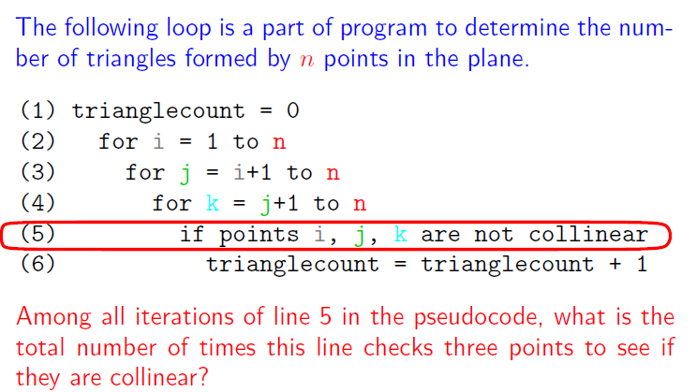
Hard to count directly. Use bijection.
Page <number>

Slide 35
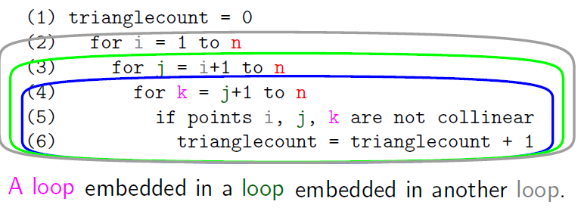
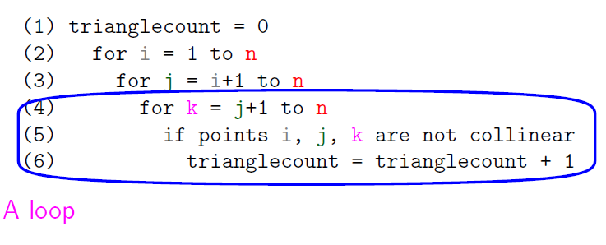
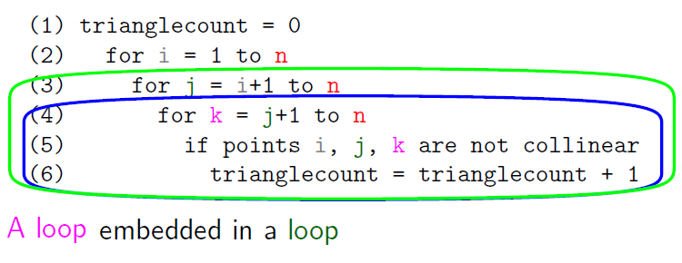
Page <number>

Slide 36

Page <number>
Increasing Triples
Can we count using general product principle?
  # of possible values for i?
    n-2
  # of possible values for j?
    Depends on value of i!
    Violates condition of general product principle

Slide 37
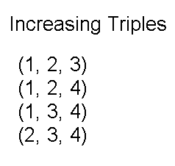
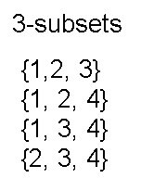
Page <number>
Use Bijection Principle
Claim: # of (i,j,k) s.t. 1≤i<j<k≤n
= # of 3-element subsets from {1,2,…n}
n=4
All increasing triples listed.
Do we have all the subsets? How about subset {2, 1, 3}?
  It is the same as {1, 2, 3}

Slide 38
Page <number>
Increasing Triples
Claim: # of (i,j,k) s.t. 1≤i<j<k≤n
= # of 3-element subsets from {1,2,…n}
Proof : X – set of those triples
Y – set of those 3-element subsets
Define f: X→Y : f((i,j,k))={i,j,k}

Slide 39















Increasing Triples
Page <number>
(1) f is injective:

Slide 40


Page <number>
Increasing Triples
(2) f is surjective:
-- Example:
Increasing triples 3-subset
f( (1,3,4)) =
(1,3,4)
{4,3,1}
f( (1,2,3)) =
(1,2,3)
{2,3,1}
-- any 3-element subset can be written as
r = {i, j, k} s.t. i<j<k
--increasing triple: (i, j, k)
f( ( i, j, k) ) = {i, j, k} = r
-- so, f is onto.
Claim proved.

Slide 41
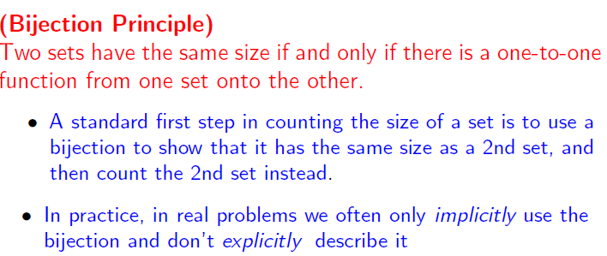
Page <number>

Slide 42
Page <number>
Increasing Triples
Same as
  The number of 3-element subsets from {1, 2, …, n}
  What is this number?
First consider another number
  The number of 3-element permutations from {1, 2, …, n}

Slide 43
Outline
Page <number>
Use of Sum/Product Principle
  General Product Principle
  Counting lists and functions
The Bijection Principle
  Functions concepts: Injection, surjection, and bijection
  The Bijection Principle
    Increasing triples and 3 elements subsets
  Counting permutations and subsets

Slide 44



Page <number>
Order matters, not required to be increasing
3-element permutations from {1, 2, 3, 4}

Slide 45
Increasing triples, 3-subsets, 3-permutations
Page <number>
n=4
Increasing triples
  (1, 2, 3), (1, 2, 4), (1, 3, 4) , (2, 3, 4)
3-element subsets
  {1, 2, 3}, {1, 2, 4}, {1, 3, 4}, {2, 3, 4}
3-element permutations

Slide 46




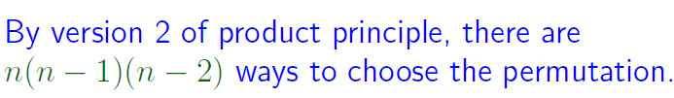
3-Element Permutations
Page <number>
General product principle can be applied here although cannot for increasing triples. Why?

Slide 47


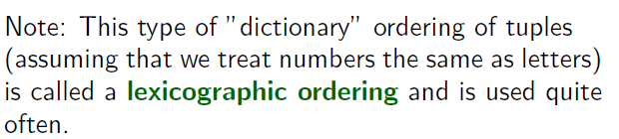
3-Element Permutations
Page <number>

Slide 48

Page <number>
3-element subsets/3-element permutations
3-element subset
3-element permutations
123,132,213
231,312,321
{1,2,3}
6
123,132,213
231,312,321
{1,2,4}
6
… …
# of 3-element subsets = # of 3-element permutations / 6

Slide 49
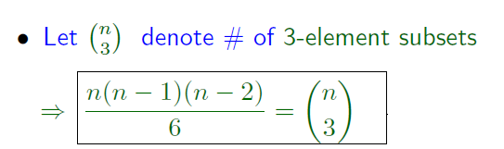

Page <number>
3-element subsets/Increasing triples
Same as
  The number of 3-element subsets from {1, 2, …, n}

Slide 50
Summary
Page <number>
Want: # of increasing triples from {1, 2, …, n}
Bijiection
  # of increasing triples = # of 3-element subsets
# of 3-element subsets = # of 3-element permutations / 6
# of 3-element permutations n(n-1)(n-2)
So
  # of increasing triples = # of 3-element subsets = n(n-1)(n-2)/6

Slide 51






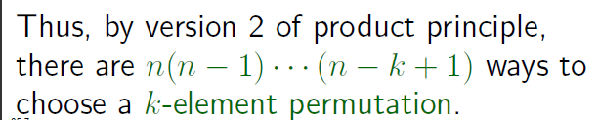
k-Element Permutations
Page <number>

Slide 52


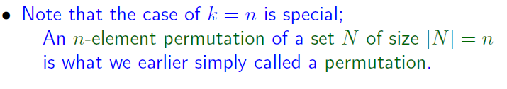

Page <number>
K-Element Permutations
Number of k-element permutations
Number of permutations of a set of size n

Slide 53

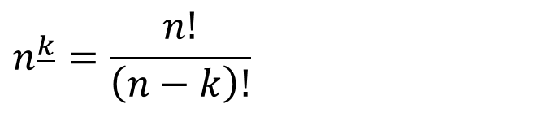
Page <number>
K-th falling factorial

Slide 54
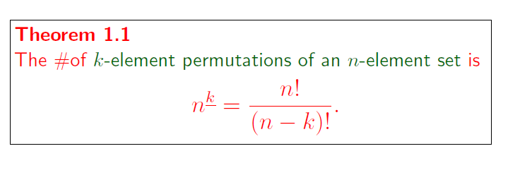
Page <number>

Slide 55

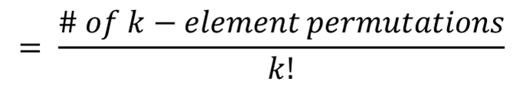
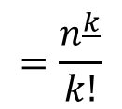
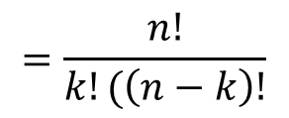
Page <number>
k-element subsets/k-element permutations
k-element subsets
k-element permutations
{1, 2, …, k}
12…k 21…k ……
……
k!
… …

Slide 56
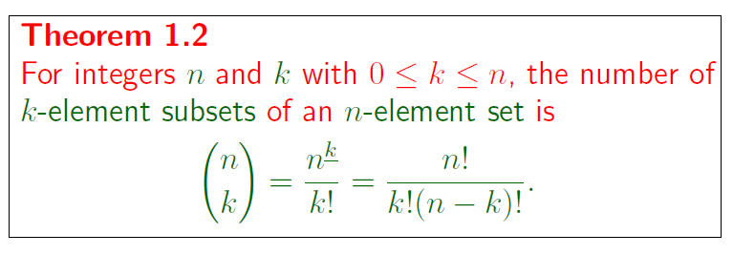


Page <number>
k-element subsets/k-element permutations

Slide 57
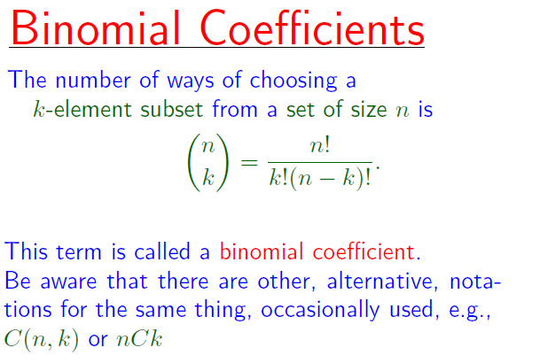
Page <number>

Slide 58
Outline
Page <number>
Use of Sum/Product Principle
  General Product Principle
  Counting lists and functions
The Bijection Principle
  Functions concepts: Injection, surjection, and bijection
  The Bijection Principle
    Increasing triples and 3 elements subsets
  Counting permutations and subsets

Slide 59


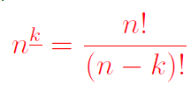
Page <number>
Summary of Results
Number of increasing triples:
Number of 3-element subsets
Number of 3-element permutations
Number of k-element subsets
Number of k-element permutations

