Slide 1
L06: Binomial Coefficients
Page <number>
Objectives:
  Properties of binomial coefficients
  Related issues: the Binomial Theorem and labeling
Reading
  SDB, pp. 52-60

Slide 2
Outline
Page <number>
Basic properties of Binomial Coefficients
Pascal’s triangle
The Binomial theorem
Labeling and Trinomial coefficients
More Properties of Binomial Coefficients
More permutations

Slide 3
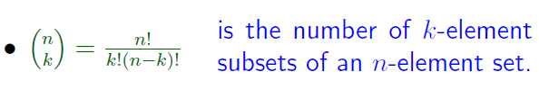




Basic properties
Page <number>

Slide 4

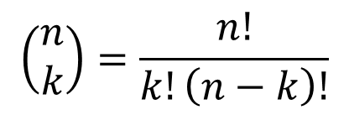
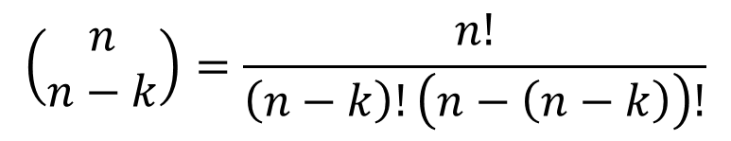
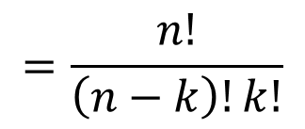
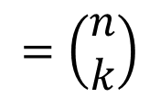
Basic Property 3
Page <number>
Algebraic proof
Correct, but not so telling.

Slide 5
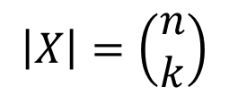
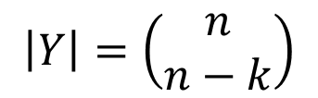
Combinatorial Proof of .
Page <number>
Proof using Bijection
Proof using Bijection
set: S = {1, 2, …, n}
X: collection of k-element subsets
Y: collection of (n-k)-element subsets
|X| = |Y|?

Slide 6

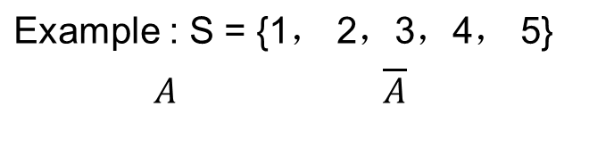


Combinatorial Proof of .
Page <number>
Complement of set: A → S \ A,
{1} {2，3，4，5}
{1,3}
{2,4,5}
S
S

Slide 7
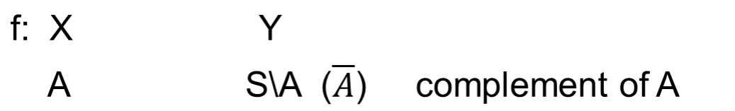



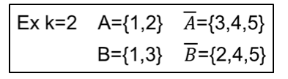







Combinatorial Proof of .
Page <number>
|X| = |Y|?

Slide 8
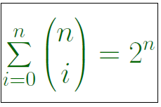
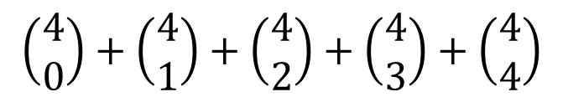
Basic Property 4
Page <number>
Example
n=4:
= 1 + 4 + 6 + 4 + 1
= 16
= 2⁴

Slide 9
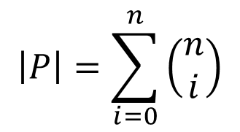

Page <number>
Combinatorial Proof of
Idea
  Two collections P and L of objects
  .
  .
  Bijection between P and L

Slide 10
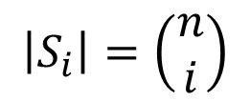
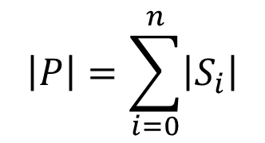
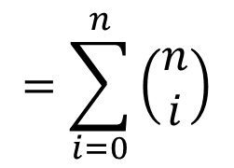
Page <number>
Combinatorial Proof of
Proof: N= {1, 2, … , n}
P: collection of all subsets of N
S_{i}: collection of i-element subsets of N
Theorem 1.2
{S₀ ,S₁ ,…,S_{n} }
is a partition of P.
Sum Principle:

Slide 11

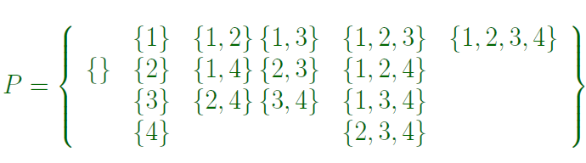



Page <number>

Slide 12
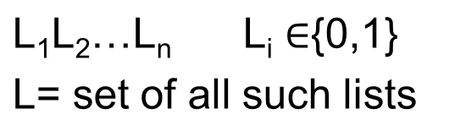

Page <number>
Combinatorial Proof of
Ex:
10101
11101
|L|=
2^{n}
Q: |P| = |L| ?
Ex:
10101 → {1,3,5}
Bijection principle
f: L → P
L₁L₂…L_{n} → S={ i | L_{i} =1}
11101 →
{1,2,3,5}

Slide 13










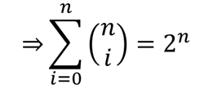


Page <number>
Combinatorial Proof of
f: L → P

Slide 14

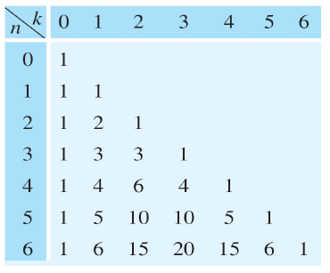









Summary of Basic Properties
Page <number>

Slide 15
Outline
Page <number>
Basic properties
Pascal’s triangle
The Binomial theorem
Labeling and Trinomial coefficients

Slide 16
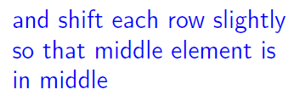
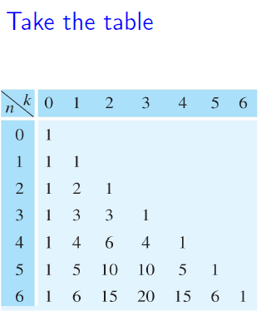
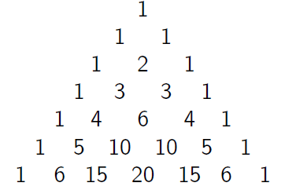
Pascal’s Triangle
Page <number>

Slide 17
Pascal’s Triangle
Page <number>
Each entry = sum of the two entries above it

Slide 18


Pascal’s Triangle
Page <number>
Each entry = sum of the two entries above it
Next row?

Slide 19
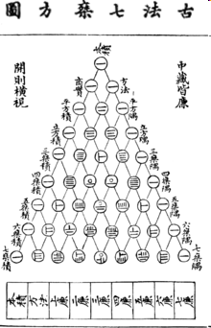
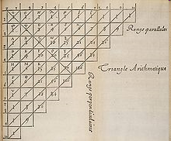
Yang Hui (1238–1298 )Triangle 杨辉三角
Page <number>
Blaise Pascal's version of the triangle

Slide 20
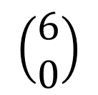
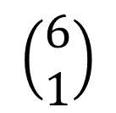
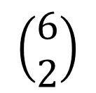
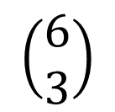
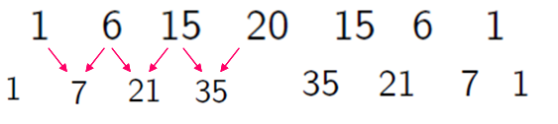
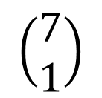
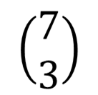
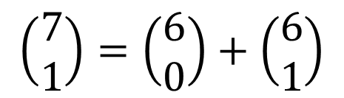
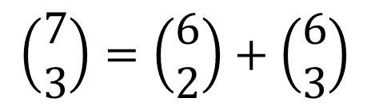

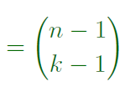
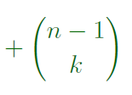
Pascal’s Triangle: General Formula
Page <number>

Slide 21
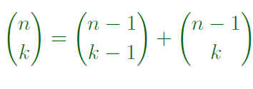

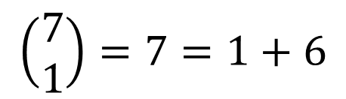
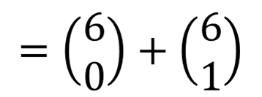
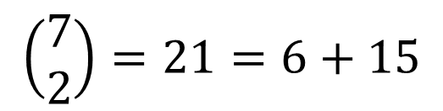
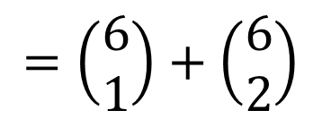
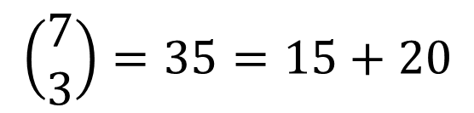
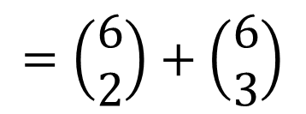
Pascal Relationship
Page <number>
Examples

Slide 22
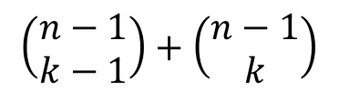
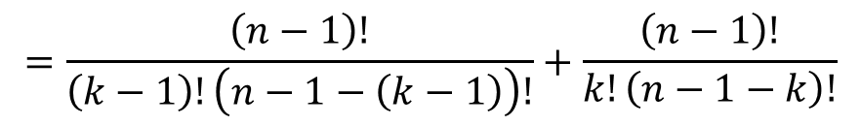
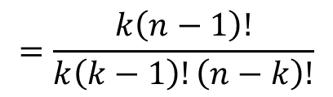
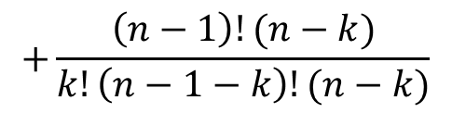
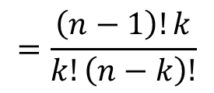
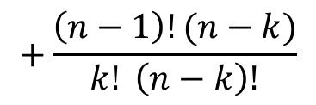
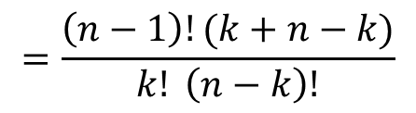



Algebraic Proof of Pascal’s Relationship
Page <number>
For reference only.
Will give proof by sum principle. More revealing.

Slide 23



Proof of Pascal’s Relationship by Sum Principle
Page <number>
S={A,B,C,D,E}
S₁: collection of 2-subsets of S
S₁={ {A,B}, {A,C}, {A,D}, {A,E}
{B,C}, {B,D}, {B,E}, {C,D}
{C,E}, {D,E} }
Splits into:
S₂ : those contain E
{S₂,S₃} : partition of S₁
S₃ : those not contain E

Slide 24





Page <number>
S₁={ {A,B}, {A,C}, {A,D}, {A,E}
{B,C}, {B,D}, {B,E}, {C,D}
{C,E}, {D,E} }
S₂ :choose two elements from S,
one of which must be E
S₃ :choose two elements from S,
but cannot choose E

Slide 25








Page <number>
General Case
S₃ :choose k elements from S,
but cannot choose x_{n}
Putting together
S₂ :choose k elements from S,
one of which must be x_{n}
Proved

Slide 26

Pascal Relationship
Page <number>

Slide 27
Outline
Page <number>
Basic properties
Pascal’s triangle
The Binomial theorem
Labeling and Trinomial coefficients

Slide 28






Expanding Powers of Binomials
Page <number>

Slide 29



The Binomial Theorem
Page <number>
We are concerned with
  Why is the theorem true?

Slide 30



Examples
Page <number>
Expands into
L₁L₂L₃ L_{i} is either x or y
Number of monomials with 2 y’s and 1 x:
Coefficient for

Slide 31




Proof of the Binomial Theorem
Page <number>
Coefficient of
  = number of lists having y in k places
  =number of ways to choose k places from n places
  =
Proved

Slide 32




Applications of the Binomial Theorem
Page <number>

Slide 33





Applications of the Binomial Theorem
Page <number>

Slide 34
Outline
Page <number>
Basic properties
Pascal’s triangle
The Binomial theorem
Labeling and Trinomial coefficients

Slide 35





Labeling with 2 Colors
Page <number>

Slide 36






Labeling with 3 Colors
Page <number>

Slide 37




Trinomial Coefficients
Page <number>

Slide 38


Number of Partitions
Page <number>

Slide 39







Trinomial Coefficients
Page <number>
Each list is of length n, consisting of x, y, z
The number of ways to partition a set of n places into 3 subsets of k1, k2 and k3 places

Slide 40
Outline
Page <number>
Basic properties
Pascal’s triangle
The Binomial theorem
Labeling and Trinomial coefficients
More Identities of Binomial Coefficient
More permutations

Slide 41


Vandermonde's Identity

Slide 42

Proof

Slide 43


Corollary
Corollary
Let n be a nonnegative integer. Then
Proof
Using Vandermonde's identity with m = n = r, we can get

Slide 44


Another Identity

Slide 45



Slide 46
Outline
Page <number>
Basic properties
Pascal’s triangle
The Binomial theorem
Labeling and Trinomial coefficients
More Identities of Binomial Coefficient
More permutations

Slide 47

Permutations with Indistinguishable Objects

Slide 48
Outline
Permutations with Indistinguishable Objects
Distributing Objects into Boxes

Slide 49
Distributing Objects into Boxes
Many counting problems can be solved by enumerating the ways objects can be placed into boxes where the order these objects are placed into the boxes does not matter.
The objects can be either distinguishable or indistinguishable. Similarly, the boxes can also be either distinguishable or indistinguishable.
Closed formulae exist only when the boxes are distinguishable.
For simplicity, we will only consider the case with distinguishable objects and distinguishable boxes in this course.

Slide 50
Distinguishable Objects and Distinguishable Boxes
Example 3
How many ways are there to distribute hands of five cards to each of four players from the standard deck of 52 cards?
Remark
The solution above is equal to the number of permutations of 52 objects, with five indistinguishable objects of each of four different types and 32 of a fifth type.

Slide 51

Distinguishable Objects and Distinguishable Boxes

