Slide 1
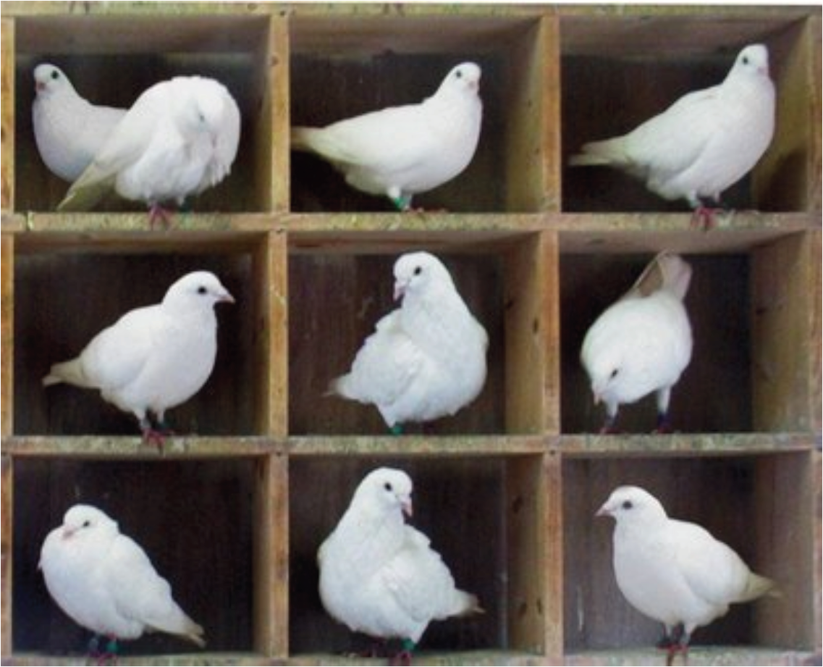
L07: Pigeonhole Principle

Slide 2
Outline
Pigeonhole Principle
Generalized Pigeonhole Principle
Reading: Rosen 6.2

Slide 3
Pigeonhole Principle
Pigeonhole principle
If k + 1 or more objects (pigeons) are placed into k boxes (pigeonholes) where k is a positive integer, then there is at least one box (pigeonhole) containing two or more of the objects (pigeons).
Corollary 2.1
A function f from a set with k + 1 or more elements to a set with k elements is not one-to-one.
The challenge is to correctly determine what are the objects (pigeons) and the boxes (pigeonholes).

Slide 4
Examples
Example 1
Among any group of 367 people, there must be at least two with the same birthday.
Example 2
In any group of 27 English words, there must be at least two that begin with the same letter.

Slide 5
Example
Example 3
How many students must be in a class to guarantee that at least two students receive the same score on the final exam, if the exam is graded on a scale from 0 to 100 points?

Slide 6
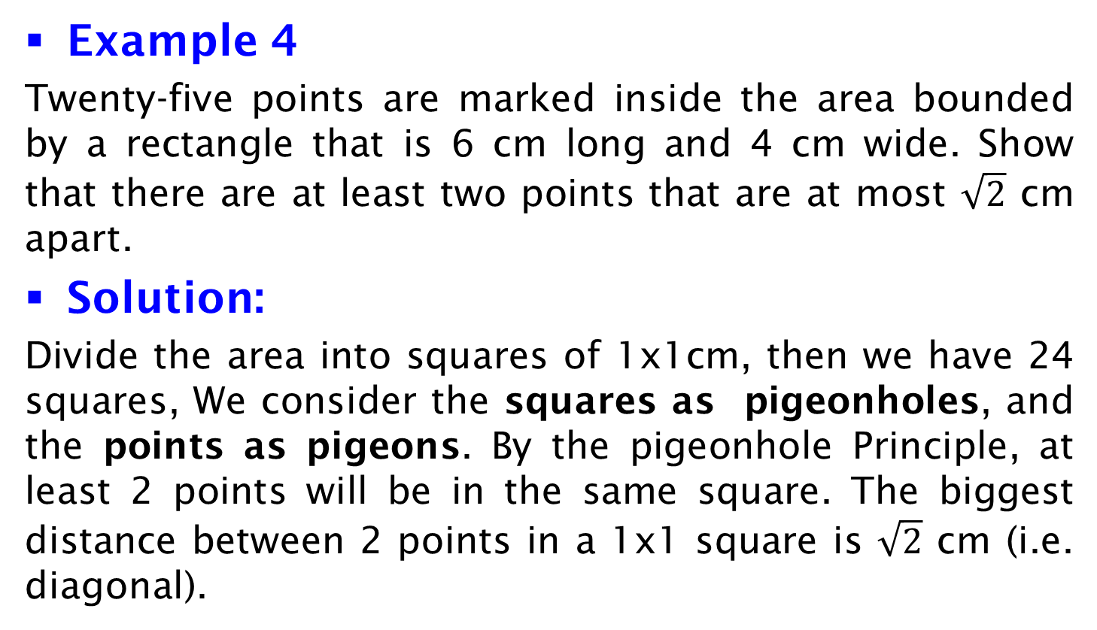
Example
Example 4
Twenty-five points are marked inside the area bounded by a rectangle that is 6 cm long and 4 cm wide. Show that there are at least two points that are at most $\sqrt{2}$ cm apart.
Solution:
Divide the area into squares of 1x1cm, then we have 24 squares, We consider the squares as pigeonholes, and the points as pigeons. By the pigeonhole Principle, at least 2 points will be in the same square. The biggest distance between 2 points in a 1x1 square is $\sqrt{2}$ cm (i.e. diagonal).

Slide 7
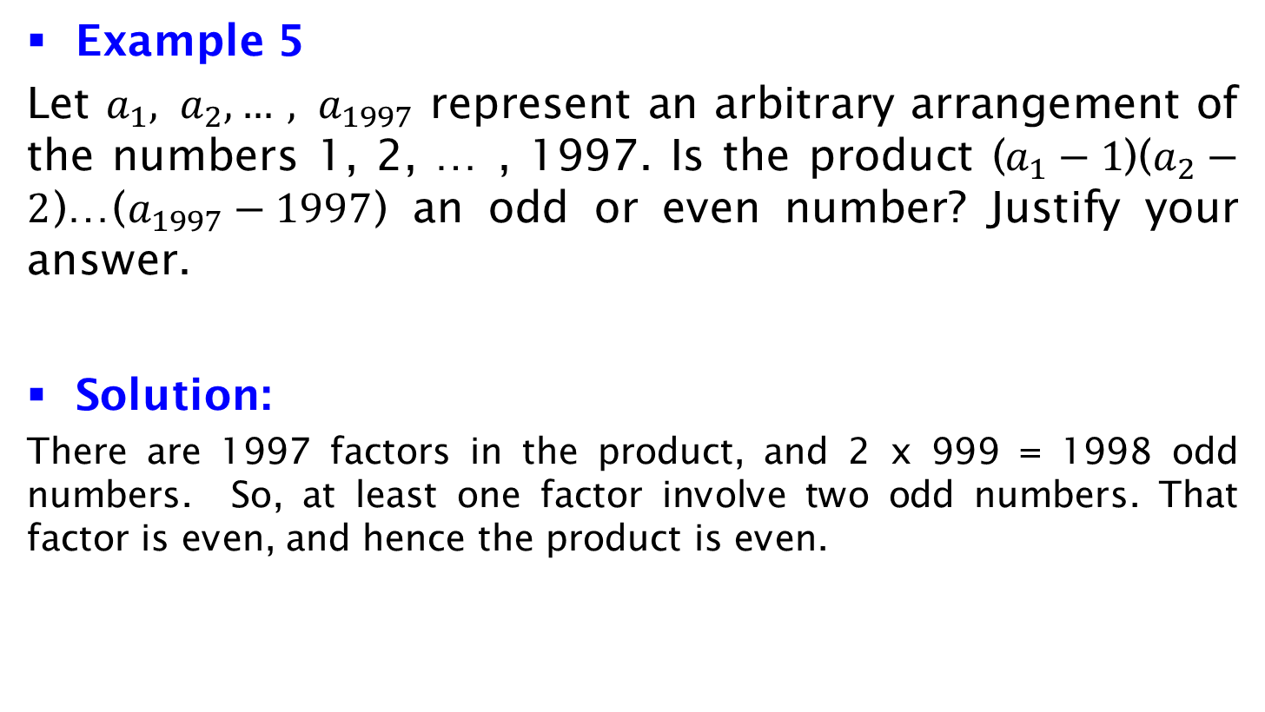
Example
Example 5
Let $a_{1}, a_{2}, …, a_{1997}$ represent an arbitrary arrangement of the numbers 1, 2, … , 1997. Is the product ($a_{1}−1$)($a_{2}−2$)…($a_{1997}−1997$) an odd or even number? Justify your answer.
Solution:
There are 1997 factors in the product, and 2 x 999 = 1998 odd numbers. So, at least one factor involve two odd numbers. That factor is even, and hence the product is even.

Slide 8
Outline
Pigeonhole Principle
Generalized Pigeonhole Principle

Slide 9

Generalized Pigeonhole Principle
Generalized pigeonhole principle
If n objects are placed into k boxes, then there is at least one box containing at least objects.
Proof
We prove it by contradiction. Suppose none of the boxes contains more than – 1 objects. Then, the total number of objects is at most k( – 1). Note that
< n/k + 1. This implies
k( – 1) < k ((n/k + 1) – 1) = n,
which contradicts the fact that there are a total of n objects.

Slide 10

Examples
Example 6
Among 100 people there are at least = 9 who were born in the same month.
Example 7
What is the minimum number of students required in a class to be sure that at least six will receive the same grade, if there are five possible
grades, A, B, C, D, and F?
Solution
It is the smallest integer n such that ⎡n/5⎤=6, which is n = 5*5 + 1 = 26.

Slide 11
Example
Example 8
How many cards must be selected from a standard deck of 52 cards to guarantee that at least three cards of the same suit are chosen? How many cards must be selected to guarantee that at least three hearts are selected?
Solution:
Let the cards to be selected be pigeons and the suits be pigeonholes. By the generalized pigeonhole principle, to guarantee at least three cards of the same suit, we need to have ⎡n/4⎤ =3, so we have n=2*4+1=9 cards.
To guarantee that at least three hearts are selected, we might have to exhaust all the clubs, diamonds, and spades first, and then pick three more cards = 13*3+3=42 cards.

Slide 12
Example
Example 9
Assume that phone numbers are of the form NXX-NXX-XXXX, where the first three digits form the area code, N represents a digit from 2 to 9 inclusive, and X represents any digit. What is the least number of area codes needed to guarantee that the 25 million phones in a state can be
assigned distinct 10-digit phone numbers?

Slide 13
Example
Solution:
Discarding the area code, by the product rule, there are 8*10⁶ different phone numbers of the form NXX-XXXX.
Applying the generalized Pigeonhole principle, we have ⎡25*10⁶ / 8*10⁶⎤ = 4, so at least one phone number of the form NXX-XXXX is shared by 4 phones.
In order to have 25*10⁶ phones assigned distinct numbers, 4 area codes are required in order to distinguish the phones sharing the same NXX-XXXX number into different areas.

