Slide 1
L10: Conditional Probability and Independence
Page <number>
Conditional probability
  Motivating examples
  Definition
Independence
  Definition
  Property
  Examples
Independent trials processes

Slide 2
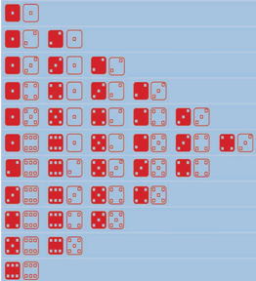



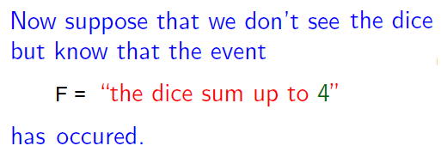
Example: Roll Two Dice

Slide 3

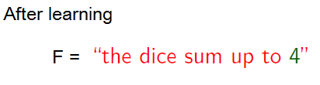

Event F and Change of Sample Spaces

Slide 4
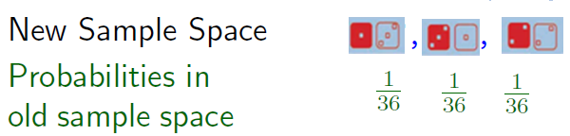

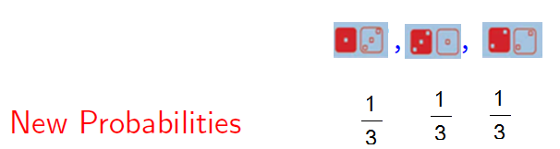




F favors none of the three remaining possible outcomes
New probabilities
  Preserve ratios
  Sum to one

Slide 5

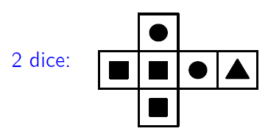

Slide 6
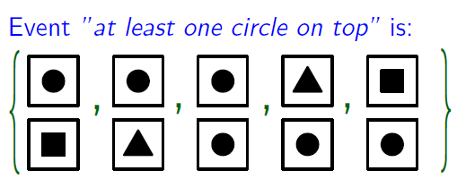




Slide 7



Slide 8
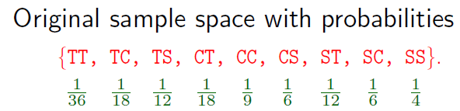
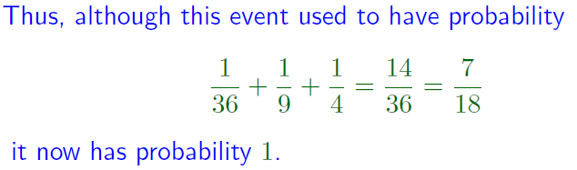


Slide 9




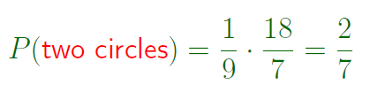

Slide 10
Outline
Page <number>
Conditional probability
  Motivating examples
  Definition
Independence
  Definition
  Property
  Examples
Independent trials processes

Slide 11
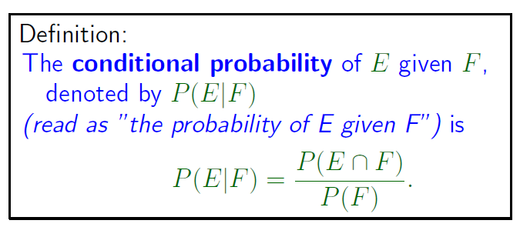
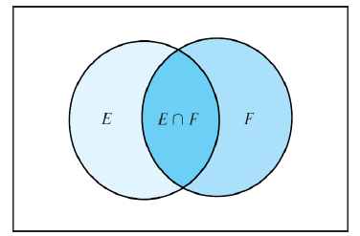
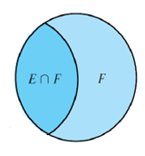

Slide 12








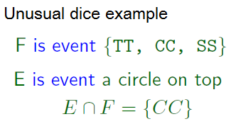





Slide 13

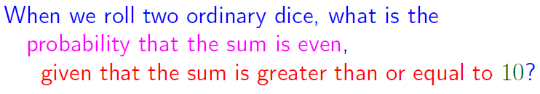




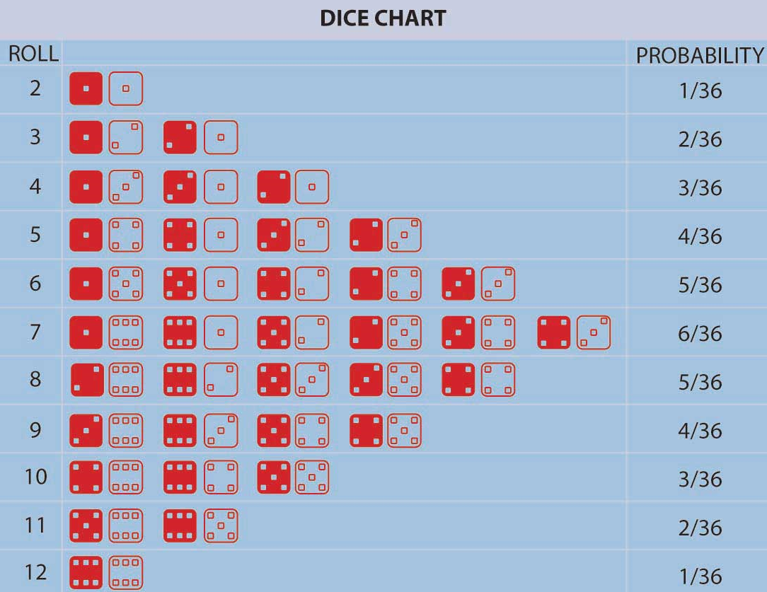
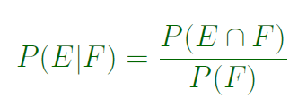



Slide 14
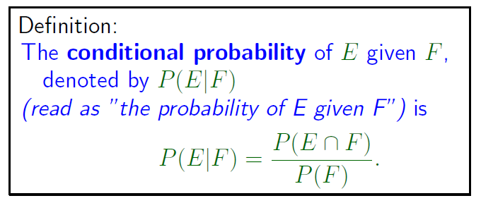
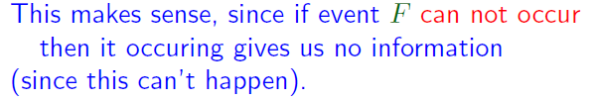
A Note

Slide 15

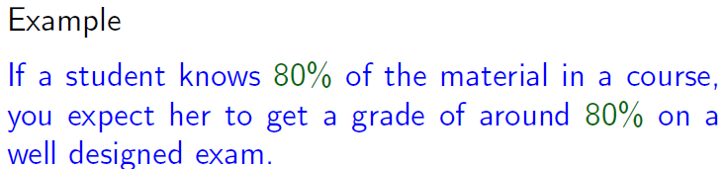
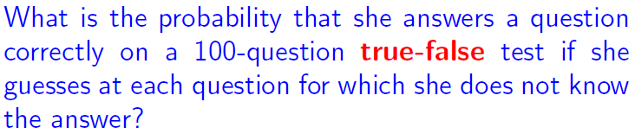
Use of Conditional Probability
Page <number>

Slide 16
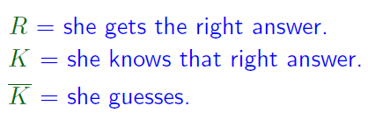













Slide 17
Outline
Page <number>
Conditional probability
  Motivating examples
  Definition
Independence
  Definition
  Property
  Examples
Independent trials processes

Slide 18
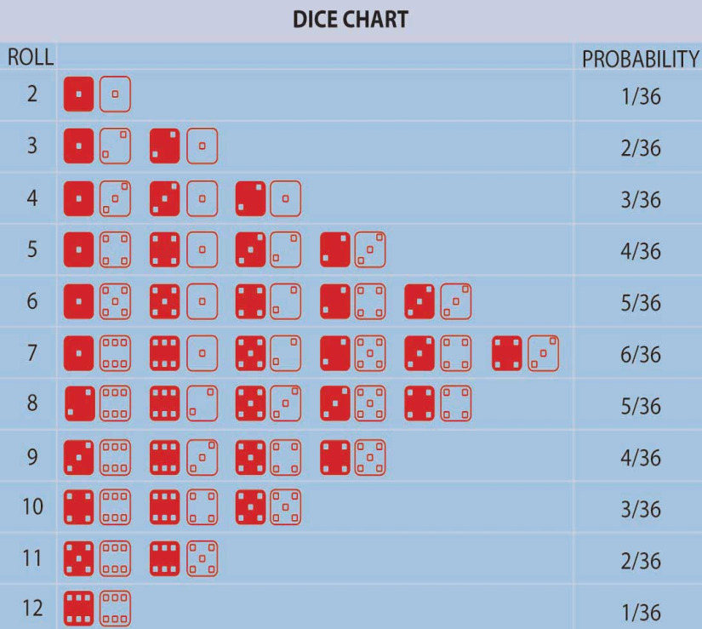
Page <number>
Motivating Example
Roll twice dice, one red and one white
E: “white die is even”
F: “red die is odd”
P(E) = 18/36 = ½
P(E | F) = P( E /\ F ) / P(F)
= (9/36) / (18/36) = = 1/2
Learning that F occurred does not change probability of E
F is irrelevant to E
E is independent of F

Slide 19

Definition
Page <number>
Roll twice dice, one red and one white
E: “white die is even”
F: “red die is odd”
E is independent of F

Slide 20
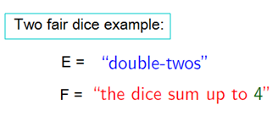


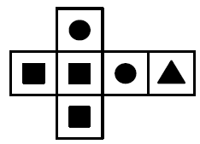




Definition
Page <number>

Slide 21
Outline
Page <number>
Conditional probability
  Motivating examples
  Definition
Independence
  Definition
  Property
  Examples
Independent trials processes

Slide 22
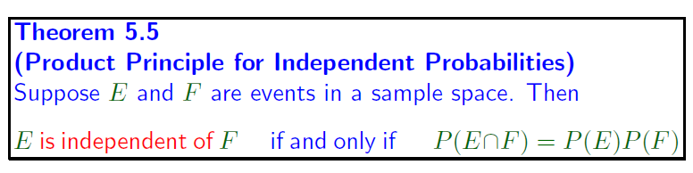









Page <number>

Slide 23
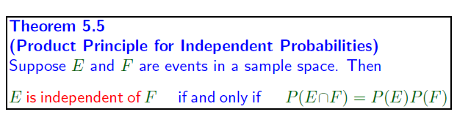

Page <number>
Example
  “white die is even” is independent “red die is odd”
So,
  “red die is odd” is independent “white die is even”

Slide 24
Outline
Page <number>
Conditional probability
  Motivating examples
  Definition
Independence
  Definition
  Property
  Examples
Independent trials processes

Slide 25
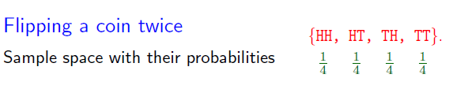




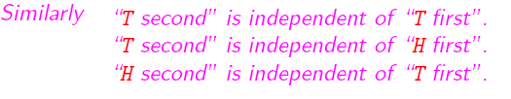
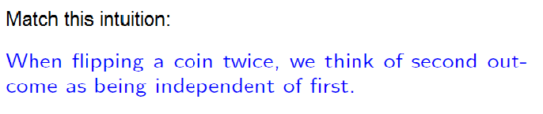
Page <number>

Slide 26

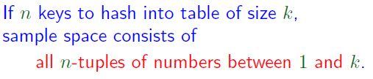
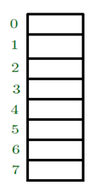

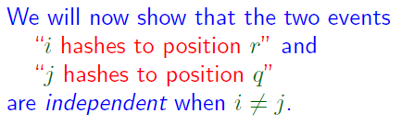
Page <number>

Slide 27
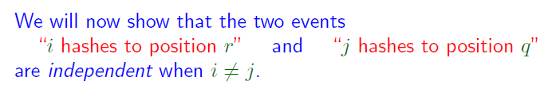



Page <number>

Slide 28
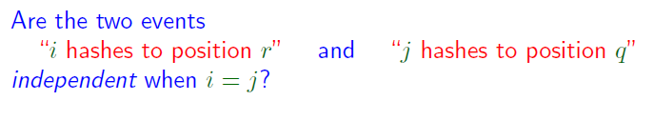





Page <number>

Slide 29
Outline
Page <number>
Conditional probability
  Motivating examples
  Definition
Independence
  Definition
  Property
  Examples
Independent trials processes

Slide 30
Multiple Stage Process
Page <number>
Recall
  Probability associated with a process with uncertain outcomes
  Sample space: set of all possible outcomes
  Event: subset of sample space
  Probability distribution: weight for each element
One stage process
  Flipping a coin once
  Throwing two dice (all at once)
Multiple stage process
  Flip coin multiple times
  Hashing: Hash keys one at a time
Next: Discuss probabilities associated with multiple stage processes

Slide 31






Independent Trial Process
Page <number>
Outcome at stage i independent of outcomes at earlier stages

Slide 32
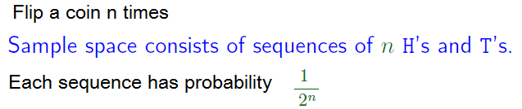




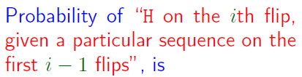




Slide 33
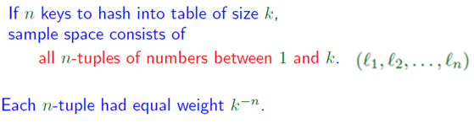














Slide 34
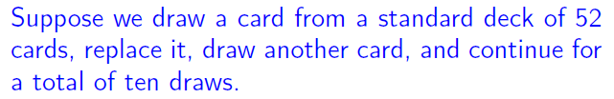


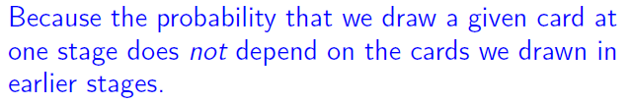
Page <number>

Slide 35
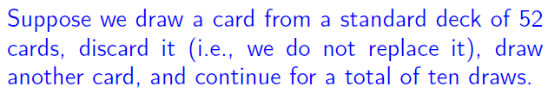



Page <number>

Slide 36
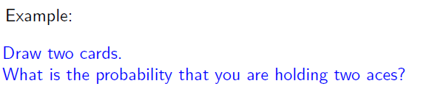
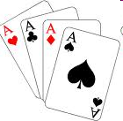








Page <number>

Slide 37
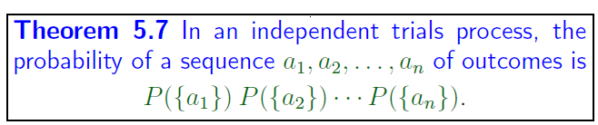


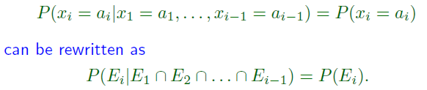




Page <number>

Slide 38
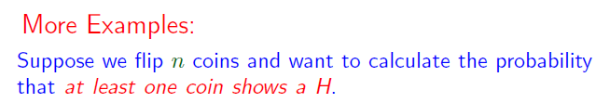






Page <number>

