Slide 1
L11: Random Variables and Expectation
Page 1
Random Variables
  The concept
  Bernoulli/Binomial random variables
Expectation of Random Variables
  The concept
  Properties
  Expectation of counts
  Expected time to first success
Reading
  SDB: 322-336

Slide 2


Functions on Sample Space
Page <number>
Probability starts with a process (test, experiment) whose outcome is uncertain
Sample space: the set of all possible outcomes
Sometimes, we want to define functions on the sample space
Example
  Process: flip a coin n times
  Sample space: set of sequences of n elements, each being H or T
  Example: n=5, Function: “Number of heads”

Slide 3
Random Variables
Page <number>
Probability starts with a process whose outcome is uncertain
Sample space: the set of all possible outcomes
Sometimes, we want to define functions on the sample space
Outcome of the process is uncertain
Function defined on the outcome is also uncertain
So, called random variable
A random variable is a function defined on the sample space
Example: “Number of heads” in n coin flips is a random variables

Slide 4


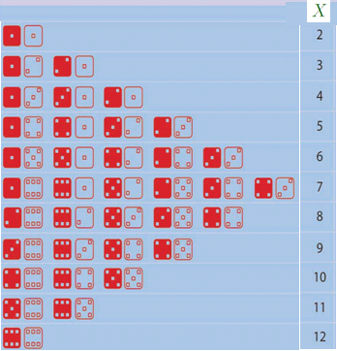
Example 2
Page <number>

Slide 5
Outline
Page <number>
Random Variables
  The concept
  Bernoulli/Binomial random variables
Expectation of Random Variables
  The concept
  Properties
  Expectation of counts
  Expected time to first success

Slide 6

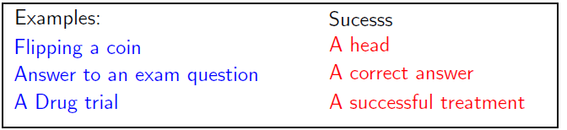

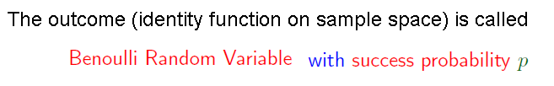
Page <number>

Slide 7

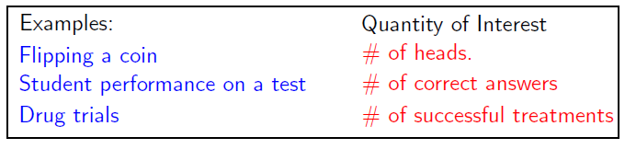
Binomial Random Variables
Page <number>
Binomial Random Variable
  # of successes in n independent Bernoulli trials

Slide 8
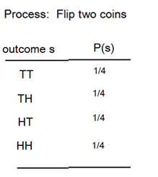
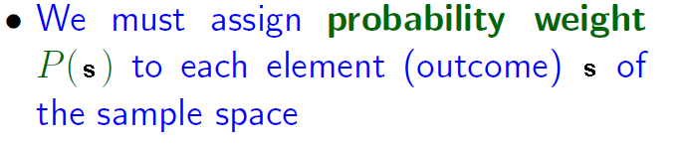
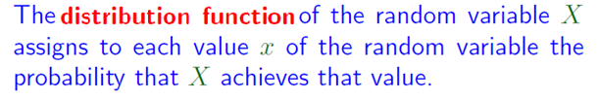
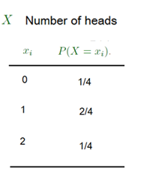
Probability Weight and Distribution Function
Page <number>

Slide 9
Value of RV and Event
Page <number>
How are these two related?
X=1 means the event {TH, HT}
P(X=1) = P(TH) + P(HT) = ¼ + ¼ = 2/4
P(X=0) = P(TT) = ¼
P(X=2) = P(HH) = 1/4

Slide 10
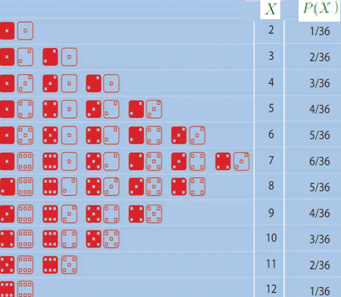
Distribution Function Example
Page <number>

Slide 11

Probability Weight and Distribution Function
Page <number>
n Bernoulli trials, each with probability of success at each trial being p
X: number of successes,
0 =< X =< n
What is P(X=k), for 0 =< k =< n?

Slide 12








Page <number>

Slide 13




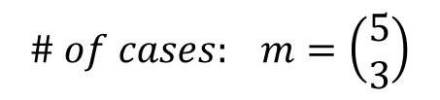



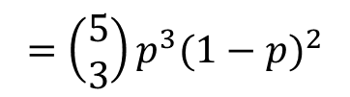
Page <number>
3 successes in 5 Bernoulli Trials
C1: S S S F F
C2: S S F S F
F F S S S

Slide 14
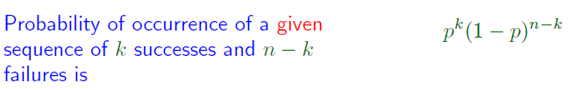



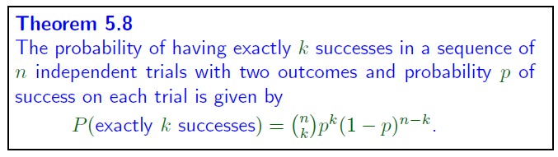
Page <number>

Slide 15







Binomial Random Variable
Page <number>
n Bernoulli trials, each with probability of success at each trial being p
X: number of successes,
X: called Binomial random variable
P: Binomial probability distribution
Do the numbers sum to 1?

Slide 16









Page <number>

Slide 17
Outline
Page <number>
Random Variables
  The concept
  Bernoulli/Binomial random variables
Expectation of Random Variables
  The concept
  Properties
  Expectation of counts
  Expected time to first success

Slide 18
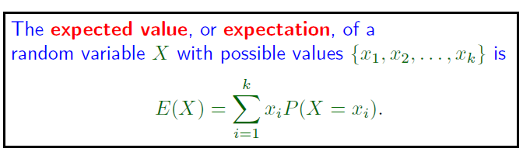
Expectation of Random Variables
Page <number>

Slide 19



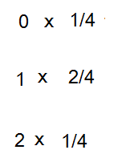

Expectation Example
Page <number>

Slide 20

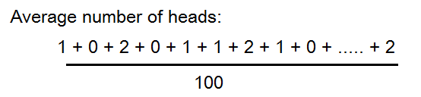



Expectation and Average
Page <number>
Expectation ~= Average over many runs of process
  Expect the average

Slide 21





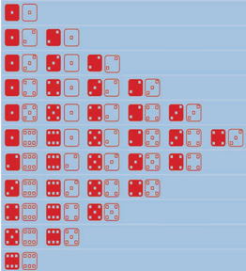



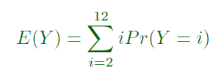


Slide 22
Outline
Page <number>
Random Variables
  The concept
  Bernoulli/Binomial random variables
Expectation of Random Variables
  The concept
  Properties
    Proof of linearity
    Use of linearity
  Expectation of counts
  Expected time to first success

Slide 23

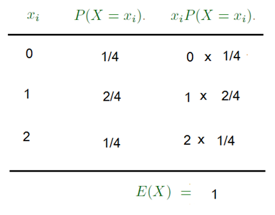



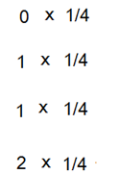

Expectation from Sample space
Page <number>
Get the same result from sample space

Slide 24

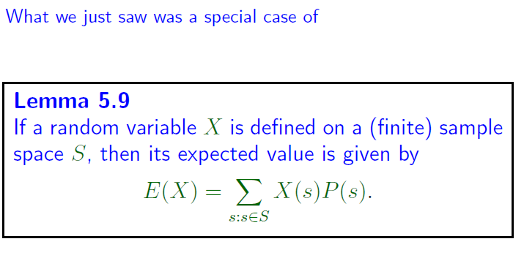
Expectation from Sample space
Page <number>

Slide 25

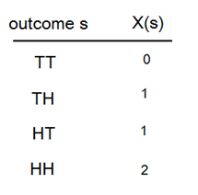



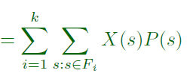
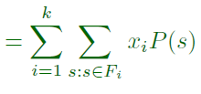

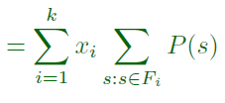



Page <number>

Slide 26
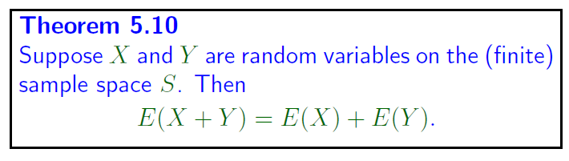





Page <number>

Slide 27


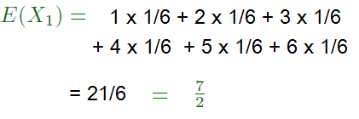



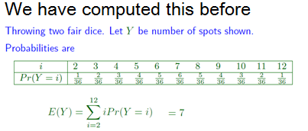
Page <number>

Slide 28

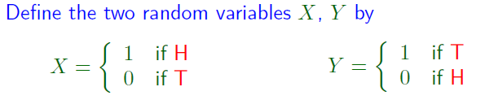





Page <number>

Slide 29
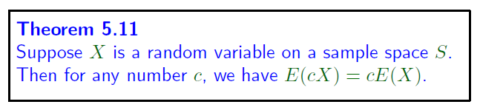
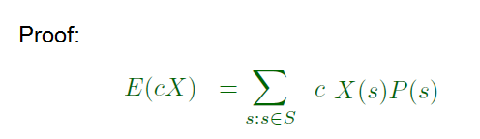


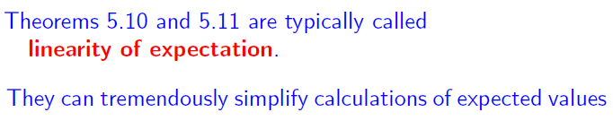
Page <number>

Slide 30
Page <number>
Outline
Random Variables
  The concept
  Bernoulli/Binomial random variables
Expectation of Random Variables
  The concept
  Properties
    Proof of linearity
    Use of linearity
  Expectation of counts
  Expected time to first success

Slide 31






Page <number>

Slide 32





Page <number>

Slide 33

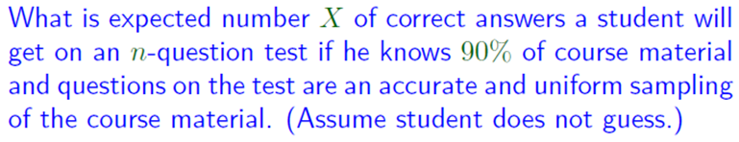
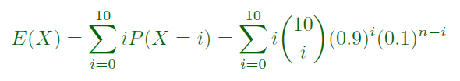
Page <number>

Slide 34

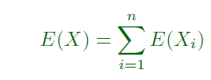
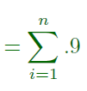

Page <number>

Slide 35
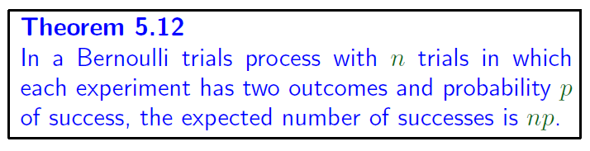




Page <number>

Slide 36
Outline
Page <number>
Random Variables
  The concept
  Bernoulli/Binomial random variables
Expectation of Random Variables
  The concept
  Properties
  Expectation of counts
  Expected time to first success

Slide 37

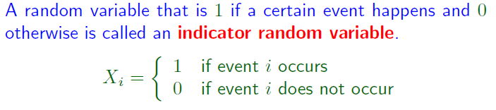






Page <number>

Slide 38
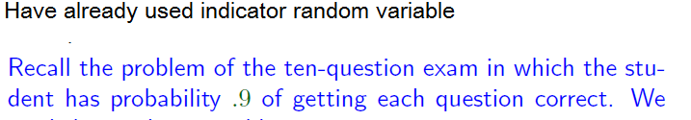
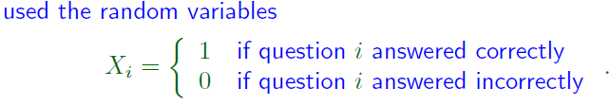

Page <number>

Slide 39







Page <number>
See L05

Slide 40






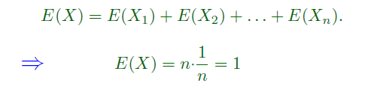


Page <number>

Slide 41
Outline
Page <number>
Random Variables
  The concept
  Bernoulli/Binomial random variables
Expectation of Random Variables
  The concept
  Properties
  Expectation of counts
  Expected time to first success

Slide 42






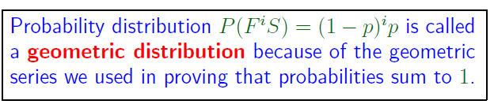
Repeating Bernoulli Trials Until Success
Page <number>

Slide 43









Number of Trials until First Success
Page <number>

Slide 44

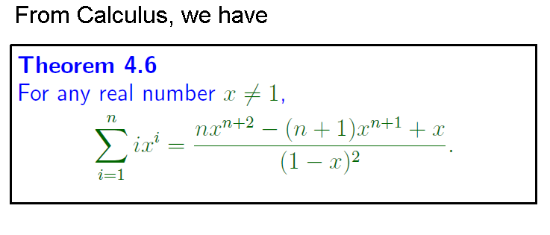

Page <number>
Let x = 1-p
Consider only 0 < p < 1
Then, 0 < x <1
Let n goes to infinity, LHS becomes

Slide 45

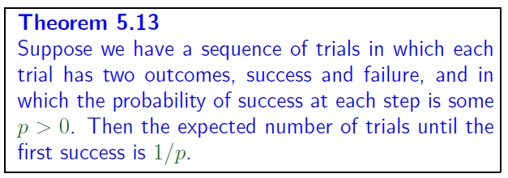
Number of Trial until First Success
Page <number>

Slide 46




Page <number>

Slide 47






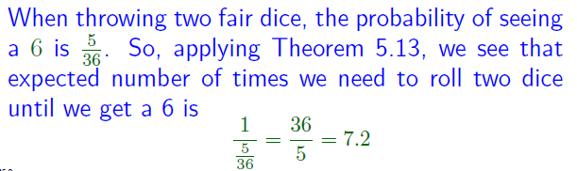
Page <number>

