Slide 1
L17: Recursion and Recurrence
Page 1
Objective
  Recursion
    A problem solving technique that reduces a big problem into smaller one problems of the same type.
  Induction
    Proving correctness of recursive programs
  Recurrence
    Running time for recursive programs
Reading:
  Textbook: 213-227

Slide 2
Outline
Page <number>
Recursive algorithm for Towers of Hanoi
  Problem and algorithm
  Correctness
  Running time
Recurrence in general
  Example: Number of subsets
  Example: Loan repayment
Solving recurrences
  One type of First-Order linear recurrences
  Another type of First-Order linear recurrences

Slide 3
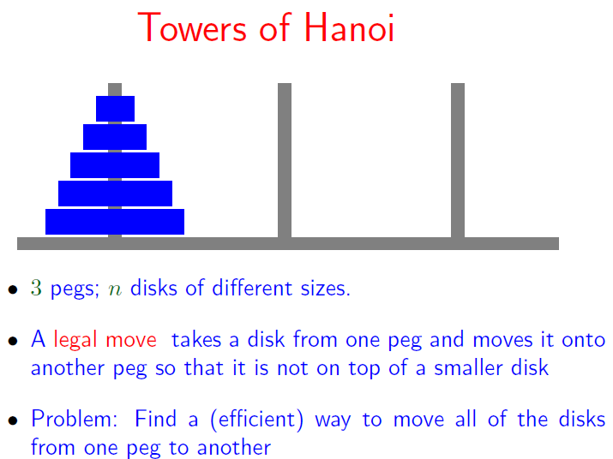
Page <number>

Slide 4
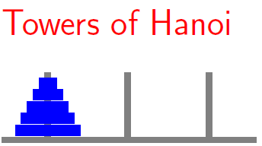
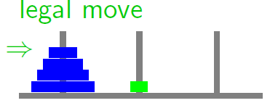
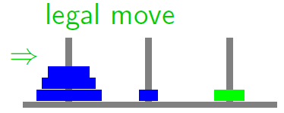
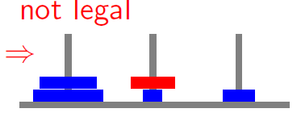
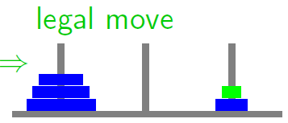
Page <number>

Slide 5

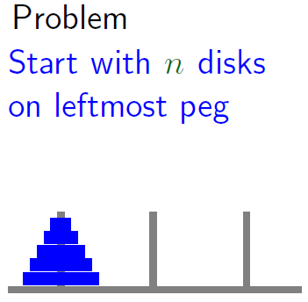
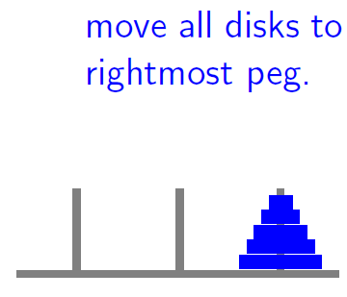
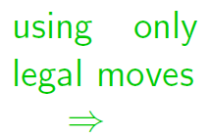
Page <number>

Slide 6
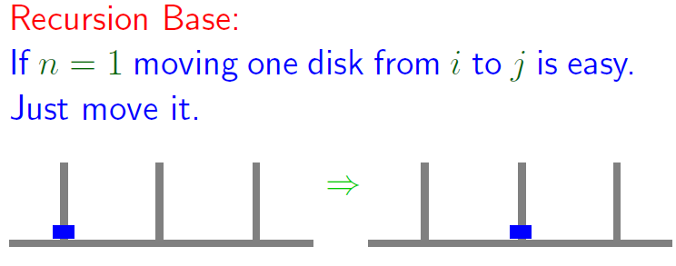
Recursive Solution of Towers of Hanoi
Page <number>

Slide 7
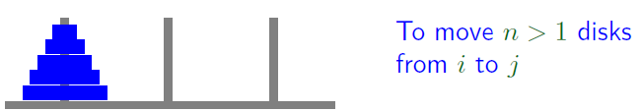
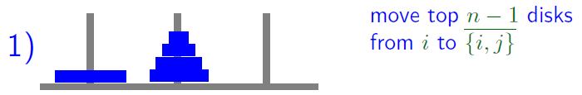
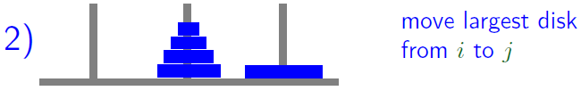

Recursive Solution of Towers of Hanoi
Page <number>

Slide 8



Recursive Solution of Towers of Hanoi
Page <number>
Task:
  Move n disks from peg i to peg j
Algorithm
  Recursion base:
    When n=1, move one disk from i to j
  Recursion

Slide 9
Outline
Page <number>
Recursive algorithm for Towers of Hanoi
  Problem and algorithm
  Correctness
  Running time
Recurrence in general
  Example: Number of subsets
  Example: Loan repayment
Solving recurrences
  Geometric serious
  First-Order linear recurrences

Slide 10
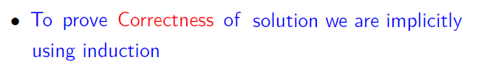

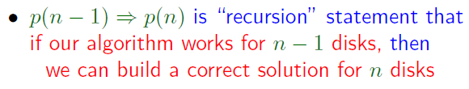

Correctness of Algorithm
Page <number>

Slide 11
Outline
Page <number>
Recursive algorithm for Towers of Hanoi
  Problem and algorithm
  Correctness
  Running time
Recurrence in general
  Example: Number of subsets
  Example: Loan repayment
Solving recurrences
  One type of First-Order linear recurrences
  Another type of First-Order linear recurrences

Slide 12





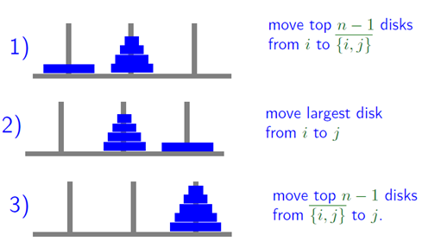
Running Time
Page <number>

Slide 13
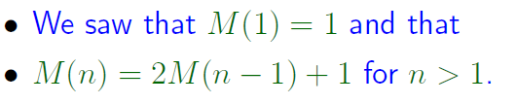










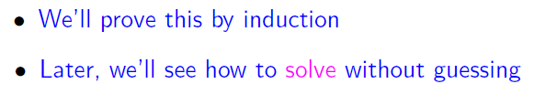
Solving the Recurrence
Page <number>

Slide 14
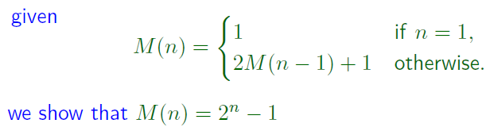








Page <number>

Slide 15
Outline
Page <number>
Recursive algorithm for Towers of Hanoi
  Problem and algorithm
  Correctness
  Running time
Recurrence in general
  Example: Number of subsets
  Example: Loan repayment
Solving recurrences
  One type of First-Order linear recurrences
  Another type of First-Order linear recurrences

Slide 16
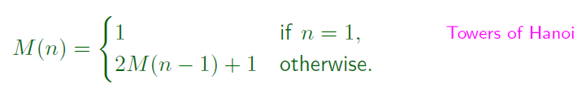

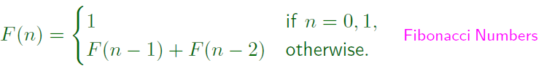
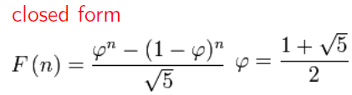
Recurrence
Page <number>
Recurrence/recurrence equation is a way to specify functions on the set of integers
It tells us how to
  get the n-th value f(n)
  from the first n-b values: f(b), f(b+1), …, f(n-1)
Need to give the value for the base case f(b) to complete the description

Slide 17
Recursive Algorithms and Recurrence
Recursive algorithm
Running time analysis: 3 steps
  Set up recurrence equation
  Solve the recurrence to get a closed-formula solution (this lecture)
  Simplify by using big-O notation (later)

Slide 18

Number of subsets
Page <number>
S(n): number of subsets of set {1, 2, 3, …., n} of size n
Question:
  How to compute S(n) from S(n-1), S(n-2), …?
Consider the case: n=3
  First row: subsets of {1, 2}
  Second: subsets of {1, 2}, each adjoined by 3
  So: S(3) = 2 S(2)

Slide 19

Number of Subsets
Page <number>
In general, subsets of set {1, 2, 3, …., n} can be divided into two groups
  subsets of set {1, 2, 3, …., n-1}
  subsets of set {1, 2, 3, …., n-1}, each adjoined by n.
  So: S(n) = 2 S(n-1)
Base case:
  S(0) =1

Slide 20
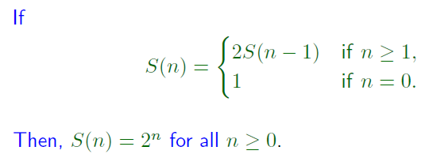








Page <number>

Slide 21





Monthly Payment for Loan
Page <number>
Initial loan amount: A
Annual interest rate: p
Monthly Payment: M
T(n): total amount still due after n months

Slide 22
Outline
Page <number>
Recursive algorithm for Towers of Hanoi
  Problem and algorithm
  Correctness
  Running time
Recurrence in general
  Example: Number of subsets
  Example: Loan repayment
Solving recurrences
  One type of First-Order linear recurrences
  Another type of First-Order linear recurrences

Slide 23





Page <number>

Slide 24


We will discuss two special cases
Page <number>

Slide 25
Outline
Page <number>
Recursive algorithm for Towers of Hanoi
  Problem and algorithm
  Correctness
  Running time
Recurrence in general
  Example: Number of subsets
  Example: Loan repayment
Solving recurrences
  One type of First-Order linear recurrences
  Another type of First-Order linear recurrences

Slide 26

One Type of First-Order Linear Recurrence
Page <number>
Examples

Slide 27









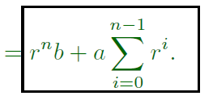

Iterating the Recurrence/Top-Down
Page <number>

Slide 28











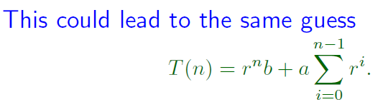
Iterating the Recurrence/Bottom-Up
Page <number>

Slide 29



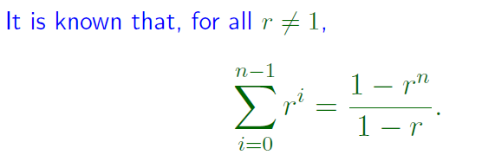

Page <number>

Slide 30



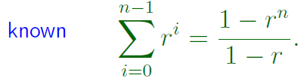
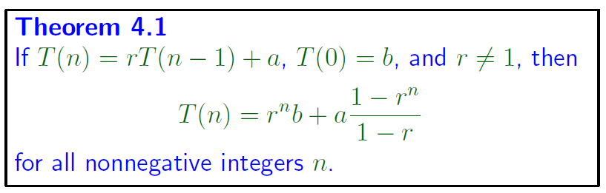
One Type of First-Order Linear Recurrence
Page <number>

Slide 31
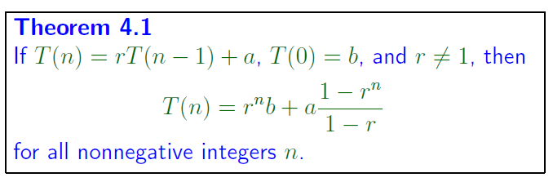



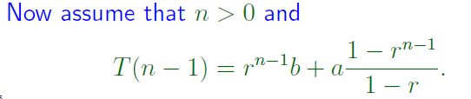
Page <number>

Slide 32







Page <number>

Slide 33




Example
Page <number>

Slide 34
Three cases
Page <number>
When r >1, T(n) is exponential in n
When r < 1, T(n) is bounded by constant: b + a/(1-r)
When r=1, T(n) is linear (not from theorem, from slide 27)

Slide 35
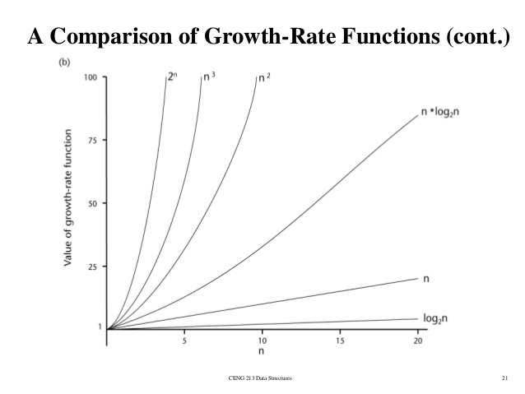

Slide 36





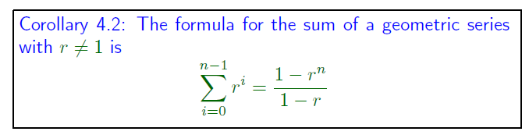
An Application of Theorem 4.1
Geometric Series
Page <number>

Slide 37
Outline
Page <number>
Recursive algorithm for Towers of Hanoi
  Problem and algorithm
  Correctness
  Running time
Recurrence in general
  Example: Number of subsets
  Example: Loan repayment
Solving recurrences
  One type of First-Order linear recurrence
  Another type of First-Order linear recurrence

Slide 38




Another Type of First-Order Linear Recurrence
Page <number>

Slide 39
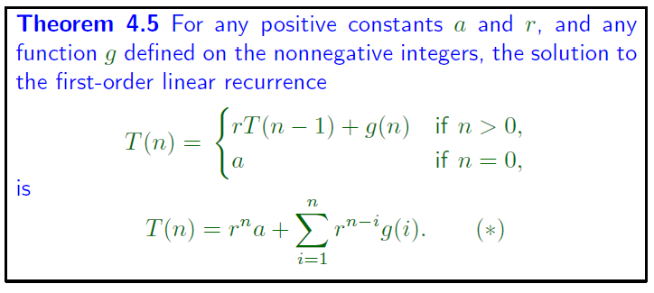




Page <number>

Slide 40







Page <number>

Slide 41








Page <number>

Slide 42


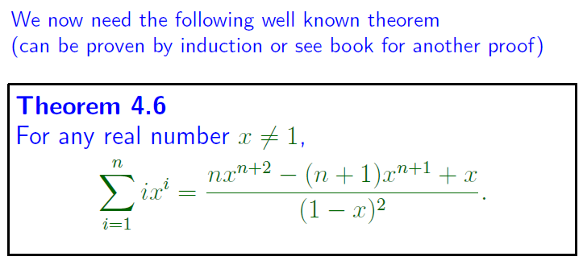
Page <number>

Slide 43
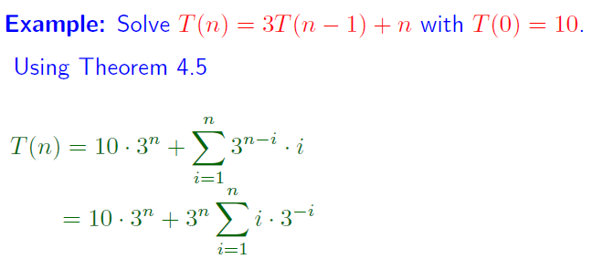


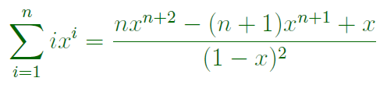

Page <number>

