Slide 1
Recap of L05
Page <number>
Page <number>
General Product Principle
  For counting list
Counting Functions
  Functions are lists
Function concepts
  Injection, surjection, and bijection
Bijiection Principle
  Increasing triples and 3-subsets

Slide 2
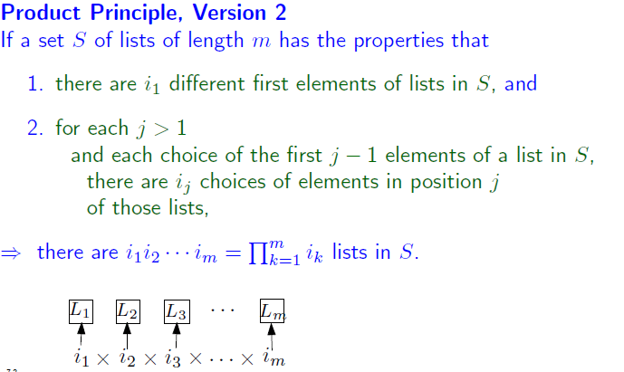
General Product Principle
Page <number>
Page <number>

Slide 3
Counting Functions
Page <number>
Page <number>
# of functions 3-element set →2-element set
= # of 3-element lists from 2-element set
= 2*2*2
f(1) f(2) f(3)

Slide 4
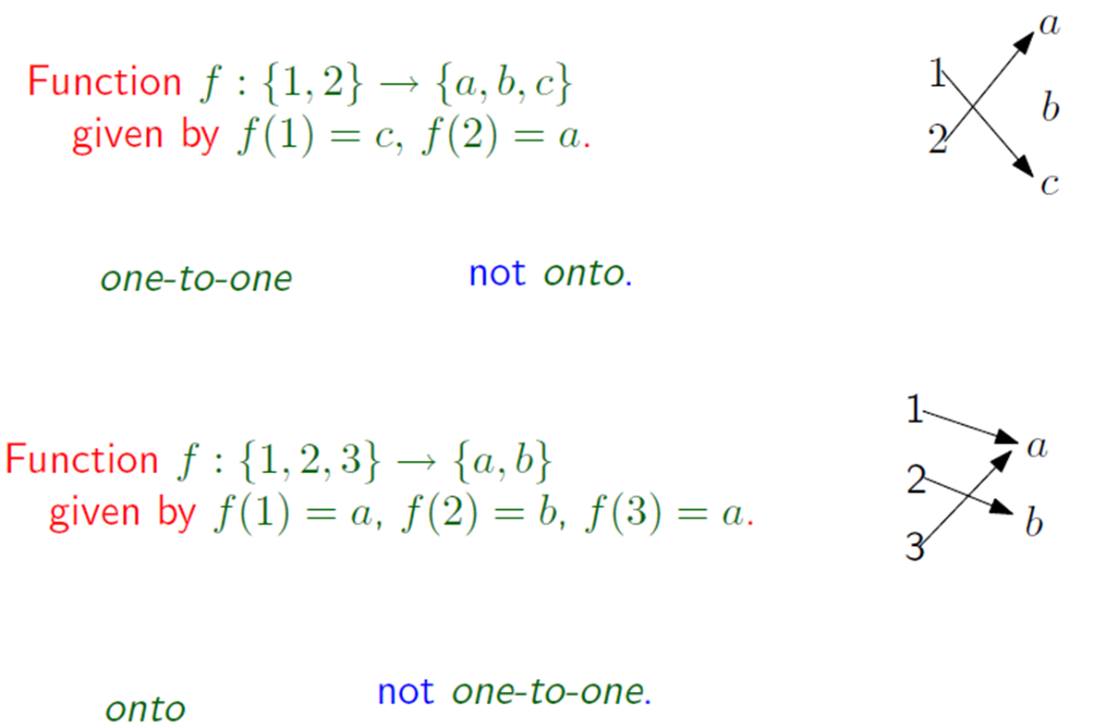
Injection and Surjection
Page <number>
Page <number>

Slide 5

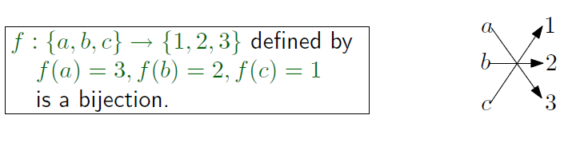
Bijection
Page <number>
Page <number>

Slide 6

Page <number>
Bijection Principle
Counting elements in S
  May be difficult directly
  Find another set T that is easy to count
  Define a function f: S → T
  Prove that f is a bijection
  Count T

Slide 7

Page <number>
Increasing Triples
Can we count using general product principle?
  # of possible values for i?
    n-2
  # of possible values for j?
    Depends on value of i!
    Violates condition of general product principle
  Note:
  one can also say that # of choices for i is n.
  But when i=n-1 or n, 0 choices for i and j.

Slide 8
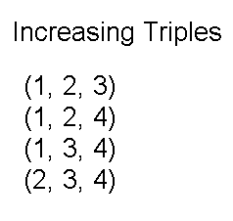
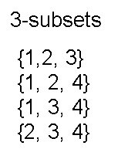
Page <number>
Use Bijection Principle
Claim: # of (i,j,k) s.t. 1≤i<j<k≤n
= # of 3-element subsets from {1,2,…n}
n=4
Increasing triple (1, 2, 3) --- three numbers standing in a line
3-subset {1, 2, 3} --- three numbers in a bag, so {1, 2, 3}={2, 3, 1}

Slide 9



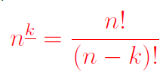
Page <number>
Page <number>
Summary
Number of increasing triples:
Number of 3-element subsets
Number of 3-element permutations
Number of k-element subsets
Number of k-element permutations

Slide 10
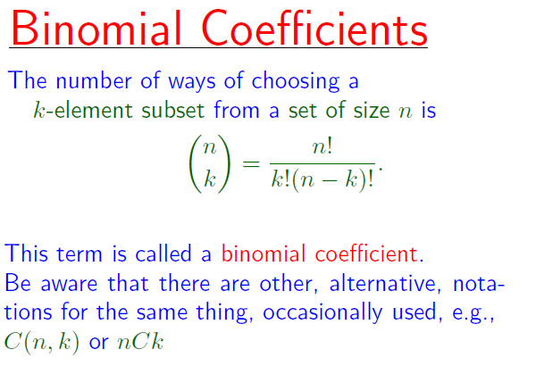
Binomial Coefficient
Page <number>

