Slide 1
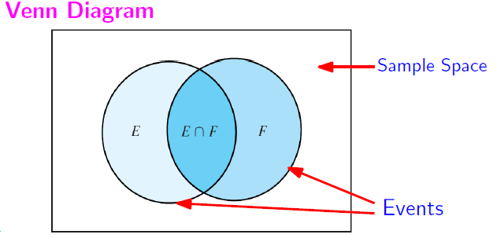
Recap of L09: The Inclusion-Exclusion Principle
Page <number>

Slide 2
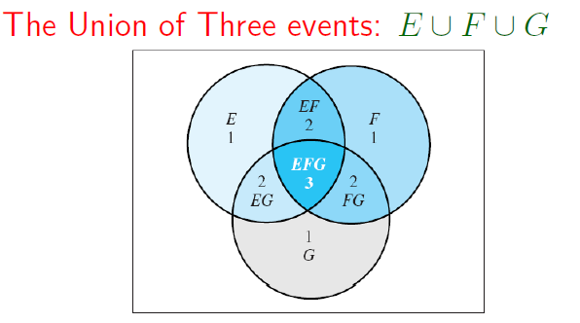
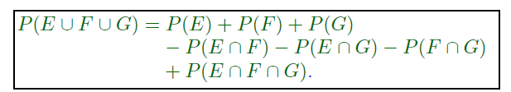
Recap of L09: The Inclusion-Exclusion Principle
Page <number>

Slide 3
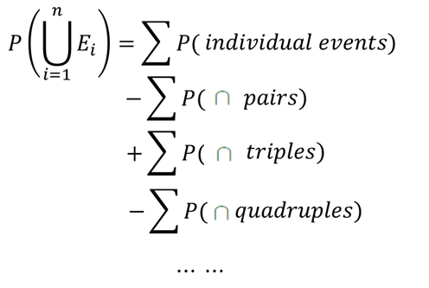
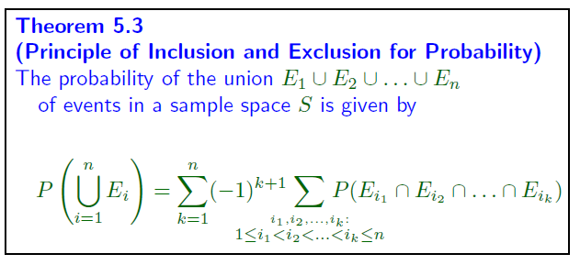
Page <number>

