Slide 1
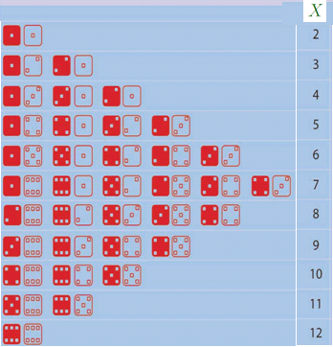


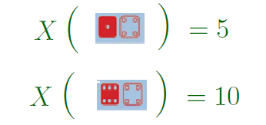
Recap of L11
Page <number>
Page <number>
Probability starts with a process whose outcome is uncertain
Sample space: the set of all possible outcomes
A random variable is a function defined on the sample space
  Uncertain because outcome of process is

Slide 2





Recap of L11
Page <number>
Page <number>
Bernoulli trial
  A test with two possible outcomes: success or failure
Bernoulli RV:
  Identity function on those outcomes
Binomial RV
  # of successes in n independent Bernoulli trials

Slide 3
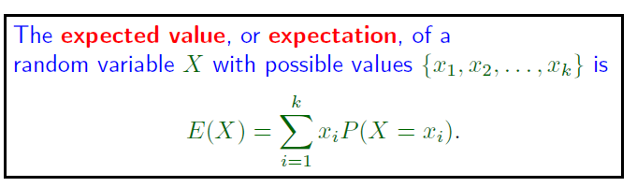
Recap of L11
Page <number>
Expectation ~= Average over many runs of process
  X: result of throwing a die, possible values 1, 2, …, 6
  E(X) = 7/2
  Throw it 1000 times, average is roughly 7/2.

Slide 4
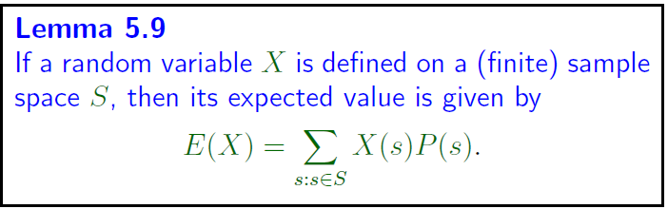

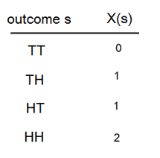



Recap of L11
Page <number>

Slide 5
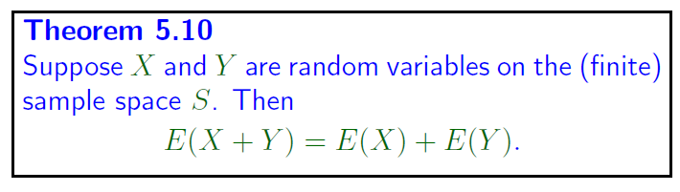
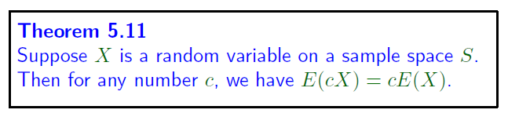
Recap of L11: Linearity of Expectation
Page <number>

Slide 6
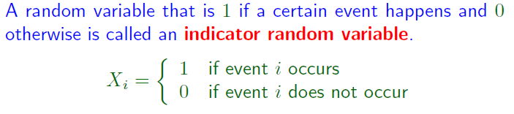

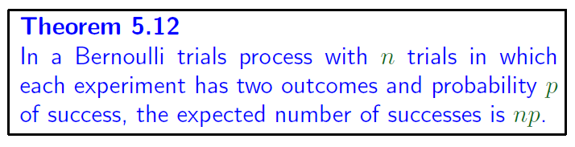
Recap L11
Page <number>
Used to count expected total number of events

Slide 7
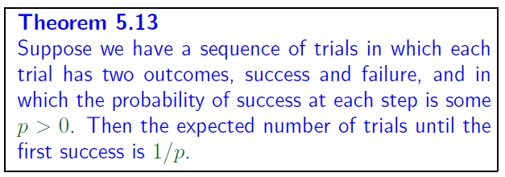
Recap L11: Number of Trials until first success
Page <number>

