Slide 1
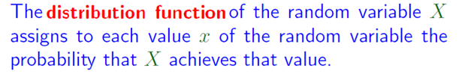
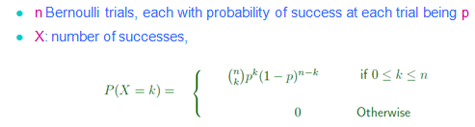
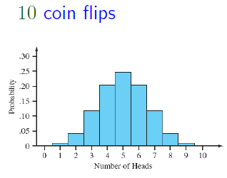

Recap of L12
Page <number>

Slide 2
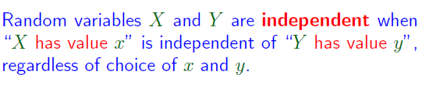
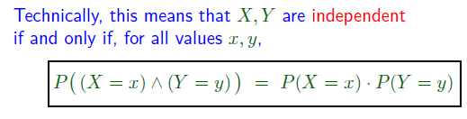

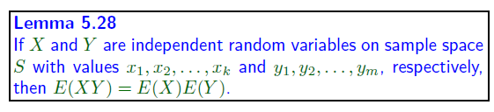
Recap of L12
Page <number>
E is independent of F
    If P(E|F) = P(E)
  The information that “Event F occurred” does not change the probability of E

Slide 3



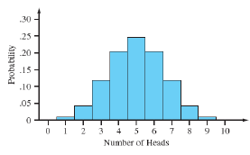

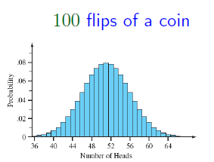
Recap of L12
Page <number>
Flip fair coin
Number of heads in 1 flip: Variance = 1/4
Number of heads in 10 flips: Variance = 10/4
Number of heads in 100 flips: Variance = 100/4

Slide 4
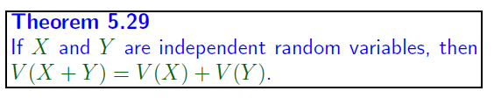
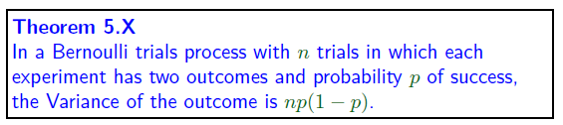

Recap of L12
Page <number>

