Slide 1

Graphics Introduction
COMP4451 Game Programming

Slide 2
Overview
Interactivity
Resolution
Pixel throughput
Evolution of graphics processing
GPU parallelism today
Real-time rendering pipeline basics
Multipass techniques: Shadows
Examples

Slide 3
Interactivity
Interactive rendering applications
Video game, architectural modeling, 3D visualization (as opposed to offline rendering, e.g., movies)
Requirement: Must be interactive
How fast is enough?
Monitors refresh at 60 Hertz (60 Hz)
Renders 60 images in each second
Display 6 frames per second (6 FPS)
Each image will be repeated 10 times!
Testing shows this is the bare minimum
http://www.realtimerendering.com/udacity/?load=demo/unit1-fps.js

Slide 4
Real-time graphics in games
Demands are often much higher
30-60 FPS are common thresholds
Tied to the 60Hz refresh rate Each image being displayed once or twice
60 FPS is upper limit
If game takes 100ms to generate the frame
10 FPS result
Display will still refresh at 60Hz but it will overwrite with same image

Slide 5
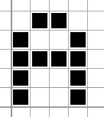
Screen resolution
Pixel: A point in your screen
Holds an RGB color value
Higher screen resolution
leads to larger number of pixels
leads to better image
leads to lower higher processing cost
leads to lower FPS!

Slide 6
Pixel throughout
A screen resolution of 1024 by 768 (modest!)
A frame rate of 60 FPS
How many pixels are we drawing per second?
A: 47,185,920
In each second the GPU has to calculate the color of a pixel over 47 million times!
A lot of computation
And that’s a lower bound
Objects can overlap and be drawn on top of others

Slide 7
How can GPUs be so fast?!
A: Parallel processing

Slide 8
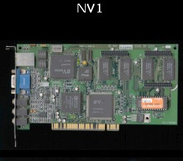
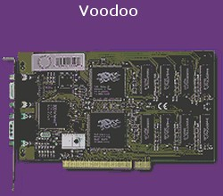
Evolution: Graphics Hardware
PC Generation 1: Cheap PC graphics was born (1995)!
NVidia’s First chip: NV1 (1995)
Z Buffer + Texture mapping (1996)
Other graphics operations on CPU!

Slide 9
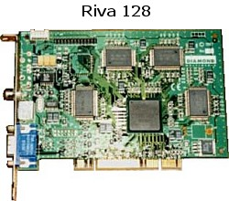
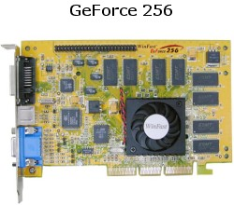
Evolution: Graphics Hardware
PC Generation 2: Fixed rendering pipeline (Cheap!)
NVidia’s NV3 (1997)
More hardware support on OpenGL (1999)
Fixed rendering pipeline on hardware!!!

Slide 10
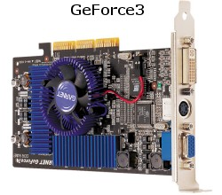
Evolution: Graphics Hardware
PC Generation 3: Programmable rendering pipeline
NVidia’s NV20 (2001)
Programmability on the rendering pipeline!
Vertex program + register combiner programming

Slide 11
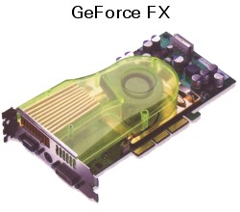
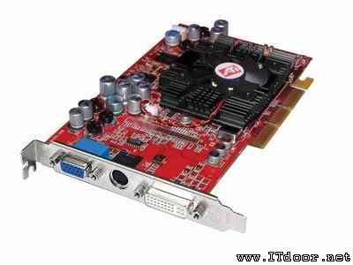
Evolution: Graphics Hardware
PC Generation 4: More Programmability and Precision
NVidia’s FX5200 – FX5950 (2002)
VS
ATI Raedon 9700 (2002)

Slide 12
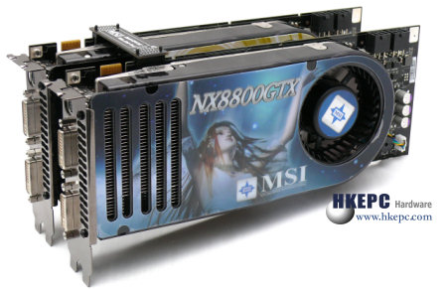
Evolution: Graphics Hardware
PC Generation 5: Unified Shader Architecture
SLI connector
Two NVidia’s Geforce8800GTX cards
Scalable Link Interface (SLI): parallel processing
Geometry shader processing

Slide 13
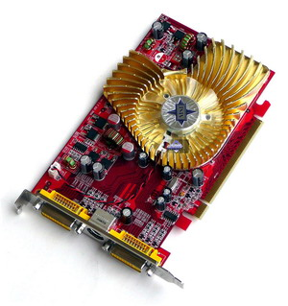
Today’s GPUs
Efficient architecture
1000+ parallel processors!
Working on vertices
Working on pixels
SIMD processing
Must execute same code
Ok for graphics applications
Improving at faster rate than CPUs

Slide 14
Graphics primitives
Primitive
Graphics object
Essential to create fancy images
Examples
Points
Line
Polygon

Slide 15
Points and Lines
Basic building block of graphs, charts
Basic primitive in creating images

Slide 16
Polygons
Generally constructed from straight lights
Multiple polygons can form 3D objects

Slide 17
Special case: Triangles
In interactive graphics, triangles rule the world
Two main reasons:
Lowest common denominator for surfaces
Can represent any surface with arbitrary accuracy
Splines, mathematical functions, volumetric isosurfaces…
Planarity, mathematical simplicity lends itself to simple, regular rendering algorithms
Such algorithms embed well in hardware

Slide 18
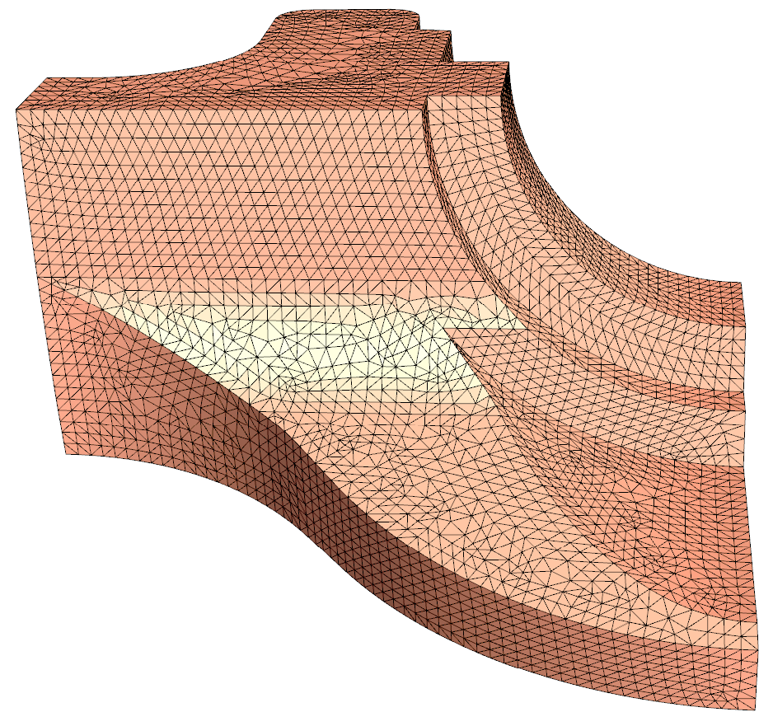
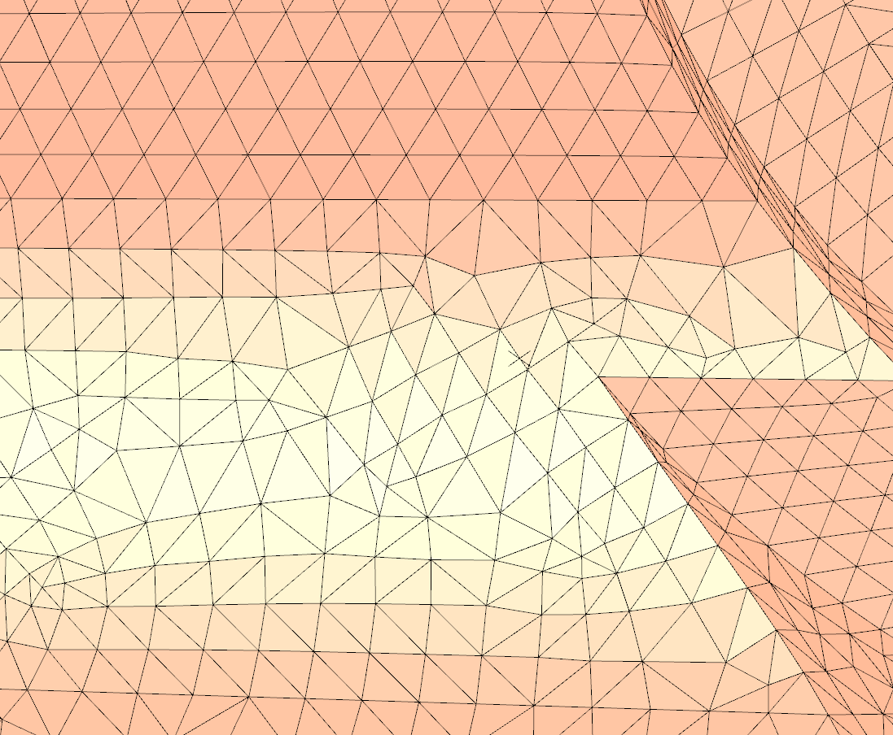
Representing 3D models
Sent to GPU:
Vertex buffer: List of vertices and their positions
Index buffer: List of triangles connecting vertices

Slide 19
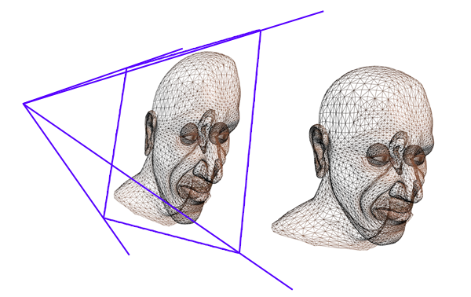
Rendering 3D models
Process the vertices (position on screen) Uses specified camera position

Slide 20
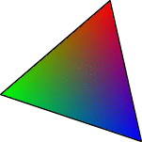
Rendering 3D models
Process the vertices (position on screen)
Rasterize the triangles
Grid: pixels on screen

Slide 21
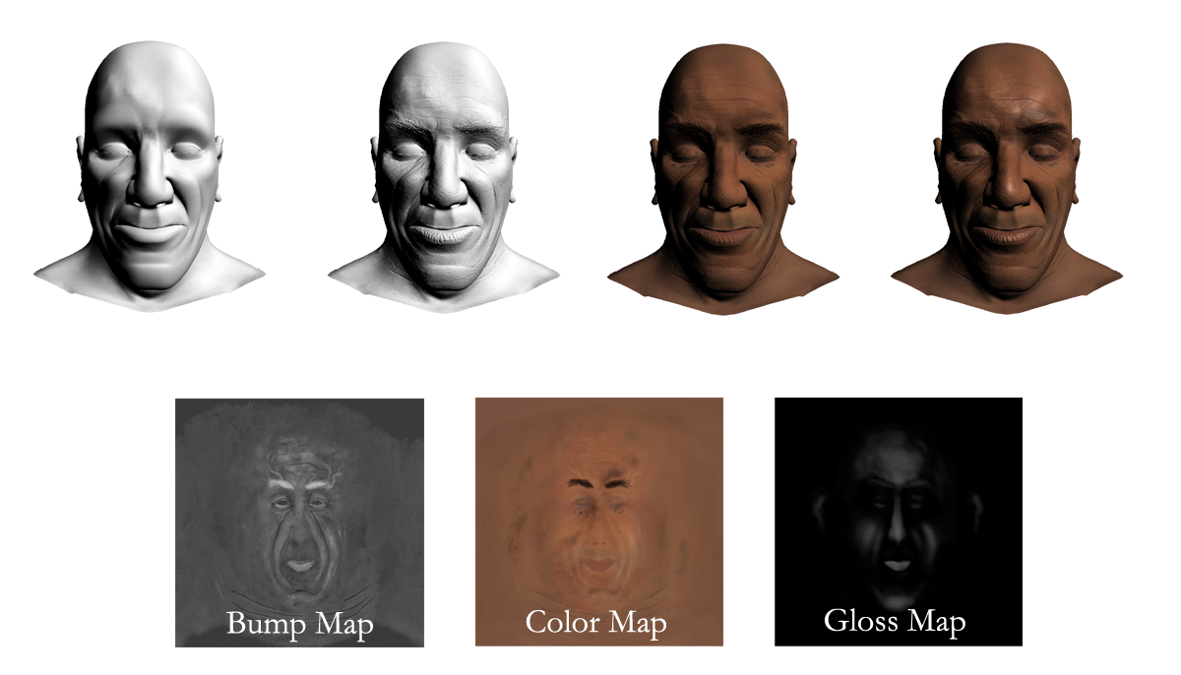
Rendering 3D models
Process the vertices (position on screen)
Rasterize the triangles
Process the pixels to generate the final image

Slide 22
Rendering “pretty” 3D models
Complex processing of pixels
Textures:

Slide 23
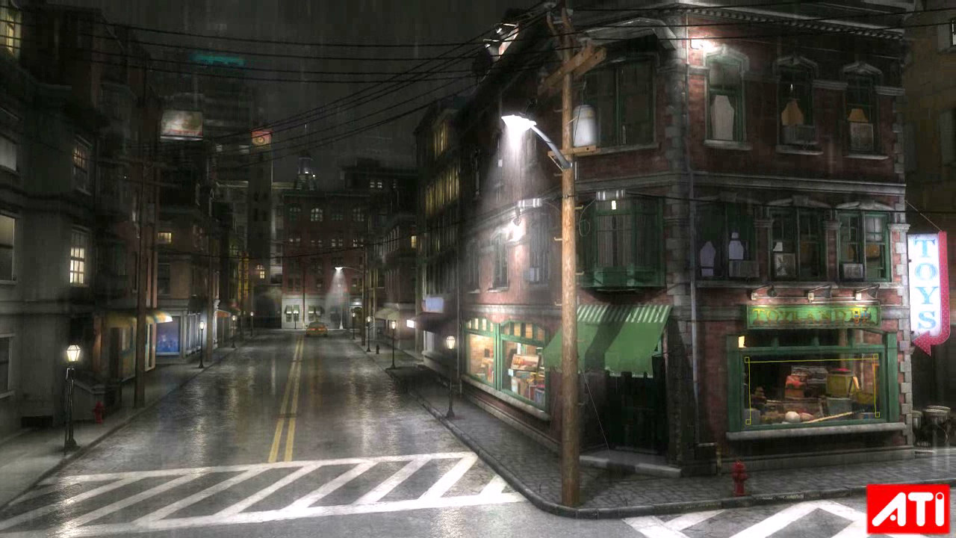
Complex scenes
Several models
Several textures per model
Several methods of computing final color
(details later)

Slide 24

Toyshop demo
https://www.youtube.com/watch?v=gp6nKyFNshs

Slide 25
GPU processing at a glance
Application
Vertex Processor
Rasterizer
Pixel Processor
Memory
Display

Slide 26
Visibility: The Depth-Buffer (Z-buffer)
Use an additional buffer (image) to hold distance to the camera (depth) per pixel
Render primitives in arbitrary order
Record their depths in the depth buffer
If the depth of a fragment about to be drawn is greater than what’s already there, throw it away
Otherwise, draw it and update the Z-buffer
Image precision hidden surface removal

Slide 27

What can we do?
Can we use the rendering pipeline to draw any 3D scene directly?
How do we handle interactions between objects?
A: Use multi-pass techniques
Example: Shadow computation
Many algorithms/effects require multiple passes

Slide 28
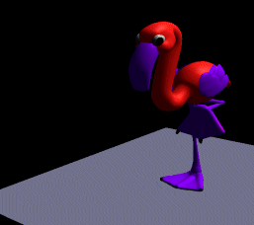
How important are shadows?

Slide 29
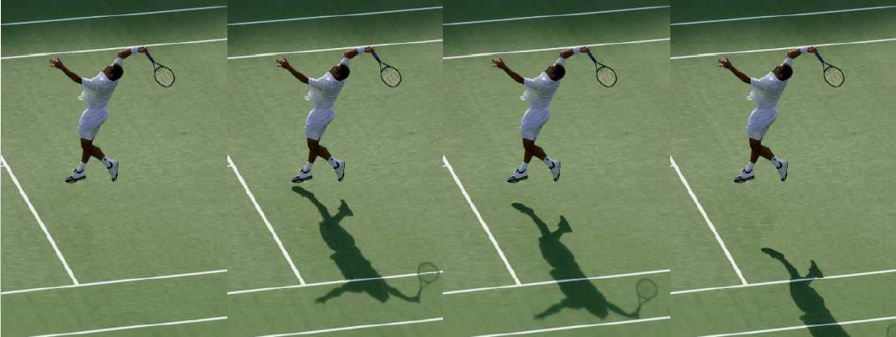
How important are shadows?

Slide 30
What is a shadow?
Shadows occur on surfaces that are not fully visible the light.
Light
Eye
Object
Shadow

Slide 31
Terminology
(area) light source
occluder
penumbra
umbra – fully shadowed region
penumbra – partially shadowed region
umbra
receiver
shadow

Slide 32
“Hard” and “Soft” Shadows
Depends on the type of light sources
Point (“Hard Shadows”)
Area (“Soft Shadows”)
point
area
umbra
penumbra

Slide 33

“Hard” and “Soft” Shadows
Hard shadow Soft shadow
– point light source – area light source

Slide 34
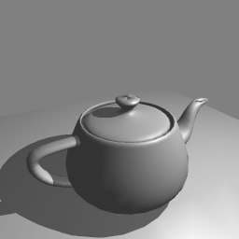

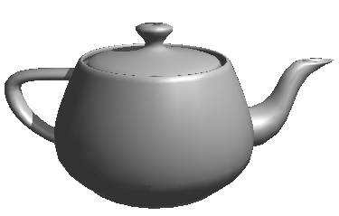
Real-time shadows
Basic idea:
Put camera at light and render
Put camera at viewer and render
Pixels that are also visible from light are not in shadow
Eye
Light

Slide 35
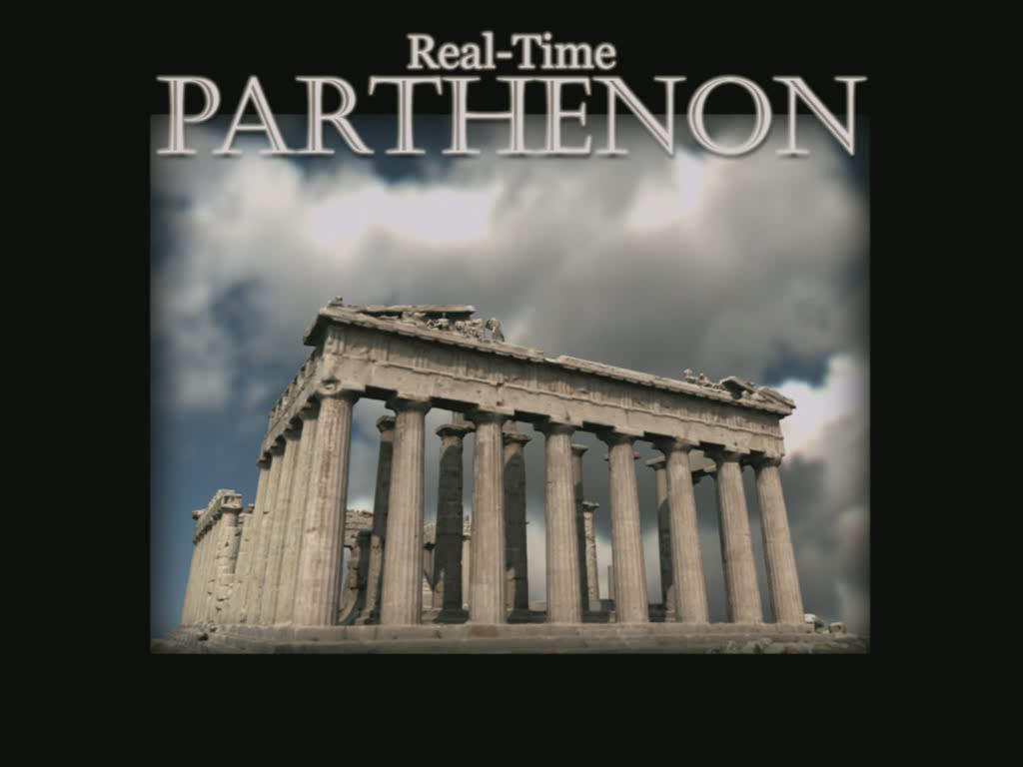
https://www.youtube.com/watch?v=3qraxOZzcnM

Slide 36
Example games
Rubik’s cube (basic graphics, UI) https://www.google.com/logos/2014/rubiks/rubiks.html
Cube slam (gameplay, neat twist on pong) https://www.cubeslam.com/fturfc
Racer-S (fancy graphics effects, camera motion) http://helloracer.com/racer-s/
Physics simulation (physjs: http://chandlerprall.github.io/Physijs/) http://chandlerprall.github.io/Physijs/examples/compound.html
Jenga (physjs) http://chandlerprall.github.io/Physijs/examples/jenga.html
HelloRun http://hellorun.helloenjoy.com/

Slide 37
Interesting concepts
Population (great visualization) http://data-arts.appspot.com/globe/
Pablo, the flamingo (deformation and music) http://pablotheflamingo.com/
Fluid WebGL (fluid simulation) http://29a.ch/sandbox/2012/fluidwebgl/

Slide 38
Overall strategy
Come up with idea and objectives for proposal
Find libraries to help achieve as many goals/effects as possible
Ensure at least one complex step/module implemented on your own

