Slide 1

Game Physics III
COMP4451 Game Programming

Slide 2
Topics
Introduction
Point Masses
Rigid Bodies
Numerical simulation
Controlling truncation error
Generalized rigid body forces
Soft Bodies
Collision Detection
Physics on the GPU

Slide 3
Example with many deformable objects
Niagara chairs
Recycling bottle
http://www.cs.cornell.edu/%7Edjames/bottledWater/
Notes:
http://www.cs.rutgers.edu/~dpai/papers/JamPai04.pdf

Slide 4
Collision Detection
Determining when objects collide not easy
Geometry can be complex (beyond spheres)
Objects can move fast
There can be many objects (say, n)
Naïve solution is O(n²) time complexity
Two basic techniques
Overlap testing
Detects whether a collision has already occurred
Intersection testing
Predicts whether a collision will occur in the future

Slide 5
Overlap Testing
Facts
Most common technique used in games
Exhibits more error than intersection testing
Concept
For every simulation step, test every pair of objects to see if overlap
Easy for simple volumes like spheres
Harder for polygonal models
Useful results of detected collision (for physics)
Collision normal vector
Time collision took place

Slide 6
Overlap Testing: Collision Time (1 of 2)
Collision time calculated by moving object back in time until right before collision
Move forward or backward ½ step, called bisection

Slide 7
Overlap Testing: Collision Time (2 of 2)
Get within a delta (close enough)
With distance moved in first step, can know “how close”
In practice, usually 5 iterations is pretty close

Slide 8
Overlap Testing: Limitations (1 of 2)
Fails with objects that move too fast
Unlikely to catch time slice during overlap

Slide 9
Overlap Testing: Limitations (2 of 2)
Possible solutions
Design constraint on speed of objects
Fastest object moves smaller distance than thinnest object
May not be practical for all games
Reduce simulation step size
Adds overhead since more computation
Note, can try different step size for different objects

Slide 10
Intersection Testing
Predict future collisions
Extrude geometry in direction of movement
Ex: swept sphere turns into a “capsule” shape
Then, see if overlap
When predicted:
Move simulation to time of collision
Resolve collision
Simulate remaining time step

Slide 11
Dealing with Complexity
Complex geometry must be simplified
Complex object can have 1000’s of polygons
Testing intersection for each is costly
Reduce number of object pair tests
There can be 100’s or 1000’s of objects
If test all, O(n²) time complexity

Slide 12
Bounding Volume (1 of 3)
Bounding volume is simple geometric shape that completely encapsulates object
Ex: approximate spiky object with ellipsoid
Does not need to encompass
May be ok for some games

Slide 13
Bounding Volume (2 of 3)
Testing cheaper
If no collision with bounding volume, done
If there is a collision, more testing desired
Commonly used bounding volumes
Sphere (compare distance with sum of radii)
Box – axis-aligned (lose fit) or oriented (tighter fit)

Slide 14
Bounding Volume (3 of 3)
For complex object, can fit several bounding volumes around unique parts
E.g., for human, boxes around torso and limbs, sphere around head
Can use hierarchical bounding volume
Ex: large sphere around whole avatar
If collide, refine with more refined bounding boxes

Slide 15
Volume sweeping (1 of 2)
Take sum of two convex volumes to create new volume
Sweep origin (center) of X all over Y

Slide 16
Volume sweeping (2 of 2)
Test if single point in X in new volume
Take center of sphere at t₀ to center at t₁
If line intersects new volume, then collision

Slide 17
Reduced Collision Tests - Partitioning
Partition space so only test objects in same cell
If N objects, then sqrt(N) x sqrt(N) cells to get linear complexity
Must align nicely
Must use multiple cells

Slide 18
Reduced Collision Tests – Plane Sweep
Objects tend to stay in same place
So, don’t need to test all pairs
Record bounds of objects along axes
Any objects with overlap on all axes should be tested further
Time consuming part is sorting bounds
Quicksort O(nlog(n))
But, since objects don’t move, can do better if use Bubblesort to repair – nearly O(n)

Slide 19
Collision Resolution (1 of 3)
Once detected, must take action to resolve
But effects on trajectories and objects can differ
Ex: Two billiard balls strike
Calculate ball positions at time of impact
Impart new velocities on balls
Play “clinking” sound effect
Ex: Rocket slams into wall
Rocket disappears
Explosion spawned and explosion sound effect
Wall destroyed and area damage inflicted

Slide 20
Collision Resolution (2 of 3)
Before:
Collision known to have occurred
Check if collision should be ignored
Other events might be triggered
Sound effects
Send collision notification messages
Collision:
Place objects at point of impact
Assign new velocities
Using physics or
Using some other decision logic

Slide 21
Collision Resolution (3 of 3)
After:
Propagate post-collision effects
Possible effects
Destroy one or both objects
Play sound effect
Inflict damage
Many effects can be done either before or after

Slide 22
Collision Resolution – Collision Step
For overlap testing, four steps
Extract collision normal
Extract penetration depth
Move the two objects apart
Compute new velocities (last lecture)
For intersection testing, two steps
Extract collision normal
Compute new velocities (last lecture)

Slide 23
Collision Resolution – Collision Normal
Find position of objects before impact
Use bisection
Use closest points to construct the collision normal vector
For spheres, normal is line connecting centers

Slide 24
Collision Resolution – Intersection Testing
Simpler than resolving overlap testing
No need to find penetration depth
No need to move objects apart
Steps:
1. Extract collision normal
2. Compute new velocities

Slide 25
Advanced Space Partitioning for Collision Detection
Traditional:
Quadtrees and Octrees
kd-Tree
BSP Trees

Slide 26
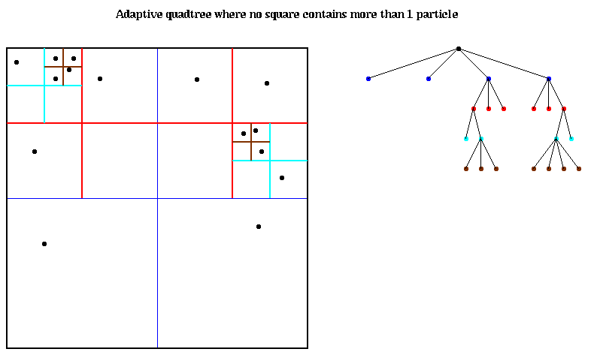
Quadtrees
Recursively subdivide space (2 axis)
No square has more than 2 particles

Slide 27
Quadtree
Refine to check collision
YES
NO (evaluated quicly)

Slide 28
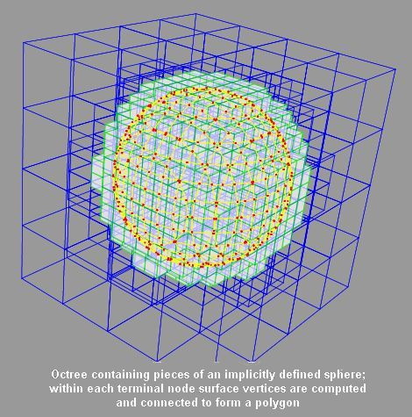
Octree
Same as quadtrees, but in three dimensions
Node has 8 children

Slide 29
BSP Tree
Binary space partitioning tree
Partition a subspace by a hyper-plane
Results in two new subspaces that can be further partitioned

Slide 30
BSP Tree
Can place element by doing front/back tests
2
1
V1
front
back
3
1
4
2
3
5
front
back
front
6
4a
4b
5
V2
front
6

Slide 31
BSP Tree
Can place element by doing front/back tests
2
1
3
front
back
1
4a
2
3
4b
5
front
back
front
6
4a
4b
5
front
6

Slide 32
Traditional SP Summary
Uniform Spatial Sub
Quadtree/Octree
kd-tree
BSP tree
(kd-tree is a special case of BSP tree)

Slide 33
BD-Tree
(Parametrized) Bounded Deformation Tree
Features:
Cost independent of geometry complexity
Based on linear deformations
Efficient, easy to implement
Uses a wrapped tree of spheres
Key: Very fast, conservative bounding hierarchy update

Slide 34
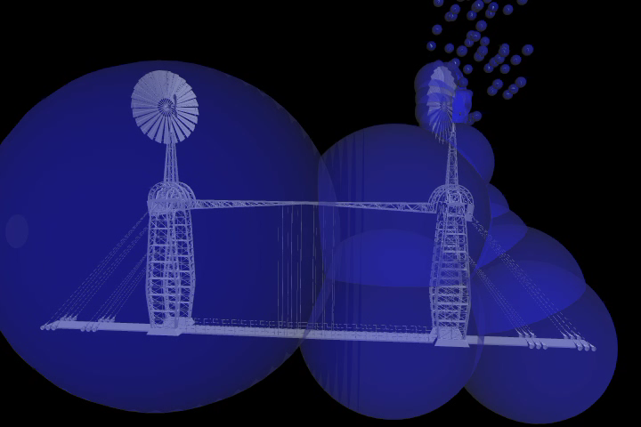
Sphere hierarchy - testing

Slide 35
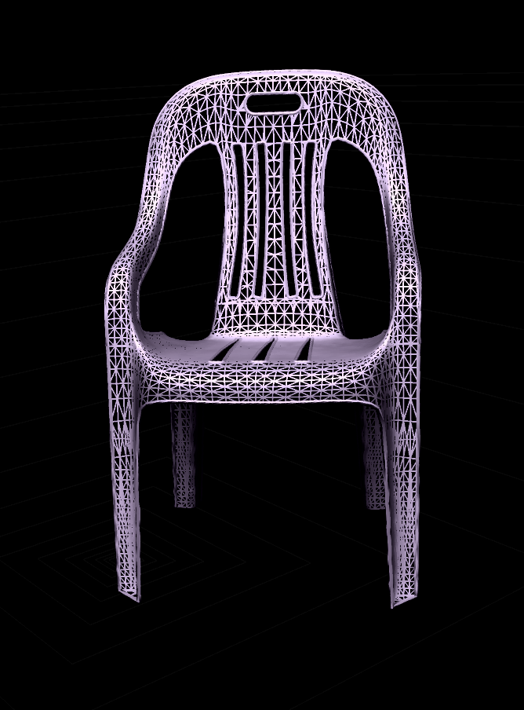
Bounded deformations - fast update
q
R
R’(q)
c
c’(q)

Slide 36
Show video
Video: http://graphics.cs.cmu.edu/projects/bdtree/JamesPai_BDTree04_divx.avi
For details, see: http://www.cs.rutgers.edu/~dpai/papers/JamPai04.pdf

Slide 37
Collision Detection Summary
Testing
Overlap
Intersection (prediction)
Control complexity
Shape with bounding volume
Could be hierarchical
Number with cells or sweeping
Handle collision (before, collision, after)
Advanced Space Partitioning

Slide 38
GPGPU and Physics

Slide 39
Physics is a data parallel task
Integrate
Collide
Solve Collisions
100%
data parallel
80%
data parallel
(coarse + fine)
95%
data parallel
(dependency)

Slide 40
Mapping concepts to GPU
Properties:
Algorithm must be data-parallel
Computations should ideally be local
Now, how do we map it?

Slide 41
The Importance of Data Parallelism
GPUs are designed for graphics
Highly parallel tasks
GPUs process independent vertices & fragments
Temporary registers are zeroed
No shared or static data (not in graphics APIs)
No read-modify-write buffers
Data-parallel processing
GPUs architecture is ALU-heavy
Multiple vertex & pixel pipelines
Hide memory latency (with more computation)

Slide 42
Arithmetic Intensity
Arithmetic intensity
ops per word transferred
Computation / bandwidth
Best to have high arithmetic intensity
Ideal GPGPU apps have
Large data sets
High parallelism
Minimal dependencies between data elements

Slide 43
Data Streams & Kernels
Streams
Collection of records requiring similar computation
Vertex positions, Voxels, etc.
Provide data parallelism
Kernels
Functions applied to each element in stream
transforms, PDE, …
Few dependencies between stream elements
Encourage high Arithmetic Intensity

Slide 44
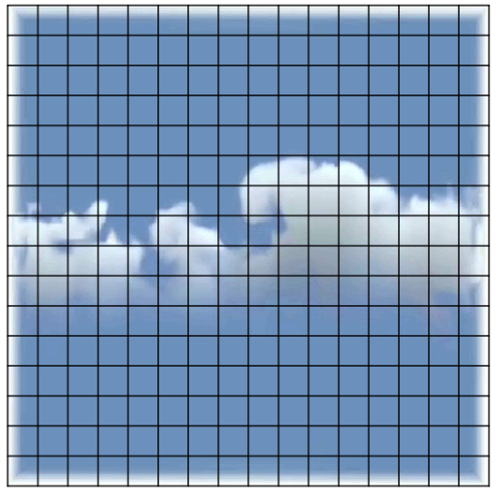
Example: Simulation Grid
Common GPGPU computation style
Textures represent computational grids = streams
Many computations map to grids
Matrix algebra
Image & Volume processing
Global Illumination
Physically-based simulation
Non-grid streams can be mapped to grids

Slide 45
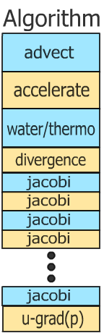
Stream Computation
Grid Simulation algorithm
Made up of steps
Each step updates entire grid
Must complete before next step can begin
Grid is a stream, steps are kernels
Kernel applied to each stream element
Cloud simulation algorithm

Slide 46

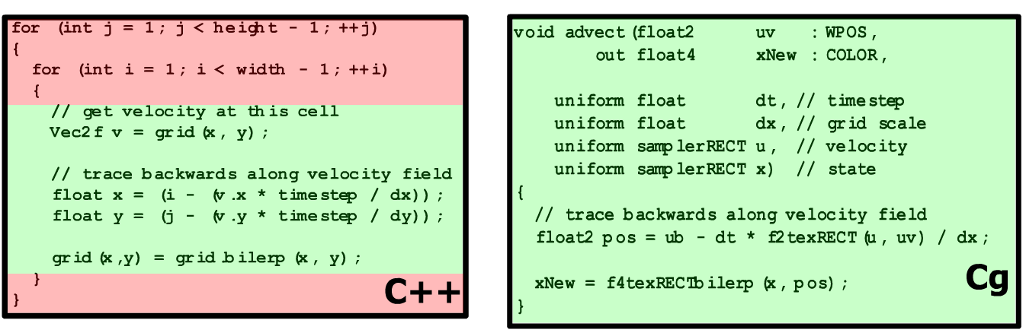
Kernels
CPU
GPU
Kernel / loop body / algorithm step = Fragment Program

Slide 47
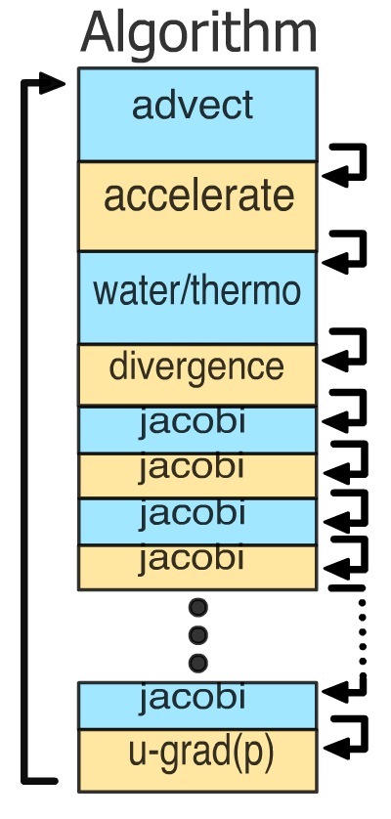
Feedback
Each algorithm step depends on the results of previous steps
Each time step depends on the results of the previous time step

Slide 48
GPU Simulation
Algorithm steps are fragment programs
Computational kernels
Current state is stored in textures
Feedback via render to texture
One question: how do we invoke computation?

Slide 49
Invoking Computation
Must invoke computation at each pixel
Just draw geometry!
Most common GPGPU invocation is a full-screen quad
So, rasterization = kernel invocation
Simple example:
https://www.youtube.com/watch?v=7EOjAdmURY4

Slide 50
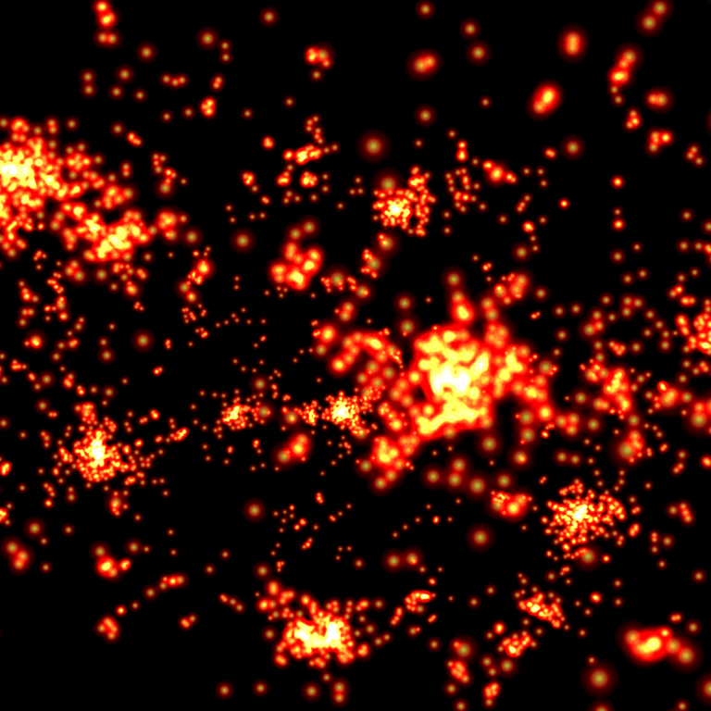
Example: N-Body Simulation
Brute force ☹
N = 8192 bodies
N² gravity computations
64M force comps. / frame
~25 flops per force
10.5 fps
17+ GFLOPs sustained
GeForce 7800 GTX
Nyland, Harris, Prins, GP² 2004 poster

Slide 51
Computing Gravitational Forces
Each body attracts all other bodies
N bodies, so N² forces
Draw into an NxN buffer
Pixel (i,j) computes force between i and j
Very simple fragment program
More than 4096 bodies makes it trickier
Limited by max buffer size…

Slide 52
Computing Gravitational Forces
N-body force Texture
Body Position Texture
N
force(i,j)
j
j
i
F(i,j) = gM_{i}M_{j} / r(i,j)²,
r(i,j) = |pos(i) - pos(j)|
0
i
N
Force is proportional to the inverse square of the distance between bodies

Slide 53
Computing Gravitational Forces
float4 force(float2 ij : WPOS,
uniform sampler2D pos) : COLOR0
{
// Pos texture is 2D, not 1D, so we need to
// convert body index into 2D coords for pos tex
float4 iCoords = getBodyCoords(ij);
float4 iPosMass = texture2D(pos, iCoords.xy);
float4 jPosMass = texture2D(pos, iCoords.zw);
float3 dir = iPos.xyz - jPos.xyz;
float r2 = dot(dir, dir);
dir = normalize(dir);
return dir * g * iPosMass.w * jPosMass.w / r2;
}

Slide 54
Computing Total Force
N-body force Texture
Have: array of (i,j) forces
Need: total force on each particle i
Sum of each column of the force array
Can do all N columns in parallel
N
force(i,j)
0
i
N
This is called a Parallel Reduction

Slide 55
Parallel Reductions
1D parallel reduction:
sum N columns or rows in parallel
add two halves of texture together
repeatedly...
Until we’re left with a single row of texels
NxN
+
Nx(N/2)
Nx(N/4)
Nx1
Requires log₂N steps

Slide 56
Update Positions and Velocities
Now we have a 1-D array of total forces
One per body
Update Velocity
u(i,t+dt) = u(i,t) + F_{total}(i) * dt
Simple pixel shader reads previous velocity and force textures, creates new velocity texture
Update Position
x(i, t+dt) = x(i,t) + u(i,t) * dt
Simple pixel shader reads previous position and velocity textures, creates new position texture

Slide 57
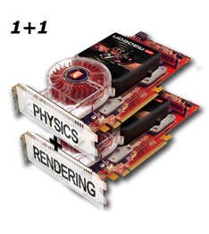
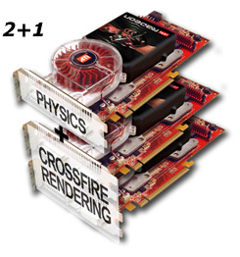
Optimize by force: Dual and Triple GPU Physics
Second (or third) GPU can be used for graphics or physics simulation, or share the primary card

Slide 58
PhysX examples
https://www.youtube.com/watch?v=6vipmar3wS4
https://www.youtube.com/watch?v=pEX13W-IuLA

