Slide 1

Game networking
COMP4451 Game Programming

Slide 2
Recap
Great progress on many games
We will be grading the presentations next week
Grading feedback will be sent by email

Slide 3
Why networking?
Multi-player games
Persisting games
Everquest
Transient games
Poker
Issues building network games:
Latency: How long does it take for state to be transmitted
Reliability: How often is data lost or corrupted (TCP vs. UDP)
Bandwidth: How much data can be transmitted in a given time
Security: How is the game-play protected from tampering (cheating)
Must consider tradeoffs

Slide 4
Latency
Delay during message transmission
Variation (jitter) also matters
Cannot be totally eliminated
Speed of light propagation yields 25-30 ms across Atlantic Ocean
With routing and queuing, usually 80 ms

Slide 5
Network Latency in Games (1 of 2)
Application tolerances
File download – minutes
Web page download – up to 10 seconds
Interactive audio – hundreds of ms
Game latencies tolerance depends upon game
First-Person Shooters – 300ms is ok
Real-Time Strategy –1 second
Other games?

Slide 6
Network Latency in Games (2 of 2)
Most important aspect of a game network
Too much latency leads to horrible game play
It makes it harder to aim and hit targets
Latency is not bandwidth
Speed of transmission vs. amount of information transmitted
Excess bandwidth can reduce the variance in latency
Excess bandwidth cannot reduce the minimum latency (dependent on distance)

Slide 7
Sources of Latency
Frame rate latency
Interation/networking sampled once per frame
Network protocol latency
OS must send/get data to/from physical network (wire)
Transmission latency
Data must be transmitted to the receiver
Processing latency
Server (or client) must compute some response to the input
You don’t have full control over these sources

Slide 8
Reducing Latency (1 of 2)
Frame rate latency
Increase the frame rate (faster graphics, faster AI, faster physics)
Network protocol latency
Send less information
Switch to a protocol with lower latency
(But may have impact on reliability and security)
Transmission latency
Send less information (less time between when the first bit and the last bit arrive)
Upgrade your physical network (from 3G to a direct Wifi connection, for instance)

Slide 9
Reducing Latency (2 of 2)
Processing latency
Make your server faster
Have more servers
Not much research devoted to latency
Most applications can handle higher latency
Service providers not promissing to reduce latency!

Slide 10
Working With Latency
Can’t remove it. Lets hide it!
Can’t be fully accurate.
A) Sacrifice accurate information
Ignore the lag
Show “old” player position
Try to improve by guessing (If your guess is wrong, incorrect information is shown)
B) Sacrifice game-play
Add lag into the local player’s experience on purpose! You then have enough time to deal with the network

Slide 11
Dead Reckoning
Dead reckoning uses prediction to move the objects (e.g., characters, bullets in a game)
Each client maintains precise state for some objects (e.g. local player)
Each client receives periodic updates of the position of others, along with velocity information, and maybe acceleration
On each frame, non-local objects are updated via extrapolation
With a client-server model
Each player runs their own version of the game
Server maintains control

Slide 12
Fixing Extrapolation Errors
What do you do when using dead reckoning, and a new position arrives for another player?
The position that just came in will not agree with the place you have the object, due to extrapolation errors
Two options:
Jump to the correct position
Interpolate the two positions over some period
Path followed will never be exact, but will match reasonably well
Target Path
Your Guess
Extrapolations from new data
Actual
New Data

Slide 13
Network Reliability
Some protocols attempt to ensure that every packet is delivered
It costs, in latency and bandwidth
Others try less hard to ensure delivery, and will not tell you if packets get lost
Latency and bandwidth requirements are lower
Other aspects of reliability:
Error checking
Order consistency

Slide 14
Is reliability always important?
Some information must be communicated:
Discrete changes in game state (e.g., a goal is scored) (if they go missing, there is no chance to recapture them)
Some information does not need to be reliably communicated:
Information that rapidly becomes out of date, and hence is sent frequently
Player position information, weapon firing information, …
The data that goes out of date quickly is also sent more often
So, important to reduce cost of each transmission

Slide 15
Internet Protocols
Two widely deployed and useful options: UDP and TCP/IP (implementation: use sockets)
TCP/IP (Transmission Control Protocol/Internet Protocol) is most commonly used
UDP (User Datagram Protocol) is also widely deployed and used
Other protocols exist:
Proprietary standards
Broadcast and Multicast are standard protocols with some useful properties, but they are not widely deployed
If the ISPs don’t provide it, you can’t use it

Slide 16
TCP/IP Overview
Advantages:
Guaranteed packet delivery
Ordered packet delivery
Packet checksum checking (some error checking)
Disadvantages:
Bandwidth and latency overhead
Packets may be delayed to preserve order
Uses:
Data that must be reliably sent, or requires one of the other properties
Games that can tolerate latency

Slide 17
UDP Overview
Advantages:
Packet based - so works with the internet
Low overhead in bandwidth and latency
Immediate delivery - as soon as it arrives it goes to the client
Disadvantages:
No reliability guarantees
No ordering guarantees
Packets can be corrupted
Can cause problems with some firewalls
Uses:
Data that is sent frequently and goes out of date quickly

Slide 18
Choosing a Protocol
The best way to do it is decide on the requirements and find the protocol to match
In most cases, that means TCP/IP
You can also design your own “protocol” by designing the contents of packets
Add cheat detection or error correction, for instance
You then wrap you protocol inside TCP/IP or UDP

Slide 19
Game-Specific Protocols
Positions, Inputs, Orientations
Spawning and Removing
Game Events
Match Configurations
State Transitions
Complaints, Connection Status
Heartbeats (pings)
Voice / Chat

Slide 20
Bandwidth (Bitrate)
Data sent/received per time
LAN – 10 Mbps to 10 Gbps
Limited size and scope
WANs – tens of kbps from modems, to 1.5 Mbps (T1, broadband), to 55 Mbps (T3)
Potentially enormous
Number of users, size and frequency of messages determines bitrate use
As does transmission technique

Slide 21
Reducing Bandwidth Demands
Bandwidth is plentiful on the Internet today
Only becomes an issue with large environments
Regardless, smaller packets reduce both bandwidth and latency (from earlier)
Latency is measured from the time the first bit leaves to the time the last bit arrives - so fewer bits have lower latency
There are two primary ways to reduce bandwidth demands
Dead reckoning allows you to send state less frequently
If player doesn’t change direction, no need to send
Area of interest management avoids sending irrelevant data

Slide 22
Area of Interest Management (~LOD or visibility)
Only send data to the people who need it
There is a catch, however: In a network you may not know where everyone is, so you don’t know what they can see
A chicken-and-egg problem
So, typically employed in client-server environments:
The server has complete information
It decides who needs to receive what information, and only sends information to those who need it
Two approaches: grid methods and aura method

Slide 23
Grid and Aura Methods
Grid methods break the world into a grid
Associate information with cells
Associate players with cells
Only send information to players in the same, or neighboring, cells
This has all the same issues as grid based visibility and collision detection
Aura methods associate an aura with each piece of information
Only send information to players that intersect the aura
Just like broad-phase collision detection with bounding volumes
Players need to find out all the information about a space when they enter it, regardless how long ago that information last changed

Slide 24

Interest Management – Auras (1 of 2)
Nodes express area of interest to them
Do not get messages for outside areas

Slide 25
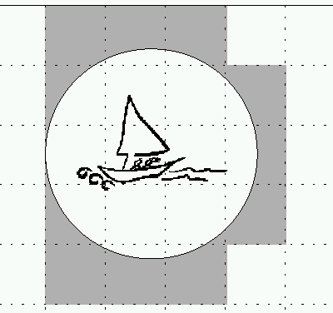

Interest Management- Auras (2 of 2)
- Divide into cells
- Easier, but less discriminating
Compute bounding box
Relatively easy, precise
Always symmetric – both receive
But can sub-divide – Focus and Nimbus

Slide 26
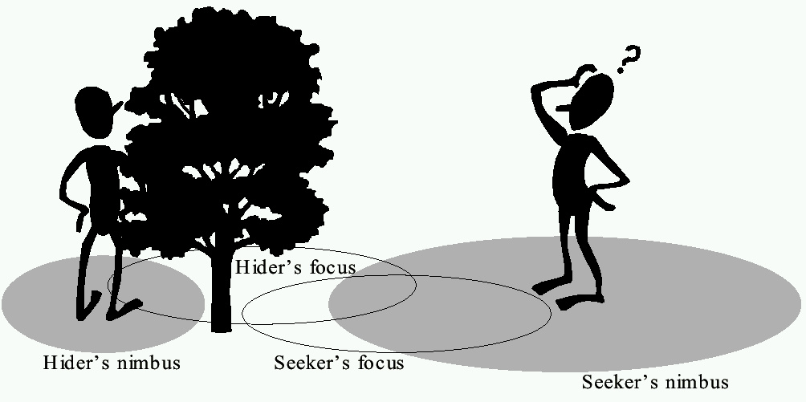
Interest Management Focus and Nimbus
nimbus must intersect with focus

Slide 27
Security and Cheating
Unique to games
Other multi-person applications don’t have
Cheaters want:
Vandalism – create havoc (relatively few)
Dominance – gain advantage (more)

Slide 28
Packet and Traffic Tampering
Reflex augmentation (enhance cheater’s reactions)
Example: aiming proxy monitors opponents movement packets, when cheater fires, improve aim
Packet interception (prevent some packets from reaching cheater)
Example: suppress damage packets, so cheater is invulnerable
Packet replay (repeat event over for added advantage)
Example: multiple bullets or rockets if otherwise limited

Slide 29
Preventing Packet Tampering
Cheaters figure out by changing bytes and observing effects
Prevent by checksums (fast, public)
Still cheaters can:
Reverse engineer checksums
Attack with packet replay
So:
Encrypt packets
Add sequence numbers (or encoded sequence numbers) to prevent replay

Slide 30
Information Exposure
Allows cheater to gain access to replicated, hidden game data (e.g., status of other players)
Passive, since does not alter traffic
Example: see through walls in FPS http://youtube.com/watch?v=0JSPmIZsh9c
Cannot be defeated by network alone
Instead:
Sensitive data should be encoded
Kept in hard-to-detect memory location
Centralized server may detect cheating (example: attack enemy could not have seen)

Slide 31
Can’t trust
Can’t always assume trusted client executables
Distribution may be the source of unexpected behavior
Better to have trusted server that puts into play client actions (centralized server)

Slide 32
Game networking issues discussed
Latency How long does it take for state to be transmitted
Reliability How often is data lost or corrupted (TCP vs. UDP)
Bandwidth How much data can be transmitted in a given time
Security How is the game-play protected from tampering (cheating)

Slide 33
Implemetation
Widely varies depending on platform
Same concepts apply
If browser-based game, check
http://socket.io
http://nodejs.org

