Slide 1

Game AI 1: Adversarial Search
COMP4451 Game Programming

Slide 2
Topics
Search techniques for adversarial games
•
–
–
–
Minimax search
Alpha-beta search
Advanced search optimizations
•
Later: More general
techniques
–
–
–
–
Pathfinding
Game agents
Finite state machine
…

Slide 3
Why
is
good
AI
important
•
You don’t want this:
https://www.youtube.com/watch?v=CXpQYngyQRI

Slide 4
Game
Playing
•
A second player (or more) is an adversary
– Examples: chess, checkers, go, tic-tac-toe, connect backgammon, bridge, poker
– Adversarial search
four,
•
Players take turns or alternate play
– Unpredictable opponent
– Solution specifies a move for every possible
opponent
move
•
Turn time limits
– How might they affect the search process?

Slide 5
Types
Games can have
– Perfect information
of
games
•
– Imperfect information
Games can be
•
–
–
Deterministic
Non-deterministic
(chance)

Slide 6
Example
Game:
Nim
variant
•
•
Deterministic, Perfect information
Two players
–
–
One pile of tokens in the middle of the
At each move, the player divides a pile
table
into
two
non-empty
Player who
piles of
cannot
different sizes
move looses the
–
game

Slide 7
Example
Game:
Nim
7
min
Assume a pile of seven
tokens
Max attempts to maximize
the advantage and win
6-1
5-2
4-3
max
5-1-1
4-2-1
3-2-2
3-3-1
min
Min always tries to move
to a state
that
is
the
worst
2-2-2-1
for
Max
4-1-1-1
3-2-1-1
max
3-1-1-1-1
2-2-1-1-1
min
2-1-1-1-1-1

Slide 8
Perfect Information, Two person games
•
Two players
– MAX and MIN
MAX moves first; alternate turns thereafter
•
•
Formal definition of
game
–
–
–
–
Initial State
Successor Function
Terminal Test
Utility Function
(how it begins)
(returns legal moves)
(is it over?)
(evaluate position)
•
No one player has
strategy
full
control, must develop
a

Slide 9
Minimax
Algorithm:
Basics
3
MAX
3
0
2
MIN
3
9
0
7
2
6
MAX
MIN
2
3
5
9
0
7
4
2
1
5
6
Process of Backing
Assumption: Both best possible move
up: minimax decision
players are knowledgeable and play the

Slide 10
Minmax Algorithm
Generate game tree to all terminal states
Apply utility function to each terminal state
Propagate utility of terminal states up one level
• MAX’s turn: MAX tries to maximize utility value
• MIN’s turn: MIN minimizes utility value
Continue backing-up values toward root, one layer time
•
•
•
•
at a
•
At root node, MAX chooses the value with highest utility

Slide 11
Minimax
Search
•
Minimax decision: maximizes utility
player assuming that the opponent perfectly and minimize its utility
for a
will play
–
–
looking ahead m moves in game tree
Search can be done in a
• i.e. traverse down a path then back up value using
depth first manner
till terminal node reached, minimax decision function.

Slide 12
Minimax:
Applied
to
min
Nim
1
7
1
6-1
1
5-2
1
4-3
max
1
4-2-1
0
3-2-2
1 3-3-1
min
0
5-1-1
3-2-1-1
0
2-2-2-1
max
0
4-1-1-1
1
0
1
2-2-1-1-1
min
3-1-1-1-1
0 2-1-1-1-1-1
max

Slide 13
Example: Partial Search for Tic-Tac-Toe
•
Full game tree may be too large to generate
– (tic-tac-toe not necessarily the case)
•
Generate tree to intermediate depth
•
Calculate utility/evaluation function nodes
for
leaf
•
Back up values to the root node so
player can make a decision
MAX

Slide 14
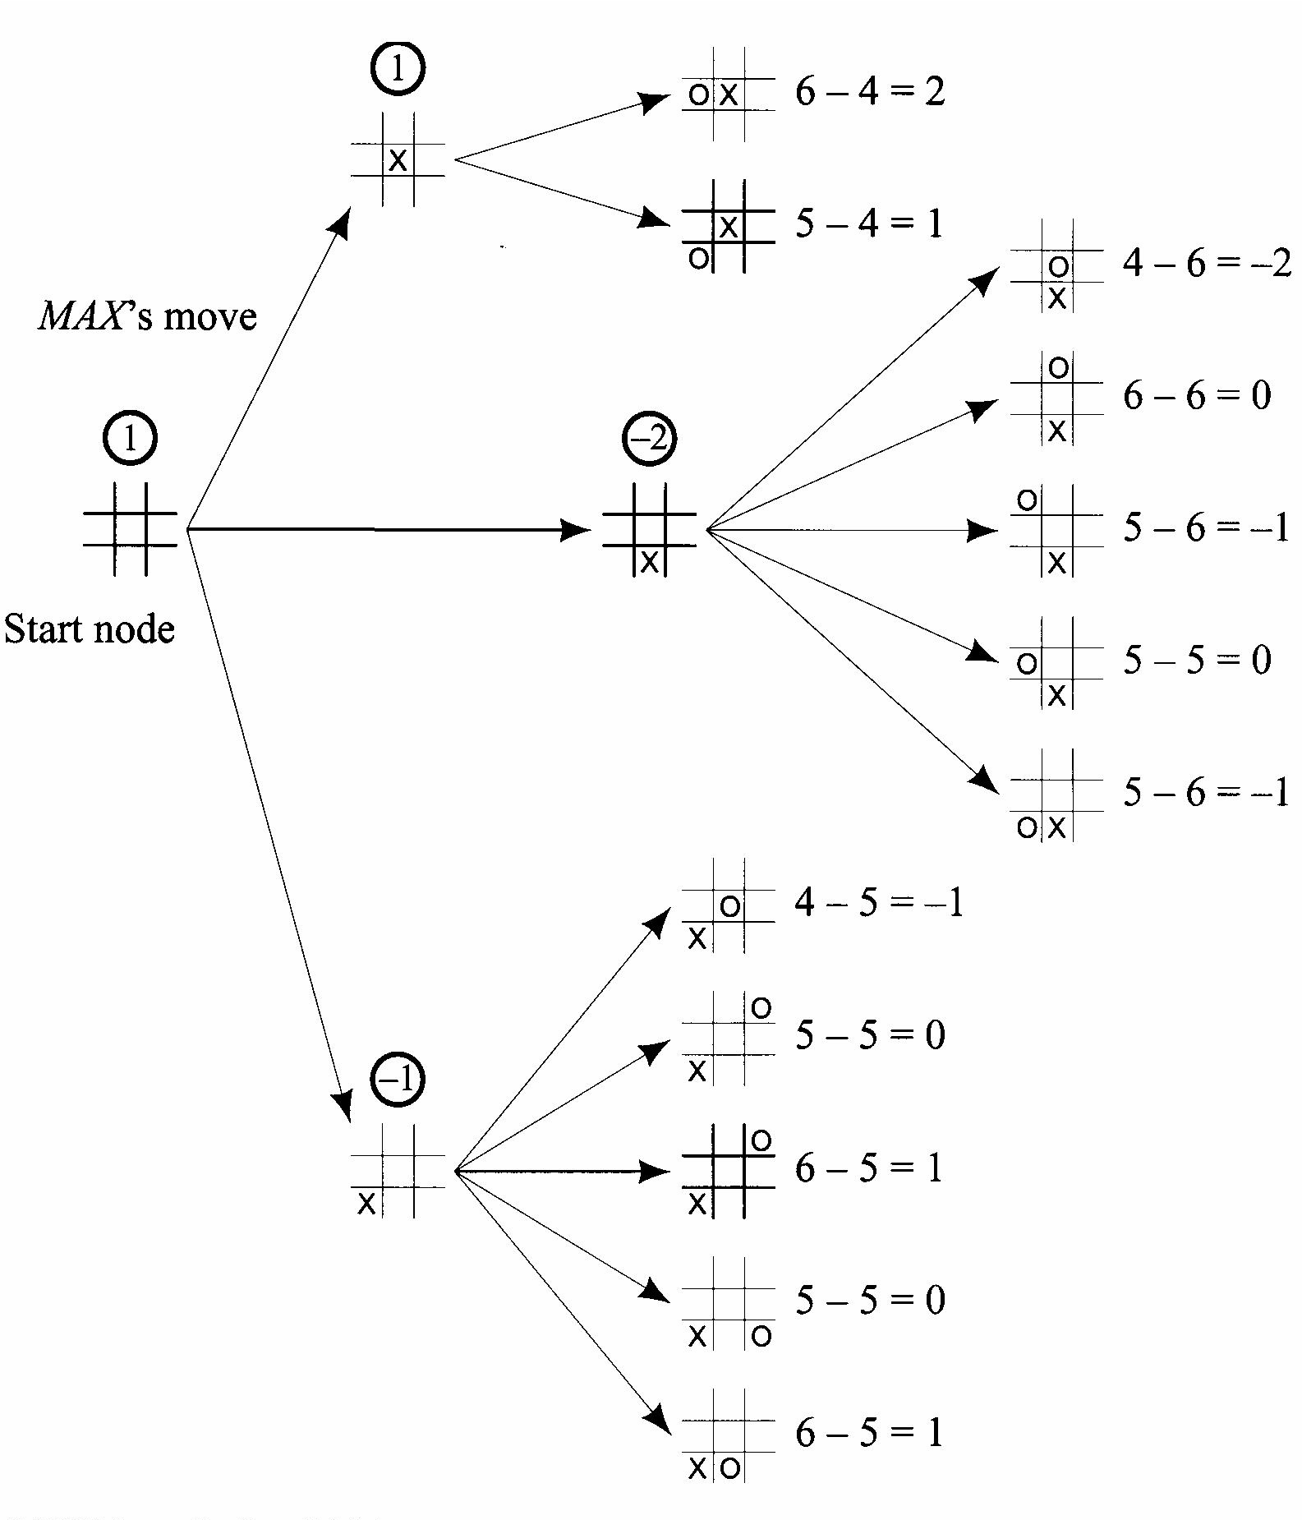
Example:
Partial
Search
for
Tic-Tac-Toe
Position p:
win for Max, u(p) = ∞
loss for MAX, u(p) = –∞
otherwise, u(p) = (# of
complete rows, cols,
still open for MAX) – complete rows, cols, still open for MIN)
& diags
(# of
and diags

Slide 15
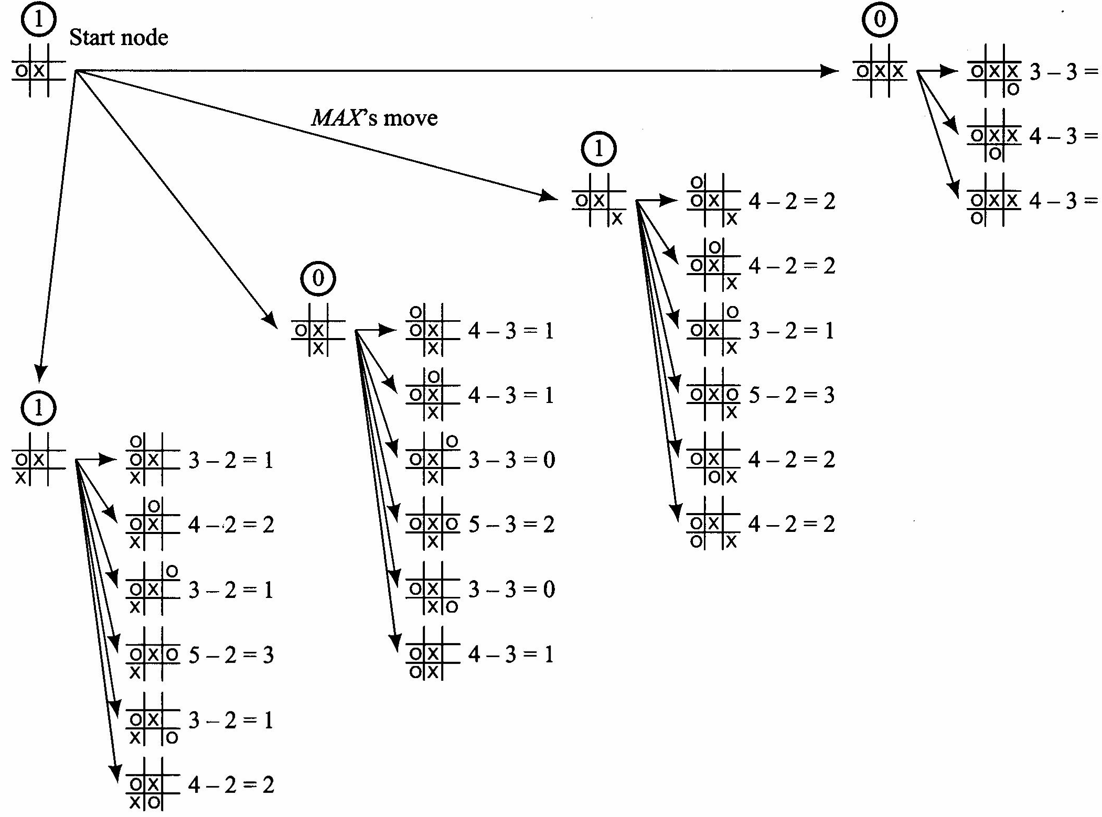
Tic-Tac-Toe
Move
2

Slide 16
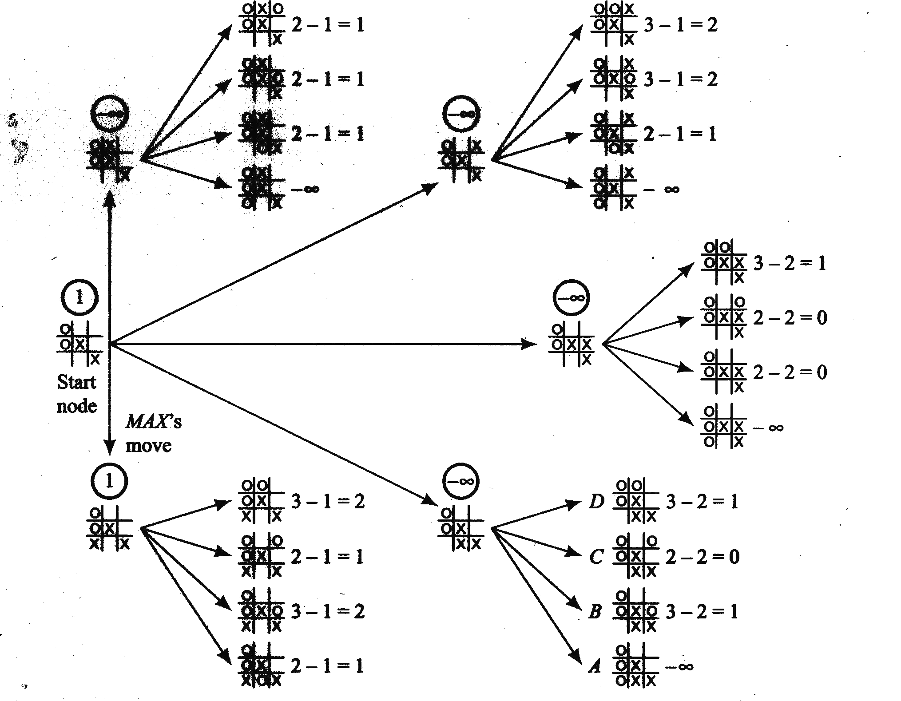
MAX
Player:
3rd
move

Slide 17
Minimax
Algorithm
3
MAX
3
0
2
MIN
3
9
0
7
2
6
MAX
MIN
2
3
5
9
0
7
4
2
1
5
6

Slide 18
Negamax
Algorithm
-3
MAX
3
0
2
MIN
-3
-9
0
-7
-2
-6
MAX
MIN
2
3
5
9 0
7
4
2
1
5
6
Negate values
when returning
Always uses max: Same function

Slide 19
Why use
a
tree
at
all?
•
•
•
Could we just compute evaluation at root?
Yes. But, not a good idea.
An evaluation function lower in
more accurate result
Lower tree nodes contain more how the game will likely end
tree produces
•
information
on

Slide 20
Complex
games
•
What happens if Minimax is applied to
games?
– What happens to the search space?
Example, chess:
large
complex
•
–
–
–
–
–
–
decent amateur program ≈ 1000
150 seconds /move (tournament
Look at approx. 150,000 moves
Chess branching factor of 35
generating trees that are 3-4 ply
Resultant play – pure amateur
moves /second
play)
(depth),

Slide 21
Complex
Games
•
Can we make search process more
intelligent, and
explore
greater
more promising
depth?
parts
of
tree
in

Slide 22
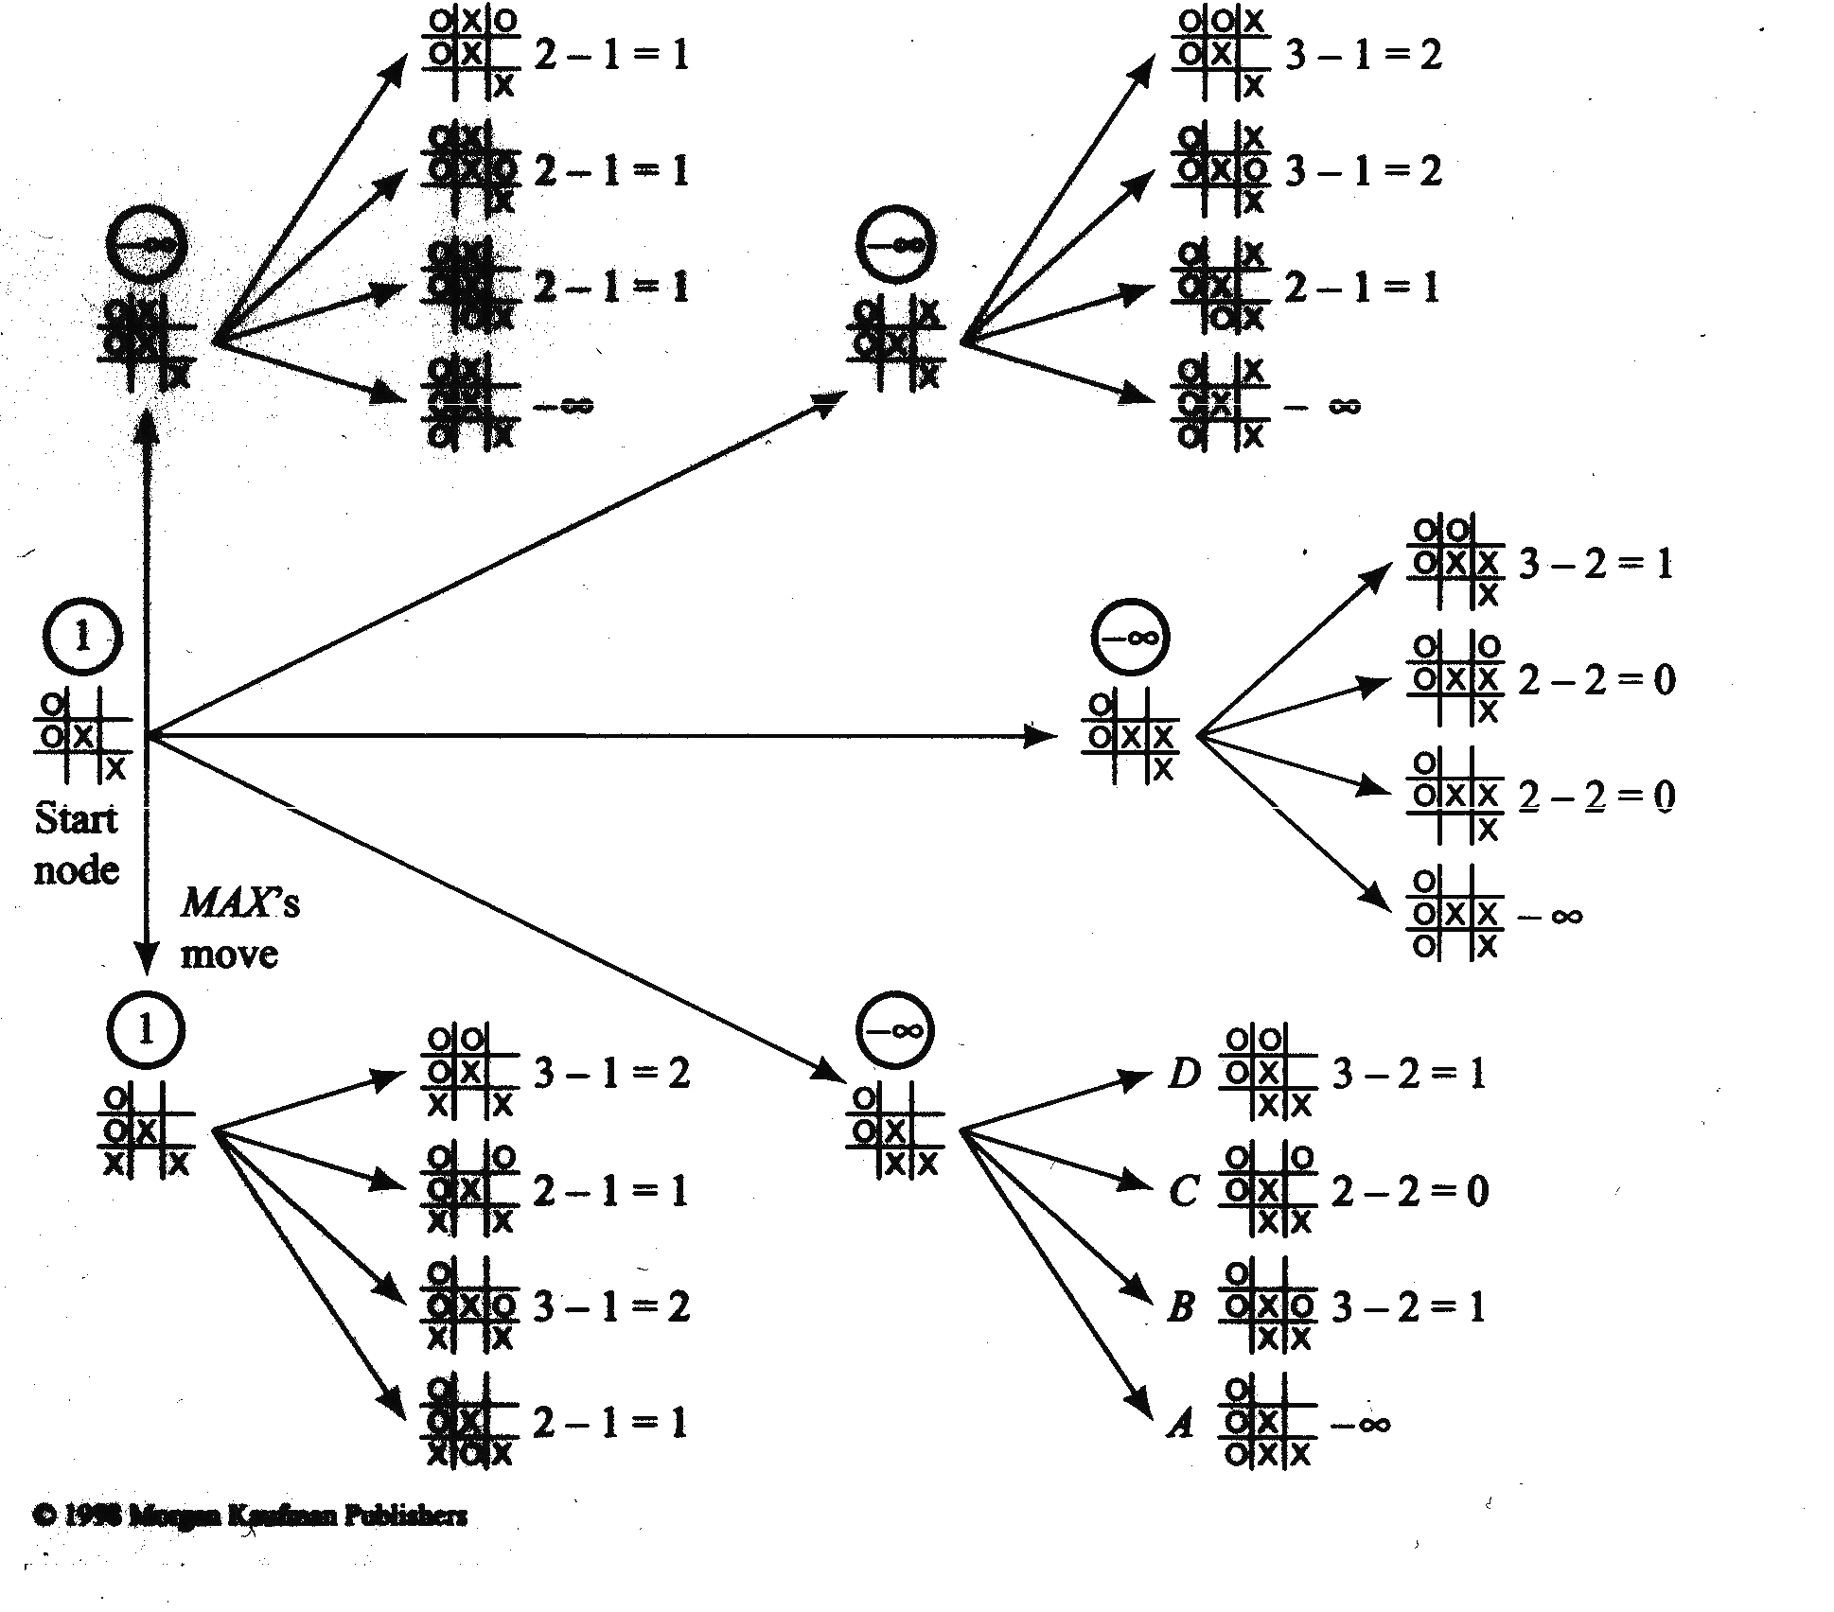
MAX
Player:
3rd
move
Search starts
depth
first
Back up value
immediately
Do not
need to
generate
these
nodes!
Why?
MIN

Slide 23
Alpha-Beta
Definitions
Pruning
•
–
–
α value – lower bound
β value – upper bound
on MAX node
on MIN node
•
Observations
–
–
α value on MAX nodes
never decrease
β values on MIN nodes never increase
•
Application
– Search
v ≤ α :
– Search
is
α
is
discontinued
cutoff
discontinued
β : β cutoff
below any MIN node
with min-value
below any MAX node
with max-
value v ≥

Slide 24
Alpha cutoffs
8
The value at your move is 8 (so far)
If you move right, the value there is 1 (so far)
Your opponent will never increase the value at this node; it will always be less than 8
You can ignore the remaining nodes
Your move
alpha cutoff
8
1
Opponents move
8
9
1
Your move
8
5
2
9
-3
1

Slide 25
Alpha cutoffs (more detail)
parent (has PBV of 8)
node being examined
You have an alpha cutoff when:
You are examining a node at which it is your opponent’s move, and
You have a previously backed up value (PBV) for the node’s parent, and
You have brought up a PBV that is less than the PBV of the node’s parent, and
The node has other children (which we can now “prune”)
8
Your move
alpha cutoff
8
1
Opponents move
8
9
1
Your move
8
5
2
9
-3
1

Slide 26
Beta cutoffs
An alpha cutoff occurs where
It is your opponent’s turn to move
You have computed a PBV for this node’s parent
The node’s parent has a higher PBV than this node
This node has other children you haven’t yet considered
A beta cutoff occurs where
It is your turn to move
You have computed a PBV for this node’s parent
The node’s parent has a lower PBV than this node
This node has other children you haven’t yet considered

Slide 27
The importance of cutoffs
If you can search to the end of the game, you know exactly how to play
The further ahead you can search, the better
If you can prune (ignore) large parts of the tree, you can search deeper on the other parts
Since the number of nodes at each level grows exponentially, the higher you can prune, the better
You can save exponential time

Slide 28
Alpha-Beta
Search
Algorithm
•
Computing α and β
– α value of MAX node = current largest
final
backed-up
value of its
–β value of
successors.
MIN node =
successors.
current
smallest
final
backed-up
value
of
its

Slide 29
Alpha-Beta
Search
Algorithm
Start with AB(n; -∞, +∞)
Alpha-Beta-Search(state) returns an action
v = MAX-VALUE(state,-∞, +∞)
return the action in SUCCESSORS(state) with value v
MAX-VALUE(state, α, β)
if TERMINAL-TEST(state) then
MIN-VALUE(state, α, β)
if TERMINAL-TEST(state) then return UTILITY(state)
v = +∞
for a, s in SUCCESSORS(state) do
v = MIN(v, MAX-VALUE(s, α, β))
if v <= α then return v
β = MIN(β, v)
return v (a utility value)
return
v = -∞
UTILITY(state)
for a, s in SUCCESSORS(state)
do
v = MAX(v, MIN-VALUE(s, α, β))
if v >= β then return v
α = MAX(α, v)
return v (a utility value)

Slide 30
Alpha-Beta Search
Performance
•
•
Uses depth-first search procedure
Search effectiveness depends on node ordering
–
–
Worst case occurs if worst moves generated first
Best case
occurs if best moves generated first:
min
first
Can
value
first for MIN nodes,
and max value
for MAX nodes.
you ensure this?

Slide 31
Heuristic Alpha-Beta Search
The higher in the search tree you can find a cutoff, the better (because of exponential growth)
To maximize the number of cutoffs you can make:
Apply the heuristic function at each node you come to, not just at the lowest level
Explore the “best” moves first
“Best” means best for the player whose move it is at that node

Slide 32
Games
with
chance
•
Example, Games with dice
–
–
–
–
Backgammon:
Can decide your Can’t depend on Game tree must
move
opponent’s; depends
on
dice
include chance
move?
nodes
•
How to pick best
– Cannot apply minimax directly

Slide 33
Games with chance
•
For each possible move, compute an
average or expected value
Must add nodes for the dice rolls!
•
•
•
Utility must be based
on expected
significantly!
value
Increases
complexity

Slide 34
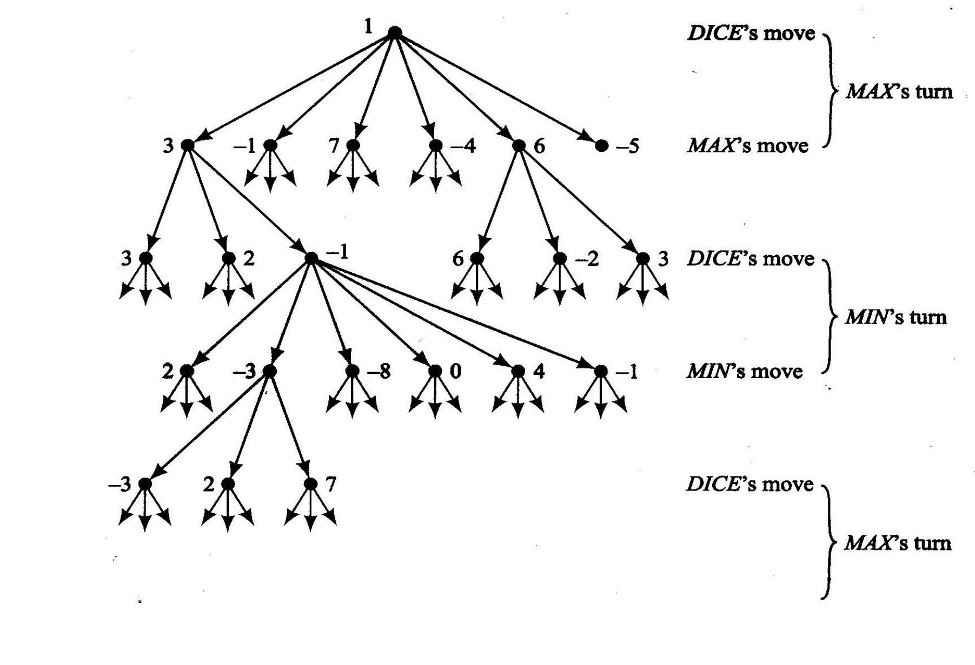
Expectimax
example

Slide 35
Transposition
Tables
•
Transposition Tables (memory)
–
–
Multiple board positions that are identical
Table contains board positions
and
results
of
a
search
from
that
position

Slide 36
Transposition
Tables
•
Issues
–
Path Dependency
•
Some games have scores dependent upon
sequence of moves
the
•
Repetitions will be identically
scored

Slide 37
Memory-Enhanced Test Driver (MTD) Algorithm
•
•
Let Gamma be the first guess of the score
Calculate another guess by calling Alpha-Beta using the
Gamma value as a bound
•
Depending on whether it fails high
guess that is higher or lower (essentially binary search)
or
fails
low,
we
pick
a
•
•
Return guess as the score
Requires an efficient transposition table

Slide 38
Opening
Books
•
Set of moves combined with information
regarding how good the average when using the moves
– Typically at the start of the game
outcome
is
•
Play books – certain games have
where plays can be employed
stages

Slide 39
Deep
Blue
vs.
Kasparov
•
•
Uses an extensive search
Computer
– Can consider more moves
– Extremely brute-force
Human
•
–
–
–
Understands board immediately
Intuition
Experience
•
Video
https://www.youtube.com/watch?v=NJarxpYyoFI

Slide 40
State
of
the
Art: Games
•
Checkers: Big breakthrough in AI: Samuels in 1952 at IBM; played itself
thousands of times and learned its own evaluation functions. Evaluation function was a weighted sum of a set of functions.
Best checkers programs now – as good as human champions
Schaeffer in 2007 proved that best human could do is a draw
•
Othello: human players refuse to play computer games, who can play
perfectly.
•
Go: branching factor of game > 300, so straight search doesn’t work.
Have to use pattern knowledge bases.
Does not match up to human champions
20 × (21 × 20 )³ ≈ 1.2 × 10 ⁹

Slide 41
State
of
the Art
Games
•
Backgammon: 2 dice ≈ 20 legal moves (can be
6000 with 1-1 roll)
–
depth 4 = as depth increases, probability of reaching
nodes decreases, so value of look ahead is diminished. (alpha-beta not a great idea)
–
best backgammon game: uses depth
good evaluation function
plays at world championship level
2
search
+
very
–

Slide 42
Final game video
Showcase your final game
A few slides and one or more demos
Describe technical details clearly
High quality narration
Consider
Background music
3m45s video hard limit (we will cutoff)
try to make it between 3m20s and 3m45s
Deadline May 6th at 11:59PM
Must be WMV format at 1920x1080 resolution (will be enforced in grading)
If cannot convert to WMV in that format, need to send it 24 hours earlier

Slide 43
Final game deliverables
Must submit code
Can also submit additional document at the same time
If you feel video not enough to showcase all your work
Poster for the demo
(We will plan demo date later this week)

