Slide 1

Game AI 2: Pathfinding and Agents
COMP4451 Game Programming

Slide 2
Topics
•
Pathfinding
– Greedy best-first search
– A* search
Game agents
Finite state machines
•
•
•
General
game
AI
techniques

Slide 3
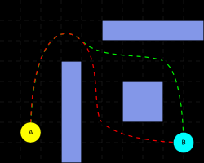
Pathfinding
in
games

Slide 4
Best-first
search
•
Idea: use an evaluation function f(n) for each node
– estimate of "desirability"
Expand most desirable unexpanded node
•
Implementation:
Order the nodes in fringe
in
decreasing
order
of
desirability
•
Special cases:
– greedy best-first search
–
A*
search

Slide 5
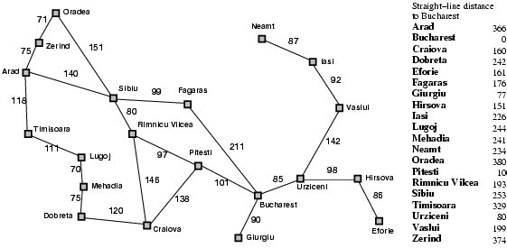
Romania
with
step
costs
in
km

Slide 6
Greedy
best-first
search
•
•
•
Evaluation function f(n) =
= estimate of cost from n
h(n) (heuristic)
to goal
e.g., h_{SLD}(n) = straight-line distance from n
Bucharest
to
•
Greedy best-first
that appears to
search expands the
be closest to goal
node

Slide 7

Greedy
best-first
search
example

Slide 8
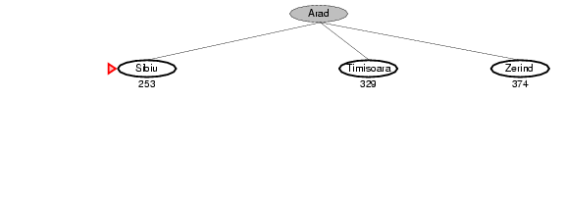
Greedy
best-first
search
example

Slide 9
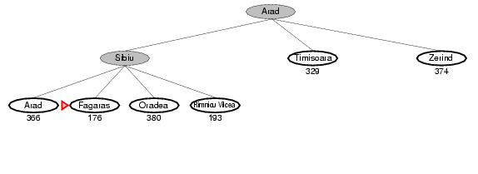
Greedy
best-first
search
example

Slide 10
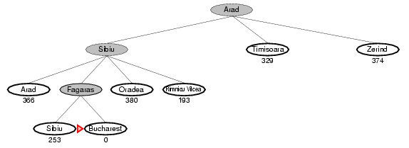
Greedy
best-first
search
example
May not be optimal!

Slide 11
A*
search
•
Idea: avoid expanding paths that are already
expensive
Evaluation function f(n) = g(n) + h(n)
•
•
•
•
g(n)
h(n)
=
=
cost so far to reach n
estimated cost
from n
cost of
to goal
path through
f(n) = estimated total
to goal
n

Slide 12

A*
search
example

Slide 13
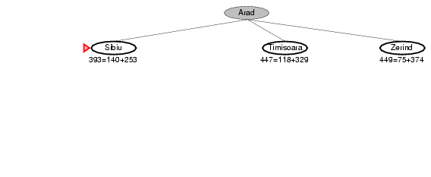
A*
search
example

Slide 14
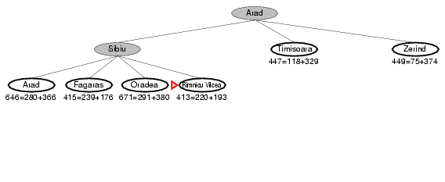
A*
search
example

Slide 15
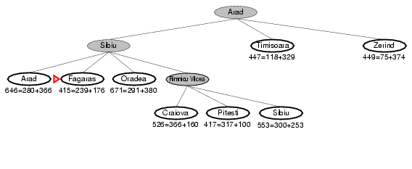
A*
search
example

Slide 16
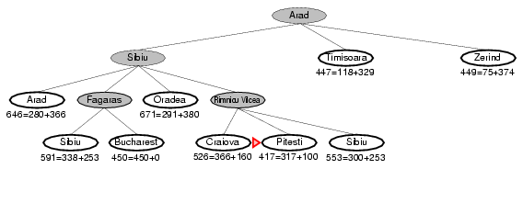
A*
search
example

Slide 17
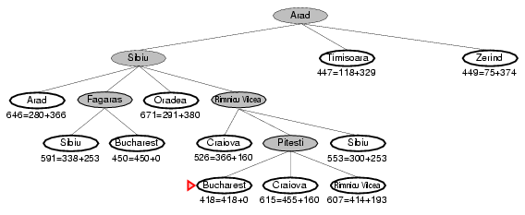
A*
search
example

Slide 18
Admissible
heuristics
•
A heuristic h(n) is admissible if for every node n,
h(n) ≤ h*(n), where h*(n) is the true cost to reach the goal state from n.
An admissible heuristic never overestimates the
•
cost to reach the
Example: h_{SLD}(n)
road distance)
Theorem: If h(n)
goal, i.e., it is optimistic
(never overestimates the actual
•
•
is admissible,
A*
is optimal

Slide 19
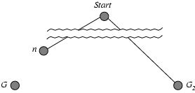
Optimality
of
A*
(proof)
•
Suppose some suboptimal goal G₂ has been generated and is in the fringe.
Let n be an unexpanded node in
the
fringe
such
that n
is
on
a
shortest
path to an optimal
goal G.
•
•
•
•
f(G₂)
g(G₂)
f(G)
f(G₂)
= g(G₂)
> g(G)
= g(G)
> f(G)
since
since since
h(G₂)
= 0
G₂ is suboptimal
h(G) = 0
from above

Slide 20
Optimality
of
A*
(proof)
•
Suppose some suboptimal goal G₂ has been generated and is in the fringe.
Let n be an unexpanded node in the fringe
such
that n
is
on
a
shortest
path to
an
optimal goal
G.
•
•
•
•
f(G₂)
h(n)
g(n)
f(n)
> f(G)
≤ h*(n)
≤ g(n) + h*(n)
≤ f(G)
from above
since h is admissible
+
h(n)
Hence f(G₂) > f(n), and
A*
will never select G₂ for expansion

Slide 21
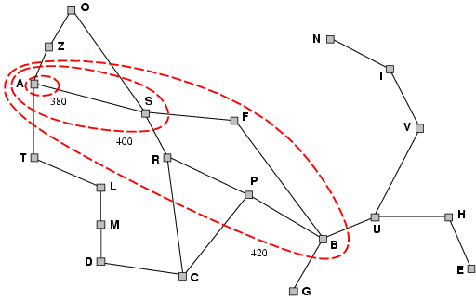
Optimality
expands nodes in order of increasing f
of
value
A*
•
•
•
A*
Gradually adds "f-contours" of nodes
Contour i
has
all
nodes
with f=f_{i},
where
f_{i}
<
f_{i+1}

Slide 22
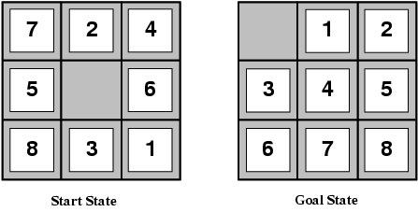
Admissible
heuristics
E.g., for
• h₁(n)
• h₂(n)
the 8-puzzle:
= number of misplaced tiles
= total Manhattan distance
(i.e., no. of squares
from
desired
location
of
each
tile)
•
•
h1(S) = ?
h2(S) = ?

Slide 23
Admissible
heuristics
E.g., for
• h₁(n)
• h₂(n)
the 8-puzzle:
= number of misplaced tiles
= total Manhattan distance
(i.e., no. of squares
from
desired
location
of
each
tile)
•
•
h1(S) = ? 8
h2(S) = ? 3+1+2+2+2+3+3+2 = 18

Slide 24
Dominance
•
•
•
If h₂(n) ≥ h₁(n)
for all n (both admissible)
then h₂ dominates h₁
h₂ is better for search
•
Typical
search costs (average number
of
nodes
expanded):
•
d=12
IDS =
A*(h₁)
A*(h₂)
IDS =
A*(h₁)
A*(h₂)
3,644,035 nodes
= 227 nodes
= 73 nodes
too many nodes
= 39,135 nodes
= 1,641 nodes
•
d=24

Slide 25
Topics
•
Pathfinding
– Greedy best-first search
– A* search
Game agents
Finite state machines
•
•
•
General
game
AI
techniques

Slide 26
Game
Agents
•
Most AI focuses around game agent
– think of agent as enemy, ally or neutral
•
Loops through:
sense-think-act cycle
specific, so talk about sense
–
Acting is event
and think
first,
then a
bit
on
act
Sense
Think
Act

Slide 27
Game
Agents
–
Sensing
(1
of
2)
•
Gather current world state
– barriers, opponents, objects, …
Constrained like a player
– cannot “cheat” by looking at game data
•
•
Vision
–
Can be quite complicated (CPU intensive) to test visibility (e.g., if only part of an object visible)
Compute vector to each object
–
•
•
•
Check
Check
Check
magnitude (ie- is it too far away?)
angle (dot product) (ie- within 120° viewing angle?)
if obscured.
Most expensive, so do last.

Slide 28
Game
Agents
–
Sensing (2
of
2)
•
Hearing
–
Ex- tip-toe past, enemy doesn’t hear, but if run past,
hears
enemy
–
Implement
as event-driven
• When player performs action, notify agents within range
• Can enhance with listen attributes by agent
– E.g., agent is “keen eared” or paying attention
•
Communication
– Model sensing data from other
agents (shouting)
•
Reaction times
– Sensing may take some time
• E.g., Start of a race
– Build in delay. Implement with
simple timer.

Slide 29
Game
Agents
–
Thinking
(1
of
3)
•
•
•
Evaluate information and make decision
As simple or elaborate as required
Generally, two ways:
1.
Pre-coded expert knowledge
•
“if-then” rules and “randomness”
2.
Search algorithm for best (optimal)
solution
•
E.g., MinMax (AB), A*

Slide 30
Game
Agents
– Thinking (2
of
3)
•
Pre-coded Expert Knowledge
–
Finite State Machines (very intuitive)
• Ex: See enemy weaker than you? Attack.
See enemy stronger? Go get help
May not scale well
• Too many cases
Often quite adequate for many AI tasks
• Many agents have quite narrow domain, so doesn’t matter
–
–

Slide 31
Game Agents
– Thinking (3
of
3)
•
Search
– Look ahead and see what move to do next
• Ex: piece on game board (MinMax), pathfinding
– Works well with known information
• E.g., can see obstacles, pieces on board
Machine learning
– Evaluate past actions, use for future action
– Slow, not as widely used
(A*)
•

Slide 32
Game
Agents
–
Acting
(1
of
2)
•
Learning and Remembering
–
–
May not be important if life is short
But if alive for 30+ seconds, can be helpful
• E.g., player attacks from right, so shield
Implementation
right
–
•
Can have a limited memory time
– Only remembers last n events
span

Slide 33
Game
Agents –
Acting
(2
of
2)
•
Making agents stupid
– Many cases,
• Ex: In FPS,
– Dumb down
easy to make agents dominate
always go for head-shot
by giving “human” conditions,
•
•
•
longer reaction times
unnecessarily vulnerable make mistakes
•
Agent cheating
–
–
–
Ideally, don’t have unfair advantage
But sometimes might “cheat” to make a challenge
Best to let player know

Slide 34
Topics
•
Pathfinding
– Greedy Best-first search
– A* search
Game agents
Finite state machines
•
•
•
General
game
AI
techniques

Slide 35
Finite
State
Machines
•
Many different rules for agents
– Ex: sensing, thinking and acting when fighting, running,
exploring…
– Can be difficult to keep rules consistent!
Try Finite State Machine
•
–
–
–
–
Probably most common game AI software pattern
Natural correspondence between states and behaviors
Easy: to diagram, program, debug
General to any problem
•
For each situation, choose appropriate state
– Number of rules for each state is small

Slide 36
Finite
State
Machines
See Enemy
Wander
Attack
No Enemy
No Enemy
Low Health
Flee
•
We have:
–
–
–
Set of states
A starting state
A transition function

Slide 37
Finite State Machines
Soccer game
Goalkeeper Behavior
–
Example
(1
of
2)
•
•
Wandering
–
Spend all of eternity wandering
near goal
–
–
When ball is
When ball is
close, positioning
coming, jump
states
Close by
Far away
•
Make separate
Position
–
Define behavior in each state
•
•
•
Define
Wander – move slowly, randomly
Position – move faster, in lines
Jump – go to ball
transitions
Coming
Going away
•
–
–
Close is 30 meters
Ball coming is based
Jump
on velocity

Slide 38
Finite State Machines
–
Example
(2
of
2)
•
Scalable
Wandering
•
Can easily add a state
the diagram on right:
to
Close by
Far away
Position
–
Scared jump ☺
•
Less
likely
to
get
to
ball
Coming
Going away
Jump

Slide 39
Finite-State
Machine:
Approaches
•
Three approaches
–
–
–
–
Hardcoded (e.g.,
Event driven
Scripted
switch
statement)
Hybrid
Approach

Slide 40
Finite-State
switch
Code is ad hoc
Inefficient
Machine:
FSM
1.
2.
•
•
Not
Has
event driven
to test all cases
3.
Harder
for
designers
to
edit
or
specify

Slide 41
Finite
State
Machine:
Event driven
•
•
Use objects
Transitions are events
– Objects create events
– E.g., player runs and all objects within range get “run sound” event
Each object can have step event
hearing
•
– Gets mapped to right action in state
by call back

Slide 42
Finite-State
Machine:
Scripted with Alternative Language
AgentFSM {
State( STATE_Wander ) OnUpdate
Execute( Wander )
if( SeeEnemy )
SetState(
STATE_Attack
)
OnEvent( AttackedByEnemy ) SetState( Attack )
State( STATE_Attack ) OnEnter
Execute( PrepareWeapon ) OnUpdate
Execute( Attack if( LowOnHealth if( NoEnemy )
OnExit
)
) SetState( SetState(
STATE_Flee ) STATE_Wander
)
Execute( StoreWeapon ) State( STATE_Flee )
OnUpdate
Execute( Flee )
if( NoEnemy )
SetState(
STATE_Wander
)
}

Slide 43
Finite-State Machine:
Scripting Advantages
Structure enforced
Events can be handed as well as polling
OnEnter and OnExit concept exists
– When created or destroyed
1.
2.
3.
4.
Can be
– Easier
authored by
learning curve
game designers/artists
than straight C/C++

Slide 44
Finite-State Machine:
Scripting Disadvantages
Not trivial to implement
•
•
Several months of development of
language
–
Custom compiler
•
With
good
compile-time
error
feedback

Slide 45
Finite-State Machine:
Hybrid Approach
•
Use
– A base class
– C-style macros to approximate a scripting
Allows FSM to be written completely in leveraging existing compiler/debugger Capture important features/extensions
language
C++
•
•
–
–
–
–
OnEnter, OnExit
Timers
Handle events
Multiple FSMs, Concurrent FSMs
•
Can’t be edited by designers or players

Slide 46
Topics
•
Pathfinding
– Greedy best-first search
– A* search
Game agents
Finite state machines
•
•
•
General
game
AI
techniques

Slide 47
Game
Movement
– Flocking
AI Techniques
(1
of
3)
•
•
•
Move groups of creatures in natural manner
Each creature follows three simple rules
–
–
–
Separation – steer to avoid crowding flock mates
Alignment – steer to average flock heading
Cohesion – steer to average position
•
Example – use for background creatures such as
Modification can use for swarming enemy
birds
or
fish.
– Formations
• Like flocking, but units keep position relative to others
• Example – military formation (archers in the back)

Slide 48
Game
AI
Techniques
(2
of
3)
•
Movement (continued)
– A* pathfinding
• (covered)
– Obstacle avoidance
Behavior organization
•
– Emergent behavior
• Create simple rules result in complex interactions
– game of life (https://www.youtube.com/watch?v=C2vgICfQawE)
– flocking
– Command hierarchy
•
•
Deal with AI decisions at different levels
Modeled after military hierarchy (e.g., General does strategy,
Soldier does fighting)
Example: Real-time or turn based strategy games -- overall strategy, squad tactics, individual fighters
•

Slide 49
Game AI
• Level of Detail AI
Techniques
(3
of
3)
–
–
–
In graphics, polygonal detail less if object far away
Same idea in AI – computation less if won’t be seen
Example – vary update frequency of NPC based on position player
from
• Bayesian network
–
–
A probabilistic model with variables and probable influences
E.g., AI can infer if player has warplanes, etc. based on what it sees in production so far
Can be good to give “human-like” intelligence without cheating or being too dumb
–

Slide 50
Summary
•
Pathfinding
– Greedy best-first search
– A* search
Game agents
Finite state machines
•
•
•
General
game
AI
techniques

Slide 51
Additional
•
Search methods:
–
–
–
–
–
Local search algorithms
Hill-climbing search
Simulated annealing
Local beam search
Genetic algorithms
search
•
Flocking

Slide 52
Local
search
algorithms
•
In many optimization problems, the path to the
is irrelevant; the goal state itself is the solution
goal
•
•
State space = set of "complete" configurations
Find configuration satisfying constraints, e.g., n-
queens
•
•
In such cases, we can use local search algorithms
keep a single "current" state, try to improve it

Slide 53

Example: n-queens
•
Put n queens on an n × n
board with
no
two
queens on
diagonal
the
same
row,
column,
or

Slide 54
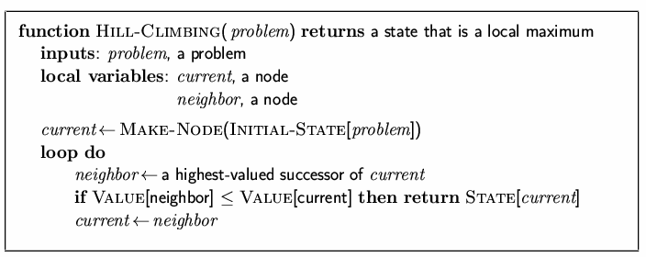
Hill-climbing
search
•
"Like climbing
amnesia"
Everest
in
thick
fog
with

Slide 55
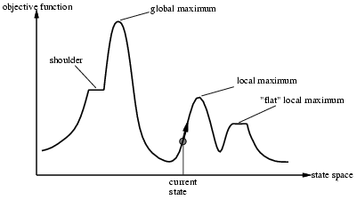
Hill-climbing
search
•
Problem: depending on
initial
state,
can
get
stuck
in
local
maxima

Slide 56
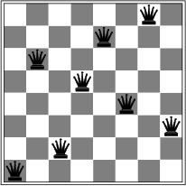
Hill-climbing
search:
8-queens
problem
•
A local minimum with h
= 1

Slide 57
Simulated
annealing
search
•
Idea: escape local maxima by allowing some "bad"
moves but gradually decrease their frequency
•
One can prove: If T decreases slowly enough,
simulated annealing search will find a global
then
optimum with probability approaching
1
•
Widely used in airline scheduling

Slide 58
Local
beam
search
•
Keep track of k states rather than just one
•
Start with k randomly generated states
•
At each iteration, all the successors of all k
generated
states are
•
If any one is a goal state, stop; else select
the k best
successors from the complete list and repeat.

Slide 59
Genetic
algorithms
•
•
•
Like simulated annealing, contains a lot of randomness
Much more random than other methods
Only resort to it, if hard to define the problem otherwise
•
A successor state is generated by combining two parent
states
Start with k randomly generated states (population)
A state is represented as a string over a finite alphabet (often
a string of 0s and 1s)
Evaluation function (fitness function). Higher values for
better states.
Produce the next generation of states by selection, crossover,
and mutation
•
•
•
•

Slide 60
Genetic
Selection:
algorithms
•
– Pick a subset of states to generate offspring
Crossover:
– Combine parts of parents to form new states
Mutation:
– Randomly modify state
(ensures they don’t all go to a bad local minimum)
•
•

Slide 61
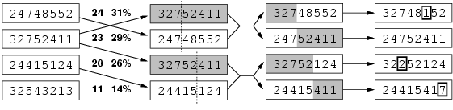
Genetic
algorithms
•
Fitness function: number of non-attacking
(min = 0, max = 8 × 7/2 = 28)
24/(24+23+20+11) = 31%
23/(24+23+20+11) = 29% etc
pairs
of
queens
•
•

Slide 62
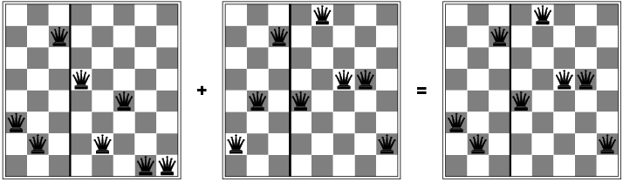
Genetic
algorithms

Slide 63
Simple
flocking
The steering behaviors
–
Separation
• steer to move away from nearby flockmates
Alignment
• steer toward average heading of nearby flockmates
to match average velocity of nearby flockmates)
Cohesion
–
(accelerate
–
• steer towards average position of nearby flockmates
(Can consider adding obstacle avoidance, migration patterns, etc…)

Slide 64
Separation

Slide 65
Alignment

Slide 66
Agregation

Slide 67
Flocking
demo
•
http://edkelleyv.com/Flocking/

