Slide 1
Ensemble Learning: An Introduction
Adapted from Slides by Tan, Steinbach, Kumar, Slides by Che Wanxiang (HIT) and Navneet Goyal

Slide 2
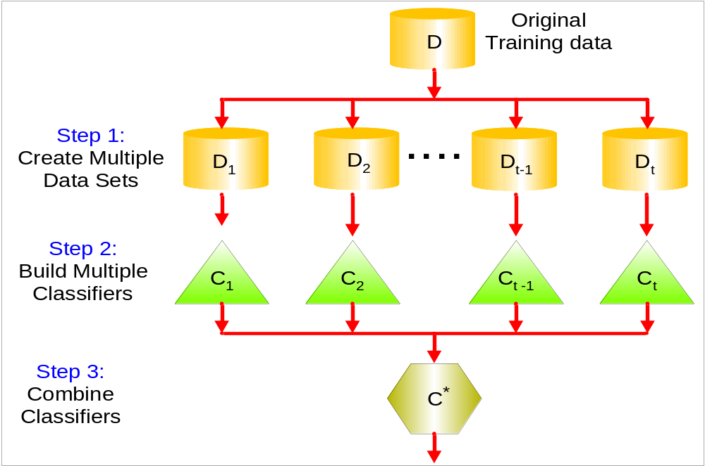
General Idea

Slide 3
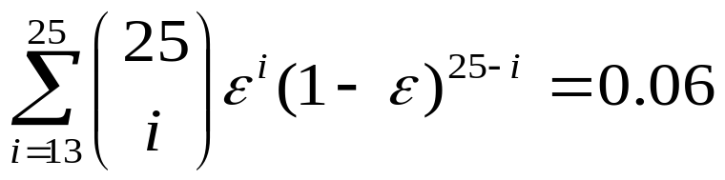
Why does it work?
Suppose there are 25 base classifiers
  Each classifier has error rate, ε = 0.35
  Assume classifiers are independent
  Probability that the ensemble classifier makes a wrong prediction:

Slide 4
Examples of Ensemble Methods
How to generate an ensemble of classifiers?
  Bagging
  Boosting

Slide 5
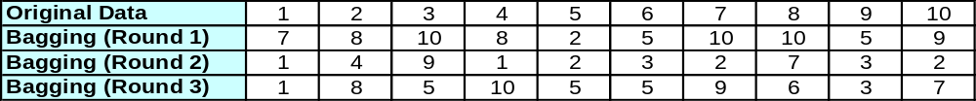
Bagging
Sampling with replacement
Build classifier on each bootstrap sample
Each sample has probability (1 – 1/n)^{n} of being selected as test data
Training data = 1- (1 – 1/n)^{n} of the original data
Training Data
Data ID

Slide 6
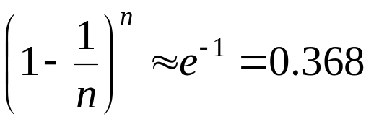
The 0.632 bootstrap
This method is also called the 0.632 bootstrap
  A particular training data has a probability of 1-1/n of not being picked
  Thus its probability of ending up in the test data (not selected) is:
  This means the training data will contain approximately 63.2% of the instances

Slide 7
Example of Bagging
Assume that the training data is:
+1
0.4 to 0.7:
-1
+1
0.3
0.8
x
Goal: find a collection of 10 simple thresholding classifiers that
collectively can classify correctly.
Each simple (or weak) classifier is:
  (x<=K → class = +1 or -1 depending on
  which value yields the lowest error; where K
  is determined by entropy minimization)

Slide 8
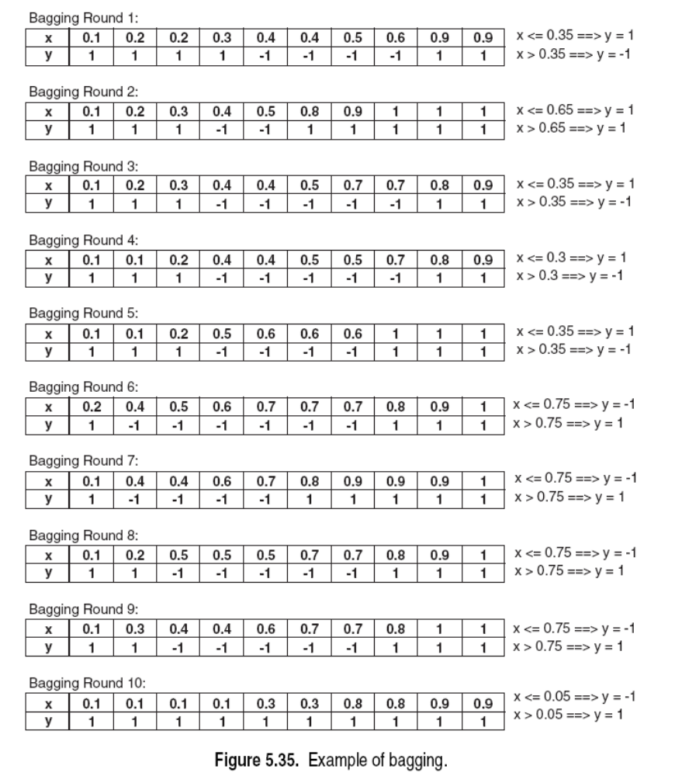

Slide 9
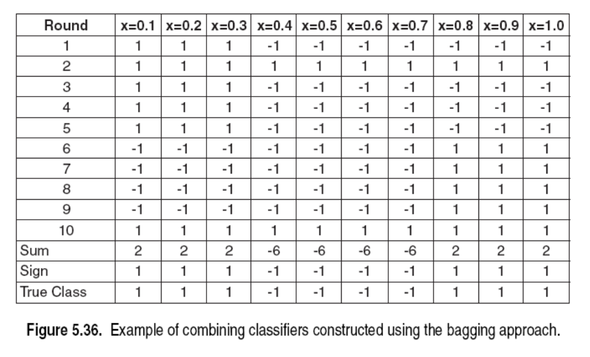
Bagging (applied to training data)
Accuracy of ensemble classifier: 100% ☺

Slide 10
Bagging- Summary
Works well if the base classifiers are unstable (complement each other)
Increased accuracy because it reduces the variance of the individual classifier
Does not focus on any particular instance of the training data
  Therefore, less susceptible to model over-fitting when applied to noisy data
What if we want to focus on a particular instances of training data?

Slide 11
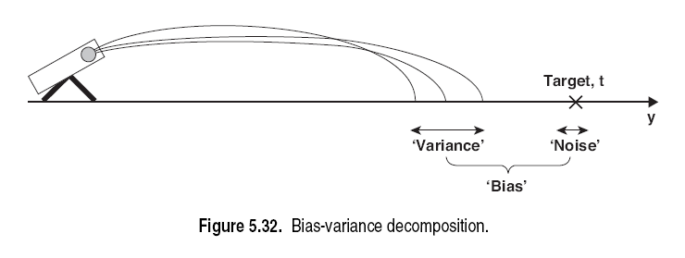

Slide 12
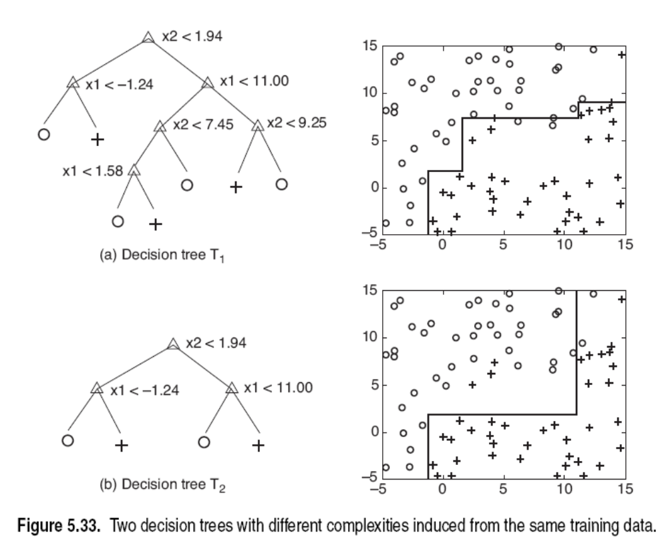

Slide 13
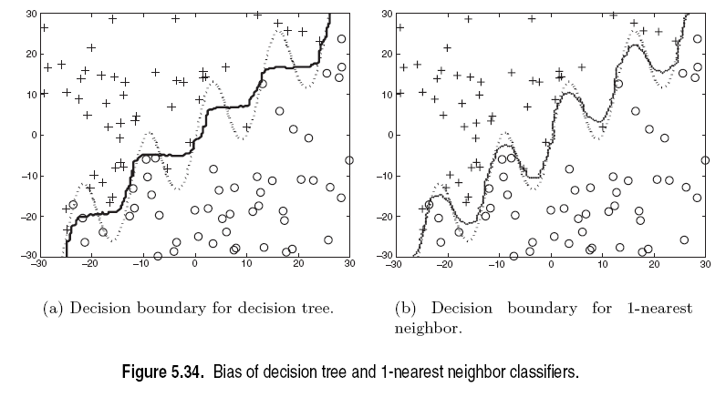

Slide 14
Boosting
An iterative procedure to adaptively change distribution of training data by focusing more on previously misclassified records
  Initially, all N records are assigned equal weights
  Unlike bagging, weights may change at the end of a boosting round

Slide 15
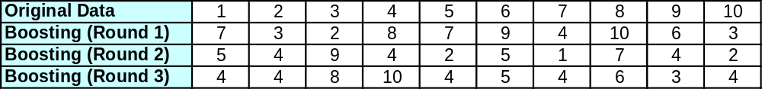
Boosting
Records that are wrongly classified will have their weights increased
Records that are classified correctly will have their weights decreased
Example 4 is hard to classify
Its weight is increased, therefore it is more likely to be chosen again in subsequent rounds

Slide 16
Boosting
Equal weights are assigned to each training instance (1/N for round 1) at first
After a classifier C_{i} is learned, the weights are adjusted to allow the subsequent classifier C_{i+1} to “pay more attention” to data that were misclassified by C_{i}.
Final boosted classifier C* combines the votes of each individual classifier
  Weight of each classifier’s vote is a function of its accuracy
Adaboost – popular boosting algorithm

Slide 17
Adaboost (Adaptive Boost)
Input:
  Training set D containing N instances
  T rounds
  A classification learning scheme
Output:
  A composite model

Slide 18
Adaboost: Training Phase
Training data D contain d labeled data (X₁,y₁), (X₂,y₂ ), (X₃,y₃),….(X_{N},y_{N})
Initially assign equal weight 1/N to each data
To generate T base classifiers, we need T rounds or iterations
Round i, data from D are sampled with replacement , to form Di (size N)
Each data’s chance of being selected in the next rounds depends on its weight
  Each time the new sample is generated directly from the training data D with different sampling probability according to the weights; these weights are not zero

Slide 19
Adaboost: Training Phase
Base classifier C_{i}, is derived from training data of Di
Error of C_{i} is tested using Di
Weights of training data are adjusted depending on how they were classified
  Correctly classified: Decrease weight
  Incorrectly classified: Increase weight
Weight of a data indicates how hard it is to classify it (directly proportional)

Slide 20
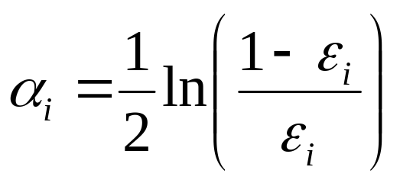
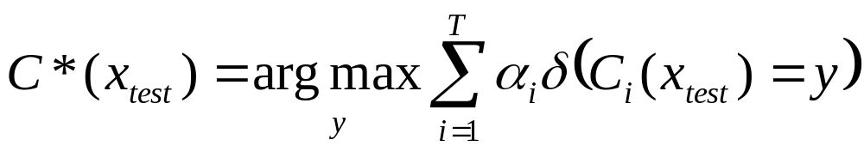
Adaboost: Testing Phase
The lower a classifier error rate, the more accurate it is, and therefore, the higher its weight for voting should be
Weight of a classifier C_{i}’s vote is
Testing:
  For each class c, sum the weights of each classifier that assigned class c to X (unseen data)
  The class with the highest sum is the WINNER!

Slide 21
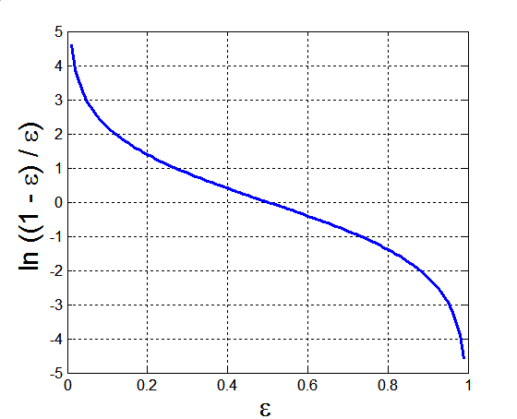
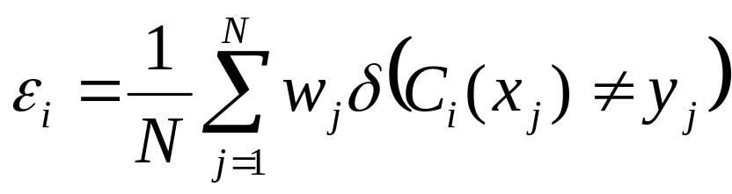
Example: AdaBoost
Base classifiers: C₁, C₂, …, C_{T}
Error rate: (i = index of classifier, j=index of instance)
Importance of a classifier:
We only consider the
left half (error< 0.5)

Slide 22
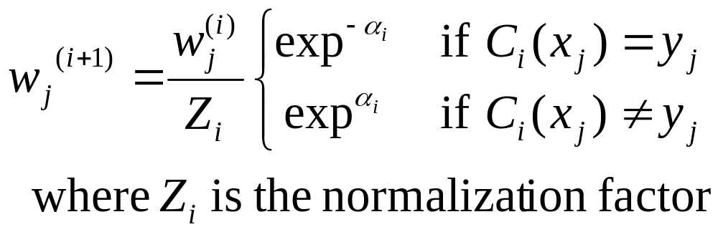
Example: AdaBoost
Assume: N training data in D, T rounds, (x_{j},y_{j}) are the training data, C_{i}, a_{i} are the classifier and weight of the i^{th} round, respectively.
Weight update on all training data in D:

Slide 23
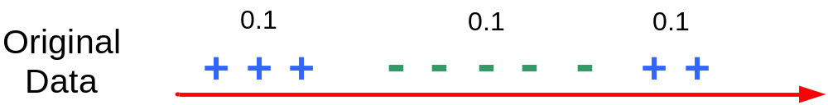
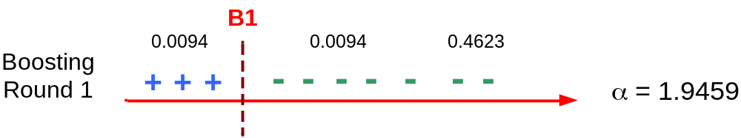
Illustrating AdaBoost
Initial weights for each data point
Data points for training

Slide 24
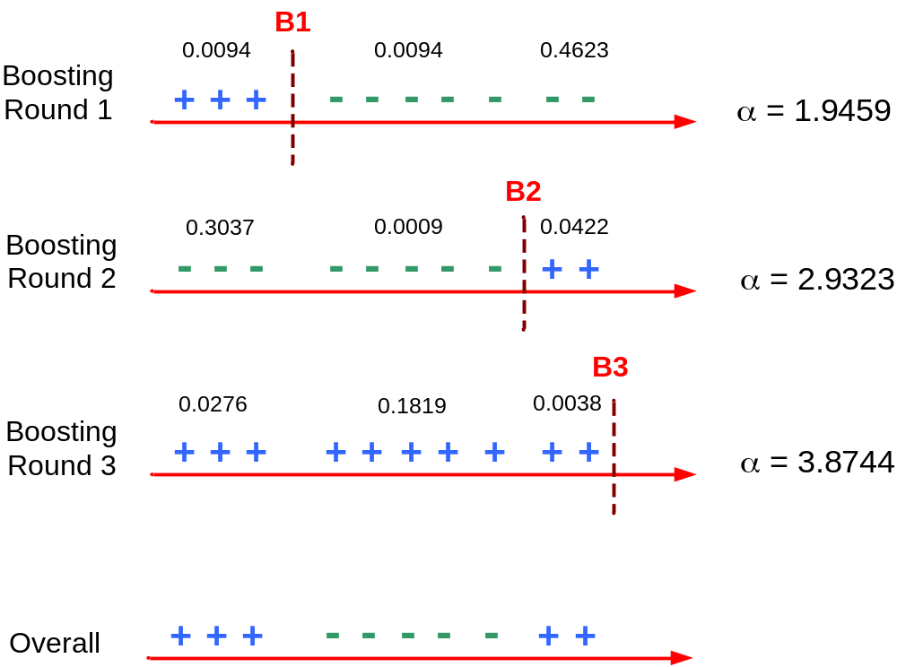
Illustrating AdaBoost

Slide 25
Random Forests
Ensemble method specifically designed for decision tree classifiers
Random Forests grows many trees
  Ensemble of unpruned decision trees
  Each base classifier classifies a “new” vector of attributes from the original data
  Final result on classifying a new instance: voting. Forest chooses the classification result having the most votes (over all the trees in the forest)

Slide 26
Random Forests
Introduce two sources of randomness: “Bagging” and “Random input vectors”
  Bagging method: each tree is grown using a bootstrap sample of training data
  Random vector method: At each node, best split is chosen from a random sample of m attributes instead of all attributes (m is F as the chosen number of attributes in the textbook)

Slide 27
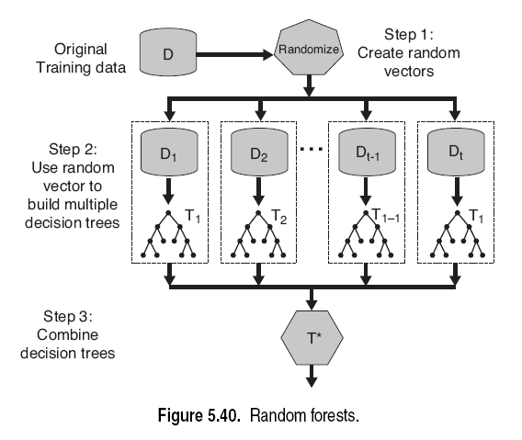
Random Forests

Slide 28
Methods for Growing the Trees
Fix a m <= M. At each node
  Method 1:
    Choose m attributes randomly, compute their information gains, and choose the attribute with the largest gain to split
  Method 2:
    (When M is not very large): select L of the attributes randomly. Compute a linear combination of the L attributes using weights generated from [-1,+1] randomly. That is, new A = Sum(Wi*Ai), i=1..L.
  Method 3:
    Compute the information gain of all M attributes. Select the top m attributes by information gain. Randomly select one of the m attributes as the splitting node.

Slide 29
Random Forest Algorithm: method 1 in previous slide
M input features in training data, a number m<<M is specified such that at each node, m features are selected at random out of the M and the best split on these m features is used to split the node. (In weather data, M=4, and m is between 1 and 4)
  m is F in the textbook
m is held constant during the forest growing
Each tree is grown to the largest extent possible (deep tree, overfit easily), and there is no pruning

Slide 30
Generalization Error of Random Forests (page 291 of Tan book)
Generalization Error <= ρ(1-s²)/s²,
  ρ is the average correlation among the trees
  s is the strength of the tree classifiers
    Strength is defined as how certain the classification results are on the training data on average
    How certain is measured Pr(C1|X)-Pr(C2-X), where C1, C2 are class values of two highest probability in decreasing order for input instance X.
Thus, higher diversity and accuracy is good for performance

