Slide 1
Data Mining Classification: Basic Concepts, Decision Trees, and Model Evaluation
Lecture Notes for Chapter 4
Part II
Introduction to Data Mining
by
Tan, Steinbach, Kumar
Adapted by Qiang Yang (2010)
© Tan,Steinbach, Kumar Introduction to Data Mining 4/18/2004 1

Slide 2
Continuous Attribute: Binary Split for Temperature?

Slide 3
Finding the best split
Sort the Temperature attribute
For each possible binary split, calculate the information gain
That is, calculate the entropy: –p(P)*logp(P) – p(N)*logp(N)
Select the smallest one
Let the value be L. Two branches: Temperature<L, and Temperature >=L.

Slide 4
Measures of Node Impurity
Gini Index
Entropy (already covered)
Misclassification error

Slide 5
How to Find the Best Split: let M be the measure
Before Splitting:
M0
A?
B?
Yes
No
Yes
No
Node N1
Node N2
Node N3
Node N4
M1
M2
M3
M4
M12
M34
Gain = M0 – M12 vs M0 – M34

Slide 6
Measure of Impurity: GINI
Gini Index for a given node t :
(NOTE: p( j | t) is the relative frequency of class j at node t).
Maximum (1 - 1/n_{c}) when records are equally distributed among all classes, implying least interesting information
Minimum (0.0) when all records belong to one class, implying most interesting information

Slide 7
Examples for computing GINI
P(C1) = 0/6 = 0 P(C2) = 6/6 = 1
Gini = 1 – P(C1)² – P(C2)² = 1 – 0 – 1 = 0
P(C1) = 1/6 P(C2) = 5/6
Gini = 1 – (1/6)² – (5/6)² = 0.278
P(C1) = 2/6 P(C2) = 4/6
Gini = 1 – (2/6)² – (4/6)² = 0.444

Slide 8
Splitting Based on GINI
Used in CART, SLIQ, SPRINT.
When a node p is split into k partitions (children), the quality of split is computed as,
where, n_{i} = number of records at child i,
n = number of records at node p.

Slide 9
Binary Attributes: Computing GINI Index
Splits into two partitions
Effect of Weighing partitions:
Larger and Purer Partitions are sought for.
B?
Yes
No
Node N1
Node N2
Gini(N1) = 1 – (5/7)² – (2/7)² = 0.194
Gini(N2) = 1 – (1/5)² – (4/5)² = 0.528
Gini(Children) = 7/12 * 0.194 + 5/12 * 0.528 = 0.333

Slide 10
Multi-way Splits: Computing Gini Index
For each distinct value, gather counts for each class in the dataset
Use the count matrix to make decisions
Multi-way split
Two-way split
(find best partition of values)

Slide 11
Continuous Attributes: Computing Gini Index
Use Binary Decisions based on one value
Several Choices for the splitting value
Number of possible splitting values = Number of distinct values
Each splitting value has a count matrix associated with it
Class counts in each of the partitions, A < v and A ≥ v
Simple method to choose best v
For each v, scan the database to gather count matrix and compute its Gini index
Computationally Inefficient! Repetition of work.

Slide 12
Continuous Attributes: Computing Gini Index...
For efficient computation: for each attribute,
Sort the attribute on values
Linearly scan these values, each time updating the count matrix and computing gini index
Choose the split position that has the least gini index
Sorted Values
Split Positions

Slide 13
Training Set: Build a Decision Tree 1

Slide 14
Classification Error
Classification error at a node t :
Measures misclassification error made by a node.
Maximum (1 - 1/n_{c}) when records are equally distributed among all classes, implying least interesting information
Minimum (0.0) when all records belong to one class, implying most interesting information

Slide 15
Examples for Computing Error
P(C1) = 0/6 = 0 P(C2) = 6/6 = 1
Error = 1 – max (0, 1) = 1 – 1 = 0
P(C1) = 1/6 P(C2) = 5/6
Error = 1 – max (1/6, 5/6) = 1 – 5/6 = 1/6
P(C1) = 2/6 P(C2) = 4/6
Error = 1 – max (2/6, 4/6) = 1 – 4/6 = 1/3

Slide 16
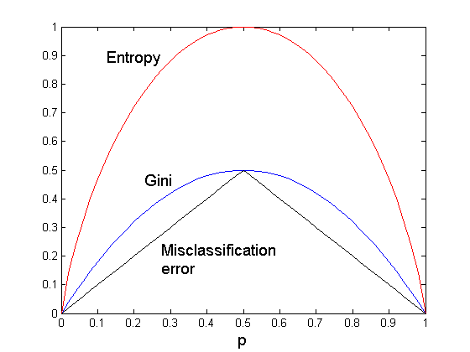
Comparison among Splitting Criteria
For a 2-class problem:

Slide 17
Tree Induction
Greedy strategy.
Split the records based on an attribute test that optimizes certain criterion.
Issues
Determine how to split the records
How to specify the attribute test condition?
How to determine the best split?
Determine when to stop splitting

Slide 18
Stopping Criteria for Tree Induction
Stop expanding a node when all the records belong to the same class
Stop expanding a node when all the records have similar attribute values
Early termination (to be discussed later)

Slide 19
Decision Tree Based Classification
Advantages:
Inexpensive to construct
Extremely fast at classifying unknown records
Easy to interpret for small-sized trees
Accuracy is comparable to other classification techniques for many simple data sets

Slide 20
Example: C4.5
Simple depth-first construction.
Uses Information Gain
Sorts Continuous Attributes at each node.
Needs entire data to fit in memory.
Unsuitable for Large Datasets.
Needs out-of-core sorting.
You can download the software from: http://www.cse.unsw.edu.au/~quinlan/c4.5r8.tar.gz

