Slide 1
Data Mining Classification: Basic Concepts, Decision Trees, and Model Evaluation
Lecture Notes for Chapter 4
Part III
Introduction to Data Mining
by
Tan, Steinbach, Kumar
Adapted by Qiang Yang (2010)
© Tan,Steinbach, Kumar Introduction to Data Mining 4/18/2004 1

Slide 2
Practical Issues of Classification
Underfitting and Overfitting
Missing Values
Costs of Classification

Slide 3
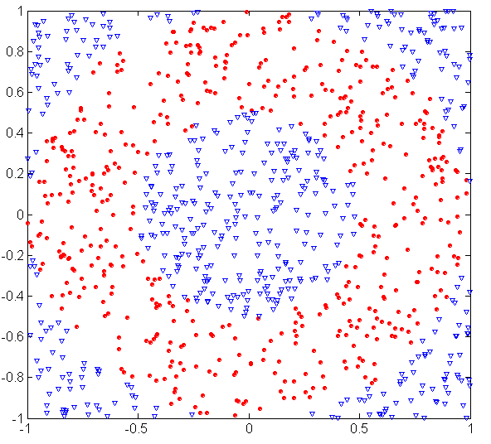
Underfitting and Overfitting (Example)
500 circular and 500 triangular data points.
Circular points:
0.5 ≤ sqrt(x₁²+x₂²) ≤ 1
Triangular points:
sqrt(x₁²+x₂²) > 0.5 or
sqrt(x₁²+x₂²) < 1

Slide 4
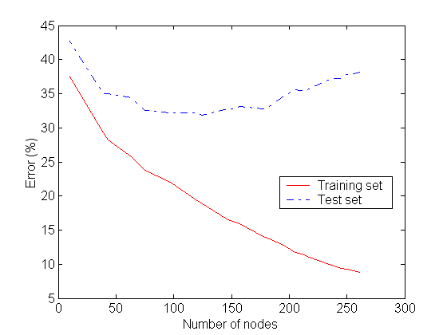
Underfitting and Overfitting
Overfitting
Underfitting: when model is too simple, both training and test errors are large

Slide 5
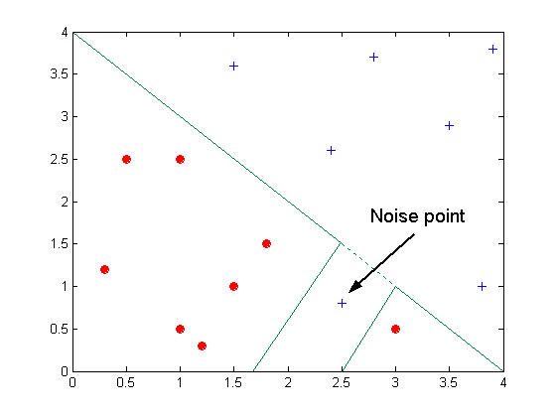
Overfitting due to Noise
Decision boundary is distorted by noise point

Slide 6
Notes on Overfitting
Overfitting results in decision trees that are more complex than necessary
Training error no longer provides a good estimate of how well the tree will perform on previously unseen records
Need new ways for estimating errors

Slide 7
Estimating Generalization Errors
Re-substitution errors: error on training (Σ e(t) )
Generalization errors: error on testing (Σ e’(t))
Methods for estimating generalization errors:
Optimistic approach: e’(t) = e(t)
Pessimistic approach:
For each leaf node: e’(t) = (e(t)+0.5)
Total error counts: e’(T) = e(T) + N × 0.5 (N: number of leaf nodes)
For a tree with 30 leaf nodes and 10 errors on training (out of 1000 instances): Training error = 10/1000 = 1%
Generalization error = (10 + 30×0.5)/1000 = 2.5%
Reduced error pruning (REP):
uses validation data set to estimate generalization error

Slide 8
Occam’s Razor
Given two models of similar generalization errors, one should prefer the simpler model over the more complex model
For complex models, there is a greater chance that it was fitted accidentally by errors in data
Therefore, one should include model complexity when evaluating a model

Slide 9
Minimum Description Length (MDL)
Cost(Model,Data) = Cost(Data|Model) + Cost(Model)
Cost is the number of bits needed for encoding.
We should search for the least costly model.
Cost(Data|Model) encodes the errors on training data.
Cost(Model) estimates model complexity, or future error…

Slide 10
How to Address Overfitting in Decision Trees
Pre-Pruning (Early Stopping Rule)
Stop the algorithm before it becomes a fully-grown tree
Typical stopping conditions for a node:
Stop if all instances belong to the same class
Stop if all the attribute values are the same
More restrictive conditions:
Stop if number of instances is less than some user-specified threshold
Stop if class distribution of instances are independent of the available features (e.g., using χ ² test)
Stop if expanding the current node does not improve impurity measures (e.g., Gini or information gain).

Slide 11
How to Address Overfitting…
Post-pruning
Grow decision tree to its entirety
Trim the nodes of the decision tree in a bottom-up fashion
If generalization error improves after trimming, replace sub-tree by a leaf node.
Heuristic: Class label of leaf node is determined from majority class of instances in the sub-tree
generalization error count = error count + 0.5*N, where N is the number of leaf nodes,
This is a heuristic used in some algorithms, but there are other ways using statistics

Slide 12
Post-Pruning based on |leaves|
Training Error (Before splitting) = 10/30
Pessimistic error (Before splitting) = (10 + 1X 0.5)/30 = 10.5/30
Training Error (After splitting) = 9/30
Pessimistic error (After splitting)
= (9 + 4 × 0.5)/30 = 11/30
Post-pruning decision: PRUNE!
Class = Yes | 20
Class = No | 10
Error = 10/30
Class = Yes | 8
Class = No | 4
Class = Yes | 3
Class = No | 4
Class = Yes | 4
Class = No | 1
Class = Yes | 5
Class = No | 1

Slide 13
Examples of Post-pruning
Optimistic error?
Pessimistic error?
Case 1:
Don’t prune for both cases
C0: 11
C1: 3
C0: 2
C1: 4
Don’t prune case 1, prune case 2
Case 2:
C0: 14
C1: 3
C0: 2
C1: 2

Slide 14
Data Fragmentation
Number of instances gets smaller as you traverse down the tree
Number of instances at the leaf nodes could be too small to make any statistically significant decision
Solution: limit number of instances per leaf node >= a user given value n.

Slide 15
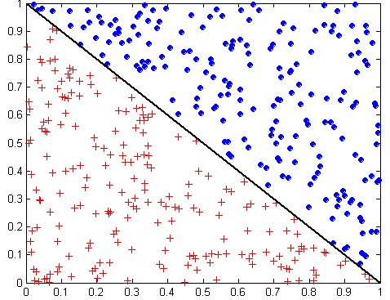
Decision Trees: Feature Construction
x + y < 1
Class = +
Class =
Test condition may involve multiple attributes, but hard to automate!
Finding better node test features is a difficult research issue

Slide 16
Model Evaluation
Metrics for Performance Evaluation
How to evaluate the performance of a model?
Methods for Performance Evaluation
How to obtain reliable estimates?
Methods for Model Comparison
How to compare the relative performance among competing models?

Slide 17
Model Evaluation
Metrics for Performance Evaluation
How to evaluate the performance of a model?
Methods for Performance Evaluation
How to obtain reliable estimates?
Methods for Model Comparison
How to compare the relative performance among competing models?

Slide 18
Metrics for Performance Evaluation
Focus on the predictive capability of a model
Rather than how fast it takes to classify or build models, scalability, etc.
Confusion Matrix: count or percentage
 | PREDICTED CLASS
ACTUAL CLASS |  | Class=Yes | Class=No
 | Class=Yes | a | b
 | Class=No | c | d
a: TP (true positive)
b: FN (false negative)
c: FP (false positive)
d: TN (true negative)

Slide 19
Metrics for Performance Evaluation…
Most widely-used metric:
 | PREDICTED CLASS
ACTUAL CLASS |  | Class=Yes | Class=No
 | Class=Yes | a (TP) | b (FN)
 | Class=No | c (FP) | d (TN)

Slide 20
Limitation of Accuracy
Consider a 2-class problem
Number of Class 0 examples = 9990
Number of Class 1 examples = 10
If model predicts everything to be class 0, accuracy is 9990/10000 = 99.9 %
Accuracy is misleading because model does not detect any class 1 example

Slide 21
Cost Matrix
 | PREDICTED CLASS
ACTUAL CLASS | C(i|j) | Class=Yes | Class=No
 | Class=Yes | C(Yes|Yes) | C(No|Yes)
 | Class=No | C(Yes|No) | C(No|No)
C(i|j): Cost of misclassifying class j example as class I
- medical diagnosis, customer segmentation

Slide 22
Computing Cost of Classification
Cost Matrix | PREDICTED CLASS
ACTUAL CLASS | C(i|j) | + | -
 | + | -1 | 100
 | - | 1 | 0
Confusion matrix
Model M₁ | PREDICTED CLASS
ACTUAL CLASS |  | + | -
 | + | 150 | 40
 | - | 60 | 250
Model M₂ | PREDICTED CLASS
ACTUAL CLASS |  | + | -
 | + | 250 | 45
 | - | 5 | 200
Accuracy = 80%
Cost = 3910
Accuracy = 90%
Cost = 4255

Slide 23
Information Retrieval Measures
 | PREDICTED CLASS
ACTUAL CLASS |  | Class=Yes | Class=No
 | Class=Yes | a | b
 | Class=No | c | d
Let C be cost (can be count in our example)
Precision is biased towards C(Yes|Yes) & C(Yes|No)
Recall is biased towards C(Yes|Yes) & C(No|Yes)
F-measure is biased towards all except C(No|No)

Slide 24
Model Evaluation
Metrics for Performance Evaluation
How to evaluate the performance of a model?
Methods for Performance Evaluation
How to obtain reliable estimates?
Methods for Model Comparison
How to compare the relative performance among competing models?

Slide 25
Methods of Estimation
Holdout
Reserve 2/3 for training and 1/3 for testing
Cross validation
Partition data into k disjoint subsets
k-fold: train on k-1 partitions, test on the remaining one
Leave-one-out: k=n

Slide 26
Test of Significance (Sections 4.5,4.6 of TSK Book)
Given two models:
Model M1: accuracy = 85%, tested on 30 instances
Model M2: accuracy = 75%, tested on 5000 instances
Can we say M1 is better than M2?
How much confidence can we place on accuracy of M1 and M2?
Can the difference in performance measure be explained as a result of random fluctuations in the test set?

Slide 27
Confidence Interval for Accuracy
Prediction can be regarded as a Bernoulli trial
A Bernoulli trial has 2 possible outcomes
Possible outcomes for prediction: correct or wrong
Collection of Bernoulli trials has a Binomial distribution:
x ∼ Bin(N, p) x: number of correct predictions
e.g: Toss a fair coin 50 times, how many heads would turn up? Expected number of heads = N×p = 50 × 0.5 = 25
Given x (# of correct predictions) or equivalently, acc=x/N, and N =# of test instances,
Can we predict p (true accuracy of model)?

Slide 28
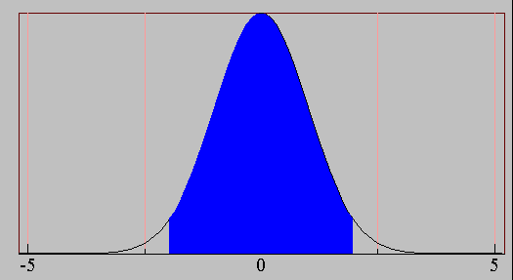
Confidence Interval for Accuracy
For large N, let be confidence
acc has a normal distribution with mean p and variance p(1-p)/N
Confidence Interval for p:
Area = 1 - α
Z_{α/2}
Z_{1- α /2}

Slide 29
Confidence Interval for Accuracy
Consider a model that produces an accuracy of 80% when evaluated on 100 test instances:
N=100, acc = 0.8
Let 1-α = 0.95 (95% confidence)
From probability table, Z_{α/2}=1.96
1-α | Z
0.99 | 2.58
0.98 | 2.33
0.95 | 1.96
0.90 | 1.65
N | 50 | 100 | 500 | 1000 | 5000
p(lower) | 0.670 | 0.711 | 0.763 | 0.774 | 0.789
p(upper) | 0.888 | 0.866 | 0.833 | 0.824 | 0.811

Slide 30
ROC (Receiver Operating Characteristic)
Page 298 of TSK book.
Many applications care about ranking (give a queue from the most likely to the least likely)
Examples…
Which ranking order is better?
ROC: Developed in 1950s for signal detection theory to analyze noisy signals
Characterize the trade-off between positive hits and false alarms
ROC curve plots TP (on the y-axis) against FP (on the x-axis)
Performance of each classifier represented as a point on the ROC curve
changing the threshold of algorithm, sample distribution or cost matrix changes the location of the point

Slide 31
How to Construct an ROC curve
Use classifier that produces posterior probability for each test instance P(+|A) for instance A
Sort the instances according to P(+|A) in decreasing order
Apply threshold at each unique value of P(+|A)
Count the number of TP, FP, TN, FN at each threshold
TP rate, TPR = TP/(TP+FN)
FP rate, FPR = FP/(FP + TN)
Instance | P(+|A) | True Class
1 | 0.95 | +
2 | 0.93 | +
3 | 0.87 | -
4 | 0.85 | -
5 | 0.85 | -
6 | 0.85 | +
7 | 0.76 | -
8 | 0.53 | +
9 | 0.43 | -
10 | 0.25 | +
Predicted by classifier
This is the ground truth

Slide 32
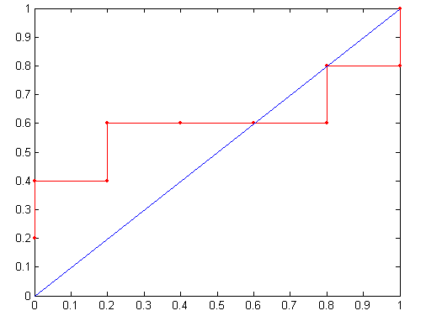
How to construct an ROC curve
Threshold >=
ROC Curve:

Slide 33
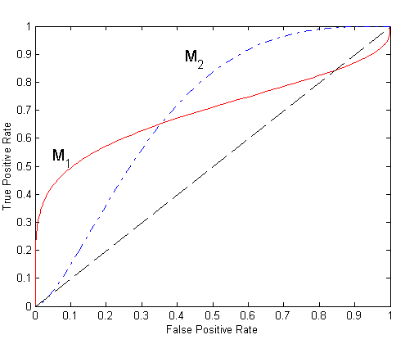
Using ROC for Model Comparison
No model consistently outperform the other
M₁ is better for small FPR
M₂ is better for large FPR
Area Under the ROC curve: AUC
Ideal:
Area = 1
Random guess:
Area = 0.5

Slide 34
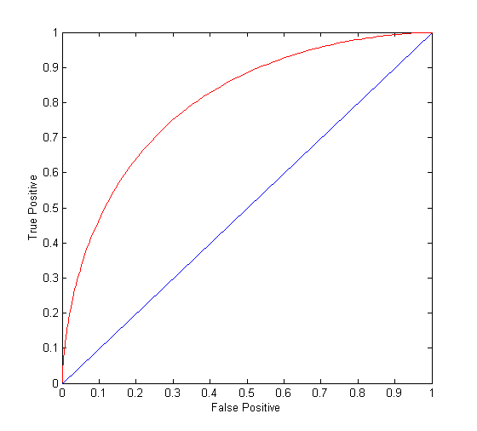
ROC Curve
(TP,FP):
(0,0): declare everything to be negative class
(1,1): declare everything to be positive class
(1,0): ideal
Diagonal line:
Random guessing
Below diagonal line:
prediction is opposite of the true class

