Slide 1

Clustering
Qiang Yang
Adapted from Tan et al. and Han et al.

Slide 2
Distance Measures
Tan et al.
From Chapter 2

Slide 3
Similarity and Dissimilarity
Similarity
  Numerical measure of how alike two data objects are.
  Is higher when objects are more alike.
  Often falls in the range [0,1]
Dissimilarity
  Numerical measure of how different are two data objects
  Lower when objects are more alike
  Minimum dissimilarity is often 0
  Upper limit varies
Proximity refers to a similarity or dissimilarity

Slide 4
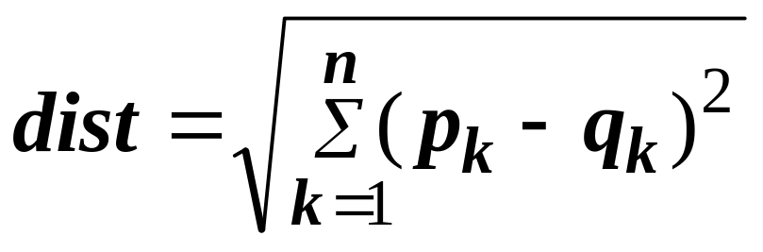
Euclidean Distance
Euclidean Distance
  Where n is the number of dimensions (attributes) and p_{k} and q_{k} are, respectively, the k^{th} attributes (components) or data objects p and q.
Standardization is necessary, if scales differ.

Slide 5
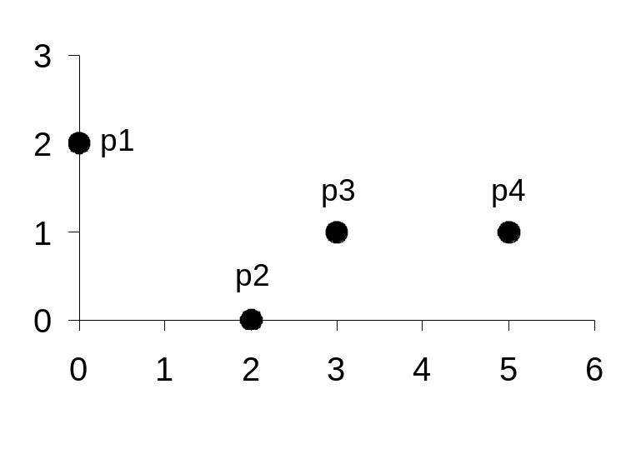
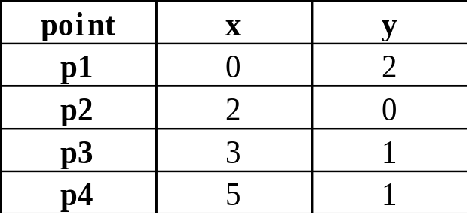
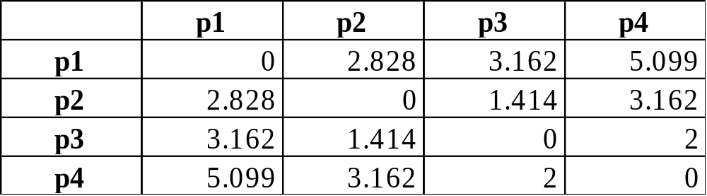
Euclidean Distance
Distance Matrix

Slide 6
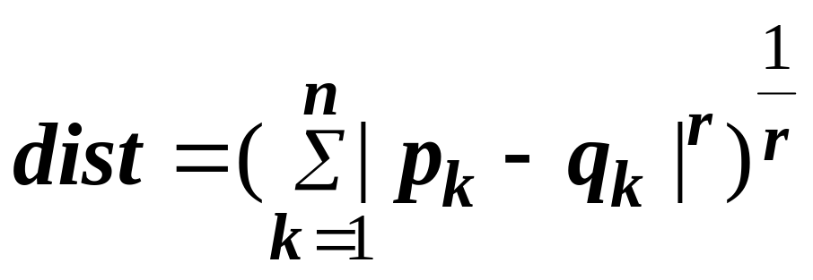
Minkowski Distance
Minkowski Distance is a generalization of Euclidean Distance
  Where r is a parameter, n is the number of dimensions (attributes) and p_{k} and q_{k} are, respectively, the kth attributes (components) or data objects p and q.

Slide 7
Minkowski Distance: Examples
r = 1. City block (Manhattan, taxicab, L₁ norm) distance.
  A common example of this is the Hamming distance, which is just the number of bits that are different between two binary vectors
r = 2. Euclidean distance
r → ∞. “supremum” (L_{max} norm, L∞ norm) distance.
  This is the maximum difference between any component of the vectors
  Example: L_infinity of (1, 0, 2) and (6, 0, 3) = ??
  Do not confuse r with n, i.e., all these distances are defined for all numbers of dimensions.

Slide 8
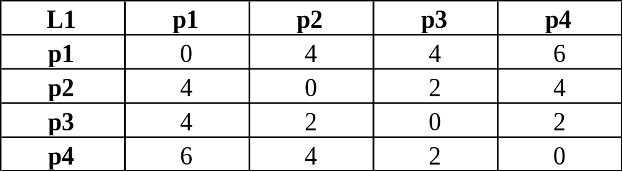
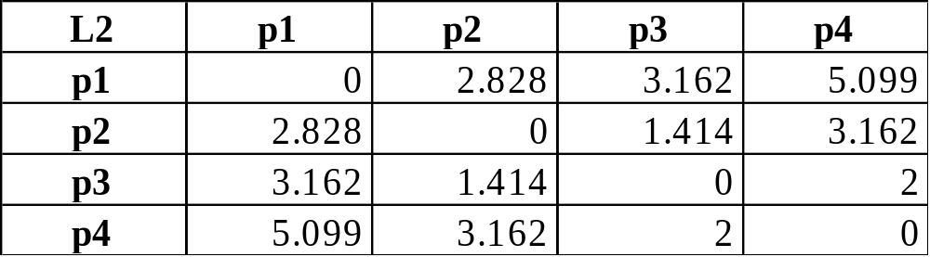
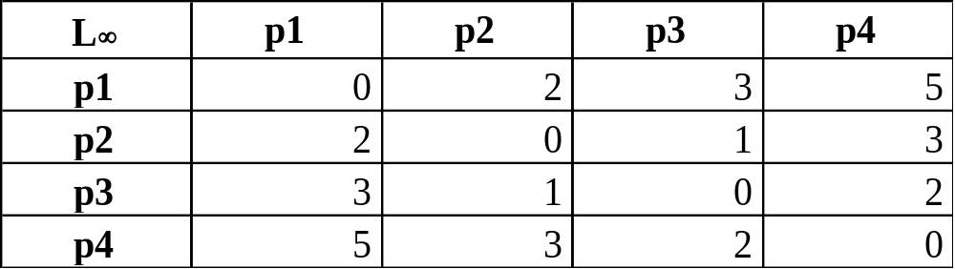
Minkowski Distance
Distance Matrix

Slide 9
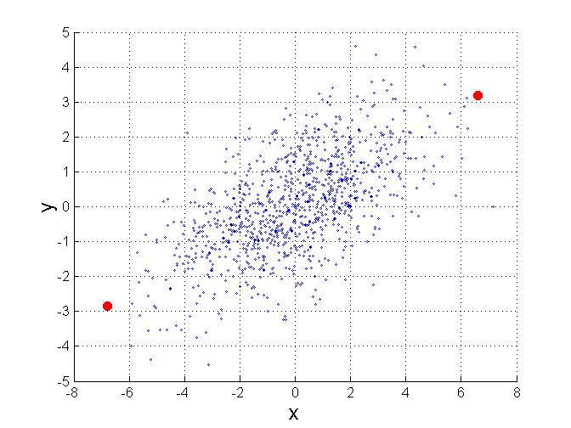
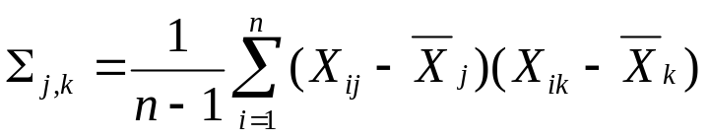
Mahalanobis Distance
Σ is the covariance matrix of the input data X
B
When the covariance matrix is identity
Matrix, the mahalanobis distance is the
same as the Euclidean distance.
Useful for detecting outliers.
Q: what is the shape of data when
covariance matrix is identity?
Q: A is closer to P or B?
A
P
For red points, the Euclidean distance is 14.7, Mahalanobis distance is 6.

Slide 10
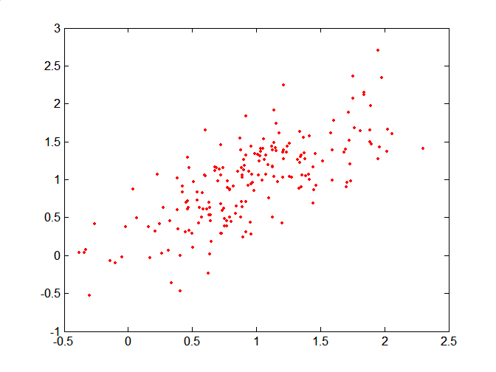
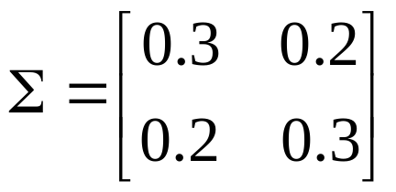
Mahalanobis Distance
Covariance Matrix:
C
B
A: (0.5, 0.5)
B: (0, 1)
C: (1.5, 1.5)
Mahal(A,B) = 5
Mahal(A,C) = 4
A

Slide 11
Common Properties of a Distance
Distances, such as the Euclidean distance, have some well known properties.
  d(p, q) ≥ 0 for all p and q and d(p, q) = 0 only if
  p = q. (Positive definiteness)
  d(p, q) = d(q, p) for all p and q. (Symmetry)
  d(p, r) ≤ d(p, q) + d(q, r) for all points p, q, and r.
  (Triangle Inequality)
where d(p, q) is the distance (dissimilarity) between points (data objects), p and q.
A distance that satisfies these properties is a metric, and a space is called a metric space

Slide 12
Common Properties of a Similarity
Similarities, also have some well known properties.
  s(p, q) = 1 (or maximum similarity) only if p = q.
  s(p, q) = s(q, p) for all p and q. (Symmetry)
where s(p, q) is the similarity between points (data objects), p and q.

Slide 13
Similarity Between Binary Vectors
Common situation is that objects, p and q, have only binary attributes
Compute similarities using the following quantities
M₀₁ = the number of attributes where p was 0 and q was 1
M₁₀ = the number of attributes where p was 1 and q was 0
M₀₀ = the number of attributes where p was 0 and q was 0
M₁₁ = the number of attributes where p was 1 and q was 1
Simple Matching and Jaccard Distance/Coefficients
SMC = number of matches / number of attributes
= (M₁₁ + M₀₀) / (M₀₁ + M₁₀ + M₁₁ + M₀₀)
J = number of value-1-to-value-1 matches / number of not-both-zero attributes values
= (M₁₁) / (M₀₁ + M₁₀ + M₁₁)

Slide 14
SMC versus Jaccard: Example
p = 1 0 0 0 0 0 0 0 0 0
q = 0 0 0 0 0 0 1 0 0 1
M₀₁ = 2 (the number of attributes where p was 0 and q was 1)
M₁₀ = 1 (the number of attributes where p was 1 and q was 0)
M₀₀ = 7 (the number of attributes where p was 0 and q was 0)
M₁₁ = 0 (the number of attributes where p was 1 and q was 1)
SMC = (M₁₁ + M₀₀)/(M₀₁ + M₁₀ + M₁₁ + M₀₀) = (0+7) / (2+1+0+7) = 0.7
J = (M₁₁) / (M₀₁ + M₁₀ + M₁₁) = 0 / (2 + 1 + 0) = 0

Slide 15
Cosine Similarity
If d₁ and d₂ are two document vectors, then
cos( d₁, d₂ ) = (d₁ • d₂) / ||d₁|| ||d₂|| ,
where • indicates vector dot product and || d || is the length of vector d.
Example:
d₁ = 3 2 0 5 0 0 0 2 0 0
d₂ = 1 0 0 0 0 0 0 1 0 2
d₁ • d₂= 3*1 + 2*0 + 0*0 + 5*0 + 0*0 + 0*0 + 0*0 + 2*1 + 0*0 + 0*2 = 5
||d₁|| = (3*3+2*2+0*0+5*5+0*0+0*0+0*0+2*2+0*0+0*0)^{0.5} = (42) ^{0.5} = 6.481
||d₂|| = (1*1+0*0+0*0+0*0+0*0+0*0+0*0+1*1+0*0+2*2) ^{0.5} = (6) ^{0.5} = 2.245
cos( d₁, d₂ ) = .3150, distance=1-cos(d1,d2)

Slide 16
Clustering: Basic Concepts
Tan et al. Han et al.
Notes:
Lecture 1

Slide 17
The K-Means Clustering Method: for numerical attributes
Given k, the k-means algorithm is implemented in four steps:
  Partition objects into k non-empty subsets
  Compute seed points as the centroids of the clusters of the current partition (the centroid is the center, i.e., mean point, of the cluster)
  Assign each object to the cluster with the nearest seed point
  Go back to Step 2, stop when no more new assignment

Slide 18
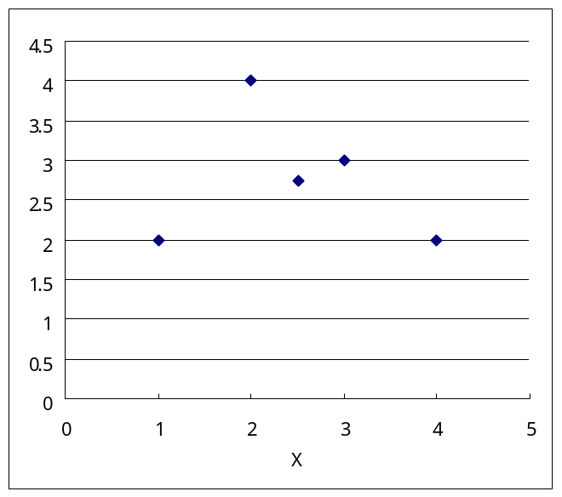
The mean point can be influenced by an outlier
X | Y
1 | 2
2 | 4
3 | 3
4 | 2
2.5 | 2.75
The mean point can be a virtual point

Slide 19



The K-Means Clustering Method
Example
10
10
9
9
8
8
7
7
6
6
5
5
4
Assign each objects to most similar center
Update the cluster means
4
3
3
2
2
1
1
0
0
0
1
2
3
4
5
6
7
8
9
10
0
1
2
3
4
5
6
7
8
9
10
reassign
reassign
K=2
Arbitrarily choose K object as initial cluster center
Update the cluster means

Slide 20



K-means Clusterings
Original Points
Optimal Clustering
Sub-optimal Clustering

Slide 21






Importance of Choosing Initial Centroids

Slide 22
Importance of Choosing Initial Centroids

Slide 23
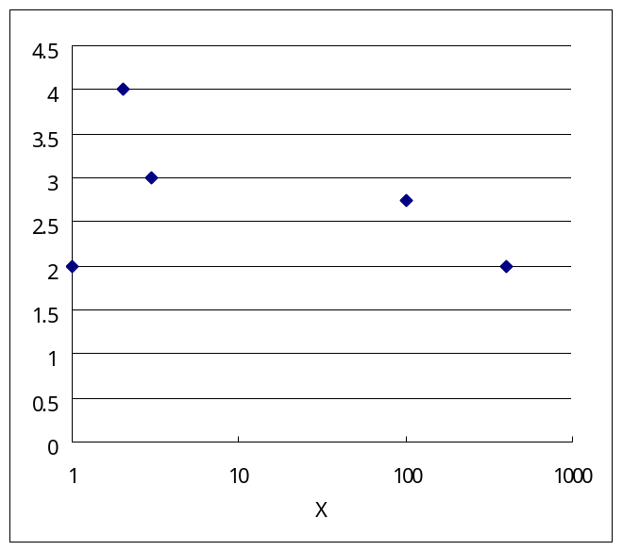
Robustness: from K-means to K-medoid
X | Y
1 | 2
2 | 4
3 | 3
400 | 2
101.5 | 2.75

Slide 24
What is the problem of k-Means Method?
The k-means algorithm is sensitive to outliers !
  Since an object with an extremely large value may substantially distort the distribution of the data.
K-Medoids: Instead of taking the mean value of the object in a cluster as a reference point, medoids can be used, which is the most centrally located object in a cluster.
10
10
9
9
8
8
7
7
6
6
5
5
4
4
3
3
2
2
1
1
0
0
1
2
3
4
5
6
7
8
9
10
0
0
1
2
3
4
5
6
7
8
9
10

Slide 25
The K-Medoids Clustering Method
Find representative objects, called medoids, in clusters
Medoids are located in the center of the clusters.
  Given data points, how to find the medoid?
10
9
8
7
6
5
4
3
2
1
0
0
1
2
3
4
5
6
7
8
9
10

Slide 26
Categorical Values
Handling categorical data: k-modes (Huang’98)
  Replacing means of clusters with modes
    Mode of an attribute: most frequent value
    Mode of instances: for an attribute A, mode(A)= most frequent value
    K-mode is equivalent to K-means
  Using a frequency-based method to update modes of clusters
  A mixture of categorical and numerical data: k-prototype method

Slide 27
Density-Based Clustering Methods
Clustering based on density (local cluster criterion), such as density-connected points
Major features:
  Discover clusters of arbitrary shape
  Handle noise
  One scan
  Need density parameters as termination condition
Several interesting studies:
  DBSCAN: Ester, et al. (KDD’96)
  OPTICS: Ankerst, et al (SIGMOD’99).
  DENCLUE: Hinneburg & D. Keim (KDD’98)
  CLIQUE: Agrawal, et al. (SIGMOD’98)

Slide 28
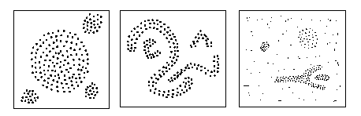
Density-Based Clustering
Clustering based on density (local cluster criterion), such as density-connected points
Each cluster has a considerable higher density of points than outside of the cluster

Slide 29
Density-Based Clustering: Background
Two parameters:
  ε: Maximum radius of the neighbourhood
  MinPts: Minimum number of points in an Eps-neighbourhood of that point
N_{ε}(p): {q belongs to D | dist(p,q) <= ε}
Directly density-reachable: A point p is directly density-reachable from a point q wrt. ε, MinPts if
  1) p belongs to N_{ε}(q)
  2) core point condition:
  |N_{ε} (q)| >= MinPts
p
MinPts = 5
ε = 1 cm
q

Slide 30

DBSCAN: Core, Border, and Noise Points
Minpts=7

Slide 31


DBSCAN: Core, Border and Noise Points
Original Points
Point types: core, border and noise
Eps = 10, MinPts = 4

Slide 32
Density-Based Clustering
Density-reachable:
  A point p is density-reachable from a point q wrt. ε, MinPts if there is a chain of points p₁, …, p_{n}, p₁ = q, p_{n} = p such that p_{i+1} is directly density-reachable from p_{i}
Density-connected
  A point p is density-connected to a point q wrt. ε, MinPts if there is a point o such that both, p and q are density-reachable from o wrt. ε and MinPts.
p
p₁
q
p
q
o

Slide 33
DBSCAN: Density Based Spatial Clustering of Applications with Noise
Relies on a density-based notion of cluster: A cluster is defined as a maximal set of density-connected points
Discovers clusters of arbitrary shape in spatial databases with noise
Outlier
Border
Eps = 1cm
MinPts = 5
Core

Slide 34
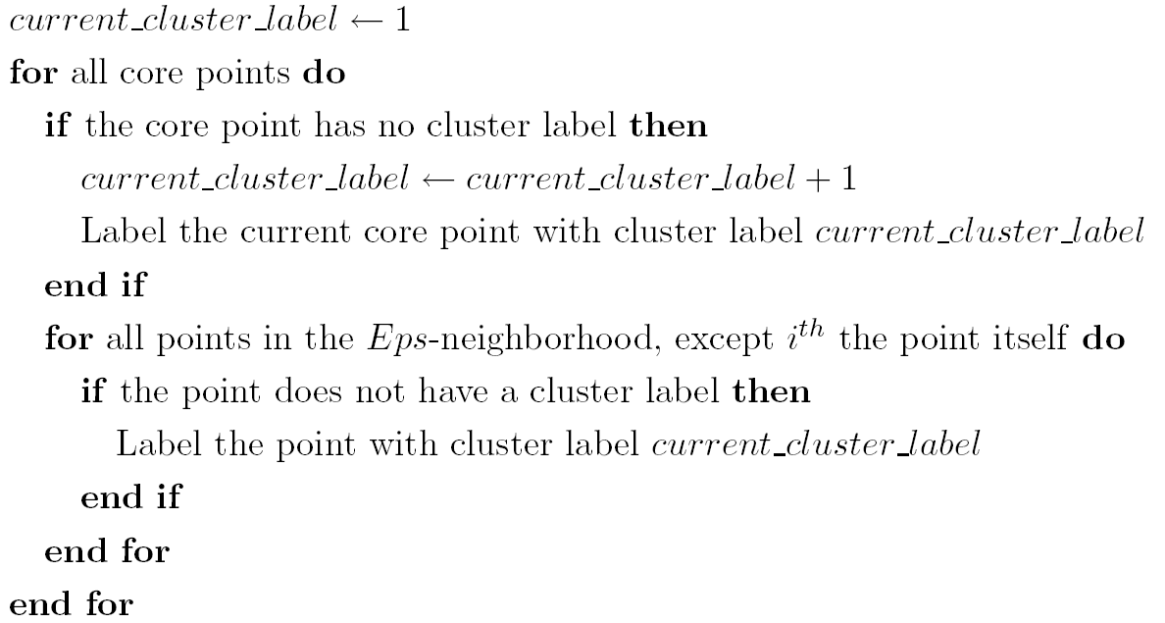
DBSCAN Algorithm
Eliminate noise points
Perform clustering on the remaining points

Slide 35
DBSCAN Properties
Generally takes O(nlogn) time
Still requires user to supply Minpts and ε
Advantage
  Can find points of arbitrary shape
  Requires only a minimal (2) of the parameters

Slide 36

When DBSCAN Works Well
Original Points
Clusters
Resistant to Noise
Can handle clusters of different shapes and sizes

Slide 37



When DBSCAN Does NOT Work Well
(MinPts=4, Eps=large value).
Original Points
Varying densities
High-dimensional data
(MinPts=4, Eps=small value; min density increases)

Slide 38
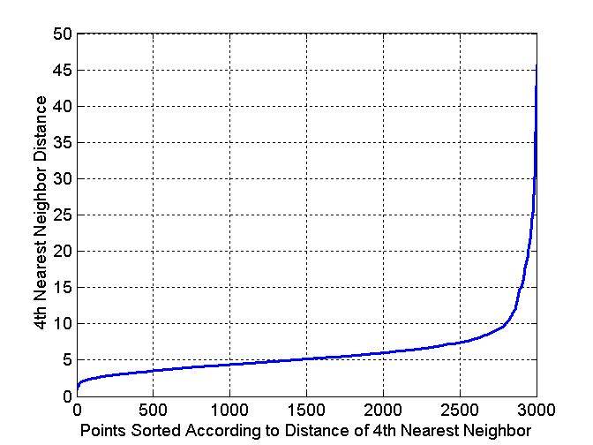
DBSCAN: Heuristics for determining EPS and MinPts
Idea is that for points in a cluster, their k^{th} nearest neighbors are at roughly the same distance
Noise points have the k^{th} nearest neighbor at farther distance
So, plot sorted distance of every point to its k^{th} nearest neighbor (e.g., k=4)
Thus, eps=10

Slide 39
Cluster Validity
For supervised classification we have a variety of measures to evaluate how good our model is
  Accuracy, precision, recall
For cluster analysis, the analogous question is how to evaluate the “goodness” of the resulting clusters?
But “clusters are in the eye of the beholder”!
Then why do we want to evaluate them?
  To avoid finding patterns in noise
  To compare clustering algorithms
  To compare two sets of clusters
  To compare two clusters

Slide 40
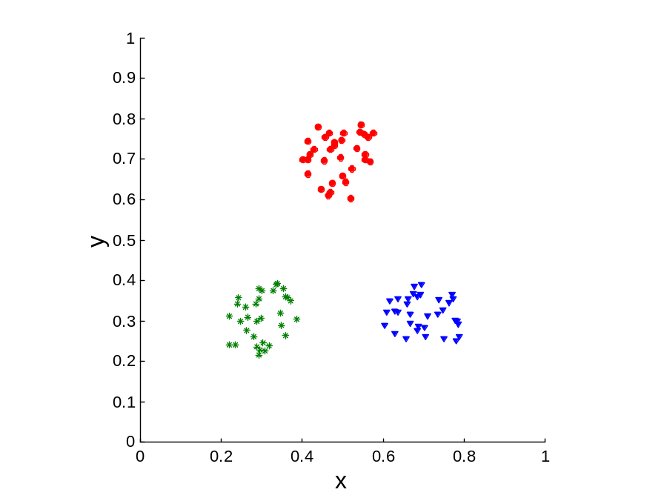
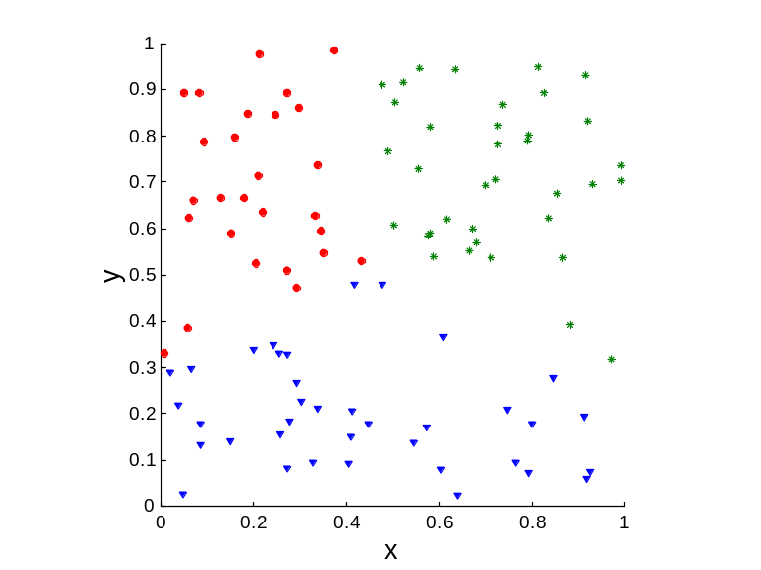
Measuring Cluster Validity Via Correlation
Correlation of incidence and proximity matrices for the K-means clusterings of the following two data sets.
Corr = -0.9235
Corr = -0.5810

Slide 41
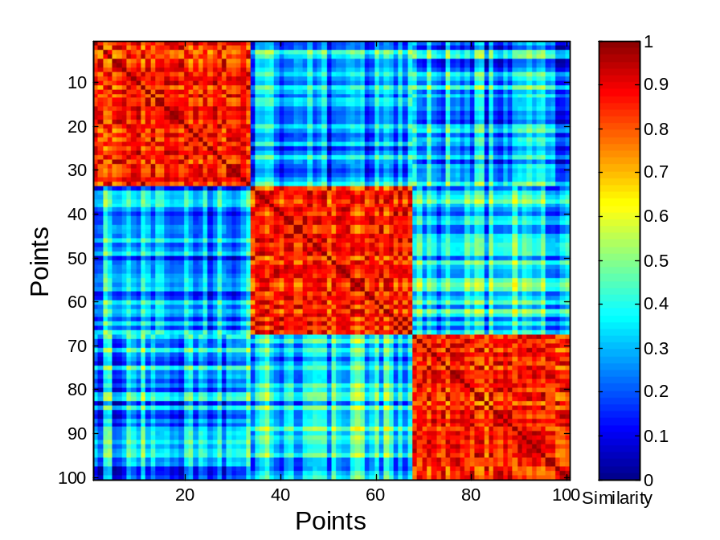
Using Similarity Matrix for Cluster Validation
Order the similarity matrix with respect to cluster labels and inspect visually.

Slide 42
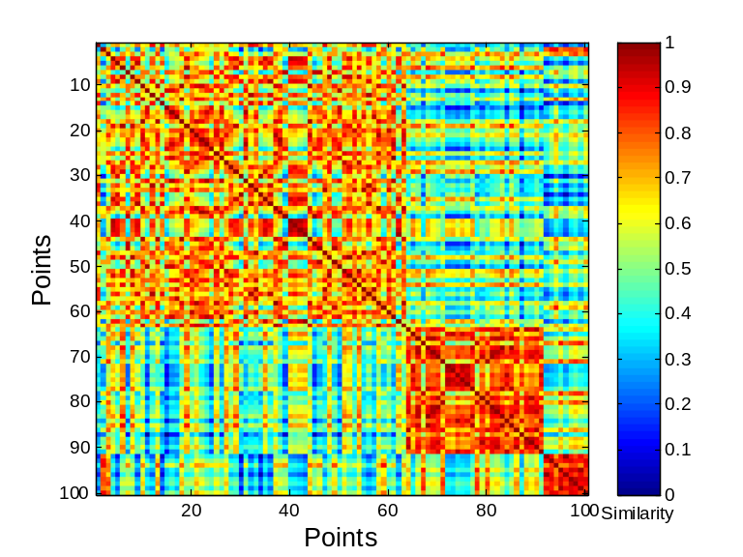
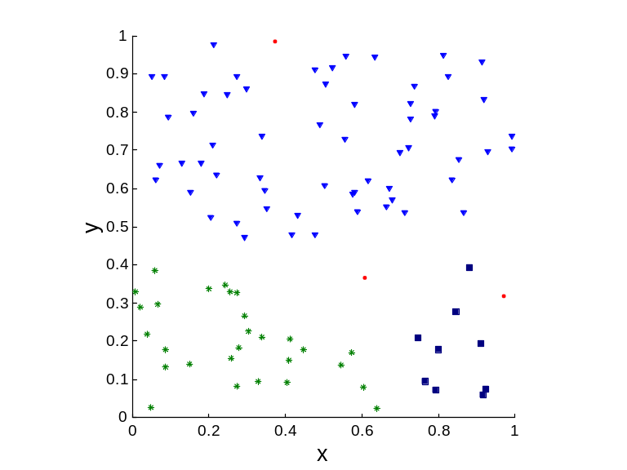
Using Similarity Matrix for Cluster Validation
Clusters in random data are not so crisp
DBSCAN

Slide 43
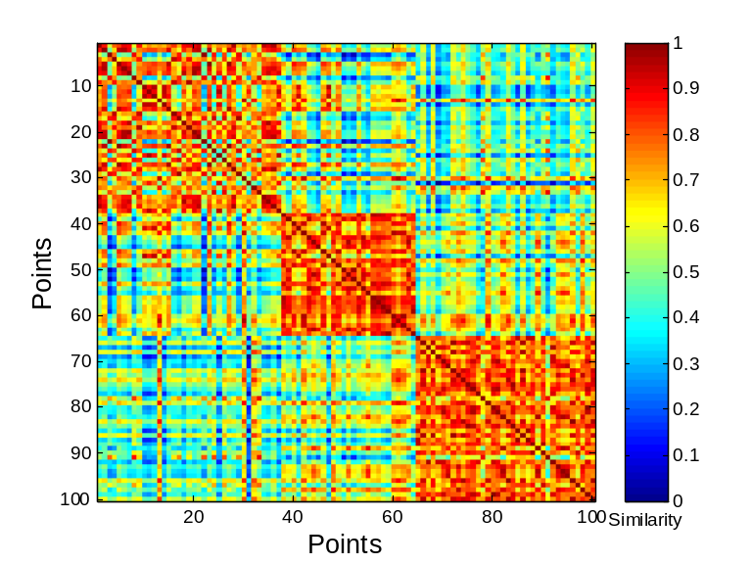
Using Similarity Matrix for Cluster Validation
Clusters in random data are not so crisp
K-means

Slide 44
Finite mixtures
Probabilistic clustering algorithms model the data using a mixture of distributions
Each cluster is represented by one distribution
  The distribution governs the probabilities of attributes values in the corresponding cluster
They are called finite mixtures because there is only a finite number of clusters being represented
Usually individual distributions are normal distribution
Distributions are combined using cluster weights

Slide 45
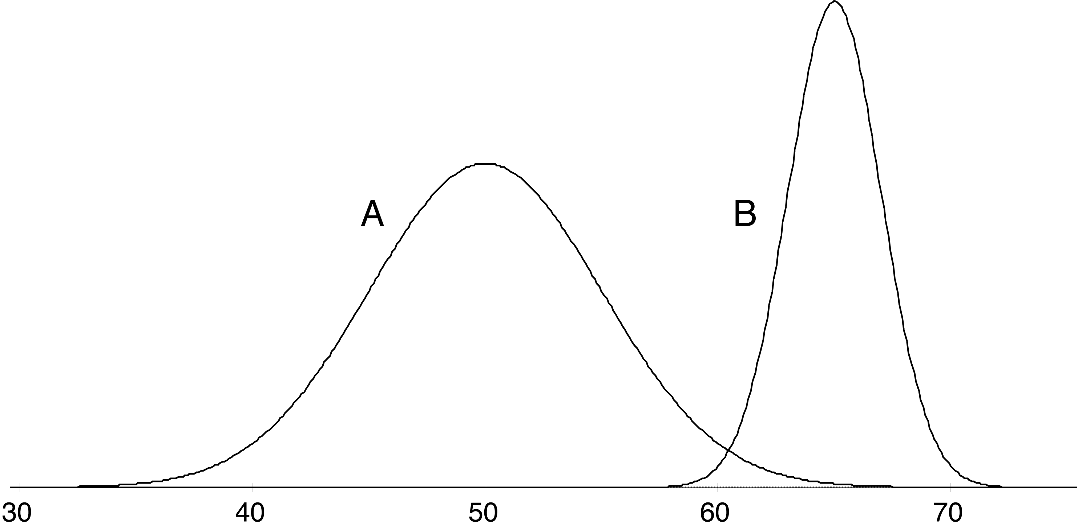
A two-class mixture model
data
A 51
A 43
B 62
B 64
A 45
A 42
A 46
A 45
A 45
B 62
A 47
A 52
B 64
A 51
B 65
A 48
A 49
A 46
B 64
A 51
A 52
B 62
A 49
A 48
B 62
A 43
A 40
A 48
B 64
A 51
B 63
A 43
B 65
B 66
B 65
A 46
A 39
B 62
B 64
A 52
B 63
B 64
A 48
B 64
A 48
A 51
A 48
B 64
A 42
A 48
A 41
model
μ_{A}=50, σ_{A} =5, p_{A}=0.6 μ_{B}=65, σ_{B} =2, p_{B}=0.4

Slide 46
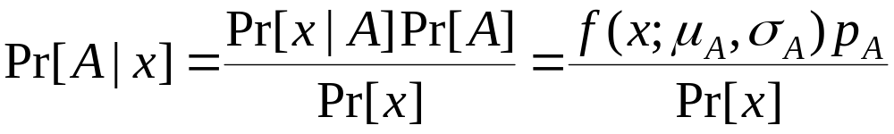
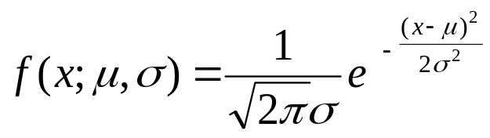

Using the mixture model
The probability of an instance x belonging to cluster A is:
with
The likelihood of an instance given the clusters is:

Slide 47
Learning the clusters
Assume we know that there are k clusters
To learn the clusters we need to determine their parameters
  I.e. their means and standard deviations
We actually have a performance criterion: the likelihood of the training data given the clusters
Fortunately, there exists an algorithm that finds a local maximum of the likelihood

Slide 48
The EM algorithm
EM algorithm: expectation-maximization algorithm
  Generalization of k-means to probabilistic setting
Similar iterative procedure:
  Calculate cluster probability for each instance (expectation step)
  Estimate distribution parameters based on the cluster probabilities (maximization step)
Cluster probabilities are stored as instance weights

Slide 49
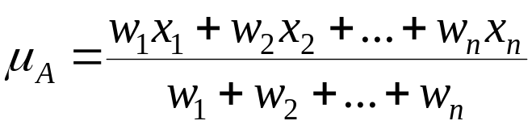
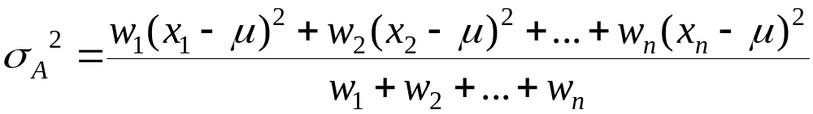
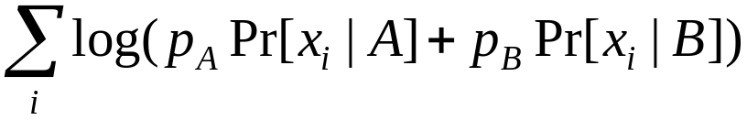
More on EM
Estimating parameters from weighted instances:
Procedure stops when log-likelihood saturates
Log-likelihood (increases with each iteration; we wish it to be largest):

