Slide 1
Chapter 17: Protection

Slide 2
Chapter 17: Protection
Goals of Protection
Principles of Protection
Protection Rings
Domain of Protection
Access Matrix
Implementation of Access Matrix

Slide 3
Objectives
Discuss the goals and principles of protection in modern computer systems
Explain how protection domains combined with an access matrix are used to specify the resources that a process may access
Examine capability-based protection system

Slide 4
Goals of Protection
In a protection model, computer system consists of a collection of objects, hardware or software
  Hardware objects: CPU, memory segments, printers, disks, and tape
  Software objects: files, programs, and semaphores
Each object has a unique name and can be accessed through a well-defined set of operations
Protection problem is to ensure that each object is accessed correctly and only by those processes allowed to do so
Mechanisms are distinct from policies, in which mechanisms determine how something will be done and policies decide what will be done.
  The separation is important for flexibility, as policies are likely to change from place to place or from time to time.
  The separation ensures that not every change in policy would require a change in the underlying mechanism.

Slide 5
Principles of Protection
The guiding principle – principle of least privilege
  Programs, users and systems should be given just enough privileges to perform their tasks - mitigate the attack
  In file permissions, this principle dictates that a user have read access but not write or execute access to a file. The principle of least privilege would require that the OS provides a mechanism to only allow read access but not write or execute access
Properly set permissions (i.e., the access rights to an object) can limit damage if entity has a bug or gets abused

Slide 6
Principles of Protection (Cont.)
Audit trail –the collection of activities in a log for monitoring review
  An audit trail is a record in the system logs
  It can reveal early warnings of an attack or provide clues as to which attack were used and assess the damage caused
No single principle is a panacea for security vulnerabilities – need defense in depth
  The theory states more layers of defense provide stronger defense than fewer layers

Slide 7

Protection Rings
User mode and kernel mode – privilege separation
Hardware support required to support the notion of separate execution
Let D_{i} and D_{j} be any two domain rings
If j < i ⇒ D_{i} ⊆ D_{j}
The innermost ring, ring 0, provides the full set of privileges

Slide 8
Protection Rings (Cont.)
Components ordered by amount of privilege and protected from each other
  For example, the kernel is in one ring and user applications in another
  This privilege separation requires hardware support
  “Gates” used to transfer between rings, for example the syscall Intel instruction, also traps and interrupts
Hypervisors (Intel) is introduced (another ring) - virtual machine managers, which create and run virtual machines, and have more capabilities than the kernels of the guest operating systems
ARM processors added TrustZone or TZ ring to protect crypto functions with access (more privileged than kernel)
  This most privileged execution environment has exclusive access to hardware-backed cryptographic features, such as the NFC Secure Element and an on-chip cryptographic key, that make handling passwords and sensitive information more secure.

Slide 9
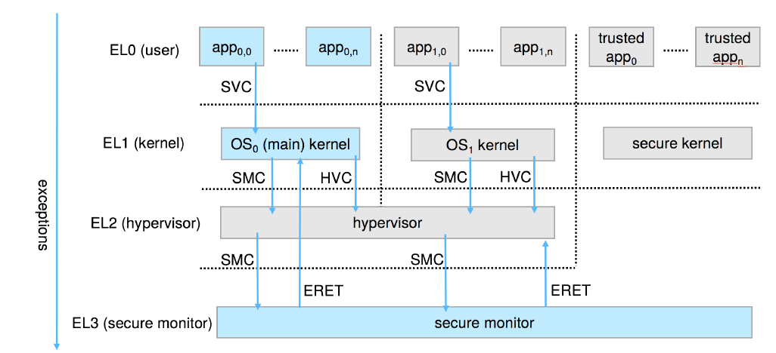
ARM CPU Architecture

Slide 10
Domain of Protection
Protection rings separate functions into different domains and order them hierarchically
Domain can be considered as a generalization of rings without a hierarchy
A computer system can be treated as processes and objects
  Hardware objects (such as CPU, memory, disk) and software objects (such as files, programs, semaphores)
Process for example should only have access to objects it currently requires to complete its task – the need-to-know principle (policy)
Implementation can be via process operating in a protection domain
  Protection domain specifies the set of resources a process may access
  Each domain specifies set of objects and types of operations may be invoked on each object

Slide 11
Domain of Protection (Cont.)
Ability to execute an operation on an object is an access right
A domain is a collection of access rights, each of which is an ordered pair <object-name, rights-set>
  An example: if domain D has the access right <file F, {read,write}>, then a process executing in domain D can both read and write file F. It cannot, however, perform any other operation on that object.
Domains may share access rights
Associations between processes and domains can be static if the set of resources available to the process is fixed throughout the process’s lifetime, or can be dynamic
If dynamic, a mechanism is available to allow domain switching, enabling the process to switch from one domain to another during different stage of execution

Slide 12
Domain of Protection (Cont.)
Domain can be realized in a variety of ways:
Each user may be a domain - the set of objects that can be accessed depends on the identity of the user. Domain switching occurs when the user is changed
Each process may be a domain - the set of objects that can be accessed depends on the identity of the process. Domain switching occurs when one process sends a message to another process and then waits for a response.
Each procedure may be a domain - the set of objects that can be accessed corresponds to the local variables defined within the procedure. Domain switching occurs when a procedure call is made

Slide 13

Domain Structure
Access-right = <object-name, rights-set>
where rights-set is a subset of all valid operations that can be performed on the object
Domain = set of access-rights
The access right <O4, {print}> shared by domains D2 and D3, thus, a process executing in either of these two domains can print object O4.

Slide 14

Access Matrix
View protection as a matrix (access matrix)
Rows represent domains, and columns represent objects
Access(i,j) consists of a set of access rights - the set of operations that a process executing in Domain_{i} can invoke on Object_{j}

Slide 15
Use of Access Matrix
The access matrix scheme provides the mechanism for specifying a variety of policies - mechanism and policy separation
The mechanism consists of implementing the access matrix and ensuring that the semantic properties hold.
  To ensure that a process executing in domain D_{i} can access only those objects specified in row i.
The policy decisions specify which rights should be included in the (i,j)th entry, and determine the domain in which each process executes
If a process in Domain D_{i} tries to do “op” on object O_{j}, then “op” must be in the access matrix
User who creates an object can define access column for that object
  When a user creates a new object O_{j} , the column O_{j} is added to the access matrix with the appropriate initialization entries, as dictated by the creator. The user may decide to enter some rights in some entries in column j and other rights in other entries, as needed.

Slide 16
Use of Access Matrix (Cont.)
This can be expanded to dynamic protection
Operations to add, delete access rights
Special access rights:
  owner of O_{i} - can add and remove any right in any entry in column
  copy op from O_{i} to O_{j} (denoted by “*”) - only within the column (that is, for the object)
  control – D_{i} can modify D_{j} access rights – modify domain objects (a row）
  transfer – switch from domain D_{i} to D_{j}
Copy and Owner applicable to an object - change the entries in a column
Control applicable to domain object - change the entries in a row
New objects and new domains can be created dynamically and included in the access-matrix model
In a dynamic protection system, we may sometimes need to revoke access rights to objects shared by different users – revocation of access right

Slide 17

Access Matrix of Figure A with Domains as Objects

Slide 18

Access Matrix with Copy Rights

Slide 19

Access Matrix With Owner Rights

Slide 20

Modified Access Matrix of Figure B

Slide 21
Implementation of Access Matrix
In general, the access matrix is sparse; that is, most of the entries will be empty
Option 1 – Global Table
  Store ordered triples <domain, object, rights-set> in table
  A requested operation M on object O_{j} within domain D_{i} -> search table for < D_{i}, O_{j}, R_{k} > with M ∈ R_{k}
  But the table could be large -> might not fit in main memory，requires additional I/O – virtual memory techniques are often used
  Difficult to group objects - For example, if everyone can read a particular object, this object must have a separate entry in every domain.

Slide 22
Implementation of Access Matrix (Cont.)
Each column = Access-control list for one object
Defines who can perform what operation
Domain 1 = Read, Write
Domain 2 = Read
Domain 3 = Read
Each row = Capability List (like a key)
For each domain, what operations allowed on what objects
      Object F1 – Read
      Object F4 – Read, Write, Execute
      Object F5 – Read, Write, Delete, Copy

Slide 23
Implementation of Access Matrix (Cont.)
Option 2 – Access lists for objects
  Each column implemented as an access list for one object
  Resulting per-object list consists of ordered pairs <domain, rights-set> defining all domains with non-empty set of access rights for the object
  Obviously, the empty entries can be discarded.
  This can be easily extended to define default set of access rights -> If M ∈ default set, also allow access (for all domains)

Slide 24
Implementation of Access Matrix (Cont.)
Option 3 – Capability list for domains
  Instead of object-based, list is domain-based
  A capability list for domain is a list of objects together with operations allowed on them
  An object represented by its name or address, called a capability
  To execute operation M on object O_{j}, a process requests operation M, specifying the capability (or pointer) for object O_{j} as a parameter
  Possession of capability means access is allowed
Capability list associated with a domain, but never directly accessible by a process executing in that domain
  Rather, the capability list itself is a protected object, maintained by OS and accessed by users only indirectly
  This avoids the possibility of capability list modification by users
  If all capabilities are secure, the object they protect is also secure against unauthorized access

Slide 25
Implementation of Access Matrix (Cont.)
Option 4 – Lock-key
  Compromise between access lists and capability lists
  Each object has list of unique bit patterns, called locks
  Each domain as list of unique bit patterns called keys
  Process in a domain can only access object if domain has key that matches one of the locks of the object
  As with capability lists, the list of keys for a domain must be managed by the operating system on behalf of the domain.
  Users are not allowed to examine or modify the list of keys (or locks) directly.

Slide 26
Comparison of Implementations
Choosing a technique for implementing an access matrix involves various trade-offs.
Global table is simple, but large, lack of grouping of objects or domains
Access lists correspond directly to the needs of users
  An access list on an object is specified when a user creates the object
  Determining set of access rights for each domain is difficult - every access to the object must be checked, requiring a search of the access list.
Capability lists useful for localizing information for a given process
  But revocation capabilities can be inefficient
Lock-key can be effective and flexible depending on the length of the keys
  Keys can be passed freely from domain to domain, easy revocation
Most systems use combination of access lists and capabilities

Slide 27
End of Chapter 17

