Slide 1
Chapter 6: Synchronization Tools

Slide 2
Chapter 6: Synchronization Tools
Background
The Critical-Section Problem
Synchronization Hardware
Mutex Locks
Semaphores

Slide 3
Objectives
Describe the critical-section problem and illustrate the race condition
Illustrate hardware solutions to the critical-section problem using compare-and-swap operations, and atomic variables
Demonstrate how mutex locks, semaphores, and condition variables can be used to solve the critical section problem

Slide 4
Background
Processes can execute concurrently
  Processes may be interrupted at any time, partially completing execution, due to a variety of reasons.
Concurrent access to any shared data may result in data inconsistency
Maintaining data consistency requires mechanism(s) to ensure the orderly execution of cooperating processes

Slide 5
Illustration of the Problem
Think about the Producer-Consumer problem
An integer counter is used to keep track of the number of buffers occupied.
  Initially, counter is set to 0
  It is incremented each time by the producer after it produces an item and places in the buffer
  It is decremented each time by the consumer after it consumes an item in the buffer.

Slide 6
Producer-Consumer Problem
while (true) {
/* produce an item in next produced */
while (counter == BUFFER_SIZE) ;
/* do nothing */
buffer[in] = next_produced;
in = (in + 1) % BUFFER_SIZE;
counter++;
}
Producer
while (true) {
while (counter == 0)
; /* do nothing */
next consumed = buffer[out];
out = (out + 1) % BUFFER_SIZE;
counter--;
/* consume the item in next consumed */
}
Consumer

Slide 7
Race Condition
counter++ could be implemented as
register1 = counter
register1 = register1 + 1
counter = register1
counter-- could be implemented as
register2 = counter
register2 = register2 - 1
counter = register2
Consider this execution interleaving with “count = 5” initially:
  S0: producer execute register1 = counter {register1 = 5}
  S1: producer execute register1 = register1 + 1 {register1 = 6}
  S2: consumer execute register2 = counter {register2 = 5}
  S3: consumer execute register2 = register2 – 1 {register2 = 4}
  S4: producer execute counter = register1 {counter = 6 }
  S5: consumer execute counter = register2 {counter = 4}

Slide 8
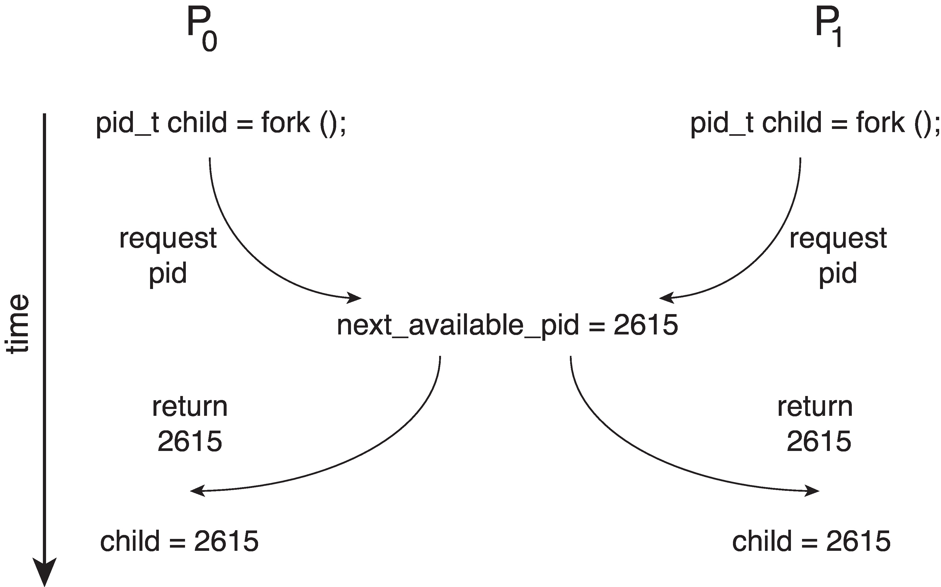
Race Condition
Processes P₀ and P₁ are creating child processes using the fork() system call
Race condition on kernel variable next_available_pid which represents the next available process identifier (pid)
Unless there is mutual exclusion, the same pid could be assigned to two different processes!

Slide 9
Critical Section Problem
A Race Condition is an undesirable situation where several processes access and manipulate a shared data concurrently and the outcome of the executions depends on the particular order in which the accesses or executions take place
  The results depend on the timing execution of programs. With some bad luck (i.e., context switches that occur at untimely points during execution), the result become non-deterministic
Consider a system with n processes {P₀, P₁, … P_{n-1}}
A process has a Critical Section segment of code (can be short or long), during which
  A process or thread may be changing shared variables, updating a table, writing a file, etc.
  We need to ensure when one process is in Critical Section, no other can be in its critical section
  In a way, mutual exclusion and critical section imply the same thing
Critical section problem is to design a protocol to solve this
  Specifically, each process must ask permissions before entering the critical section in entry section, may follow critical section with exit section, then remainder section

Slide 10

Critical Section
The general structure of process p_{i} is

Slide 11
Solution to Critical-Section Problem
1. Mutual exclusion - If process P_{i} is executing in its critical section, no other processes can be executing in their critical sections
2. Progress - If no process is executing in its critical section and there exist some processes that wish to enter their critical sections, the selection of a process that will enter the critical section next cannot be postponed indefinitely – selection of one process entering
3. Bounded Waiting - A bound must exist on the number of times that other processes are allowed to enter their critical sections after a process has made a request to enter its critical section and before that request is granted – any waiting process
Assume that each process executes at a nonzero speed, and there is no assumption concerning relative speed of the n processes

Slide 12
Critical-Section Problem in Kernel
Kernel code - the code the operating system is running, is subject to several possible race conditions
  A kernel data structure that maintains a list of all open files can be updated by multiple kernel processes, i.e., two processes were to open files simultaneously
  Other kernel data structures such as the one maintaining memory allocation, process lists, interrupt handling and etc.
Two general approaches are used to handle critical sections in operating system, depending on whether the kernel is preemptive or non-preemptive
  Preemptive – allows preemption of process when running in the kernel mode, not free from the race condition, and increasingly more difficult in SMP architectures.
  Non-preemptive – runs until exiting the kernel mode, blocks, or voluntarily yields CPU. This is essentially free of race conditions in the kernel mode, possibly used in single-processor system

Slide 13
Synchronization Tools
Many systems provide hardware support for implementing the critical section code. On uniprocessor systems – it could simply disable interrupts, currently running code would execute without being pre-empted or interrupted. But this is generally too inefficient on multiprocessor systems
Operating systems provide hardware and high level API support for critical section code
Programs | Share Programs
Hardware | Load/Store, Disable Interrupts, Test&Set, Compare&Swap
High level APIs | Locks, Semaphores

Slide 14
Synchronization Hardware
Modern OS provides special atomic hardware instructions
    Atomic = non-interruptible
There are two commonly used hardware instructions
  Either test a memory word and set a value – Test_and_Set()
  Or swap contents of two memory words – Compare_and_Swap()

Slide 15
test_and_set Instruction
Definition:
boolean test_and_set (boolean *target)
{
boolean rv = *target;
*target = TRUE;
return rv:
}

Slide 16
Solution using test_and_set()
Shared boolean variable lock, initialized to FALSE
Solution:
do {
while (test_and_set(&lock))
; /* do nothing */
/* critical section */
lock = false;
/* remainder section */
} while (true);

Slide 17
compare_and_swap Instruction
Definition:
int compare_and_swap(int *value, int expected, int new_value) {
int temp = *value;
if (*value == expected)
*value = new_value;
return temp;
}

Slide 18
Solution using compare_and_swap
Shared Boolean variable lock initialized to FALSE; Each process has a local Boolean variable key
Solution:
do {
while (compare and swap(&lock, 0, 1) != 0)
; /* do nothing */
/* critical section */
lock = 0;
/* remainder section */
} while (true);

Slide 19
Bounded-waiting Mutual Exclusion with test_and_set
do {
waiting[i] = true;
key = true;
while (waiting[i] && key)
key = test_and_set(&lock);
waiting[i] = false;
/* critical section */
j = (i + 1) % n;
while ((j != i) && !waiting[j])
j = (j + 1) % n;
if (j == i)
lock = false; /* no one is waiting, so release the lock */
else
waiting[j] = false; /* Unblock process j */
/* remainder section */
} while (true);

Slide 20
Sketch Proof
Mutual-exclusion: P_{i} enters its critical section only if either waiting[i]==false or key==false. The value of key can become false only if test_and_set() is executed. Only the first process to execute test_and_set() will find key==false; all others must wait. The variable waiting[i] can become false only if another process leaves its critical section; only one waiting[i] is set to false, thus maintaining the mutual-exclusion requirement.
Progress: since a process existing its critical section either sets lock to false or sets waiting[j] to false. Both allow a process that is waiting to enter its critical section to proceed.
Bounded-waiting; when a process leaves its critical section, it scans the array waiting in cyclic order {i+1, i+2, …,n-1,0,1,…i-1}. It designates the first process in this ordering that is in the entry section (waiting[j]==true) as the next one to enter the critical section. Any process waiting to enter its critical section will thus do so within n-1 turns.

Slide 21
Atomic Variables
Typically, instructions such as compare-and-swap are used as building blocks for other (more sophisticated) synchronization tools.
One tool is an atomic variable that provides atomic (uninterruptible) updates on basic data types such as integers and Booleans.
For example, the increment() operation on the atomic variable sequence ensures sequence is incremented without interruption - increment(&sequence);
The increment() function can be implemented as follows:
void increment(atomic_int *v)
{
int temp;
do {
temp = *v;
}
while (temp != (compare_and_swap(v,temp,temp+1));
}

Slide 22
Mutex Locks
OS builds software tools to solve the critical section problem
The simplest tool that most OSes use is mutex lock
To access the critical regions with it by first acquire() a lock then release() it afterwards
  Boolean variable indicating if lock is available or not
Calls to acquire() and release() must be atomic (non-interruptible)
  Usually implemented via hardware atomic instructions
But this solution requires busy waiting. This lock therefore called a spinlock
  Spinlock wastes CPU cycles due to busy waiting, but it has one advantage in that no context switch is required when a process must wait on a lock, and a contest switch may take considerable time. Thus, when locks are expected to be held for short times, spinlock is useful
  Spinlocks are often used in multiprocessor systems where one thread can “spin” on one processor while another thread performs its critical section on another processor

Slide 23
acquire() and release()
acquire() {
while (!available)
; /* busy wait */
available = false;;
}
release() {
available = true;
}
do {
acquire lock
critical section
release lock
remainder section
} while (true);
Solutions based on the idea of lock to protect critical section
Operations are atomic (non-interruptible) – at most one thread acquires a lock at a time
Lock before entering critical section for accessing share data
Unlock upon departure after accessing shared data
Wait if locked - all synchronization involves busy waiting, should “sleep” if waiting for a long time

Slide 24
Semaphore
Semaphore S – non-negative integer variable, can be considered as a generalized lock
  First defined by Dijkstra in late 1960s. It can behave similarly as mutex lock, but more sophisticated in its usage - the main synchronization primitive used in original UNIX
Two standard operations modify S: wait() and signal()
  Originally called P() and V(), where P() stands for “proberen” (to test) and V() stands for “verhogen” (to increment) in Dutch
It is critical that semaphore operations are executed atomically, which guarantees that no more than one process can execute wait() and signal() operations on the same semaphore at the same time.
The semaphore can only be accessed via these two atomic operations except initialization
  wait (S) {
  while (S <= 0)
  ; // busy wait
  S--;
  }
  signal (S) {
  S++;
  }

Slide 25
Semaphore Usage
Counting semaphore – An integer value can range over an unrestricted domain
  Counting semaphore can be used to control access to a given resource consisting of a finite number of instances; semaphore value is initialized to the number of resource available
Binary semaphore – integer value can range only between 0 and 1
  This can behave similar to mutex locks, can also be used in different ways
This can also be used to solve various synchronization problems
Consider P₁ and P₂ that shares a common semaphore synch, initialized to 0; it ensures that P1 process executes S₁ before P2 process executes S₂
  P1:
  S₁;
  signal(synch);
  P2:
  wait(synch);
  S₂;

Slide 26
Semaphore Implementation with no Busy waiting
With each semaphore there is an associated waiting queue
Each entry in a waiting queue has two data items:
  value (of type integer)
  pointer to next record on the queue
Two operations:
  block – place the process invoking the operation on the appropriate waiting queue
  wakeup – remove one of processes in the waiting queue and place it in the ready queue
Semaphore values may become negative, whereas this value can never be negative under the classical definition of semaphores with busy waiting.
If a semaphore value is negative, its magnitude is the number of processes currently waiting on the semaphore.

Slide 27
Semaphore Implementation with no Busy waiting (Cont.)
typedef struct{
int value;
struct process *list;
} semaphore;
wait(semaphore *S) {
S->value--;
if (S->value < 0) {
add this process to S->list;
block();
}
}
signal(semaphore *S) {
S->value++;
if (S->value <= 0) {
remove a process P from S->list;
wakeup(P);
}
}
Noticing that
Increment and decrement are done before checking the semaphore value, unlike the busy waiting implementation
The sleep() operation suspends the process that invokes it.
The wakeup(P)operation resumes the execution of a suspended process P.

Slide 28
Deadlock and Starvation
Deadlock – two or more processes are waiting indefinitely for an event that can be caused by only one of the waiting processes (details in Chapter 7)
Let S and Q be two semaphores initialized to 1
P₀ P₁
wait(S); wait(Q);
wait(Q); wait(S);
… …
signal(S); signal(Q);
signal(Q); signal(S);
Consider if P0 executes wait(S) and P1 wait(Q). When P0 executes wait(Q), it must wait until P1 executes signal(Q), However, P1 is waiting until P0 execute signal(S). Since these signal() operations will never be executed, P0 and P1 are deadlocked, extremely difficult to debug
Starvation – indefinite blocking
  A process may never be removed from the semaphore queue, in which it is suspended. For instance, if we remove processes from the queue associated with a semaphore using LIFO (last-in, first-out) order or based on certain priorities.

Slide 29
End of Chapter 6

