Slide 1
Chapter 7: Synchronization Example

Slide 2
Synchronization Examples
Classic Problems of Synchronization
  Bounded-Buffer Problem
  Readers and Writers Problem
Window Synchronization
POSIX Synchronization

Slide 3
Bounded-Buffer Problem
n buffers, each can hold one item
Semaphore mutex initialized to the value 1
Semaphore full initialized to the value 0
Semaphore empty initialized to the value n

Slide 4
Bounded Buffer Problem (Cont.)
The structure of the producer process
do {
...
/* produce an item in next_produced */
...
wait(empty);
wait(mutex);
...
/* add next produced to the buffer */
...
signal(mutex);
signal(full);
} while (true);

Slide 5
Bounded Buffer Problem (Cont.)
The structure of the consumer process
do {
wait(full);
wait(mutex);
...
/* remove an item from buffer to next_consumed */
...
signal(mutex);
signal(empty);
...
/* consume the item in next consumed */
...
} while (true);

Slide 6
Readers-Writers Problem
A data set is shared among a number of concurrent processes
  Readers – only read the data set; they do not perform any updates
  Writers – can both read and write
Problem – allow multiple readers to read the data set at the same time
  Only one single writer can access shared data at a time
Several variations of how readers and writers are treated – all involve different priorities.
The simplest solution, referred to as the first readers-writers problem, requires that no reader be kept waiting unless a writer has already gained access to the shared data
  Shared data update (by writers) can be delayed
Shared Data
  Data set
  Semaphore rw_mutex initialized to 1
  Semaphore mutex initialized to 1
  Integer read_count initialized to 0

Slide 7
Readers-Writers Problem (Cont.)
The structure of a writer process
do {
wait(rw_mutex);
...
/* writing is performed */
...
signal(rw_mutex);
} while (true);

Slide 8
Readers-Writers Problem (Cont.)
The structure of a reader process
do {
wait(mutex);
read_count++;
if (read_count == 1)
wait(rw_mutex);
signal(mutex)
...
/* reading is performed */
...
wait(mutex);
read_count--;
if (read_count == 0)
signal(rw_mutex);
signal(mutex);
} while (true);
Note:
rw_mutex controls the access to shared data (critical section) for writers, and the first reader. The last reader leaving the critical section also has to release this lock
mutex controls the access of readers to the shared variable count
Writers wait on rw_mutex, first reader yet gain access to the critical section also waits on rw_mutex. All subsequent readers yet gain access wait on mutex

Slide 9
Readers-Writers Problem Variations
First variation – no reader kept waiting unless a writer has gained access to use shared object. This is simple, but can result in starvation for writers, thus can potentially significantly delay the update of the object.
Second variation – once a writer is ready, it needs to perform update asap. In another word, if a writer starts waiting to access the object (this implies that there are readers reading at the moment), no new readers may start reading, i.e., they must wait after the writer updates the object. Of course, those reader(s) inside will finish reading the object while the writer waits outside
A solution to either problem may result in starvation
The problem can be solved or at least partially by kernel providing reader-writer locks, in which multiple processes are permitted to concurrently acquire a reader-writer lock in read mode, but only one process can acquire the reader-writer lock for writing （exclusive access). Acquiring a reader–writer lock thus requires specifying the mode of the lock: either read or write access

Slide 10
Synchronization Examples
Solaris
Windows XP
Linux
Pthreads

Slide 11
Solaris Synchronization
Implements a variety of locks to support multitasking, multithreading (including real-time threads), and multiprocessing
Uses adaptive mutex for efficiency when protecting data from short code segments, usually less than a few hundred instructions
  Starts as a standard semaphore implemented as a spinlock in a multiprocessor system
  If lock held, and by a thread running on another CPU, spins to wait for the lock to become available
  If lock held by a non-run-state thread, block and sleep waiting for signal of lock being released
Uses condition variables
Uses readers-writers locks when longer sections of code need access to data. These are used to protect data that are frequently accessed, but usually in a read-only manner. The readers-writer locks are relatively expensive to implement.

Slide 12
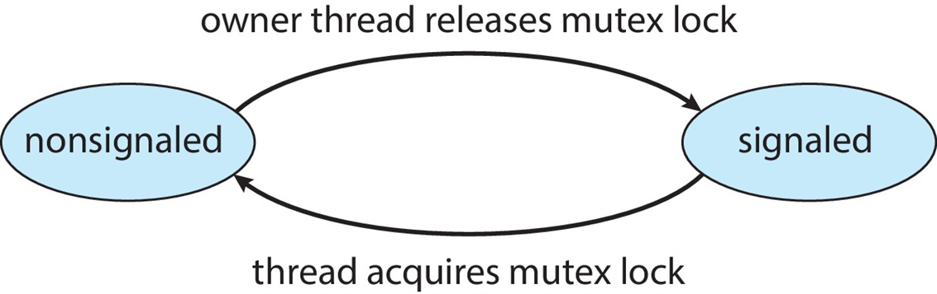
Windows Synchronization
The kernel uses interrupt masks to protect access to global resources in uniprocessor systems
The kernel uses spinlocks in multiprocessor systems (to protect short code segments)
  For efficiency, the kernel ensures that a thread will never be preempted while holding a spinlock
For thread synchronization outside the kernel （user mode), Windows provides dispatcher objects, threads synchronize according to several different mechanisms, including mutex locks, semaphores, events, and timers
  Events are similar to condition variables; they may notify a waiting thread when a desired condition occurs
  Timers are used to notify one or more thread that a specified amount of time has expired
  Dispatcher objects either signaled-state (object available) or non-signaled state (this means that another thread is holding the object, therefore the thread will block)

Slide 13
Linux Synchronization
Linux:
  Prior to kernel Version 2.6, disables interrupts to implement short critical sections
  Version 2.6 and later, fully preemptive kernel
Linux provides:
  semaphores
  Spinlocks – for multiprocessor systems
  atomic integer, and all math operations using atomic integers performed without interruption
  reader-writer locks
On single-CPU system, spinlocks replaced by enabling and disabling kernel preemption

Slide 14
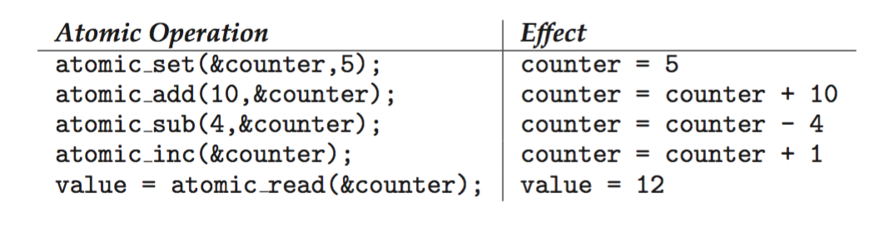
Atomic Variables
Atomic variables - atomic_t is the type for atomic integer
Consider the variables
atomic_t counter;
int value;

Slide 15
POSIX Synchronization
POSIX API provides
  mutex locks
  semaphores
  condition variables
Widely used on UNIX, Linux, and MacOS

Slide 16
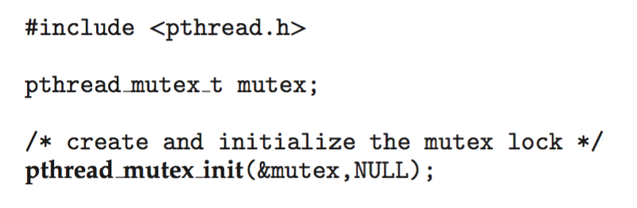
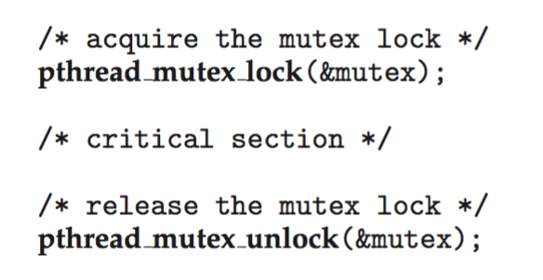
POSIX Mutex Locks
Creating and initializing the lock
Acquiring and releasing the lock

Slide 17
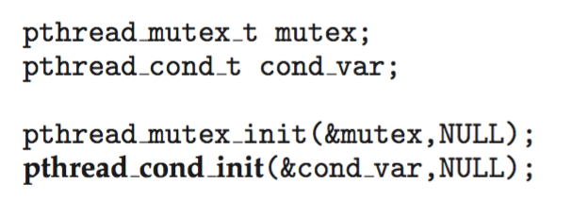
POSIX Condition Variables
POSIX condition variables are associated with a POSIX mutex lock to provide mutual exclusion: Creating and initializing the condition variable:

Slide 18
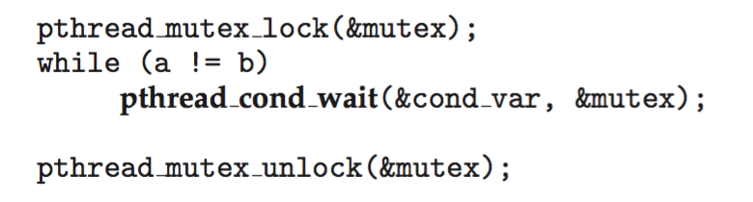
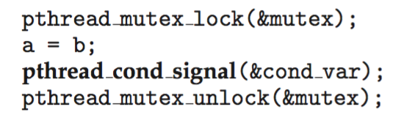
POSIX Condition Variables
Thread waiting for the condition a == b to become true:
Thread signaling another thread waiting on the condition variable:

Slide 19
End of Chapter 7

