Slide 1
Spring 2022 COMP 3511 Review #4

Slide 2
Coverages
Scheduling Examples
Synchronization

Slide 3
Multilevel Feedback Queue (MLFQ) Scheduling
Multilevel-feedback-queue or MLFQ scheduler defined by
The number of queues
scheduling algorithms for each queue
method used to determine when to upgrade a process
method used to determine when to demote a process
method used to determine which queue a process will enter when that process needs service
MLFQ is commonly used in many systems such as BSD Unix, Solaris, Window NT and subsequent Window operating systems
MLFQ has several distinctive advantages:
It does not require prior knowledge on CPU burst time
It handles interactive jobs well by delivering similar performance as that of SJF or SRTF
It is also “fair” by making progress on CPU-bound jobs

Slide 4
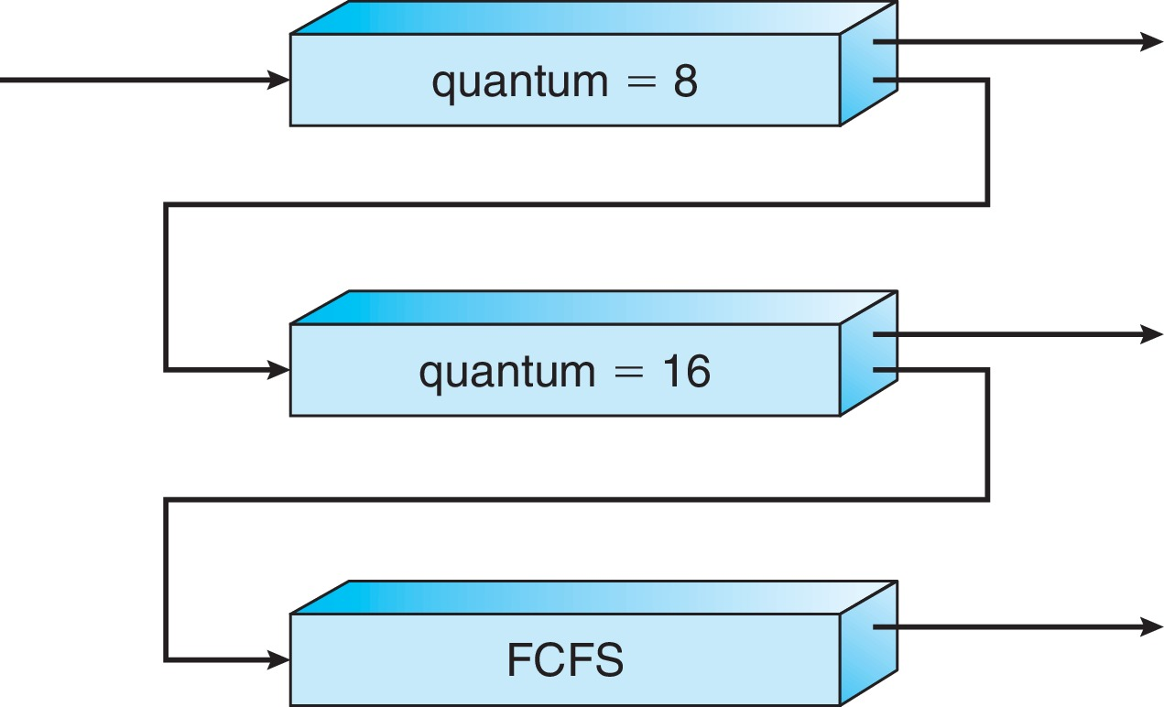
Example of Multilevel Feedback Queue
Three queues:
Q₀ – RR with time quantum 8 milliseconds
Q₁ – RR time quantum 16 milliseconds
Q₂ – FCFS
Scheduling
A new job enters queue Q₀ which is served FCFS, also preempts jobs from Q1 or Q2 if currently running on CPU
When it gains CPU, job receives 8 ms
If it does not finish in 8 milliseconds, job is moved to the queue Q₁
At Q₁ job is again served FCFS and receives 16 additional milliseconds
If it still does not complete, it is preempted and moved to queue Q₂
If a job from Q₁ or Q₂ is preempted by a new job from Q₀, it joins the head of the queue Q₁ or Q₂ , respectively
This approximates SRTF:
CPU bound jobs drop like a rock
Short-running I/O bound jobs stay near top

Slide 5
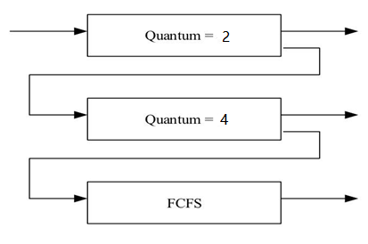
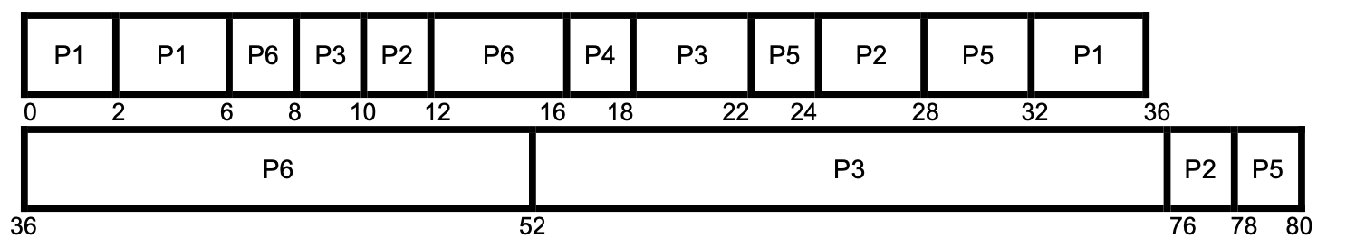
MLFQ Scheduling: Example
Process | Arrival Time | Burst Time
P1 | 0 | 10
P2 | 10 | 8
P3 | 8 | 30
P4 | 16 | 2
P5 | 22 | 8
P6 | 6 | 22

Slide 6
MLFQ Scheduling: Example
Averaging waiting time = turn-around time - CPU burst time
P1: 36-0-10 = 26
P2: 78-10-8 = 60
P3: 76-8-30 = 38
P4: 18-16-2 = 0
P5: 80-22-8 = 50
P6: 52-6-22 = 24
Average waiting time: (26+60+38+0+50+24)/6 =33

Slide 7
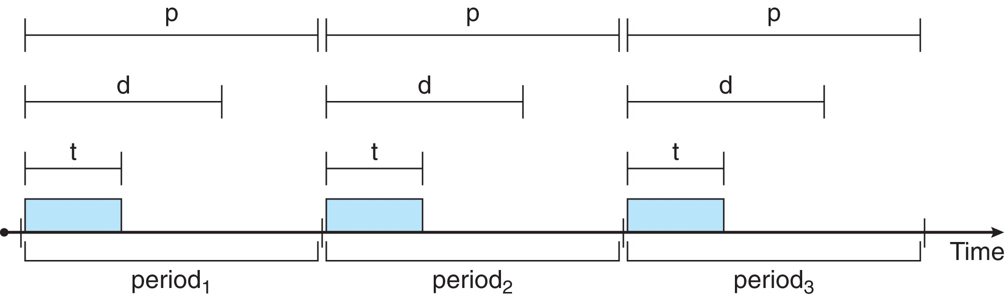
Priority-based Scheduling
Note that providing a preemptive, priority-based scheduler only guarantees soft real-time functionality. Processes have the characteristics: periodic ones require CPU at constant intervals (periods)
Has processing time t, deadline d, period p , in which 0 ≤ t ≤ d ≤ p
The rate of a periodic task is 1/p
A process may have to announce its deadline requirements to the scheduler. The scheduler decides whether to admit the process or not depending on whether it can guarantee that the process will complete on time (by its deadline)

Slide 8
Rate Montonic Scheduling
A static priority is assigned based on the inverse of its period
Shorter (longer) period = higher (lower) priority;
The rationale is to assign a higher priority to tasks requiring CPU more often

Slide 9
RM Scheduling: Example
Process | Processing Time | Deadline | Period
P1 | 1 | 2 | 4
P2 | 2 | 5 | 6
P3 | 3 | 7 | 9
P1
P2
P3
P1
P3
P2
P1
P3
P3
P1
P2
P3
0
1
4
6
10
12
16
3
5
8
9
13
15
Miss one deadline: P3 arrives at time 0 misses the deadline (7) by finishing at time 10

Slide 10
Earliest Deadline First Scheduling (EDF)
Earliest-deadline-first (EDF) scheduling assigns priorities dynamically according to the deadline
the earlier (later) the deadline, the higher (lower) the priority

Slide 11
EDF Scheduling: Example
Process | Processing Time | Deadline | Period
P1 | 1 | 2 | 4
P2 | 2 | 5 | 6
P3 | 3 | 7 | 9
P1
P1
P2
P3
P1
P3
P2
P2
P1
P3
P3
P2
4
8
10
12
0
1
3
5
7
9
13
14
16
Misses no deadlines

Slide 12
Critical Section Problem
The race condition - the results depend on the timing execution of the code. With some bad luck, i.e., context switches that occur at untimely points during the execution, the result could be wrong. In fact, we may get an indeterminate result , where it is not known what the output will be and it is indeed likely to be different across runs
A Critical Section is a piece of code that accesses a shared variable or a shared resource, thus race condition might occur and needs to be avoided
A critical section must NOT be concurrently executed by more than one thread – mutual exclusion. This guarantees that if one thread is executing within a critical section, the others will be prevented from doing so
The idea behind making a series atomic actions - “all or nothing”; it should either appear as if all of the actions be executed at once, or that none of them occurred. This prevents race condition
However, it is not of advantage to design “atomic update” of complex data structure, a matrix, for instance. Instead, a general set of synchronization primitives are designed, some with hardware support, in combination the operating system assistance

Slide 13
Solution to Critical-Section Problem
1. Mutual exclusion - If process P_{i} is executing in its critical section, no other processes can be executing in their critical sections
2. Progress - If no process is executing in its critical section and there exist some processes that wish to enter their critical sections, the selection of a process that will enter the critical section next cannot be postponed indefinitely – selection of one process entering
3. Bounded Waiting - A bound must exist on the number of times that other processes are allowed to enter their critical sections after a process has made a request to enter its critical section and before that request is granted – any waiting process

Slide 14
Peterson’s Solution
A classical software-based solution- this provides a good algorithmic description of solving the critical-section (CS) problem
Two-process solution
Assume that the load and store instructions are atomic; that is, cannot be interrupted
The two processes share two variables:
int turn;
Boolean flag[2]
The variable turn indicates whose turn (which process) it is to enter the critical section
The flag array is used to indicate if a process is ready to enter the critical section. flag[i] = true implies that process P_{i} is ready and requests to enter the CS

Slide 15
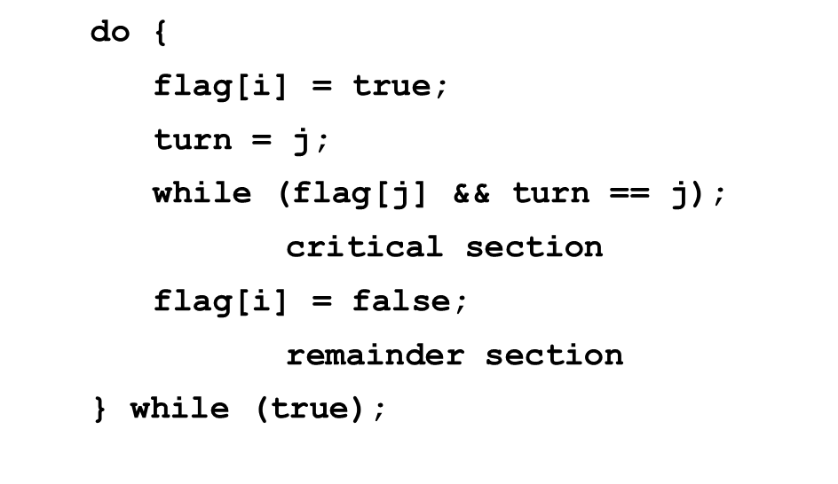
Algorithm for Process P_{i}
P₀
P₁
do {
flag[0] = true;
turn = 1;
while (flag[1] && turn == 1);
critical section
flag[0] = false;
remainder section
} while (true);
do {
flag[1] = true;
turn = 0;
while (flag[0] && turn == 0);
critical section
flag[1] = false;
remainder section
} while (true);

Slide 16
Peterson’s Solution – Proof
Mutual exclusion: P_{i} enters its critical section only if either flag[j] == false or turn ==i. If both processes are trying to enter the critical section flag[0]==flag[1] == true, the value of turn can be either 0 or 1 but not both
P_{i} can be prevented from entering its critical section only if it is stuck in the while loop with the condition flag[j]==true and turn==j;
If P_{j} is not ready to enter the critical section, then flag[j]==false and P_{i} can enter its critical section.
If P_{j} is inside the critical section, once P_{j} exits its critical section, it will reset flag[j]to false, allowing P_{i} can to enter its critical section. If P_{j} resets flag[j] to true, it must also set turn to i. Thus since P_{i} does not change the value of the variable turn while executing the while statement, P_{i} can will enter its critical section (progress) after at most one entry (bounded waiting)

Slide 17
Peterson’s Solution – Discussion
The solution works to protect “Critical Section” part of the codes, but
It is really complex even for a simple example – two processes
Codes are different for different threads, what if there are many
It involves “busy waiting”, when one thread is inside “Critical Section”, the other has to wait, wasting CPU cycles
OS provides better solutions (high level primitives) beyond load and store

Slide 18


