Slide 1
Stable Matching

Slide 2
The Stable Marriage Problem (input)
Goal. Given n men, n women, and their preference lists, find a "suitable" matching.
  Participants rate members of opposite sex.
  Each man lists women in order of preference from best to worst.
  Each woman lists men in order of preference from best to worst.
favorite
least favorite
favorite
least favorite
1st
2nd
3rd
1st
2nd
3rd
X
A
B
C
A
Y
X
Z
Y
B
A
C
B
X
Y
Z
Z
A
B
C
C
X
Y
Z
Men’s Preference lists
Women’s Preference lists
Notes:
med school admissions has some distracting asymmetries: each college looking for several applicants, but each student looking for one college; there may be more (fewer) applicants than available slots for colleges; each student does not apply to every college
"bare-bones" version of the problem; also a change of scenery
preserves essential nature of problem; in particular our solution to this simplified version extends to more general case

Slide 3
The Stable Marriage Problem (input)
Goal. Given n men, n women, and their preference lists, find a "suitable" matching.
  Participants rate members of opposite sex.
  Each man lists women in order of preference from best to worst.
  Each woman lists men in order of preference from best to worst.
Problem historically stated in terms of men/women but actually has broad applications
  Matching Medical students and Hospital residency places in US
  Auction mechanisms for sponsored internet search
  JUPAS
  ……
Notes:
med school admissions has some distracting asymmetries: each college looking for several applicants, but each student looking for one college; there may be more (fewer) applicants than available slots for colleges; each student does not apply to every college
"bare-bones" version of the problem; also a change of scenery
preserves essential nature of problem; in particular our solution to this simplified version extends to more general case

Slide 4
The Stable Marriage Problem (output)
A set of n m-w pairs that constitute a perfect and stable matching
Perfect matching: everyone is matched monogamously.
  Each man is matched to exactly one woman.
  Each woman is matched to exactly one man.
Stability: no incentive for any unmatched pair to undermine assignment by joint action.
  In matching M, an unmatched pair m-w is unstable if man m and woman w prefer each other to their current partners.
  Unstable pair m-w could each improve by divorcing their current partners and getting together.
Stable matching: perfect matching with no unstable pairs.
Stable marriage/matching problem. Given the preference lists of n men and n women, find a stable matching (if one exists).

Slide 5
Stable Matching Problem
Q. Is assignment X-C, Y-B, Z-A stable?
favorite
least favorite
favorite
least favorite
1st
2nd
3rd
1st
2nd
3rd
X
A
B
C
A
Y
X
Z
Y
B
A
C
B
X
Y
Z
Z
A
B
C
C
X
Y
Z
Men’s Preference Lists
Women’s Preference Lists

Slide 6
Stable Matching Problem
Q. Is assignment X-C, Y-B, Z-A stable?
No. X-B is an unstable pair. X and B prefer each other to their current matches (C and Y, respectively).
favorite
least favorite
favorite
least favorite
1st
2nd
3rd
1st
2nd
3rd
X
A
B
C
A
Y
X
Z
Y
B
A
C
B
X
Y
Z
Z
A
B
C
C
X
Y
Z
Men’s Preference Lists
Women’s Preference Lists

Slide 7
Stable Matching Problem
Q. Is assignment X-A, Y-B, Z-C stable?
A. Yes.
favorite
least favorite
favorite
least favorite
1st
2nd
3rd
1st
2nd
3rd
X
A
B
C
A
Y
X
Z
Y
B
A
C
B
X
Y
Z
Z
A
B
C
C
X
Y
Z
Men’s Preference Lists
Women’s Preference Lists

Slide 8
Stable Matching Problem
Q. Do stable matchings always exist?
A. Yes. (This is not obvious; we will prove later)
Q. Is the stable matching unique?
A. No. It is possible that there are several stable matchings
favorite
least favorite
favorite
least favorite
1st
2nd
3rd
1st
2nd
3rd
X
A
B
C
A
Y
X
Z
Y
B
A
C
B
X
Y
Z
Z
A
B
C
C
X
Y
Z
Men’s Preference Lists
Women’s Preference Lists
Notes:
Suffixes to check all 3 possible matchings: {A-B, C-D}, {A-C, B-D}, {A-D, B-C}

Slide 9
Propose-And-Reject Algorithm
Propose-and-reject algorithm. [Gale-Shapley 1962] Intuitive algorithm that guarantees to find a stable matching.
Initialize each person to be free.
while (some man is free and hasn't proposed to every woman) {
Choose such a man m
w = 1st woman on m's list to whom m has not yet proposed
if (w is free)
assign m and w to be engaged
else if (w prefers m to her fiancé m')
assign m and w to be engaged, and m' to be free
else
w rejects m
}
Shapley won Nobel Prize in Economics (partially) for this in 2012.
Gale was not eligible because he had died in 2008.

Slide 10
Proof of Correctness: Termination
Claim. Algorithm terminates after at most n² iterations of while loop.
Pf. A man starts from the first woman in his list and then continues in decreasing order of preference, without proposing to the same woman again. There are only n² possible proposals. ▪
Notes:
stable matching is unique for worst-case instance

Slide 11
Proof of Correctness: Perfection
Perfection means that in the end of the algorithm each man and woman gets matched to exactly one partner.
Observation 1. Men propose to women in decreasing order of preference.
Observation 2. Once a woman is matched, she never becomes unmatched; she only "trades up."
Claim. All men and women get matched.
Pf. (by contradiction)
  Suppose, for sake of contradiction, that man Z is not matched upon termination of algorithm.
  Then some woman, say A, is not matched upon termination.
  By Observation 2, A was never proposed to.
  But, Z must have proposed to everyone, since he ends up single. ▪

Slide 12
Proof of Correctness: Stability
Claim. No unstable pairs.
Pf. (by contradiction)
  Suppose A-Z is an unstable pair: each prefers each other to their partner in Gale-Shapley matching S*.
  Case 1: Z never proposed to A.
  ⇒ Z prefers his GS partner to A.
  ⇒ A-Z is stable.
  Case 2: Z proposed to A.
  ⇒ A rejected Z (right away or later)
  ⇒ A prefers her GS partner to Z.
  ⇒ A-Z is stable.
  In either case A-Z is stable, a contradiction. ▪
men propose in decreasing
order of preference
S*
A-Y
B-Z
. . .
women only trade up

Slide 13
Efficient Implementation
Efficient implementation. We describe O(n²) time implementation.
Representing men and women.
  Assume men are named 1, …, n.
  Assume women are named 1', …, n'.
Engagements.
  Maintain a list of free men, e.g., in a queue or stack.
  Maintain two arrays wife[m], and husband[w].
    if m matched to w then wife[m]=w and husband[w]=m
    Otherwise, set entry to 0 if unmatched
Men proposing.
  For each man, maintain a list (linked list or array) of women, ordered by preference.
Notes:
could use stack instead of queue for list of free men

Slide 14
Efficient Implementation
Women rejecting/accepting.
  Does woman w prefer man m to man m'?
  Naïve implementation requires O(n) time for this comparison.
  For each woman, create inverse of preference list of men.
  Constant time access for each query after O(n) preprocessing.
1’
1st
2nd
3rd
4th
5th
6th
7th
8th
Pref
8
3
7
1
4
5
6
2
1’
1
2
3
4
5
6
7
8
Inverse
4th
8th
2nd
5th
6th
7th
3rd
1st
Amy prefers man 3 to 6
since inverse[3] < inverse[6]
for i = 1 to n
inverse[pref[i]] = i
2
7

Slide 15
Understanding the Solution
Q. For a given problem instance, there may be several stable matchings. Recall that Gale-Shapely gives us freedom to decide which man proposes Do all executions of Gale-Shapley yield the same stable matching? If so, which one?
A. Yes, it always returns the (unique) matching that is optimal for the men (proof omitted).
Optimal for the men means: each man gets his best possible partner in any possible stable matching.
Observation. Man and Women are not equivalent in the algorithm.
Men propose, women accept/reject.
To get a woman optimal algorthm have women propose and men accept/reject.
Several variants of the problem exist with many applications.

Slide 16
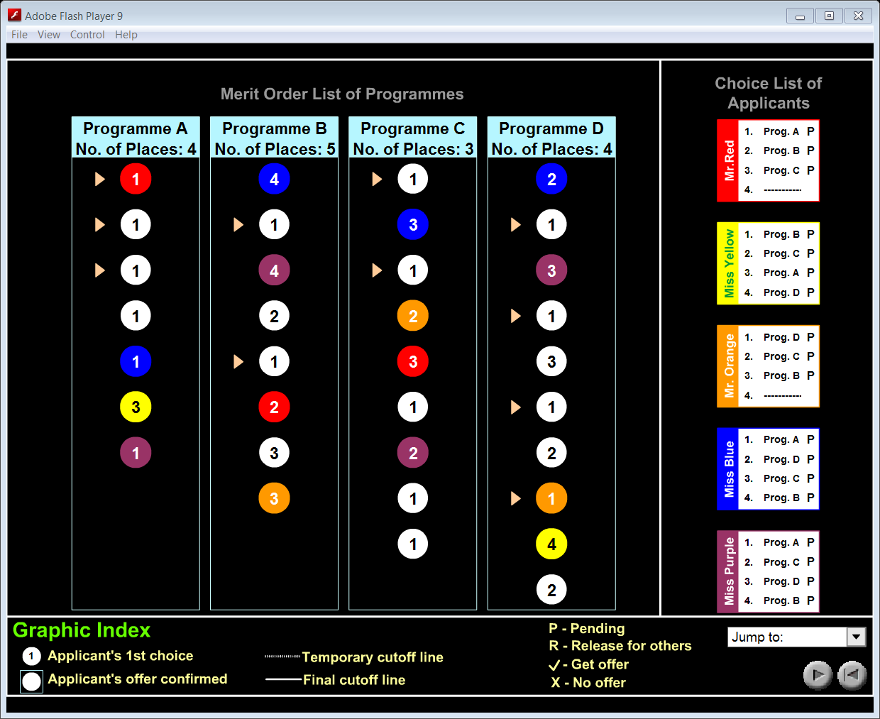
JUPAS Admission Scheme

Slide 17
JUPAS Admission Scheme
Applicants correspond to men that order their programme choices (which correspond to women).
Differences w.r.t. to the basic version of the problem:
Many more applicants than programme (places)
A programme is matched to many (instead of one) applicants.
# it’s matched to is its intake
http://www.jupas.edu.hk/
The JUPAS computer system will match (the "iteration process") the order of preference you have assigned to your programme choice list with the position you have been placed in each merit order list of these programmes. You will then be made an offer of the highest priority on your programme choice list for which you have the required rating.
In other words the matching is optimal (i.e., fair) for the applicants.

