Slide 1
COMP 221: Artificial Intelligence
http://www.cs.ust.hk/~qyang/221/
Instructor: Qiang Yang qyang@cs.ust.hk
Readings
  Required: Textbook by Russell & Norvig, 2nd Edition
  Recommended: various papers and books
Grading: see course website

Slide 2
Course Topics by Week
Weeks 1-4: Search (1 and 2-person) & Constraint Satisfaction
Weeks 5-7: KR&R I: Logic representation & Theorem Proving, KR&R II: Planning and Diagnosis
Weeks 8-9: Machine Learning
Nov 1: Midterm Exam, 19:00 to 21:00
Weeks 10-11: Machine Learning
Week 12: Games & Multi-agent
Week 13: Natural Language Processing, Applications
After Dec 3: Final Exam

Slide 3
Intro to Artificial Intelligence
Thanks: Professor Dan Weld

Slide 4
Historical Perspective
(4th C BC+) Aristotle, George Boole, Gottlob Frege, Alfred Tarski
  formalizing the laws of human thought
(16th C+) Gerolamo Cardano, Pierre Femat, James Bernoulli, Thomas Bayes
  formalizing probabilistic reasoning
(1950+) Alan Turing, John von Neumann, Claude Shannon
  thinking as computation
(1956) John McCarthy, Marvin Minsky, Herbert Simon, Allen Newell
  start of the field of AI

Slide 5
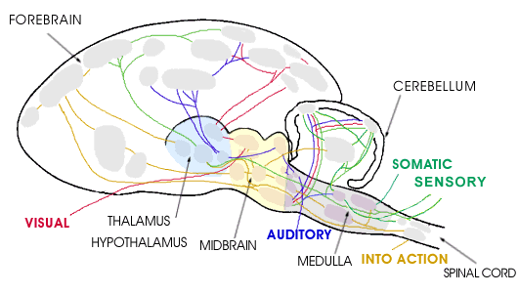
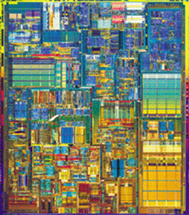
Hardware
10¹¹ neurons
10¹⁴ synapses
cycle time: 10⁻³ sec
10⁷ transistors
10¹⁰ bits of RAM
cycle time: 10⁻⁹ sec
Notes:
Far fewer interconnections!
Much faster update!

Slide 6
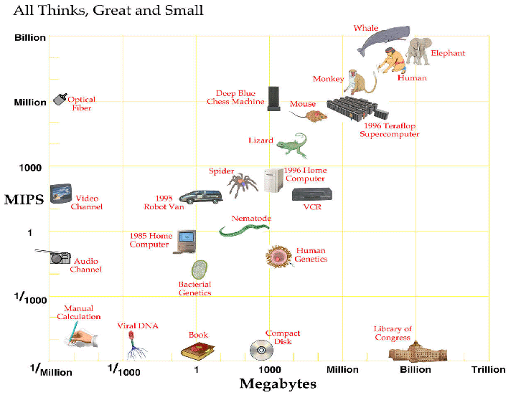
Computer vs. Brain

Slide 7
Evolution of Computers

Slide 8
Projection
In near future computers will have
  As many processing elements as our brain,
  But far fewer interconnections
  Much faster updates.
Fundamentally different hardware
  Requires fundamentally different algorithms!
  Very much an open question.

Slide 9
What is Intelligence?
The Turing test
Notes:
Ability to interact with world
Ability to PERCEIVE and ACT
Reasoning, Planning
Make decisions
Websters: “Capacity to learn and Understand Problems”
LEARNING and ADAPTATION: also major thrust at Microsoft Research!

Slide 10
Dimensions of the AI Definition
human-like vs. rational
Systems that think like humans
Systems that think rationally
thought
vs.
behavior
Systems that act like humans
Systems that act rationally

Slide 11
AI as Science
Science:
Where did the physical universe come from? And what laws guide its dynamics?
How did biological life evolve? And how do living organisms function?
What is the nature of intelligent thought?

Slide 12
AI as Engineering
How can we make software systems more powerful and easier to use?
  Speech & intelligent user interfaces
  Autonomic computing
  SPAM detection
  Mobile robots, softbots & immobots
  Data mining
  Modeling biological systems
  Medical expert systems...

Slide 13
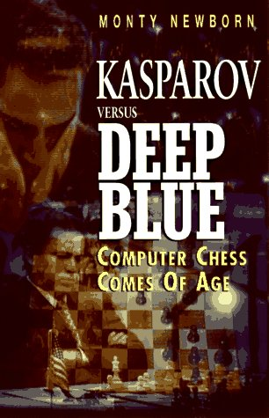
State of the Art
  Saying Deep Blue doesn’t really think about chess is like saying an airplane doesn’t really fly because it doesn’t flap its wings.
  – Drew McDermott
“
I could feel – I could smell – a new kind of intelligence across the table”
-Gary Kasparov

Slide 14

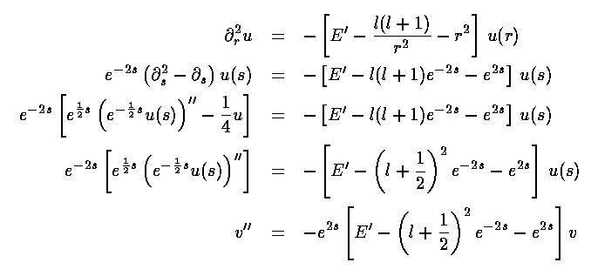
Mathematical Calculation

Slide 15
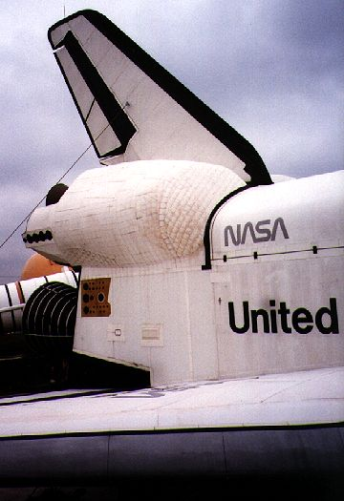
Shuttle Repair Scheduling

Slide 16
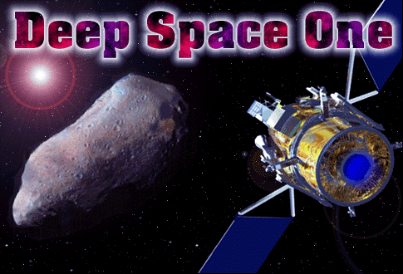
Started: January 1996
Launch: October 15th, 1998
Experiment: May 17-21
courtesy JPL
Notes:
Some Recent AI Success Stories

Slide 17
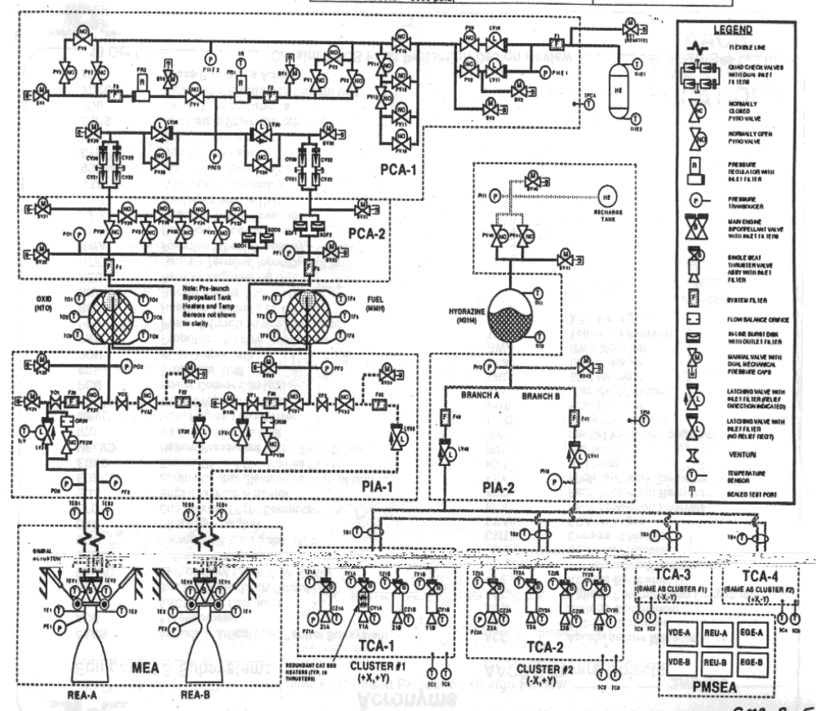
Compiled into 2,000 variable
SAT problem
Real-time planning and diagnosis

Slide 18
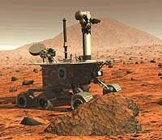
Mars Rover

Slide 19
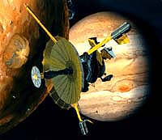
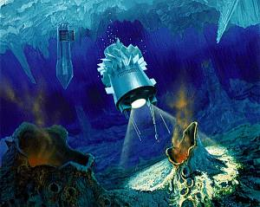
Europa Mission ~ 2018

Slide 20
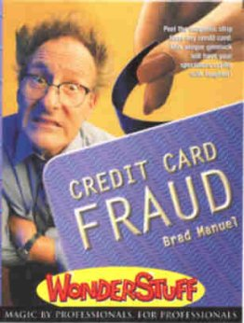
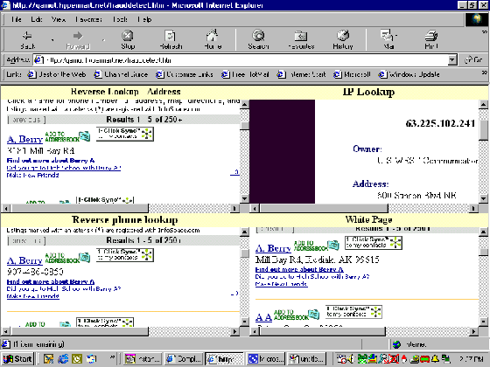
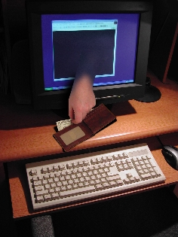
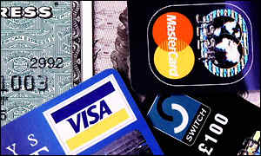
Credit Card Fraud Detection

Slide 21
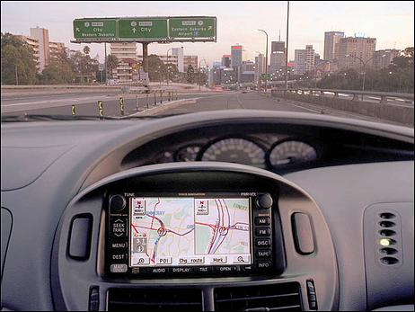
Speech Recognition

Slide 22
DARPA Grand Challenge
http://en.wikipedia.org/wiki/DARPA_Grand_Challenge

Slide 23
Limits of AI Today
Today’s successful AI systems
  operate in well-defined domains
  employ narrow, specialize knowledge
Commonsense Knowledge
  needed in complex, open-ended worlds
    Your kitchen vs. GM factory floor
  understand unconstrained Natural Language

Slide 24
Role of Knowledge in Natural Language Understanding
WWW Information Extraction
Speech Recognition
  “word spotting” feasible today
  continuous speech – rapid progress
Translation / Understanding
  limited progress
  The spirit is willing but the flesh is weak. (English)
  The vodka is good but the meat is rotten. (Russian)
Notes:
automatic translation only really successful in
very limited domains – eg weather reports
as a tool for human editors to extensively revise

Slide 25
How the heck do we understand?
John gave Pete a book.
John gave Pete a hard time.
John gave Pete a black eye.
John gave in.
John gave up.
John’s legs gave out beneath him.
It is 300 miles, give or take 10.
Notes:
Language understanding depends heavily on knowledge of the domain of discourse.
Consider Knowledge required just for the word “give”

Slide 26
How to Get Commonsense?
CYC Project (Doug Lenat, Cycorp)
  Encoding 1,000,000 commonsense facts about the world by hand
  Coverage still too spotty for use!
  (But see Digital Aristotle project)
Machine Learning
Alternatives?
Notes:
Machine learning – bootstrapping?
Data mining the web?
Reinforcement learning -

Slide 27
Recurrent Themes
Explicit Knowledge Representation vs. Implicit
  Neural Nets - McCulloch & Pitts 1943
    Died out in 1960’s, revived in 1980’s
    Simplified model of real neurons, but still useful; parallelism
  Brooks “Intelligence without Representation”

Slide 28
Recurrent Themes II
Logic vs. Probability
  In 1950’s, logic dominates (McCarthy, …
    attempts to extend logic “just a little” (e.g. non-monotonic logics)
  1988 – Bayesian networks (Pearl)
    efficient computational framework
  Today’s hot topic: combining probability & FOL & Learning

Slide 29
Recurrent Themes III
Weak vs. Strong Methods
  Weak – general search methods (e.g. A* search)
  Knowledge intensive (e.g expert systems)
    more knowledge ⇒ less computation
  Today: resurgence of weak methods
    desktop supercomputers
  How to combine weak & strong?

Slide 30
Recurrent Themes IV
Importance of Representation
  Features in ML
  Reformulation
The mutilated checkerboard
Checkerboard
Domino

Slide 31
AI: Topics
Agents
  Search thru Problem Spaces, Games & Constraint Sat
    One person and multi-person games
    Search in extremely large space
  Knowledge Representation and Reasoning
    Proving theorems
    Model checking
  Learning
    Machine learning, data mining,
  Planning
    Probabilistic vs. Deterministic
  Robotics
    Vision
    Control
    Sensors
    Activity Recognition

Slide 32
Intelligent Agents
Have sensors, effectors
Implement mapping from percept sequence to actions
percepts
Environment
Agent
actions
Performance Measure

Slide 33
Implementing ideal rational agent
Table lookup agents
Agent program
  Simple reflex agents
  Agents with memory
    Reflex agent with internal state
    Goal-based agents
    Utility-based agents

Slide 34
Simple reflex agents
AGENT
Sensors
what world is
like now
ENVIRONMENT
what action
should I do now?
Condition/Action rules
Effectors

Slide 35
Reflex agent with internal state
Sensors
What world was like
what world is
like now
How world evolves
ENVIRONMENT
what action
should I do now?
Condition/Action rules
AGENT
Effectors

Slide 36
Goal-based agents
Sensors
What world was like
what world is
like now
How world evolves
What my actions do
what it’ll be like
if I do acts A1-An
ENVIRONMENT
what action
should I do now?
Goals
AGENT
Effectors

Slide 37
Utility-based agents
Sensors
What world was like
what world is
like now
How world evolves
what it’ll be like
if I do acts A1-An
What my actions do
How happy
would I be?
ENVIRONMENT
Utility function
what action
should I do now?
AGENT
Effectors

Slide 38
Properties of Environments
Observability: full vs. partial vs. non
Deterministic vs. stochastic
Episodic vs. sequential
Static vs. … vs. dynamic
Discrete vs. continuous
Travel agent
WWW shopping agent
Coffee delivery mobile robot

