Slide 1
K Nearest Neighbor Classification Methods
Qiang Yang

Slide 2
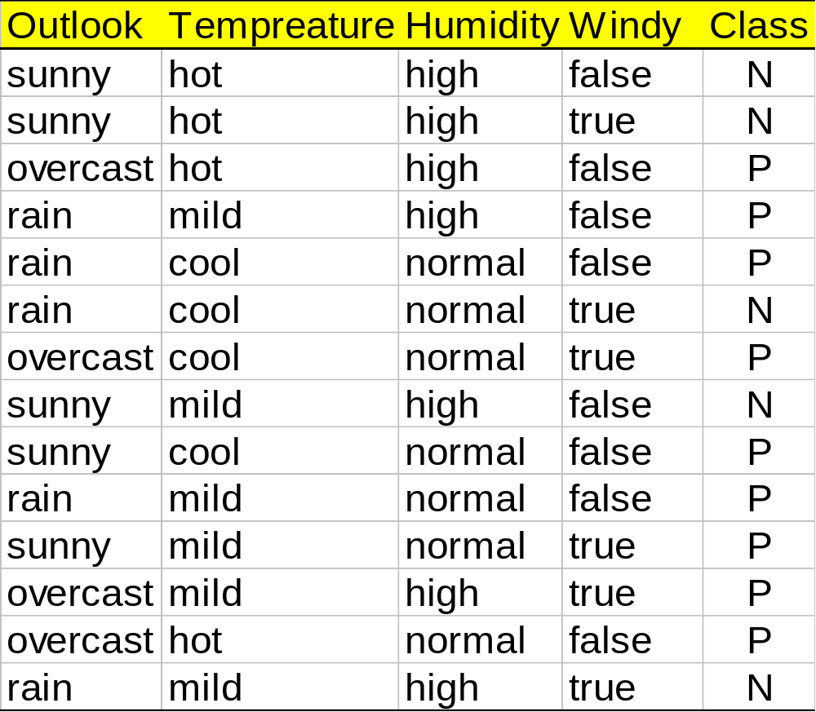
Training Set

Slide 3
The K-Nearest Neighbor Method
Used for prediction/classification
Given input x, (e.g., <sunny, normal, ..?>
#neighbors = K (e.g., k=3)
  Often a parameter to be determined
    The form of the distance function
  K neighbors in training data to the input data x:
    Break ties arbitrarily
All k neighbors will vote: majority wins
Weighted K-means
“K” is a variable:
  Often we experiment with different values of K=1, 3, 5, to find out the optimal one
Why important?
  Often a baseline
  Must beat this one to claim innovation
Forms of K-NN
  Document similarity
    Cosine
  Case based reasoning
    Edited data base
    Sometimes better than 100%
  Image understanding
    Manifold learning
    Distance metric

Slide 4
How to decide the distance?
Try 3-NN on this data:
Outlook | Temperature | Humidity | Windy | Play
sunny | hot | high | FALSE | no
sunny | hot | high | TRUE | no
overcast | hot | high | FALSE | yes
rainy | mild | high | FALSE | yes
rainy | cool | normal | FALSE | yes
rainy | cool | normal | TRUE | no
overcast | cool | normal | TRUE | yes
sunny | mild | high | FALSE | no
sunny | cool | normal | FALSE | yes
rainy | mild | normal | FALSE | yes
sunny | mild | normal | TRUE | yes
overcast | mild | high | TRUE | yes
overcast | hot | normal | FALSE | yes
rainy | mild | high | TRUE | no
testing

Slide 5
K-NN can be misleading
Consider applying K-NN on the training data
  What is the accuracy?
  Why?
  What should we do in testing?

