Slide 1
Search I: Chapter 3
Aim: achieving generality
Q: how to formulate a problem as a search problem?

Slide 2
Search (one solution)
Brute force
  DFS, BFS, iterative deepening, iterative broadening
Heuristic
  Best first, beam, hill climbing, simulated annealing, limited discrepancy
Optimizing
  Branch & bound, A*, IDA*, SMA*
Adversary Search
  Minimax, alpha-beta, conspiracy search
Constraint Satisfaction
  As search, preprocessing, backjumping, forward checking, dynamic variable ordering

Slide 3
Search (Internet and Databases)
Look for all solutions
Must be efficient
Often uses indexing
Also uses heuristics (e.g., Google )
More than search itself
  NLP can be important
  Scale up to thousands of users
  Caching is often used

Slide 4
Outline
Defining a Search Space
Types of Search
  Blind
  Heuristic
  Optimization
  Adversary Search
  Constraint Satisfaction
Analysis
  Completeness
  Time & Space Complexity

Slide 5
Specifying a search problem?
What are states (nodes in graph)?
What are the operators (arcs between nodes)?
Initial state?
Goal test?
[Cost?, Heuristics?, Constraints?]
7 2 3
1 2 3
4 1 6
4 5 6
E.g., Eight Puzzle
8 5
7 8

Slide 6
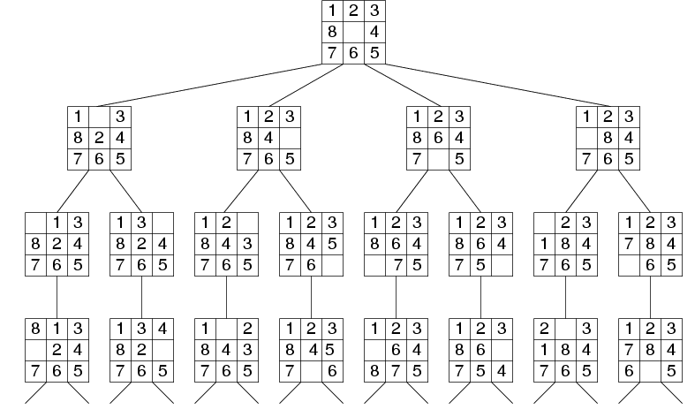
Example:
Fragment of 8-Puzzle Problem Space

Slide 7
Recap: Search thru a
Problem Space / State Space
Input:
  Set of states
  Operators [and costs]
  Start state
  Goal state [test]
Output:
  Path: start ⇒ a state satisfying goal test
  [May require shortest path]
Notes:
State Space Search is basically a GRAPH SEARCH PROBLEM
STATES are whatever you like!
OPERATORS are a compact DESCRIPTION of possible STATE TRANSITIONS – the EDGES of the GRAPH
May have different COSTS or all be UNIT cost
OUTPUT may be specified either as ANY PATH (REACHABILITY), or a SHORTEST PATH

Slide 8
Cryptarithmetic
Input:
  Set of states
  Operators [and costs]
  Start state
  Goal state (test)
Constraints:
  Assign only integers to letters
  no two letters share same digits
Output:
SEND
+ MORE
------
MONEY
Notes:
STATE: partial assignment of letters to numbers
GOAL state: TOTAL assignment that is a correct sum
OPERATOR: assign a number to a letter
DON’T CARE about PATH LENGTH. In fact, ALL solution paths exactly 8 LETTERS long!

Slide 9
Concept Learning
Labeled Training Examples
<p1,blond,32,mc,ok>
<p2,red,47,visa,ok>
<p3,blond,23,cash,ter>
<p4,…
Output: f: <blond,…> → {ok, ter}
Input:
  Set of states
  Operators [and costs]
  Start state
  Goal state (test)
Output:
Notes:
STATE: partial assignment of letters to numbers
GOAL state: TOTAL assignment that is a correct sum
OPERATOR: assign a number to a letter
DON’T CARE about PATH LENGTH. In fact, ALL solution paths exactly 8 LETTERS long!

Slide 10
Symbolic Integration
∫
E.g. x²e^{x} dx =
e^{x}(x²-2x+2) + C
Operators:
Integration by parts
Integration by substitution
…

Slide 11
Towers of Hanoi
What are states (nodes in graph)?
What are the operators (arcs between nodes)?
Initial state?
Goal test?
a
b
c

Slide 12
Towers of Hanoi: Domain
(define (domain hanoi)
(:predicates (on ?disk1 ?disk2)
(smaller ?disk1 ?disk2)
(clear ?disk))
(:action MOVE
:parameters (?disk ?source ?dest)
:precondition
(and (clear ?disk)
(on ?disk ?source)
(clear ?dest)
(smaller ?disk ?dest))
:effect
(and (on ?disk ?dest)
(not (on ?disk ?source))
(not (clear ?dest))
(clear ?source))))

Slide 13
Problem Instance: 4 Disks
(define (problem hanoi4)
(:domain hanoi)
(:length (:parallel 15))
(:objects D1 D2 D3 D4
P1 P2 P3)
(:init
(on D1 D2)
(on D2 D3)
(on D3 D4)
(on D4 P1)
(clear D1)
(clear P2)
(clear P3)
(smaller D1 D2)
(smaller D1 D3)
(smaller D1 D4)
(smaller D1 P1)
etc.
(:goal
(and
(on D1 D2)
(on D2 D3)
(on D3 D4)
(on D4 P3))))

Slide 14
Water Jug
You are given two jugs, a 4-gallon one and a 3-gallon one. Neither has any measure markers on it. There is a pump that can be used to fill the jugs with water.
How can you get exactly 2 gallons of water into the 4-gallon jug?

Slide 15
Waterjug
(x, y)
(2, 0) ->(…) In one step?
  (3, 0)
  (0, 0)
  (2, 4)
  ?
Fillx: (x, y)
  precond: (x<3)
  Postcond: (3, y)
Pour all of y into x:
  Precond: x+y<3
  Postcond (x+y, 0)

Slide 16
Planning
c
What is Search Space?
  What are states?
  What are arcs?
What is Initial State?
What is Goal?
Path Cost?
Heuristic?
a
b
PickUp(Block)
PutDown(Block)
a
b
c

Slide 17
Blocks World
Standard benchmark domain for search algorithms
Robot arm(s) can pick up blocks and stack them on other blocks
Straight stack constraint: at most one block can be on a block; any number can be on the table
Multiple arms operate synchronously in parallel

Slide 18
Blocks World in PDDL
(:predicates (on ?x ?y)
(on-table ?x)
(clear ?x)
(arm-empty ?a)
(holding ?a ?x))
(:action pick-up :parameters (?a ?obj)
:precondition
(and (clear ?obj)
(on-table ?obj)
(arm-empty ?a))
:effect
(and (not (on-table ?obj))
(not (clear ?obj))
(not (arm-empty ?a))
(holding ?a ?obj)))

Slide 19
Blocks World in PDDL
(:action put-down
:parameters (?a ?obj)
:precondition (holding ?a ?obj)
:effect
(and (not (holding ?a ?obj)
(clear ?ob)
(arm-empty ?a)
(on-table ?obj)))

Slide 20
Blocks World in PDDL
(:action stack
:parameters (?a ?obj ?underobj)
:precondition
(and (holding ?a ?obj)
(clear ?underobj))
:effect
(and (not (holding ?a ?obj))
(not (clear ?underobj))
(clear ?obj)
(arm-empty ?a)
(on ?obj ?underobj)))

Slide 21
Blocks World in PDDL
(:action unstack
:parameters (?a ?sob ?underobj)
:precondition
(and (on ?obj ?underobj)
(clear ?obj)
(arm-empty ?a))
:effect
(and (holding ?a ?obj)
(clear ?underobj)
(not (clear ?obj))
(not (arm-empty ?a))
(not (on ?obj ?underobj)))))

Slide 22
Problems in PDDL
;;; bw-large-a
;;;
;;; Initial: 3/2/1 5/4 9/8/7/6
;;; Goal: 1/5 8/9/4 2/3/7/6
(define (problem bw-large-a)
(:domain prodigy-bw)
(:objects 1 2 3 4 5 6 7 8 9 a1 a2)
(:init (arm-empty a1) (arm-empty a2)
(on 3 2)
(on 2 1) etc

Slide 23
Missionaries and Cannibals
.
What are states (nodes in graph)?
What are the operators (arcs between nodes)?
Initial state?
Goal test?
Try at least 2 Representations
m m m
c c c

Slide 24
Search Strategies
Blind Search
  Depth first search
  Breadth first search
  Iterative deepening search
  Iterative broadening search
Heuristic Search
Optimizing Search
Constraint Satisfaction

Slide 25
Tree-Search (problem, fringe) returns a solution, or failure
Page 72 of R&N
fringe <- Insert (Make-Node (Initial-State (problem)));
Loop do
  If fringe is empty then return failure;
  node <- Remove-First (fringe);
  If Goal-Test(problem) applied to State(node) succeeds then return Solution (node);
  fringe = Insert-All (Expand (node, problem), fringe);
End Loop
(solution returns the sequence of actions obtained by following parent pointers back to the root)

Slide 26
What is in a node?
State = m(i, j) (in 8-puzzle)
Action=the last action taken to get to state
Depth from root of tree
Path-Cost from root of tree (assume we know step cost).
Parent node pointer

Slide 27
Expand(node, problem) returns a set of nodes
Page 72 of R&N
Successors = empty set;
For each <action, result> in ; result = after applying action
  Successor-FN[problem](State[node]) do
  S = a new node
  State[S]=result; parent-node[S]=node; action[S]=action
  Path-cost[S]=path-cost[node]+step-cost[node, action, S];
  Depth=depth[node]+1;
  add S to Successors
Return Successors

Slide 28
Search with Trees
Consider an example
Page 76 of text
Initially: fringe = [A]
Look for goal: M

Slide 29
Heuristic Search
A heuristic function is:
  Function from a state to a real number
    Low number means state is close to goal
    High number means state is far from the goal
  Every node has a function f(node)!
Designing a good heuristic is very important!
(And hard)
More on this in a bit...

Slide 30
Depth First Search
Maintain stack of nodes to visit for fringe
Evaluation
  Complete?
  Time Complexity?
  Space Complexity?
Not for infinite spaces
O(b^d)
a
O(d)
b
c
d
e
f
g
h

Slide 31
Breadth First Search
Maintain queue of nodes to visit for fringe
Evaluation
  Complete?
  Time Complexity?
  Space Complexity?
Yes
a
O(b^d)
b
c
O(b^d)
d
e
f
g
h

Slide 32
Iterative Deepening Search
DFS with limit; incrementally grow limit (page78)
a
b
c

Slide 33
Iterative Deepening Search
DFS with limit; incrementally grow limit
Evaluation
  Complete?
  Time Complexity?
  Space Complexity?
Yes
a
O(b^d)
b
c
O(d)
d
e
f
g
h

Slide 34
Iterative Deepening DFS
For depth = 0 to infinity do
  result = Depth-Limited-Search (problem, depth);
  If result != cutoff, then, return result;

Slide 35
Complexity of IDS?
Space?
Best Time?
Worst Time?
Avg Time?

