Slide 1

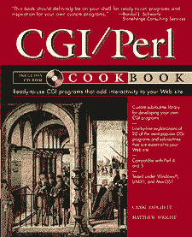
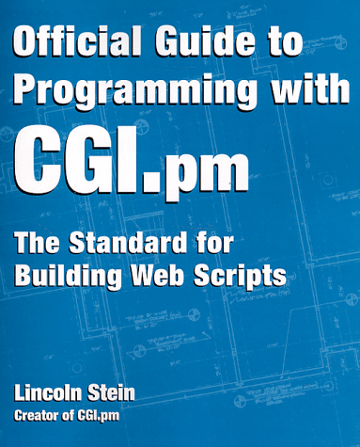

Software Tools
CGI Programming
in Perl

Slide 2
CGI Programming
Last time we looked at designing a static web page. Today we will see how to design dynamic web pages using CGI programs.
A CGI program allows the user to interact with a web page by generating HTML code that depends on the user input.
For example, web pages with an entry form or buttons use a CGI program to get the input from the user, and display appropriate results.
Since the Web mainly contains text, Perl is the most popular language for CGI programming because it is good at text manipulation.

Slide 3
CGI Programming
cssystem considers CGI programs a security risk, and does not allow them.
ITSC, however, allows CGI programs
    e.g., uststu1.ust.hk, uststu2.ust.hk
Place your CGI programs in a directory called cgi-bin in your public_html directory. mkdir $HOME/public_html/cgi-bin
Then, place your CGI programs under the directory $HOME/public_html/cgi-bin and the URL is :
http://home-cgi.ust.hk/cgi-bin/cgiwrap/~login/program.cgi
Your CGI program should also have execute permission set: chmod a+x program.cgi

Slide 4
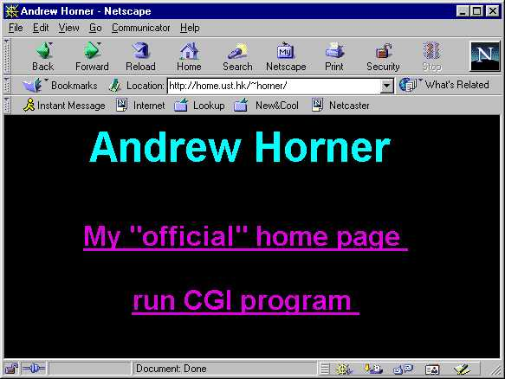
My ITSC Home Page

Slide 5
HTML of My Home Page
<HTML>
<HEAD><TITLE>Andrew Horner</TITLE></HEAD>
<BODY TEXT="aqua" LINK="violet" VLINK="deepviolet" ALINK="green" BGCOLOR="black">
<P ALIGN=CENTER><B><font size="8" face="Arial">
Andrew Horner</font></B></P>
<P ALIGN=CENTER><B><font size="6" face="Arial">
<a href="http://www.cs.ust.hk/~horner">My "official" home page</a></font></B></P>
<P ALIGN=CENTER><B><font size="6" face="Arial">
<a href="http://home-cgi.ust.hk/cgi-bin/cgiwrap/~horner/hello.cgi"> run CGI program</a></font></B></P>
</BODY>
</HTML>

Slide 6
Hello World CGI Program
Here is a “Hello World” CGI program:
#!/usr/local/bin/perl5 -w
# hello world CGI program
print <<END_OF_MULTILINE_TEXT;
Content-type: text/html
<HTML>
<HEAD>
<TITLE>Hello World Program</TITLE>
</HEAD>
<BODY>
<H1>Hello World!</H1>
</BODY>
</HTML>
END_OF_MULTILINE_TEXT
Blank line (no spaces or tabs) required!

Slide 7
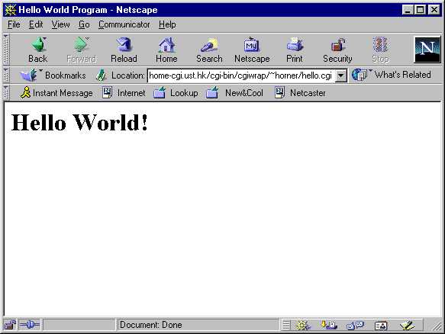
Hello World Output

Slide 8
Here Documents
The previous example uses a here document.
It starts with the << and a word called the end token (END_OF_MULTILINE_TEXT).
Here documents are a convenient way to quote a multiline string.
The string begins on the next line and continues up to a line containing the end token at the start of the line.
Here documents are very useful for generating HTML.

Slide 9
Hello World Details
The Content-type line identifies the type of output we are generating (text/html).
It is immediately followed by a blank line, which must contain no spaces or tabs. This line separates the CGI header from the HTML code.
After the blank line comes the HTML, which is sent to be formatted and displayed on the user’s browser.

Slide 10
Testing CGI Programs
Make sure your program runs properly from the command line before testing it on the web:
$ ~horner/public_html/cgi-bin/hello.cgi
Content-type: text/html
<HTML>
<HEAD>
<TITLE>Hello World Program</TITLE>
</HEAD>
<BODY>
<H1>Hello World!</H1>
</BODY>
</HTML>
$

Slide 11
The CGI Module
Using here documents in Perl is still a painful way to generate HTML.
Perl has a CGI module to make it easier.
To use the CGI module in your program, include the following line near the top of your program:
use CGI qw(:standard);
The use statement is like #include in C++; it brings in predefined functions from another file at compile time.

Slide 12
Simpler Hello World
Below is the “Hello World” program using the CGI module:
#!/usr/local/bin/perl5 -w
# hello world CGI program using CGI module
use CGI qw(:standard);
print header();
print start_html("Hello World Program");
print h1("Hello World!");
print end_html();
CGI module functions return strings, which we can then send to print.
Notes:
http://home-cgi.ust.hk/cgi-bin/cgiwrap/~horner/hello1.cgi

Slide 13
Simpler Hello World
In the previous program,
  header() returns a string containing the Content-type line with a following blank line
  start_html(string) returns string as an HTML title
  h1(string) returns string as a first-level HTML heading, and
  p(string) would return string as a new HTML paragraph.

Slide 14
Adding Textfields
CGI provides various widgets for accepting user input in forms.
One of the most common widgets is the textfield widget, which allows the user to enter text in a box.
In addition to start_html(), you also need start_form() before you add your textfield.
textfield() is often called inside a p() function.
  The first argument is the name of the textfield
  The second argument is the default value.
print start_form;
print p("Bill is: ", textfield("bill","cheap"));
print end_form;

Slide 15
Hello Gates
A form with a textfield widget:
#!/usr/local/bin/perl5 -w
# Bill Gates CGI program
use CGI qw(:standard);
$billvalue = param("bill"); # get value from bill-field
print header(), start_html("Hello Bill Gates");
print h1("Hello Gates Lovers!");
if($billvalue){ # display, if user has hit Return
print p("Yes, Bill is $billvalue.");
}else{ # otherwise, ask for user-input
print hr, start_form; # hr() is <HR> HTML
print p("Bill is: ", textfield("bill","cheap"));
print end_form, hr;
}
print end_html();

Slide 16
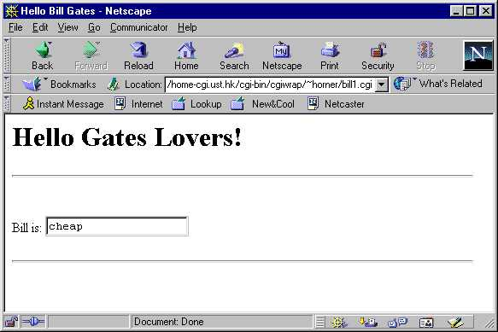
Hello Gates Initial Screen
When we click on a link that points to this program, you will see the below screen.
The text field is initially filled with the default value.
Notes:
http://home-cgi.ust.hk/cgi-bin/cgiwrap/~horner/bill1.cgi

Slide 17
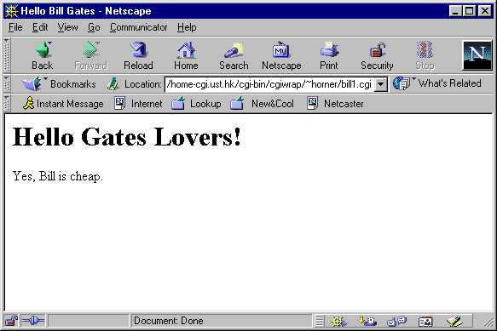
Hello Gates Result Screen
If the user does not change the default value, but hits return, the following is displayed:

Slide 18
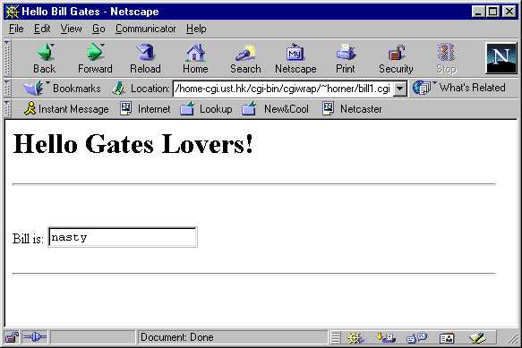
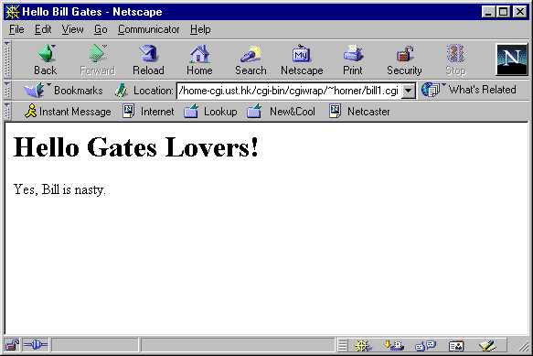
Hello Gates Screens
If the user changes the bill field as in the left screen, the right screen results:

Slide 19
Other Form Widgets
Now we know how to create simple text fields and respond to them.
What about other widgets like buttons, checkboxes, and menus?
The program on the following slides includes:
  popup menus,
  a submit button (named “send”), and
  a button to reset the entire form, erasing all user input.

Slide 20
Bill’s Fans page1
#!/usr/local/bin/perl5 -w
# Bill Gates CGI program v. 2
use strict;
use CGI qw(:standard);
print header(), start_html("Bill Gates Fans");
print h1("Bill Gates Fan Page");
if(param()){ # if the form has already been filled out
my $who = param("name");
my $what = param("billWord");
my $howmuch = param("money");
if($howmuch == 100){
print p("Yes $who, Bill is $what, and he has 100,000,000
times more money than you!");
}else{
print p("Incorrect $who! Bill has US\$100 billion.");
}
Notes:
http://home-cgi.ust.hk/cgi-bin/cgiwrap/~horner/bill2.cgi

Slide 21
Bill’s Fans page2
}else{ # first time, so display clean form
print hr(), start_form();
print p("Your name: ", textfield("name"));
print p("What is Bill? ",
popup_menu("billWord", ["cheap", "rich", "powerful"]));
print p("How many billion US dollars does Bill have? ",
popup_menu("money", [1,10,100,1000]));
print p(submit("send"), reset("clear"));
print end_form;
}
print end_html();

Slide 22
References
Why the square brackets around the arrays in the previous example?
["cheap", "rich", "powerful"]
[1,10,100,1000]
The brackets create a reference (pointer) to an array.
popup_menu() expects an array reference as its second argument.
You can also create an array reference by using a backslash in front of a named array, as in \@choices:
my @choices = qw(cheap, rich, powerful);
print p("What is Bill? ", popup_menu("billWord", \@choices));

Slide 23
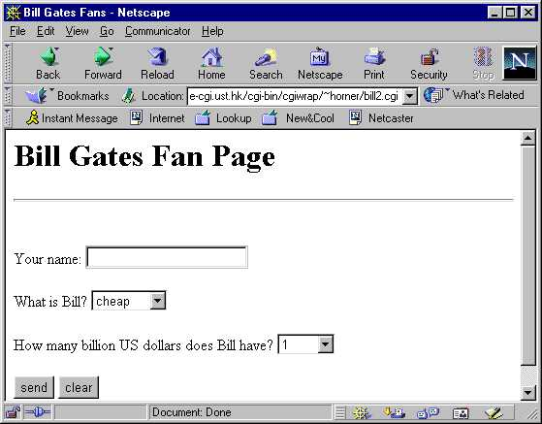
Bill’s Fans Initial Screen
Here is the initial screen and default values the user sees:
Notes:
http://home-cgi.ust.hk/cgi-bin/cgiwrap/~horner/bill2.cgi

Slide 24
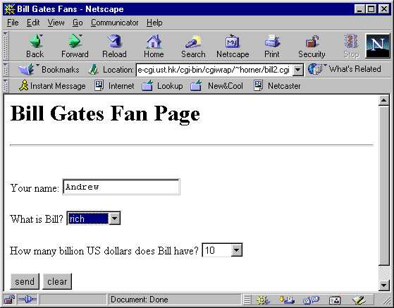
Bill’s Fans Initial Screen
The user fills in the form:

Slide 25
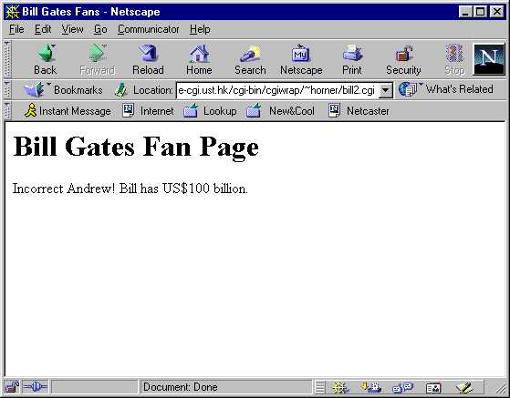
Bill’s Fans Result Screen
The resulting screen after the hitting “send”:

Slide 26
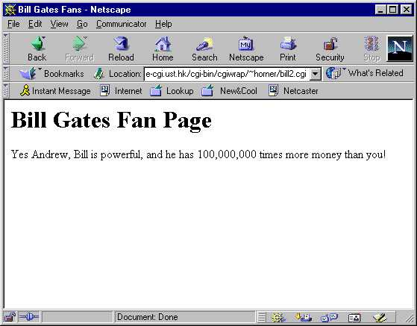
Bill’s Fans Result Screen
The resulting screen after the re-submitting the correct value:

