Slide 1

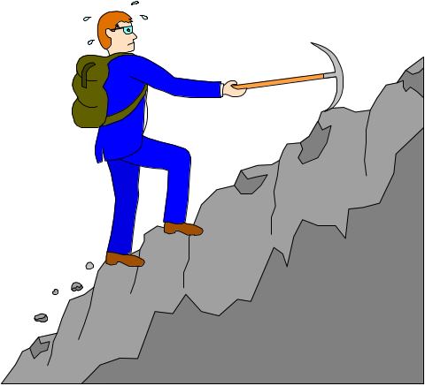

Software Tools
Server Push
and
Client Pull

Slide 2
Dynamic Documents
Browsers have always been driven by user input. You click on a link or an icon or an image and some data comes to you.
As soon as people saw that, they wanted servers to be able to push new data to the browser.
An obvious example is a businessman who wants to see new stock quotes every 5 minutes.
Until recently, that has not been possible.
Browsers recently added two complementary methods for generating dynamic documents: server push and client pull.

Slide 3
Server Push Idea
Server push idea:
The server sends a chunk of data.
The browser displays the data, but leaves the connection open.
The server sends more data whenever it wants and the browser displays it, always leaving the connection open.

Slide 4
Client Pull Idea
Client pull idea
The server sends a chunk of data, including a command that says "reload this data in 5 seconds", or "go load this other URL in 10 seconds”.
After the specified time has elapsed, the client either reloads the current data or gets the new data.

Slide 5
Server Push vs. Client Pull
In server push, a HTTP connection is held open for an indefinite period of time (until the server sends a terminator, or until the client interrupts the connection).
In client pull, a HTTP connection is never held open. Instead, the client is told when to open a new connection, and what data to get.

Slide 6
Server Push vs. Client Pull
Server push is like when you are talking on the phone with your girlfriend all evening: you talk for a while, she talks for a while, you start watching TV, she is shopping for clothes, but you never hang-up.
Client pull is like making several phone calls only when you have something to say: you call your Mom and tell her you will be home at 6PM, then you hang-up, later you call her again, and tell her it will be 8PM, then you hang-up, and finally you call her again and tell her you won't be coming home tonight!

Slide 7
Client Pull Example 1
A simple use of client pull is to periodically reload a document.
For example, name the following document doc1.html and try loading it in Netscape:
<HTML><HEAD>
<META HTTP-EQUIV="Refresh" CONTENT=1>
<title>Document ONE</title>
</HEAD><BODY>
<h1>Bill is great!</h1>
</BODY></HTML>
You will notice that the document reloads itself once a second.

Slide 8
Client Pull
If we wanted to wait 12 seconds instead, we could have used this HTML command:
<META HTTP-EQUIV="Refresh" CONTENT=12>
Make sure the META tag is inside the HEAD of your HTML document, before any displayed text or images.
You can interrupt the infinite reloading by pressing the "Back" button.

Slide 9
Client Pull
You can also cause another document to be reloaded in place of the current document.
The META tag would be:
<META HTTP-EQUIV="Refresh" CONTENT="12; URL=http://home.ust.hk/~horner/doc2.html">
Important note: Use the full pathname in the URL (e.g. http://whatever/whatever). Do not use a relative URL.

Slide 10
Client Pull Example 2
The following example shows two HTML documents, doc2.html and doc3.html, each of which causes the other to load (so if you load one, your browser will flip back and forth between them forever).
Here is doc2.html:
<HTML><HEAD>
<META HTTP-EQUIV=REFRESH CONTENT="1;
URL=http://home.ust.hk/~horner/doc3.html">
<title>Document TWO</title>
</HEAD><BODY>
<h1>Bill is greater!</h1>
</BODY></HTML>

Slide 11
Client Pull Example 2
Here is doc3.html:
<HTML><HEAD>
<META HTTP-EQUIV=REFRESH CONTENT="1;
URL=http://home.ust.hk/~horner/doc2.html">
<title>Document THREE</title></HEAD><BODY>
<h1>Bill is greatest!</h1></BODY></HTML>
When you load one of the documents, the browser will load the other in 1 second, then the first in another second, then the second again in another second, and so on forever.

Slide 12
Client Pull
How do you stop it?
The easiest way is to either close the window, or quickly change the URL address.
Neat trick: The reload interval can be 0 seconds! This will cause the browser to load the new data as soon as it possibly can (after the current data is fully displayed).
Another neat trick: The HTML data can be of any type: a table, an image, an audio clip, whatever. One fun thing to do is a 0-second update of a series of still images for a poor man's animation.

Slide 13
Server Push
Server push is the other dynamic document method, complementing client pull.
Unlike client pull, server push uses a connection that is held open over multiple responses, so the server can send more data any time it wants.
The major advantage is that the server has total control over when and how often new data is sent.
Also, this method can be more efficient, since new HTTP connections do not have to be opened all the time.
Also, server push is easily interruptible (you can just hit "Stop" and interrupt the connection).

Slide 14
Accessing Server Push
You should also store your server push CGI programs in cgi-bin.
However, to access them from a web page, the URL is slightly different:
<P ALIGN=CENTER><B><font size="3" face="Arial">
<a href="http://home-cgi.ust.hk/cgi-bin/nph-cgiwrap/~horner/counter.cgi">
server push: date</font></B></P>
The nph means “non-parsed headers” in the cgiwrap wrapper program. If you forget and use the regular cgiwrap, it will cause a “CGI Programming Error” message when you try to access the program.

Slide 15
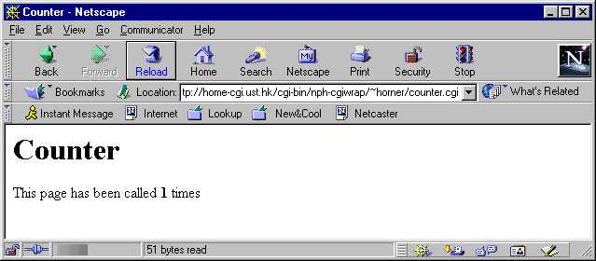
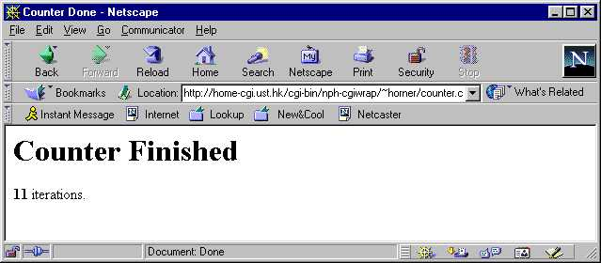
Counter Example: Output
The top screen will be displayed until the counter reaches 10.
Then the bottom screen will replace it.

Slide 16
Counter Example page1
#!/usr/local/bin/perl5.00404
use CGI::Push qw(:standard);
do_push(-next_page=>\&next_page,
-last_page=>\&last_page,
-delay=>0.5);
Need most-recent Perl version available on ITSC server
Include CGI Push module
delay is number of seconds between reloads
do_push() takes as input references to 2 functions and a delay. The first function is called repeatedly until returning undef, when the last function is called once.

Slide 17
Counter Example page2
sub next_page {
my($q,$counter) = @_;
if($counter >= 10){
return undef;
}
return start_html("Counter"),
h1("Counter"),"\n",
"This page has been called ", strong($counter)," times",
end_html();
}
subroutine to generate HTML counter
The Push module will pass 2 scalars to the function. The second scalar is how many times the function has been called.
return undef to break loop
Output the HTML to the return statement

Slide 18
Counter Example page3
sub last_page {
my($q,$counter) = @_;
return start_html("Counter Done"),
h1("Counter Finished"),
strong($counter), " iterations.",
end_html;
}
Same idea as next_page(), except this function is only called once at the end to display the final HTML page.

Slide 19
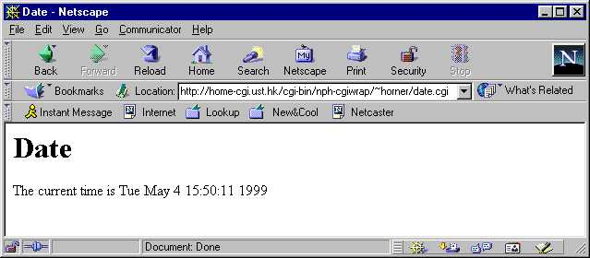
Date Example: Output
The following example shows the current time indefinitely (until the user hits the “Stop” or “Back” buttons), updating the time each second.

Slide 20
Date Example
#!/usr/local/bin/perl5.00404
use CGI::Push qw(:standard);
do_push(-next_page=>\&date_page,
-last_page=>\&date_page,
-delay=>1.0);
sub date_page {
return start_html("Date"),
h1("Date"),"\n",
"The current time is ", scalar(localtime),"\n",
end_html();
}
same page used as last page
1-second delay
no exit condition, loops indefinitely
converts date output to easy-to-read format

Slide 21
Accessing Server Push
Don’t forget!
To access your server push CGI program, the URL is slightly different from other CGI programs (even though they are stored in the same directory):
<P ALIGN=CENTER><B><font size="3" face="Arial">
<a href="http://home-cgi.ust.hk/cgi-bin/nph-cgiwrap/~horner/date.cgi">
server push: date</font></B></P>

