Slide 1


Software Tools
Introduction to UNIX

Slide 2
Instructor
Huamin Qu
Office Rm 3508
Email huamin@ust.hk
Web www.huamin.org
Office hours: After class
Tu & Th 16:30 – 17:30
By appointment

Slide 3
TAs
Chuck-Jee Chau (Jee) (Quiz & Lab Questions)
Haomian Wang (Eric) (Lab 1A)
Ka-Kei Chung (Charles) (Lab 1B)
Wing-Yi Chan (Winnie) (Lab 1C)

Slide 4
Course Home Page
The course home page
http://www.cse.ust.hk/~huamin/111/index.htm

Slide 5
Grading
10 Lab assignments 20% (2% each)
Midterm Exam 50% (12 April)
Project and Presentation 30% (Last 6 lectures)

Slide 6
Comp111
Project & Presentation General Topics
For the comp111 project, you will devise, implement, and document your own custom application.
You will choose your own topic that includes Unix, Shellscripting, or Perl:
  Your own Shellscript custom application
  Your own Perl script custom application
  Your own Perl CGI custom application
  Your own Server Push/Client Pull custom application

Slide 7
COMP111 Project & Presentation
You will work in groups of normally 4 people.
Presentations will be in the last 6 classes of the semester.
The tentative format for the project is the following:
  7-minute presentation (like short conference presentation, or my lectures)
  3-minutes for Q&A (while the next group sets up)
You will turn in by 21 Apr 2008 (email me):
  a softcopy of your PowerPoint notes
  a softcopy of a short paper (4 pages) summarizing your presentation
  any source code (Perl, shellscripts)

Slide 8
Topics
Unix system
Shell programming
Perl
Regular expressions
Web programming (HTML & CGI)
Server

Slide 9
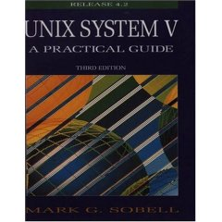
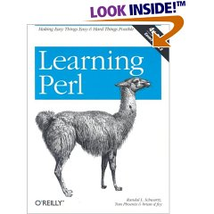
Course Texts

Slide 10
Class
In class we will have
  Lectures
  In-class exercises
  Quizs

Slide 11
Quiz
The quotation “It’s a Unix system. I know this” appears in movie
2001: A Space Odyssey
Jurassic Park
Star Wars
Alien

Slide 12
Answer
http://www.youtube.com/watch?v=bhOk2H2Mv6U&feature=related

Slide 13
Jurassic Park (1993)
“It’s a Unix system. I know this”
The park software is written in Pascal; a program is clearly visible in one of the monitor close-ups on the UNIX system.
From http://www.imdb.com/title/tt0107290/trivia

Slide 14




What is UNIX?
UNIX is an Operating System (OS).
An operating system is a control program that helps the user communicate with the computer hardware.
The most popular operating systems: Windows -- from Microsoft. (Windows is the “Big Mac” of operating systems -- cheap and “billions served”.)
UNIX was developed long before Windows, about 36 years ago at AT&T Bell Labs in the US.

Slide 15
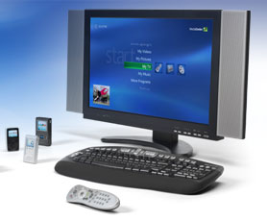

What is UNIX?
UNIX is an operating system for experts, used on high-end workstations, database servers, and web servers.
UNIX provides some powerful features:
  security - private and shared files
  multi-user support
  data sent to display, files, or printers in same way
  interprocess communication
Microsoft keeps trying to upgrade Windows to try to replace UNIX as the “OS for experts”.
  WindowsXP for client
  Windows Server 2003 R2, Exchange Server 2007 for server

Slide 16



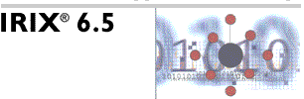

UNIX Versions
There are two main types of UNIX:
  BSD (Berkeley Software Distribution)
  System V (developed at AT&T)
Our book covers UNIX System V
There are many different versions of
UNIX for different hardware:
  Linux for the PC, including
    Mandriva (running in CS Lab2, some PG/faculty desktops, and Linux CPU servers; used to be called Mandrake)
    Red Hat
    Fedora Core (free community version of Red Hat)
    Debian (freeware)
  Sun Microsystem’s Solaris
  Hewlett-Packard’s HP-UX
  IBM’s AIX
  SGI’s IRIX

Slide 17






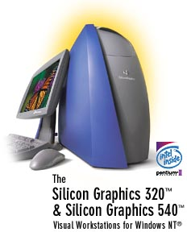


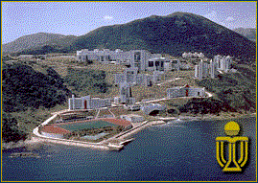
Who Uses UNIX?
Big companies. They especially use UNIX servers, preferring its stability. They can afford to hire employees with UNIX experience.
  Computer manufacturers such as Sun, SGI, IBM, and HP
  Computer chip manufacturers like Motorola & Intel
  Software companies
  Banks
  Hong Kong Government
  Hospital Authority
  Universities
Small companies that use Linux
  OS free

Slide 18
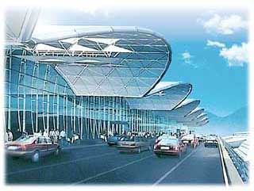

Most Important Feature of UNIX
Most important feature of UNIX: STABILITY
  36 years to get the bugs out
  Important in shared environments and critical applications
Shared Environments Example: University
  Windows crashes 1-2 times/month in labs
  UNIX servers crash usually only when hard disk fails
  UNIX more reliable than Windows
Critical Applications
  Bank – Don’t want to lose money in ATM transactions!
  Hospital - Don’t want to wait for reboot during operation!
  Airport - Air traffic control landing planes.
  PCW - Don’t want phone system going down!

Slide 19
Unix History
http://www.levenez.com/unix/
http://www.princeton.edu/~mike/unixpeople.htm
http://www.bell-labs.com/history/unix/
http://www.cs.uchicago.edu/~mark/51081/lecture.1/lecture.1.ppt

Slide 20

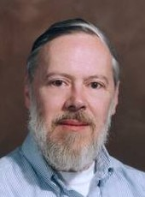
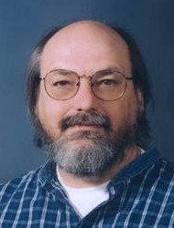




Key Persons
Brian Kernighan | Dennis Ritchie | Ken Thompson | Bill Joy | Steve Jobs | Linus Torvalds | Richard Stallman

Slide 21
Key Persons
Brian Kernighan | Dennis Ritchie | Ken Thompson | Bill Joy | Steve Jobs | Linus Torvalds | Richard Stallman
Quiz: Which key person has visited HKUST before?

Slide 22
Key Persons
Ken Thompson (Turing Award 1983)
Dennis Ritchie (Turing Award 1983)
“ For their development of generic operating systems theory and specifically for the implementation of the UNIX operating system”

Slide 23
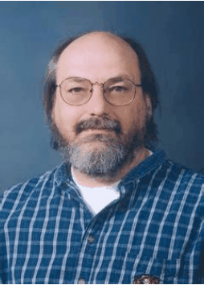
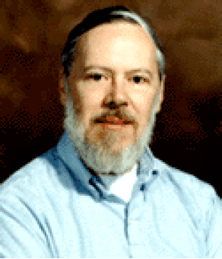

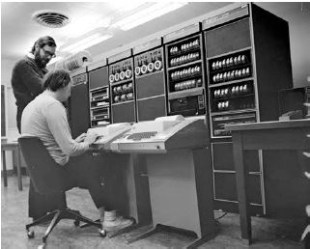
History of Unix (1960s)
Multics (Multiplexed Information and Computing Service) Operating System
Key players
  AT&T Bell
  Thompson and Dennis Ritchie

Slide 24
History of Unix (1970s)
Multics -> Unics -> Unix
1970 Unix OS ran on the PDP-11/20
1973 Unix was rewritten in C
1976 First licensed release (Version 6)
1977 1BST (1st Berkeley Software Distributions)
1978 First portable version (Version 7)
1979 Berkeley BSD

Slide 25
History of Unix (1980s)
1983 System V becomes Industry Standard
1986 BSD 4.3, AT&T Version 9

Slide 26
History of Unix (1990s)
1993 Linux

Slide 27
Image of Unix
Elite
Free spirit + Creative
Stable +Secure
Open source

Slide 28
Philosophy of Unix
Minimal design (Simplicity)
“KISS - Keep it simple, Stupid”
“Simple is beautiful”
“Do one thing, and do it well”
Open access

Slide 29
Quotations
“Technically, Unix is a simple, coherent system which pushes a few good ideas to the limit”
– Sunil Das
“Unix is simple and coherent, but it takes a genius (or at any rate, a programmer) to understand and appreciate its simplicity”
– Dennnis Ritchie

