Slide 1

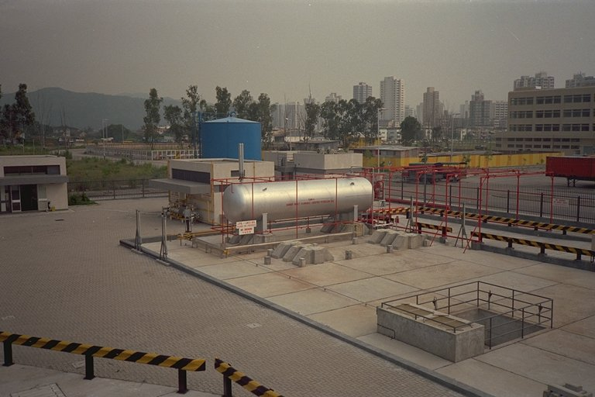
Software Tools
UNIX Utilities

Slide 2
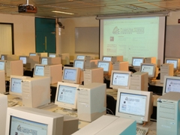
Getting Started on UNIX
The machines in CS Lab2 are named csl2wk01 through csl2wk41.
csl2wk01 means “CSLab2, workstation#1”
The full machine name for csl2wk01 is: csl2wk01.cs.ust.hk

Slide 3

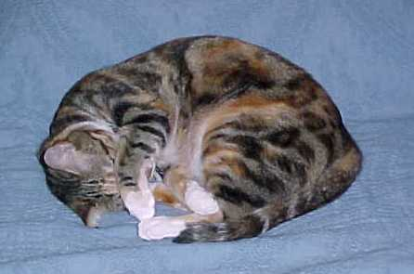
UNIX File Utilities
ls list files in current directory
cat display file
more display one screen of file
rm remove (delete) a file
cp copy source file to target file
mv rename or move a file
lpr print a file
man online UNIX help manual
mpage print multiple pages on postscript printer
        (not standard UNIX command; OpenSource command)

Slide 4

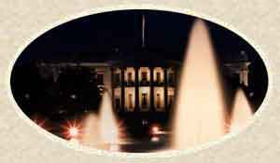
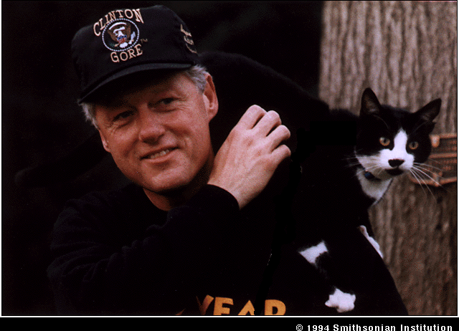
UNIX File Utilities - Example
$ ls
letter1 secret/
$ cat letter1
Ms. Lewinski:
It is getting late. Please order some pizza and stop
by my office. We’ll tidy up a few more things before
calling it a night.
Thanks!
Bill
$ cp letter1 letter2
$ ls
letter1 letter2 secret/

Slide 5


File Utilities - Example con’t
$ mv letter1 letter3
$ ls
letter2 letter3 secret/
$ lpr –Pcll2a letter2
$ mpage –Pcll2a letter2
$ rm letter2
$ ls
letter3 secret/

Slide 6

$ man ls
Reformatting page. Wait... done
User Commands ls(1)
NAME
ls - list contents of directory
SYNOPSIS
/usr/bin/ls [ -aAbcCdfFgilLmnopqrRstux1 ] [ file... ]
/usr/xpg4/bin/ls [ -aAbcCdfFgilLmnopqrRstux1 ] [ file... ]
DESCRIPTION
For each file that is a directory, ls lists the contents of
the directory; for each file that is an ordinary file, ls
repeats its name and any other information requested. The
output is sorted alphabetically by default. When no argu-
ment is given, the current directory is listed. When
several arguments are given, the arguments are first sorted
appropriately, but file arguments appear before directories
and their contents.
There are three major listing formats. The default format
for output directed to a terminal is multi-column with
--More--(5%)

Slide 7

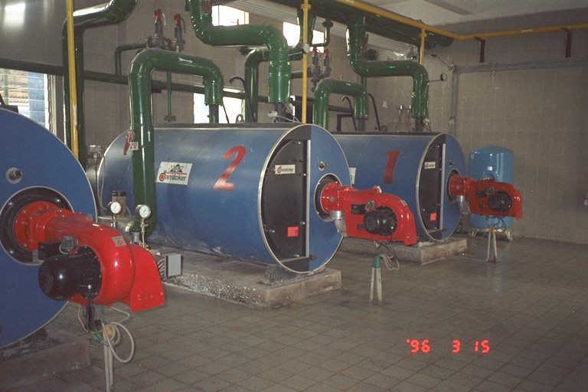
The UNIX Shell
The UNIX shell listens to what you type and executes commands at your request.
ls, lpr, mv, rm,
...
Command
Library
User command:
lpr file
Printers
Files
Memory
UNIX
Kernel
UNIX
Shell
result or status
results
(on screen)

Slide 8
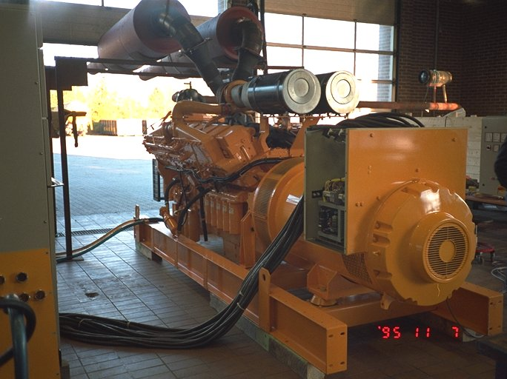
Popular Shells
sh Bourne shell (the original shell)
csh C-shell (pronounced as “sea shell”)
tsch Like csh with more functions (Lab2 default)
bash “Bourne again” shell
ksh Korn shell
zsh Z-shell (not on
Lab2 machines)

Slide 9
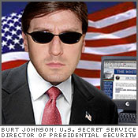

Finding Info
who Who is logged on, where & when
$ who
horner pts/0 Jan 29 09:52 (csz469.cs.ust.hk)
gbush pts/1 Jan 29 10:43 (csz213.cs.ust.hk)
finger A bit more login information
$ finger
Login Name Tty Idle Login Time Office Office Phone
horner Andrew Horner pts/0 Sep 5 10:18 (csz469.cse.ust.hk)
gbush George W pts/1 121:07 Sep 5 09:06 (csz213.cse.ust.hk)

Slide 10
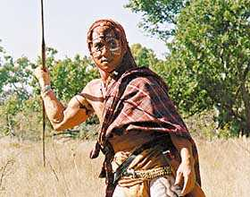
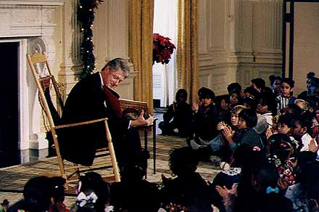
Finding Info
write Send message to another user
$ whoami
horner
$ write clinton
Bill, you’ve been idle for a
long time! What are you doing?
[hit CTRL-D to end write message]
$
---------------------------------------------------------
$ whoami
clinton
Message from horner on csz096.cs.ust.hk [ Fri Jan 29 20:18:47 .
Bill, you’ve been idle for a
long time! What are you doing?
EOF
$

Slide 11
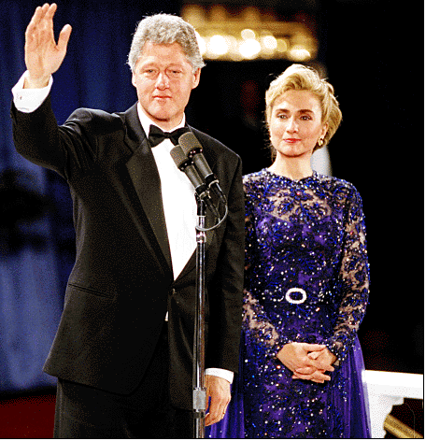
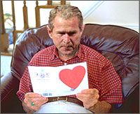
More Utilities
echo Display command line input to screen
$ echo Hi, I am Bill, and she’s the boss!
Hi, I am Bill, and she’s the boss!
date Print the date and time
$ date
Tue Sep 5 12:24:07 HKT 2007

Slide 12
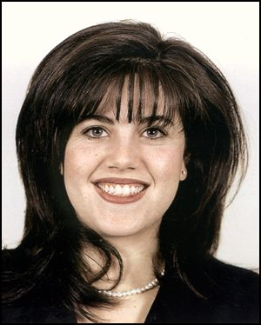
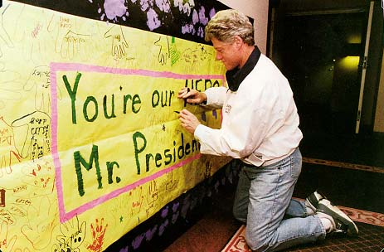
More Utilities
head Display first few lines of file
$ head -2 letter3
Ms. Lewinski:
It is getting late. Please order some pizza and stop
tail Display last few lines of file
$ tail -2 letter3
Thanks!
Bill
grep Find a pattern in a file
$ grep ”some pizza” letter3
It is getting late. Please order some pizza and stop

Slide 13
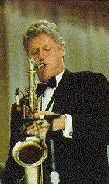
More Utilities
sort Sort the lines in lexical order
$ sort letter3
Bill
by my office. We'll tidy up a few more things before
calling it a night.
It is getting late. Please order some pizza and stop
Ms. Lewinski:
Thanks!
$ sort -r letter3
Thanks!
Ms. Lewinski:
It is getting late. Please order some pizza and stop
calling it a night.
by my office. We'll tidy up a few more things before
Bill

Slide 14
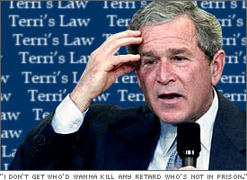
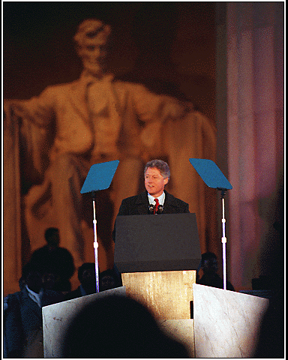
More Utilities
uniq Display file with duplicate adjacent lines removed
$ cat names
George W. Bush
Bill Gates
Bill Gates
Bill Clinton
George W. Bush
$ uniq names
George W. Bush
Bill Gates
Bill Clinton
George W. Bush

Slide 15

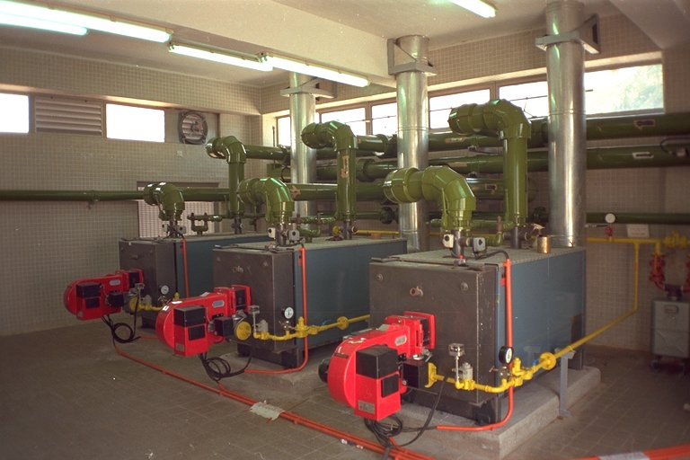

Input/Output Redirection
On UNIX, the standard input (stdin) is the keyboard; the standard output (stdout) is the display screen.
$ sort
waits for you to type in the data from the keyboard and displays the sorted data on the screen.
keyboard
sort
display

Slide 16
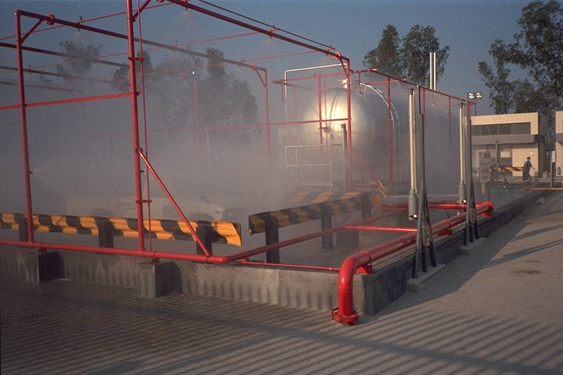
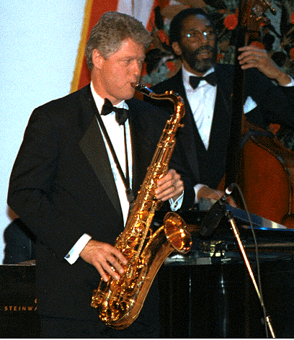
Input/Output Redirection
Using the “>” character after a command to redirect output to a named file:
$ sort names > names.sort
$ uniq names.sort
Bill Clinton
Bill Gates
George W. Bush
names
sort
names.sort
uniq
display

Slide 17
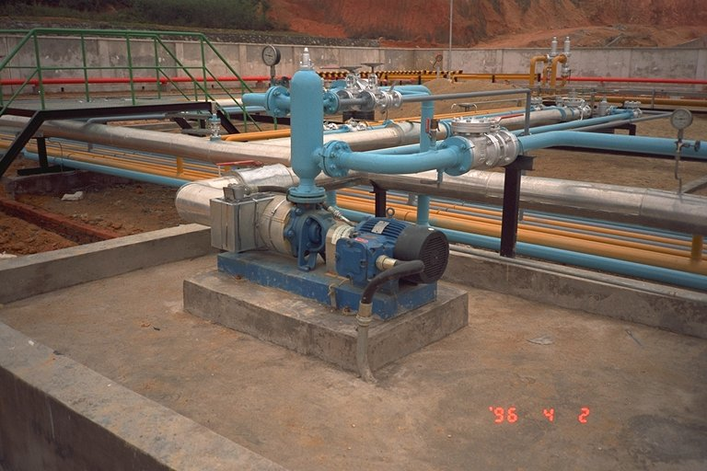
Input/Output Redirection
Using the “<” character after a command to redirect input from a named file:
$ uniq < names.sort
This is the same as:
$ uniq names.sort
Using input and output redirection together:
$ sort < names > names.sort
names.sort
uniq
display
names
sort
names.sort

Slide 18

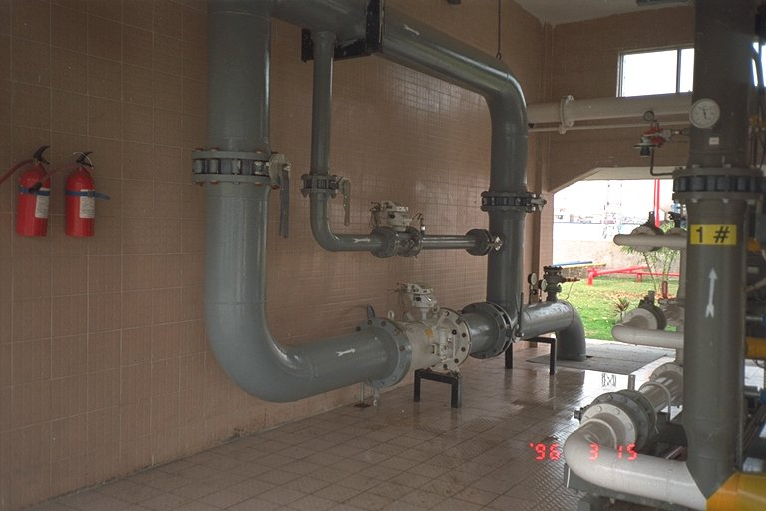
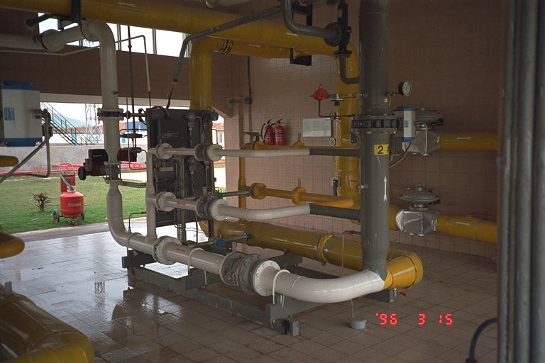
Pipes
The standard output of a program can be “piped” into the standard input of another program:
$ sort names | uniq
Bill Clinton
Bill Gates
George W. Bush
names
sort
uniq
display

Slide 19
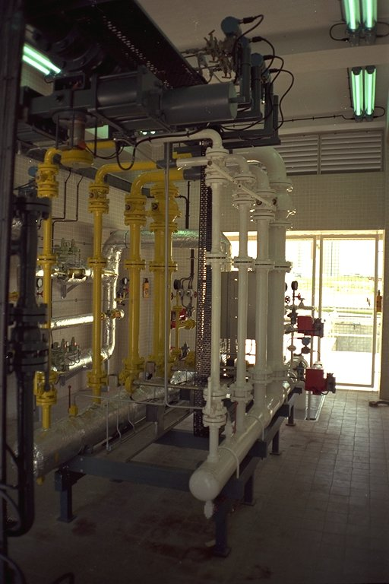
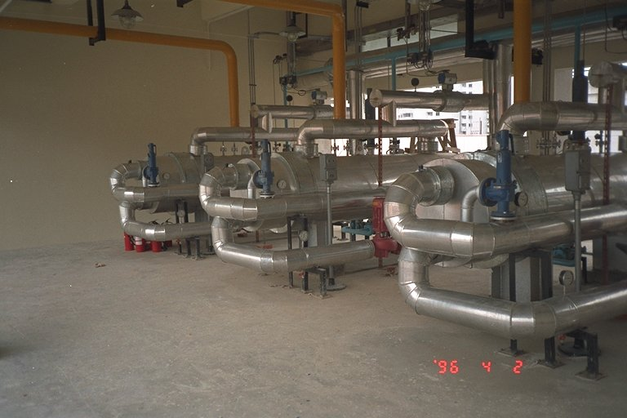

Pipes
Several pipes can be connected:
$ cat names | sort | uniq
Bill Clinton
Bill Gates
George W. Bush
Pipes and I/O redirection can be used together:
$ sort -r names | uniq >names.rev
$ cat names.rev
George W. Bush
Bill Gates
Bill Clinton

