Slide 1
Lecture 4: Exception Handling and Text IO (Ch 14)
Adapted by Fangzhen Lin for COMP3021 from Y. Danial Liang’s PowerPoints for Introduction to Java Programming, Comprehensive Version, 9/E, Pearson, 2013.

Slide 2
Motivations
When a program runs into a runtime error, the program terminates abnormally. How can you handle the runtime error so that the program can continue to run or terminate gracefully? This is the subject we will introduce in this lecture.

Slide 3
Objectives
To get an overview of exceptions and exception handling (§14.2).
To explore the advantages of using exception handling (§14.2).
To distinguish exception types: Error (fatal) vs. Exception (nonfatal) and checked vs. unchecked (§14.3).
To declare exceptions in a method header (§14.4.1).
To throw exceptions in a method (§14.4.2).
To write a try-catch block to handle exceptions (§14.4.3).
To explain how an exception is propagated (§14.4.3).
To obtain information from an exception object (§14.4.4).
To develop applications with exception handling (§14.4.5).
To use the finally clause in a try-catch block (§14.5).
To use exceptions only for unexpected errors (§14.6).
To rethrow exceptions in a catch block (§14.7).
To create chained exceptions (§14.8).
To define custom exception classes (§14.9).
To discover file/directory properties, to delete and rename files/directories, and to create directories using the File class (§14.10).
To write data to a file using the PrintWriter class (§14.11.1).
To read data from a file using the Scanner class (§14.11.2).
To understand how data is read using a Scanner (§14.11.3).
To develop a program that replaces text in a file (§14.11.4).
To open files using a file dialog box (§14.12).
To read data from the Web (§14.13).

Slide 4
Exception-Handling Overview
Show runtime error
Quotient
Fix it using an if statement
QuotientWithIf
With a method
QuotientWithMethod

Slide 5
Exception Advantages
QuotientWithException
The advantages of using exception handling: it enables a method to throw an exception to its caller. Without this capability, a method must handle the exception or terminate the program:
  A callee can detect an error but does not know what to do with it;
  A caller needs the callee to tell it whether any error has occured and decides what to do based on the type of errors.

Slide 6
Handling InputMismatchException
InputMismatchExceptionDemo
By handling InputMismatchException, your program will continuously read an input until it is correct.

Slide 7

Exception Types

Slide 8
System Errors
System errors are thrown by JVM and represented in the Error class. The Error class describes internal system errors. Such errors rarely occur. If one does, there is little you can do beyond notifying the user and trying to terminate the program gracefully.

Slide 9
Exceptions
Exception describes errors caused by your program and external circumstances. These errors can be caught and handled by your program.

Slide 10
Runtime Exceptions
RuntimeException is caused by programming errors, such as bad casting, accessing an out-of-bounds array, and numeric errors.

Slide 11
Checked Exceptions vs. Unchecked Exceptions
RuntimeException, Error and their subclasses are known as unchecked exceptions. All other exceptions are known as checked exceptions, meaning that the compiler forces the programmer to check and deal with the exceptions.

Slide 12
Unchecked Exceptions
In most cases, unchecked exceptions reflect programming logic errors that are not recoverable. For example, a NullPointerException is thrown if you access an object through a reference variable before an object is assigned to it; an IndexOutOfBoundsException is thrown if you access an element in an array outside the bounds of the array. These are the logic errors that should be corrected in the program. Unchecked exceptions can occur anywhere in the program. To avoid cumbersome overuse of try-catch blocks, Java does not mandate you to write code to catch unchecked exceptions.

Slide 13
Unchecked Exceptions
Unchecked exception.

Slide 14

Declaring, Throwing, and Catching Exceptions

Slide 15
Declaring Exceptions
Every method must state the types of checked exceptions it might throw. This is known as declaring exceptions.
public void myMethod()
throws IOException
public void myMethod()
throws IOException, OtherException

Slide 16
Throwing Exceptions
When the program detects an error, the program can create an instance of an appropriate exception type and throw it. This is known as throwing an exception. Here is an example,
throw new TheException();
TheException ex = new TheException();
throw ex;

Slide 17
Throwing Exceptions Example
/** Set a new radius */
public void setRadius(double newRadius)
throws IllegalArgumentException {
if (newRadius >= 0)
radius = newRadius;
else
throw new IllegalArgumentException(
"Radius cannot be negative");
}

Slide 18
Catching Exceptions
try {
statements; // Statements that may throw exceptions
}
catch (Exception1 exVar1) {
handler for exception1;
}
catch (Exception2 exVar2) {
handler for exception2;
}
...
catch (ExceptionN exVar3) {
handler for exceptionN;
}

Slide 19

Catching Exceptions

Slide 20
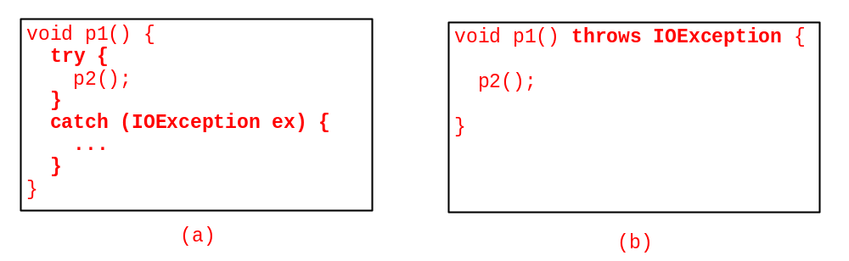
Catch or Declare Checked Exceptions
Java forces you to deal with checked exceptions. If a method declares a checked exception (i.e., an exception other than Error or RuntimeException), you must invoke it in a try-catch block or declare to throw the exception in the calling method. For example, suppose that method p1 invokes method p2 and p2 may throw a checked exception (e.g., IOException), you have to write the code as shown in (a) or (b).

Slide 21
Example: Declaring, Throwing, and Catching Exceptions
Objective: This example demonstrates declaring, throwing, and catching exceptions by modifying the setRadius method in the Circle class defined in Chapter 8. The new setRadius method throws an exception if radius is negative.
TestCircleWithException
CircleWithException

Slide 22
The finally Clause
try {
statements;
}
catch(TheException ex) {
handling ex;
}
finally {
finalStatements;
}

Slide 23
Trace a Program Execution
animation
Suppose no exceptions in the statements
try {
statements;
}
catch(TheException ex) {
handling ex;
}
finally {
finalStatements;
}
Next statement;

Slide 24
Trace a Program Execution
animation
The final block is always executed
try {
statements;
}
catch(TheException ex) {
handling ex;
}
finally {
finalStatements;
}
Next statement;

Slide 25
Trace a Program Execution
animation
Next statement in the method is executed
try {
statements;
}
catch(TheException ex) {
handling ex;
}
finally {
finalStatements;
}
Next statement;

Slide 26
Trace a Program Execution
animation
try {
statement1;
statement2;
statement3;
}
catch(Exception1 ex) {
handling ex;
}
finally {
finalStatements;
}
Next statement;
Suppose an exception of type Exception1 is thrown in statement2

Slide 27
Trace a Program Execution
animation
try {
statement1;
statement2;
statement3;
}
catch(Exception1 ex) {
handling ex;
}
finally {
finalStatements;
}
Next statement;
The exception is handled.

Slide 28
Trace a Program Execution
animation
try {
statement1;
statement2;
statement3;
}
catch(Exception1 ex) {
handling ex;
}
finally {
finalStatements;
}
Next statement;
The final block is always executed.

Slide 29
Trace a Program Execution
animation
try {
statement1;
statement2;
statement3;
}
catch(Exception1 ex) {
handling ex;
}
finally {
finalStatements;
}
Next statement;
The next statement in the method is now executed.

Slide 30
Trace a Program Execution
animation
try {
statement1;
statement2;
statement3;
}
catch(Exception1 ex) {
handling ex;
}
catch(Exception2 ex) {
handling ex;
throw ex;
}
finally {
finalStatements;
}
Next statement;
statement2 throws an exception of type Exception2.

Slide 31
Trace a Program Execution
animation
try {
statement1;
statement2;
statement3;
}
catch(Exception1 ex) {
handling ex;
}
catch(Exception2 ex) {
handling ex;
throw ex;
}
finally {
finalStatements;
}
Next statement;
Handling exception

Slide 32
Trace a Program Execution
animation
try {
statement1;
statement2;
statement3;
}
catch(Exception1 ex) {
handling ex;
}
catch(Exception2 ex) {
handling ex;
throw ex;
}
finally {
finalStatements;
}
Next statement;
Execute the final block

Slide 33
Trace a Program Execution
animation
try {
statement1;
statement2;
statement3;
}
catch(Exception1 ex) {
handling ex;
}
catch(Exception2 ex) {
handling ex;
throw ex;
}
finally {
finalStatements;
}
Next statement;
Rethrow the exception and control is transferred to the caller

Slide 34
Cautions When Using Exceptions
Exception handling separates error-handling code from normal programming tasks, thus making programs easier to read and to modify. Be aware, however, that exception handling usually requires more time and resources because it requires instantiating a new exception object, rolling back the call stack, and propagating the errors to the calling methods.

Slide 35
When to Throw Exceptions
An exception occurs in a method. If you want the exception to be processed by its caller, you should create an exception object and throw it. If you can handle the exception in the method where it occurs, there is no need to throw it.

Slide 36
When to Use Exceptions
When should you use the try-catch block in the code? You should use it to deal with unexpected error conditions. Do not use it to deal with simple, expected situations. For example, the following code
try {
System.out.println(refVar.toString());
}
catch (NullPointerException ex) {
System.out.println("refVar is null");
}

Slide 37
When to Use Exceptions
is better to be replaced by
if (refVar != null)
System.out.println(refVar.toString());
else
System.out.println("refVar is null");

Slide 38
Defining Custom Exception Classes
Use the exception classes in the API whenever possible.
Define custom exception classes if the predefined classes are not sufficient.
Define custom exception classes by extending Exception or a subclass of Exception.

Slide 39
Custom Exception Class Example
In Listing 13.8, the setRadius method throws an exception if the radius is negative. Suppose you wish to pass the radius to the handler, you have to create a custom exception class.
InvalidRadiusException
CircleWithRadiusException
TestCircleWithRadiusException

Slide 40
The File Class
The File class is intended to provide an abstraction that deals with most of the machine-dependent complexities of files and path names in a machine-independent fashion. The filename is a string. The File class is a wrapper class for the file name and its directory path.

Slide 41
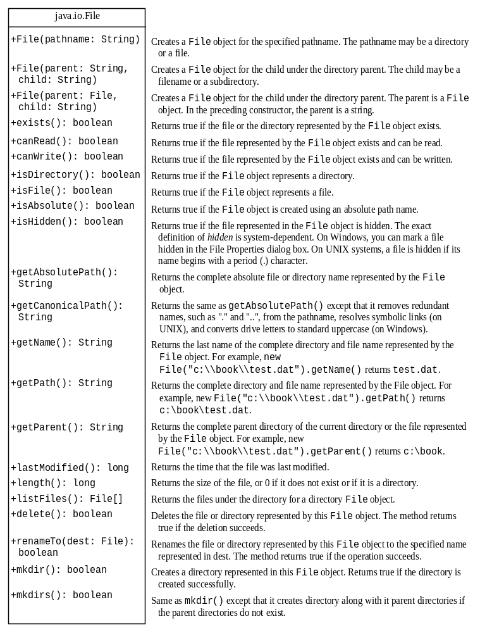
Obtaining file properties and manipulating file

Slide 42


Problem: Explore File Properties
Objective: Write a program that demonstrates how to create files in a platform-independent way and use the methods in the File class to obtain their properties. The following figures show a sample run of the program on Windows and on Unix.
TestFileClass

Slide 43
Text I/O
A File object encapsulates the properties of a file or a path, but does not contain the methods for reading/writing data from/to a file. In order to perform I/O, you need to create objects using appropriate Java I/O classes. The objects contain the methods for reading/writing data from/to a file. This section introduces how to read/write strings and numeric values from/to a text file using the Scanner and PrintWriter classes.

Slide 44

Writing Data Using PrintWriter
WriteData

Slide 45
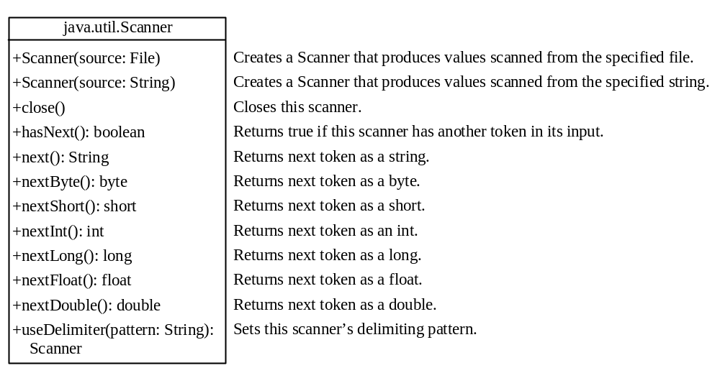
Reading Data Using Scanner

Slide 46
Problem: Replacing Text
Write a class named ReplaceText that replaces a string in a text file with a new string. The filename and strings are passed as command-line arguments as follows:
  java ReplaceText sourceFile targetFile oldString newString
For example, invoking
  java ReplaceText FormatString.java t.txt StringBuilder StringBuffer
replaces all the occurrences of StringBuilder by StringBuffer in FormatString.java and saves the new file in t.txt.
ReplaceText

Slide 47
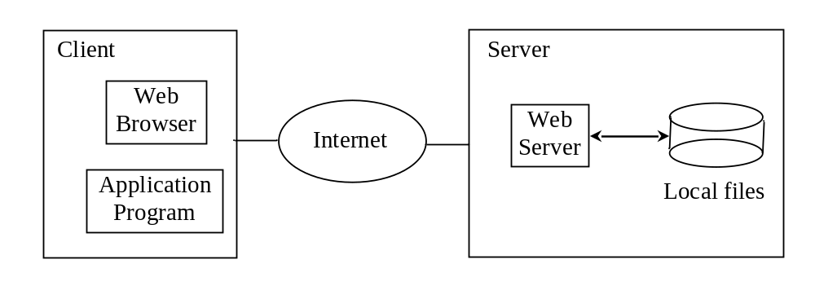
Reading Data from the Web
Just like you can read data from a file on your computer, you can read data from a file on the Web.

Slide 48
Reading Data from the Web
URL url = new URL("www.google.com/index.html");
After a URL object is created, you can use the openStream() method defined in the URL class to open an input stream and use this stream to create a Scanner object as follows:
Scanner input = new Scanner(url.openStream());
ReadFileFromURL

Slide 49
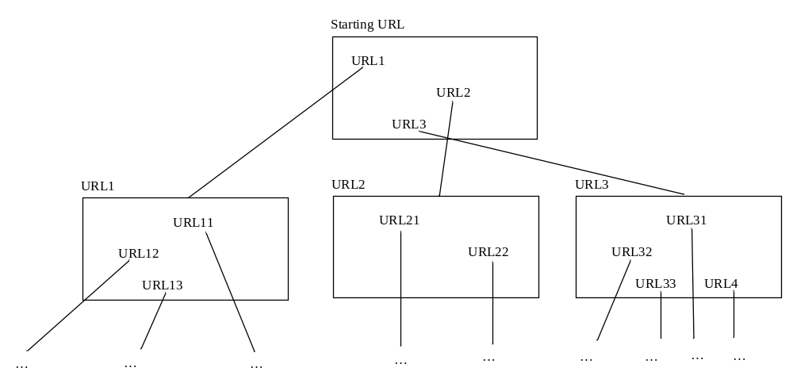
Case Study: Web Crawler
This case study develops a program that travels the Web by following hyperlinks.

Slide 50
Case Study: Web Crawler
The program follows the URLs to traverse the Web. To make sure that each URL is traversed only once, the program maintains two lists of URLs. One list stores the URLs pending for traversing and the other stores the URLs that have already been traversed. The algorithm for this program can be described as follows:

Slide 51
Case Study: Web Crawler
Add the starting URL to a list named listOfPendingURLs;
while listOfPendingURLs is not empty {
Remove a URL from listOfPendingURLs;
if this URL is not in listOfTraversedURLs {
Add it to listOfTraversedURLs;
Display this URL;
Exit the while loop when the size of S is equal to 100.
Read the page from this URL and for each URL contained in the page {
Add it to listOfPendingURLs if it is not is listOfTraversedURLs;
}
}
}
WebCrawler

Slide 52
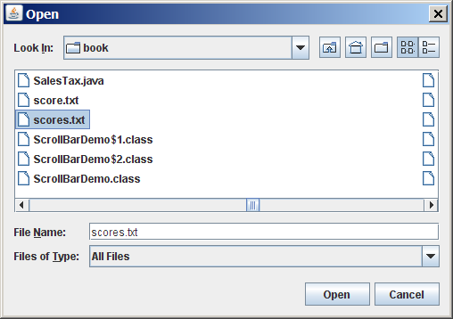
(GUI) File Dialogs
ReadFileUsingJFileChooser

