Slide 1
Lecture 9: Generics (Ch 21)

Slide 2
Objectives
To know the benefits of generics (§21.1).
To use generic classes and interfaces (§21.2).
To declare generic classes and interfaces (§21.3).
To understand why generic types can improve reliability and readability (§21.3).
To declare and use generic methods and bounded generic types (§21.4).
To use raw types for backward compatibility (§21.5).
To know wildcard types and understand why they are necessary (§21.6).
To convert legacy code using JDK 1.5 generics (§21.7).
To understand that generic type information is erased by the compiler and all instances of a generic class share the same runtime class file (§21.8).
To know certain restrictions on generic types caused by type erasure (§21.8).
To design and implement generic matrix classes (§21.9).

Slide 3
Utility Container:
Stack/Queue/Tree/Hashtable
Let us consider how to implement a stack of “things”, assuming the thing is class ClassA.
class Stack{
ClassA elements[];
int pos = 0;
public void push(ClassA a) {
elements[pos++]=a;
}
public ClassA pop(){
return elements[--pos];
}
public void pushAll(Stack s){
for(//there is element in me)
s.push(pop());
}
public void popAll(Stack s) {
for(//there is element in s)
push(s.pop());
}
}
Version 1
Illustration

Slide 4

Customer won’t buy your code
It works with ClassAA that extends ClassA.
It doesn’t work with ClassB and ClassC
The big “O”, java.lang.Object comes to rescue!
class Stack{
Object elements[];
int pos = 0;
public void push(Object a) {
elements[pos++]=a;
}
public Object pop(){
return elements[--pos];
}
public void pushAll(Stack s){
for(//there is element in me)
s.push(pop());
}
public void popAll(Stack s) {
for(//there is element in s)
push(s.pop());
}
}
Version 2

Slide 5

Customer bought your code but asked for a refund later
Your code works with ClassA and ClassB when “consuming” elements.
Your code requires casting when getting them “out of” the stack
Stack s = new Stack();
s.push(new ClassA());
s.push(new ClassB());
ClassA a = (ClassA)s.pop();
What’s the problem with this way of programming?

Slide 6
Casting Objects
You have already used the casting operator to convert variables of one primitive type to another. Casting can also be used to convert an object of one class type to another within an inheritance hierarchy. In the preceding section, the statement
  m(new Student());
assigns the object new Student() to a parameter of the Object type. This statement is equivalent to:
  Object o = new Student(); // Implicit casting
  m(o);
The statement Object o = new Student(), known as implicit casting, is legal because an instance of Student is automatically an instance of Object.
(From Inheritance Lecture)

Slide 7
Why Casting Is Necessary?
Suppose you want to assign the object reference o to a variable of the Student type using the following statement:
  Student b = o;
A compilation error would occur. Why does the statement Object o = new Student() work and the statement Student b = o doesn’t?
o = new Student();
o = new Teacher();
b = o;
Enclose the target object type in parentheses and place it before the object to be cast, as follows:
  Student b = (Student)o; // Explicit casting
(From Inheritance Lecture)

Slide 8
Casting from
Superclass to Subclass
Explicit casting must be used when casting an object from a superclass to a subclass. This type of casting may not always succeed.
  Apple x = (Apple)fruit;
  Orange x = (Orange)fruit;
(From Inheritance Lecture)

Slide 9
Casting is bad
Remember the devil: void*?
If: Object o = new Object() and Apple a = (Apple)o, you get a runtime error.
It was mostly used when you use collection classes such as “LinkedList”.
No longer necessary with the use of Generics
(From Inheritance Lecture)

Slide 10
Motivating Example – Old Style
The cast is annoying
but essential!
List stones = new LinkedList();
stones.add(new Stone(RED));
stones.add(new Stone(GREEN));
stones.add(new Stone(RED));
Stone first = (Stone) stones.get(0);
public int countStones(Color color) {
int tally = 0;
Iterator it = stones.iterator();
while (it.hasNext()) {
Stone stone = (Stone) it.next();
if (stone.getColor() == color) {
tally++;
}
}
return tally;
}
8.<number>
© O. Nierstrasz, O. Greevy, A. Kuhn
P2 — Clients and Servers
Notes:
The compiler can only guarantee that an Object is returned by the iterator. To ensure
The assignment to a variable of type Stone is type safe we need the cast.
The cast introduces clutter and also increases the risk of error, since the programmer may be mistaken.

Slide 11
Why Do You Get a Warning?
public class ShowUncheckedWarning {
public static void main(String[] args) {
java.util.ArrayList list =
new java.util.ArrayList();
list.add("Java Programming");
}
}
To understand the compile warning on this line, you need to learn Java generics.

Slide 12
Fix the Warning
public class ShowUncheckedWarning {
public static void main(String[] args) {
java.util.ArrayList<String> list =
new java.util.ArrayList<String>();
list.add("Java Programming");
}
}
`
No compile warning on this line.

Slide 13
What is Generics?
Generics is the capability to parameterize types.
You can define a class or a method with generic types that can be substituted using concrete types by the compiler.
For example, you may define a generic stack class that stores the elements of a generic type. From this generic class, you may create a stack object for holding strings and a stack object for holding numbers. Here, strings and numbers are concrete types that replace the generic type.

Slide 14
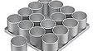
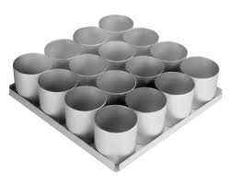
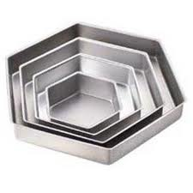
Remember Cake Molds?
Generics are sort of like components of a mold.
Generics are actually not classes. They need to assemble other classes to become classes
Old way:
A container of classes of uniform shapes
New way:
A container of classes of specific shapes

Slide 15
Why Generics?
The key benefit of generics
  Enable errors to be detected at compile time rather than at runtime.
  A generic class or method permits you to specify allowable types of objects that the class or method may work with.
  If you attempt to use the class or method with an incompatible object, the compile error occurs.

Slide 16
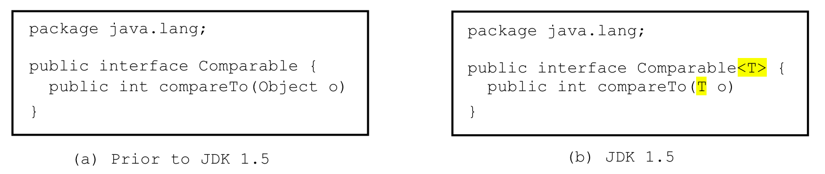
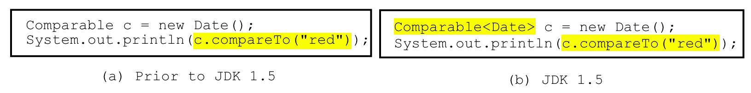
Generic Type
Generic Instantiation
Runtime error
Improves reliability
Compile error
GenericMotivation
_interfaces.ComparableRectangle, ComparableRectangleWithGeneric

Slide 17

Stack in generics
class Stack<T>{
T elements[];
int pos = 0;
public void push(T a) {
elements[pos++]=a;
}
public T pop(){
return elements[--pos];
}
public void pushAll(Stack<T> s){
for(//there is element in me)
s.push(pop());
}
public void popAll(Stack<T> s) {
for(//there is element in s)
push(s.pop());
}
}
Stack<ClassA> s1 = new Stack<ClassA>();
s.push(new ClassA());
ClassA a = s1.pop();
Stack<ClassB> s2 = new Stack<ClassB>();
s2.push(new ClassB());
ClassB b = s2.pop();
s2.push(new ClassA());
ClassB b1 = (ClassB) s1.pop();
Version 3

Slide 18
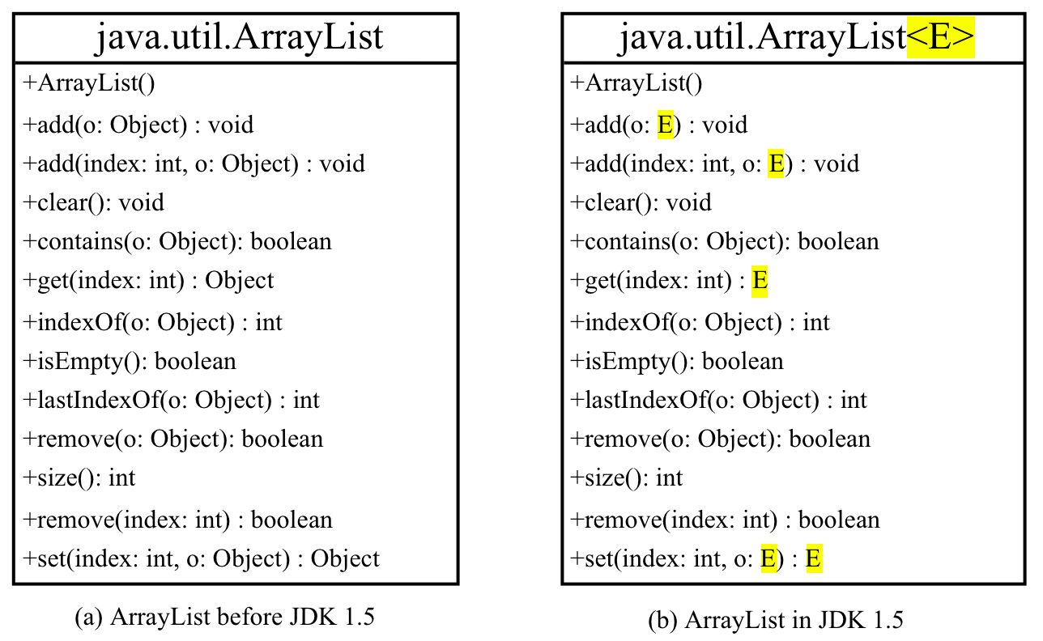
Generic ArrayList in JDK 1.5

Slide 19
No Casting Needed
ArrayList<Double> list = new ArrayList<Double>();
list.add(5.5); // 5.5 is automatically converted to new Double(5.5)
list.add(3.0); // 3.0 is automatically converted to new Double(3.0)
Double doubleObject = list.get(0); // No casting is needed
double d = list.get(1); // Automatically converted to double

Slide 20
Generic Types Restriction
Generic types must be reference types.
The following statement is wrong:
ArrayList<int> ints = new ArrayList<int>();
Use wrapper class types:
ArrayList<Integer> ints = …

Slide 21
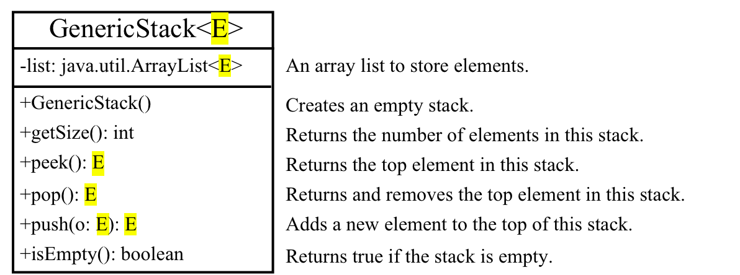
Declaring Generic Classes and Interfaces
GenericStack

Slide 22
Multiple Type Parameter
Our coffee shop lunch menu
  Meat + Starch + Soup
  (Pork/Beef/Chicken)+(Rice/Italy noodle/Fries)+(Cream/Vegetable soup)
class Lunch<M,St,S> {
M meat_;
St starch_;
S soup_;
public Lunch(M meat, St starch, S soup){
meat_ = meat;
starch_=starch;
soup_=soup;
}
}
Beef b = new Beef();
Rice r = new Rice();
MushroomSoup s = new MushroomSoup();
Lunch<Beef, Rice, MushroomSoup> l = new Lunch<Beef, Rice, MushroomSoup>(b,r,s);

Slide 23
Problem 1:
Incorrect Parameter Types
Node b = new Node();
TreeNode r = new TreeNode();
BTreeNode s = new BTreeNode();
Lunch<Node, TreeNode, BTreeNode> l = new Lunch<Node, TreeNode, BTreeNode>(b,r,s);
We want to more properly say the following:
Lunch<subtypes of Meat, subtypes of Starch, subtypes of Soup>

Slide 24
Bounded Generic Types
public class Meat { … }
public class Starch { … }
public class Soup { … }
public class Beef extends Meat { … }
public class CreamSoup extends Soup { … }
class Lunch <M extends Meat,St extends Starch,S extends Soup> {
M meat_;
St starch_;
S soup_;
public Lunch(M meat, St starch, S soup){
meat_ = meat;
starch_=starch;
soup_=soup;
}
}

Slide 25
Generic Methods
public static <E> void print(E[] list) {
for (int i = 0; i < list.length; i++)
System.out.print(list[i] + " ");
System.out.println();
}
public static void print(Object[] list) {
for (int i = 0; i < list.length; i++)
System.out.print(list[i] + " ");
System.out.println();
}
GenericMethodDemo
Notes:
We can use a type variable E in the place of Object. Show GenericMethodDemo.

Slide 26
public class Test {
public static void main(String[] args) {
Integer[] integers = {1,2,3,4,5};
String[] strings = {"London", "Paris", "New York", "Austin"};
Object[] objects = {"London", "Paris", "New York", "Austin", 1};
Test.<Integer>print(integers);
Test.<String>print(strings);
Test.print(objects);
Test.print1(integers);
Test.print1(strings);
Test.print1(objects);
}
public static <E> void print(E[] list) {
for (int i = 0; i < list.length; i++)
System.out.print(list[i] + " ");
System.out.println();
}
public static void print1(Object[] list) {
for (int i = 0; i < list.length; i++)
System.out.print(list[i] + " ");
System.out.println();
}
}
GenericTest
Notes:
Developers can flexibly refine the level of uniformity of an array. What if we re-implement the generic print method with print(E[] list, boolean ordered) or print(E[] list, boolean noDuplicate).

Slide 27
Bounded Generic Type
public static void main(String[] args ) {
Rectangle rectangle = new Rectangle(2, 2);
Circle circle = new Circle(2);
System.out.println("Same area? " + equalArea(rectangle, circle));
}
public static <E> boolean
equalArea(E object1, E object2) {
return object1.getArea() == object2.getArea();
}
public static <E extends GeometricObject> boolean
equalArea(E object1, E object2) {
return object1.getArea() == object2.getArea();
}
Difference?
BoundedTypeDemo
Notes:
What is the difference between equalArea(rectangle, circle) and <GeometricObject>equalArea(rectangle, circle)?

Slide 28
Bounded Generic Type
public static void main(String[] args ) {
Rectangle rectangle = new Rectangle(2, 2);
Circle circle = new Circle(2);
System.out.println("Same area? " + equalArea(rectangle, circle));
}
public static boolean equalArea(GeometricObject o1, GeometricObject o2) {
return o1.getArea() == o2.getArea();
}
public static <E extends GeometricObject> boolean
equalArea(E object1, E object2) {
return object1.getArea() == object2.getArea();
}
Difference?
Notes:
Why couldn’t we replace the generic method with public static boolean equalArea(GeometricObject o1, GeometricObject o2)? Use Sensor <- SpeedSensor, UltraSonicSensor, … as an example, and we want to develop a generic utility method to compare two sensor values. Suppose it only makes sense to compare SpeedSensor with another SpeedSensor, and similarly does UltraSonicSensor.

Slide 29
Problem 2:
Inheritance of Generic Types
Define Subclasses of Generic types not required!
ClassA extends ClassB
Subtype
  ClassA is a subtype of ClassB
  Stack<ClassA> is NOT a subtype of Stack<ClassB>
Are we losing polymorphism?
  This creates trouble for us
  Customer requests a refund because they want more flexibility

Slide 30
Are we losing polymorphism?
class Stack<T>{
public void pushAll(Stack<T> s){
for(//there is element in me)
s.push(pop());
}
public void popAll(Stack<T> s) {
for(//there is element in s)
push(s.pop());
}
}
//Let us say ClassB is a
//subclass of ClassA
Stack<ClassA> s1 = new Stack<ClassA>();
Stack<ClassB> s2 = new Stack<ClassB>();
s2.pushAll(s1);
//should be OK since ClassB is also a
//type of ClassA. s1 that handles the
//super type can handle subtypes
s1.popAll(s2);
//should be OK since ClassA is a super
//type of ClassB. Again, s1 should be
//able to take subtypes of ClassA.
It seems that parameter s should behave polymorphically

Slide 31
We need “wild card”
In defining a generic type
  “E extends ClassA” represents all subtypes of ClassA
In defining a container variable that behaves polymorphically
  “? extends” represent any sub types.
  “? super” represent any super types

Slide 32
Support Polymorphism
class Stack<T>{
public void pushAll(Stack<? super T> s){
for(//there is element in me)
s.push(pop());
}
public void popAll(Stack<? extends T> s) {
for(//there is element in s)
push(s.pop());
}
}
class Stack<T>{
public void pushAll(Stack<T> s){
for(//there is element in me)
s.push(pop());
}
public void popAll(Stack<T> s) {
for(//there is element in s)
push(s.pop());
}
}
Version 4
Stack<ClassA> s1 = new Stack<ClassA>();
Stack<ClassB> s2 = new Stack<ClassB>();
s2.pushAll(s1);
s1.popAll(s2);

Slide 33
Wildcards
Why wildcards are necessary? One more example.
WildCardDemo1
? unbounded wildcard
? extends T bounded wildcard
? super T lower bound wildcard:
WildCardDemo22
WildCardDemo3
Notes:
Although Integer is a subtype of Number. GenericStack<Integer> however is not a subtype of GenericStack<Number>. As such, WildCardDemo1 has a compilation error at max(intStack). Need to be fixed by:
public static double max(GenericStack<? extends Number> stack) { …
Similarly, GenericStack<Integer> is not a subtype of GenericStack<Object>
Can we replace <? super T> in WildCardDemo3 by <? extends T>?

Slide 34
Raw Type and Backward Compatibility
// raw type
ArrayList list = new ArrayList();
This is roughly analogous to:
ArrayList<Object> list = new ArrayList<Object>();
Or more accurately can be thought of:
ArrayList<?> list = new ArrayList<?>(); // wildcard type

Slide 35
Raw Type is Unsafe
// Max.java: Find a maximum object
public class Max {
/** Return the maximum between two objects */
public static Comparable max(Comparable o1, Comparable o2) {
if (o1.compareTo(o2) > 0)
return o1;
else
return o2;
}
}
Runtime Error:
Max.max("Welcome", 23);
Max.java

Slide 36
Make it Safe
// Max1.java: Find a maximum object
public class Max1 {
/** Return the maximum between two objects */
public static <E extends Comparable<E>> E max(E o1, E o2) {
if (o1.compareTo(o2) > 0)
return o1;
else
return o2;
}
}
Compile time error:
Max.max("Welcome", 23);
GenericSortNew

Slide 37
Erasure on Generics
Generics are implemented using an approach called type erasure.
public static <T> int count(T[] anArray, T elem) {
int cnt = 0;
for (T e : anArray)
if (e.equals(elem))
++cnt;
return cnt;
}
public static int count(Object[] anArray, Object elem) {
int cnt = 0;
for (Object e : anArray)
if (e.equals(elem))
++cnt;
return cnt;
}

Slide 38
Erasure on Generics
Generics are a wrapper over java.lang.Object to ensure backwards compatibility
Generics are implemented using an approach called type erasure.
  Unbound variable replaced by “Object”
  Bounded variable “ T extends ClassA”, “? super ClassB” replaced by bound, “ClassA” or “ClassB”.
The types used to instantiate generics serve as “comments”.
What generics really is:
  Compile time checks
  Hints to generate the casting correctly.
  Enforcing the usage of the same type

Slide 39
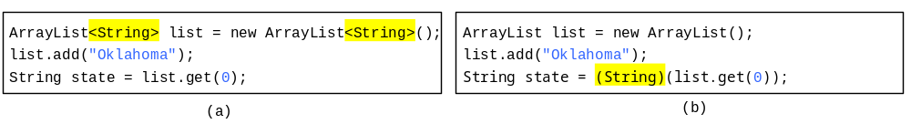
Compile Time Checking
For example, the compiler checks whether generics is used correctly for the following code in (a) and translates it into the equivalent code in (b) for runtime use. The code in (b) uses the raw type.

Slide 40
Checks and Hints
class Parent<T> {
T compute(T t){return t;}
}
p = new Parent<String>();
String s = p.compute(“s”);
String s = p.compute(circle);
class Parent{
Object compute(Object t){
return t; }
}
p = new Parent();
String s = (String) p.compute(“s”);
String s = (String) p.compute(circle);
Generics tells us p can only deal with Strings . This information is stored in the compiler not in the code

Slide 41
Type Enforcement
class Parent<T extends Geom> {
T compute(T t1, T t2){return t1.same(t2);}
}
p = new Parent<Circle>();
String s = p.compute(circle, triangle);
Generics tells us these two parameters have to be the same type, not just subclass of Geom. This information is stored in the compiler not in the code
class Parent{
Geom compute(Geom t1, Geom t2){
return t1.same(t2); }
}
p = new Parent();
Geom = (Circle) p.compute((Circle)circle, (Circle)triangle);

Slide 42
Method Overriding
Apply the erasure concept before polymorphic matching
class T {
1: <E> void m(E e) { }
}
class X extends T {
2: void m(Object o) { }
}
T t = new X();
t.<Object>m(new Object());
t.<String>m(new String());
dispatch to 2
dispatch to 2
The generic T in X is type erased with “Object”. T becomes :
class T {
void m (Object e) {}
}
Notes:
both calls will be dispatched to method 2

Slide 43
Method Overriding
Apply the erasure concept before polymorphic matching
class T {
1: <E> void m(E e) { }
}
class X extends T {
2: void m(String o) { }
}
T t = new X();
t.<Object>m(new Object());
t.<String>m(new String());
dispatch to 1
dispatch to 1
T will become:
class T {
void m(Object o){}
}, hence, m is overloaded, not overridden.

Slide 44
Method Overriding
Apply the erasure concept before polymorphic matching
class T {
1: void m(String e) { }
}
class X<E> extends T {
2: void m(E o) { }
}
T t = new X<String>();
t.m(new String());
dispatch to 1
X will become:
class X extends T {
void m(Object o){}
}, hence, m is overloaded, not overridden.

Slide 45
Method Overriding
Overriding works in this case
class T<E> {
1: void m(E e) { }
}
class X extends T<String> {
2: void m(String o) { }
}
T<String> t = new X();
t.m(new Object());
t.m(new String());
T t = new X();
t.m(new Object());
compile error
dispatch to 2
class X {
void m(Object o){
m((String)o);
}
void m(String o){}
}
Special treatment by Java compiler

Slide 46
Important Facts
It is important to note that a generic class is shared by all its instances regardless of its actual generic type.
  GenericStack<String> stack1 = new GenericStack<String>();
  GenericStack<Integer> stack2 = new GenericStack<Integer>();
Although GenericStack<String> and GenericStack<Integer> are two types, but there is only one class GenericStack loaded into the JVM.
TestInstanceof
Notes:
Run TestInstanceof

Slide 47
Restrictions on Generics
Restriction 1: Cannot Create an Instance of a Generic Type. (i.e., new E()).
Restriction 2: Generic Array Creation is Not Allowed. (i.e., new E[100]).
Restriction 3: A Generic Type Parameter of a Class is Not Allowed in a Static Context.
Restriction 4: Exception Classes Cannot be Generic.
Notes:
1,2: cannot decide E dynamically
3,4: A generic class is shared by all its instances regardless of its actual generic types. There is only a single copy of static field.
4: catch cannot differentiate different generic types of the same exception after type erasure.

Slide 48
Not allowed in a static context
public class Test<E> {
public static void m (E o1) { // Illegal
}
public static E o1; // Illegal
static {
E o2; // Illegal
}
}
Notes:
What if Test<String>.o1 and Test<Date>.o1 after type erasure?

Slide 49
Not allowed in exception classes
public class MyException<T> extends Exception {}
try {
…
}
catch (MyException <Integer> ex) {
…
}
catch (MyException<Circle> ex) {
…
}
Notes:
Problems arise with the erasure of generic type.

Slide 50
Designing Generic Matrix Classes
Objective: This example gives a generic class for matrix arithmetic. This class implements matrix addition and multiplication common for all types of matrices.
GenericMatrix

Slide 51
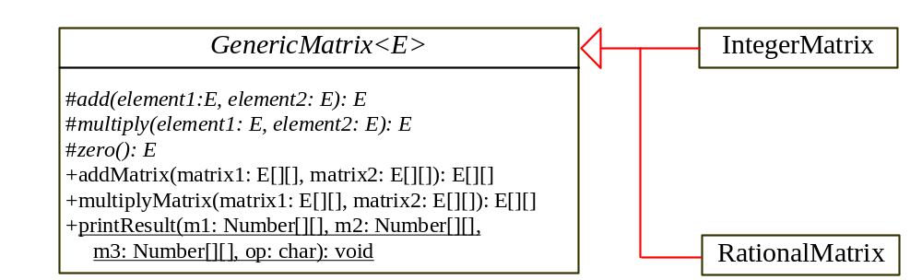
UML Diagram

Slide 52
Source Code
Objective: This example gives two programs that utilize the GenericMatrix class for integer matrix arithmetic and rational matrix arithmetic.
IntegerMatrix
TestIntegerMatrix
RationalMatrix
TestRationalMatrix

Slide 53
Subclassing Generics
  1. Child generic / Parent regular → Just another generic class
  class Parent {}
  class Child<T> extends Parent {}
  2. Child regular / Parent generic → Automatically parameterize parent using Object
  class Parent<T> {}
  class Child extends Parent {} or
  class Child extends Parent<String> {}

Slide 54
Subclassing Generics
  3. Child generic / Parent generic → Can either force homogeneous types or use automatic parameterization as in Case 2
  class Parent<T> {}
  class Child<T, E> extends Parent<E> {}
  or class Child<T, E> extends Parent<String> {}
  or class Child<T, E> extends Parent {}
  4. Child regular / Parent regular → the old way
  class Parent {}
  class Child extends Parent {}

