Slide 1
Lecture 1: Introduction to Java
(Chapter 1)
Adapted by Fangzhen Lin for COMP3021 from Y. Danial Liang’s PowerPoints for Introduction to Java Programming, Comprehensive Version, 9/E, Pearson, 2013.

Slide 2
Objectives
To describe the relationship between Java and the World Wide Web (§1.5).
To understand the meaning of Java language specification, API, JDK, and IDE (§1.6).
To write a simple Java program (§1.7).
To display output on the console (§1.7).
To explain the basic syntax of a Java program (§1.7).
To create, compile, and run Java programs (§1.8).
To display output using the JOptionPane message dialog boxes (§1.9).
To become familiar with Java programming style and documentation (§1.10).
To explain the differences between syntax errors, runtime errors, and logic errors (§1.11).

Slide 3

How Data is Stored?
Data of various kinds, such as numbers, characters, and strings, are encoded as a series of bits (zeros and ones). Computers use zeros and ones because digital devices have two stable states, which are referred to as zero and one by convention. The programmers need not to be concerned about the encoding and decoding of data, which is performed automatically by the system based on the encoding scheme. The encoding scheme varies. For example, character ‘J’ is represented by 01001010 in one byte. A small number such as three can be stored in a single byte. If computer needs to store a large number that cannot fit into a single byte, it uses a number of adjacent bytes. No two data can share or split a same byte. A byte is the minimum storage unit.

Slide 4
Programs
Computer programs, known as software, are instructions to the computer.
You tell a computer what to do through programs. Without programs, a computer is an empty machine. Computers do not understand human languages, so you need to use computer languages to communicate with them.
Programs are written using programming languages.

Slide 5

Popular High-Level Languages

Slide 6
Why Java?
The answer is that Java enables users to develop and deploy applications on the Internet for servers, desktop computers, and small hand-held devices. The future of computing is being profoundly influenced by the Internet, and Java promises to remain a big part of that future. Java is the Internet programming language.
Java is a general purpose programming language.
Java is the Internet programming language.

Slide 7
Java, Web, and Beyond
Java can be used to develop Web applications.
Java Applets
Java Web Applications
Java can also be used to develop applications for hand-held devices such as Palm and cell phones

Slide 8
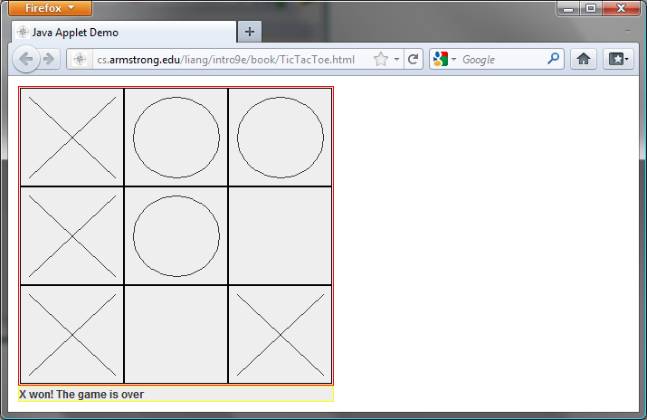
Examples of Java’s Versatility (Applets)

Slide 9
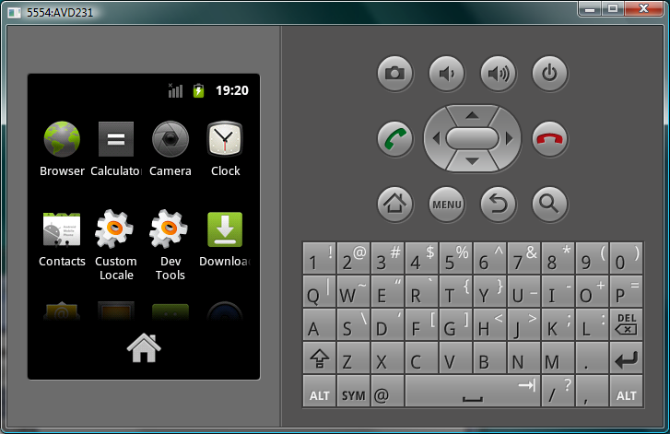
PDA and Cell Phone

Slide 10
Java’s History
James Gosling and Sun Microsystems
Oak
Java, May 20, 1995, Sun World
HotJava
  The first Java-enabled Web browser
Early History Website:
http://www.java.com/en/javahistory/index.jsp

Slide 11
Characteristics of Java
Java Is Simple
Java Is Object-Oriented
Java Is Distributed
Java Is Interpreted
Java Is Robust
Java Is Secure
Java Is Architecture-Neutral
Java Is Portable
Java's Performance
Java Is Multithreaded
Java Is Dynamic
www.cs.armstrong.edu/liang/JavaCharacteristics.pdf

Slide 12
Characteristics of Java
Java Is Simple
Java Is Object-Oriented
Java Is Distributed
Java Is Interpreted
Java Is Robust
Java Is Secure
Java Is Architecture-Neutral
Java Is Portable
Java's Performance
Java Is Multithreaded
Java Is Dynamic
Java is partially modeled on C++, but greatly simplified and improved. Some people refer to Java as "C++--" because it is like C++ but with more functionality and fewer negative aspects.

Slide 13
Characteristics of Java
Java Is Simple
Java Is Object-Oriented
Java Is Distributed
Java Is Interpreted
Java Is Robust
Java Is Secure
Java Is Architecture-Neutral
Java Is Portable
Java's Performance
Java Is Multithreaded
Java Is Dynamic
Java is inherently object-oriented. Although many object-oriented languages began strictly as procedural languages, Java was designed from the start to be object-oriented. Object-oriented programming (OOP) is a popular programming approach that is replacing traditional procedural programming techniques.
One of the central issues in software development is how to reuse code. Object-oriented programming provides great flexibility, modularity, clarity, and reusability through encapsulation, inheritance, and polymorphism.

Slide 14
Characteristics of Java
Java Is Simple
Java Is Object-Oriented
Java Is Distributed
Java Is Interpreted
Java Is Robust
Java Is Secure
Java Is Architecture-Neutral
Java Is Portable
Java's Performance
Java Is Multithreaded
Java Is Dynamic
Distributed computing involves several computers working together on a network. Java is designed to make distributed computing easy. Since networking capability is inherently integrated into Java, writing network programs is like sending and receiving data to and from a file.

Slide 15
Characteristics of Java
Java Is Simple
Java Is Object-Oriented
Java Is Distributed
Java Is Interpreted
Java Is Robust
Java Is Secure
Java Is Architecture-Neutral
Java Is Portable
Java's Performance
Java Is Multithreaded
Java Is Dynamic
You need an interpreter to run Java programs. The programs are compiled into the Java Virtual Machine code called bytecode. The bytecode is machine-independent and can run on any machine that has a Java interpreter, which is part of the Java Virtual Machine (JVM).

Slide 16
Characteristics of Java
Java Is Simple
Java Is Object-Oriented
Java Is Distributed
Java Is Interpreted
Java Is Robust
Java Is Secure
Java Is Architecture-Neutral
Java Is Portable
Java's Performance
Java Is Multithreaded
Java Is Dynamic
Java compilers can detect many problems that would first show up at execution time in other languages.
Java has eliminated certain types of error-prone programming constructs found in other languages.
Java has a runtime exception-handling feature to provide programming support for robustness.

Slide 17
Characteristics of Java
Java Is Simple
Java Is Object-Oriented
Java Is Distributed
Java Is Interpreted
Java Is Robust
Java Is Secure
Java Is Architecture-Neutral
Java Is Portable
Java's Performance
Java Is Multithreaded
Java Is Dynamic
Java implements several security mechanisms to protect your system against harm caused by stray programs.

Slide 18
Characteristics of Java
Java Is Simple
Java Is Object-Oriented
Java Is Distributed
Java Is Interpreted
Java Is Robust
Java Is Secure
Java Is Architecture-Neutral
Java Is Portable
Java's Performance
Java Is Multithreaded
Java Is Dynamic
Write once, run anywhere
With a Java Virtual Machine (JVM), you can write one program that will run on any platform.

Slide 19
Characteristics of Java
Java Is Simple
Java Is Object-Oriented
Java Is Distributed
Java Is Interpreted
Java Is Robust
Java Is Secure
Java Is Architecture-Neutral
Java Is Portable
Java's Performance
Java Is Multithreaded
Java Is Dynamic
Because Java is architecture neutral, Java programs are portable. They can be run on any platform without being recompiled.

Slide 20
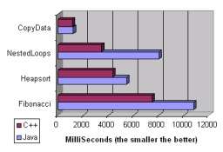
Characteristics of Java
Java Is Simple
Java Is Object-Oriented
Java Is Distributed
Java Is Interpreted
Java Is Robust
Java Is Secure
Java Is Architecture-Neutral
Java Is Portable
Java's Performance
Java Is Multithreaded
Java Is Dynamic
Extracted from: C++ vs. Java 1.6 - A fair benchmark
http://www.irrlicht3d.org/pivot/entry.php?id=446
Java runs slightly slower than C++

Slide 21
Characteristics of Java
Java Is Simple
Java Is Object-Oriented
Java Is Distributed
Java Is Interpreted
Java Is Robust
Java Is Secure
Java Is Architecture-Neutral
Java Is Portable
Java's Performance
Java Is Multithreaded
Java Is Dynamic
Multithread programming is smoothly integrated in Java, whereas in other languages you have to call procedures specific to the operating system to enable multithreading.

Slide 22
Characteristics of Java
Java Is Simple
Java Is Object-Oriented
Java Is Distributed
Java Is Interpreted
Java Is Robust
Java Is Secure
Java Is Architecture-Neutral
Java Is Portable
Java's Performance
Java Is Multithreaded
Java Is Dynamic
Java was designed to adapt to an evolving environment. New code can be loaded on the fly without recompilation. There is no need for developers to create, and for users to install, major new software versions. New features can be incorporated transparently as needed.

Slide 23
JDK Versions
JDK 1.02 (1995)
JDK 1.1 (1996)
JDK 1.2 (1998)
JDK 1.3 (2000)
JDK 1.4 (2002)
JDK 1.5 (2004) a. k. a. JDK 5 or Java 5
JDK 1.6 (2006) a. k. a. JDK 6 or Java 6
JDK 1.7 (2011) a. k. a. JDK 7 or Java 7

Slide 24
JDK Editions
Java Standard Edition (J2SE)
  J2SE can be used to develop client-side standalone applications or applets.
Java Enterprise Edition (J2EE)
  J2EE can be used to develop server-side applications such as Java servlets, Java ServerPages, and Java ServerFaces.
Java Micro Edition (J2ME).
  J2ME can be used to develop applications for mobile devices such as cell phones.
We use J2SE to introduce Java programming.

Slide 25
Popular Java IDEs
NetBeans
Eclipse: used for this course and taught in the lab.

Slide 26
A Simple Java Program
Listing 1.1
//This program prints Welcome to Java!
public class Welcome {
public static void main(String[] args) {
System.out.println("Welcome to Java!");
}
}
Welcome

Slide 27
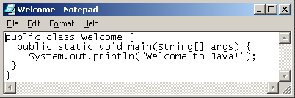
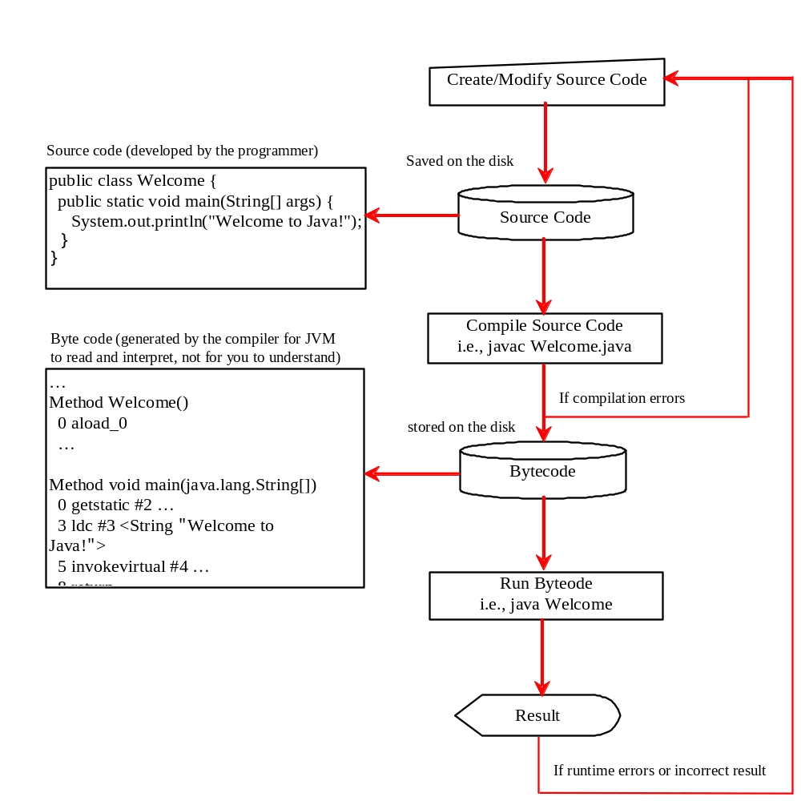
Creating, Compiling, and Running Programs

Slide 28
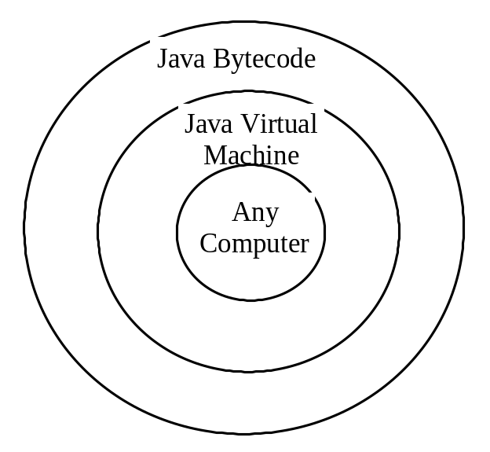
Compiling Java Source Code
You can port a source program to any machine with appropriate compilers. The source program must be recompiled, however, because the object program can only run on a specific machine. Nowadays computers are networked to work together. Java was designed to run object programs on any platform. With Java, you write the program once, and compile the source program into a special type of object code, known as bytecode. The bytecode can then run on any computer with a Java Virtual Machine, as shown below. Java Virtual Machine is a software that interprets Java bytecode.

Slide 29
Anatomy of a Java Program
Class name
Main method
Statements
Statement terminator
Reserved words
Comments
Blocks

Slide 30
Class Name
Every Java program must have at least one class. Each class has a name. By convention, class names start with an uppercase letter. In this example, the class name is Welcome.
//This program prints Welcome to Java!
public class Welcome {
public static void main(String[] args) {
System.out.println("Welcome to Java!");
}
}

Slide 31
Main Method
Line 2 defines the main method. In order to run a class, the class must contain a method named main. The program is executed from the main method.
//This program prints Welcome to Java!
public class Welcome {
public static void main(String[] args) {
System.out.println("Welcome to Java!");
}
}

Slide 32
Statement
A statement represents an action or a sequence of actions. The statement System.out.println("Welcome to Java!") in the program in Listing 1.1 is a statement to display the greeting "Welcome to Java!“.
//This program prints Welcome to Java!
public class Welcome {
public static void main(String[] args) {
System.out.println("Welcome to Java!");
}
}

Slide 33
Statement Terminator
Every statement in Java ends with a semicolon (;).
//This program prints Welcome to Java!
public class Welcome {
public static void main(String[] args) {
System.out.println("Welcome to Java!");
}
}

Slide 34
Reserved words
Reserved words or keywords are words that have a specific meaning to the compiler and cannot be used for other purposes in the program. For example, when the compiler sees the word class, it understands that the word after class is the name for the class.
//This program prints Welcome to Java!
public class Welcome {
public static void main(String[] args) {
System.out.println("Welcome to Java!");
}
}

Slide 35

Blocks
A pair of braces in a program forms a block that groups components of a program.

Slide 36
Displaying Text in a Message Dialog Box
you can use the showMessageDialog method in the JOptionPane class. JOptionPane is one of the many predefined classes in the Java system, which can be reused rather than “reinventing the wheel.”
WelcomeInMessageDialogBox

Slide 37
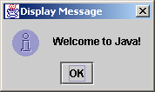
The showMessageDialog Method
JOptionPane.showMessageDialog(null,
"Welcome to Java!",
"Display Message",
JOptionPane.INFORMATION_MESSAGE);

Slide 38
Two Ways to Invoke the Method
There are several ways to use the showMessageDialog method. For the time being, all you need to know are two ways to invoke it.
One is to use a statement as shown in the example:
  JOptionPane.showMessageDialog(null, x,
  y, JOptionPane.INFORMATION_MESSAGE);
where x is a string for the text to be displayed, and y is a string for the title of the message dialog box.
The other is to use a statement like this:
  JOptionPane.showMessageDialog(null, x);
where x is a string for the text to be displayed.

Slide 39
Programming Style and Documentation
Appropriate Comments
Naming Conventions
Proper Indentation and Spacing Lines
Block Styles

Slide 40
Appropriate Comments
Include a summary at the beginning of the program to explain what the program does, its key features, its supporting data structures, and any unique techniques it uses.
Include your name, class section, instructor, date, and a brief description at the beginning of the program.

Slide 41
Naming Conventions
Choose meaningful and descriptive names.
Class names:
  Capitalize the first letter of each word in the name. For example, the class name ComputeExpression.

Slide 42
Proper Indentation and Spacing
Indentation
  Indent two spaces.
Spacing
  Use blank line to separate segments of the code.

Slide 43

Block Styles
Use end-of-line style for braces.

Slide 44
Programming Errors
Syntax Errors
  Detected by the compiler
Runtime Errors
  Causes the program to abort
Logic Errors
  Produces incorrect result

Slide 45
Syntax Errors
public class ShowSyntaxErrors {
public static main(String[] args) {
System.out.println("Welcome to Java);
}
}

Slide 46
Runtime Errors
public class ShowRuntimeErrors {
public static void main(String[] args) {
System.out.println(1 / 0);
}
}

Slide 47
Logic Errors
public class ShowLogicErrors {
public static void main(String[] args) {
System.out.println("Celsius 35 is Fahrenheit degree ");
System.out.println((9 / 5) * 35 + 32);
}
}

Slide 48
Supplements on the Companion Website
See Supplement I.B for installing and configuring JDK
See Supplement I.C for compiling and running Java from the command window for details
www.cs.armstrong.edu/liang/intro9e/supplement.html

