Slide 1
Midterm Review
Adapted by Fangzhen Lin for COMP3021 from Y. Danial Liang’s PowerPoints for Introduction to Java Programming, Comprehensive Version, 9/E, Pearson, 2013.

Slide 2
Our journey to Java expert
Object and classes
Java treatment of String
Exceptions
Inheritance
GUI
Abstract class and Interface
Event driven programming

Slide 3
Class and Object

Slide 4
Constructors
Constructors are a special kind of methods that are invoked to construct objects.
Circle() {
}
Circle(double newRadius) {
radius = newRadius;
}

Slide 5
Constructors, cont.
A constructor with no parameters is referred to as a no-arg constructor.
· Constructors must have the same name as the class itself.
· Constructors do not have a return type—not even void.
· Constructors are invoked using the new operator when an object is created. Constructors play the role of initializing objects.

Slide 6
Default Constructor
A class may be declared without constructors. In this case, a no-arg constructor with an empty body is implicitly declared in the class. This constructor, called a default constructor, is provided automatically only if no constructors are explicitly declared in the class.

Slide 7
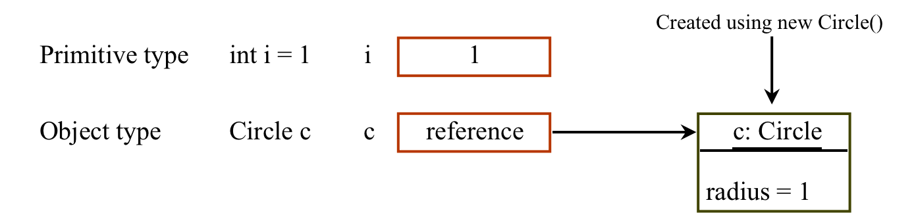
Differences between Variables of
Primitive Data Types and Object Types

Slide 8
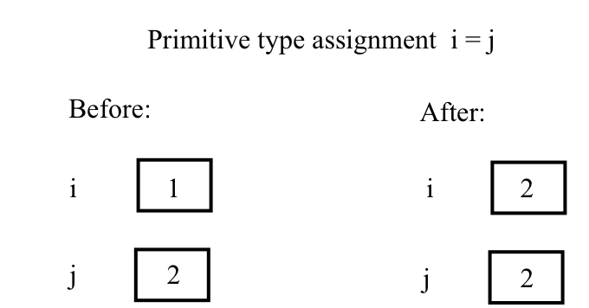
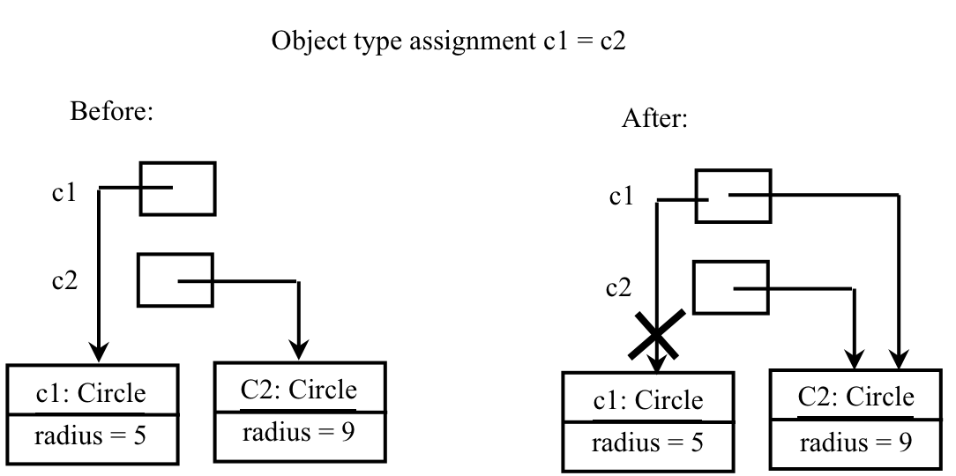
Copying Variables of Primitive Data Types and Object Types
Duplicating content
Creating an alias

Slide 9
Initialization of Instance Fields
Several ways:
  Explicit initialization
  Initializer
  (or initialization) block
  Constructors
In the order of their appearance

Slide 10
Initialization of Instance Fields
Explicit initialization: initialization at declaration.
  private double salary = 0.0;
  private String name = “”;

Slide 11
Initialization of Instance Fields
Initializer (or initialization) block:
  Class declaration can contain arbitrary blocks of codes.
  class Employee
  { …
  private int id;
  private static int nextId=1;
  // object initializer block
  {
  id = nextId;
  nextId++;
  }
  …
  }

Slide 12
Initialization of Instance Fields
Initialization by constructors
class Employee
{
  …
  private int id;
  private static int nextId=1;
Employee(){
  id = nextId;
  nextId++;
  }
}

Slide 13
Initialization of Instance Fields
What happens when a constructor is called
  All data fields initialized to their default value (0, false, null)
  Field initializers and instance initializer blocks are executed according to their order of appearance
  Body of the constructor is executed after the body of its superclass’s constructor
    Note that a constructor might call another constructor at line 1.
Notes:
Comp201 class stops here

Slide 14
Initialization of Static Fields
When a class is loaded into memory
  All static data fields initialized to their default value (0, false, null)
  Static field initializers and static initializer blocks are executed in the order of their appearance
  Note that static fields are initialized once when its parent class is loaded.

Slide 15
Object Initialization Summary
Static then instance
Parent then child
For each class
  Field
  Initialization block
  Constructor
  class Employee
  { …
  private int id;
  private static int nextId=1;
  // object initializer block
  {
  id = nextId;
  nextId++;
  }
  static {
  //something else
  }
  public static void main(String s[]){
  System.out.println(“”);
  }
  }

Slide 16
Java Strings

Slide 17
Constructing Strings
String newString = new String(stringLiteral);
String message = new String("Welcome to Java");
Since strings are used frequently, Java provides a shorthand initializer for creating a string:
String message = "Welcome to Java";

Slide 18
Strings Are Immutable
A String object is immutable; its contents cannot be changed. Does the following code change the contents (“Java”) of the string object?
String s = "Java";
s = "HTML";

Slide 19
Interned Strings
Since strings are immutable and are frequently used, to improve efficiency and save memory, the JVM uses a unique instance for string literals with the same character sequence. Such an instance is called interned. For example, the following statements:

Slide 20
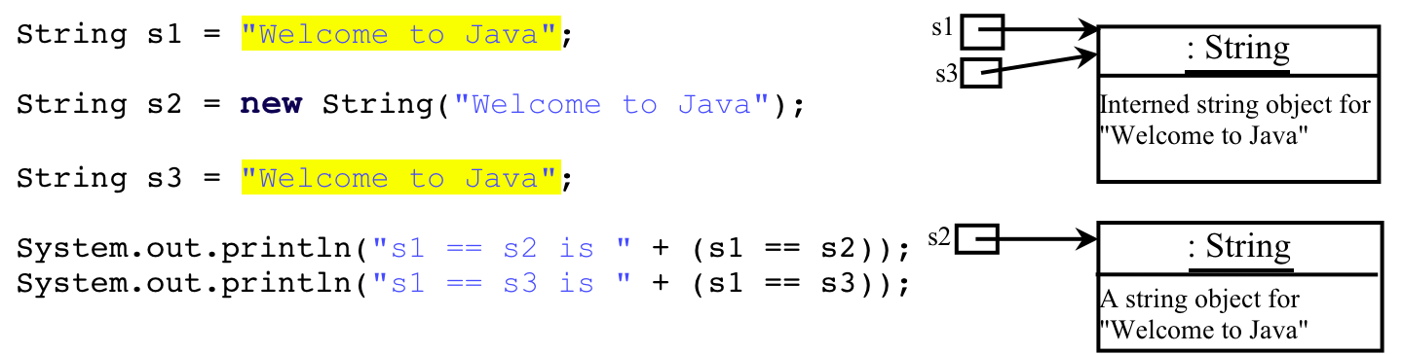
Examples
Flyweight Design pattern
display
s1 == s2 is false
s1 == s3 is true
A new object is created if you use the new operator.
If you use the string initializer, no new object is created if the interned object is already created.

Slide 21
Exception Handling

Slide 22
Review points
Basic syntax of declaring/checking a generic type.
Difference between checked/unchecked exceptions
The exception handling mechanism
  “Stack unwinding” sequence
  Polymorphic matching

Slide 23

Exception Types

Slide 24
Checked Exceptions vs. Unchecked Exceptions
RuntimeException, Error and their subclasses are known as unchecked exceptions. All other exceptions are known as checked exceptions, meaning that the compiler forces the programmer to check and deal with the exceptions.

Slide 25
Catching Exceptions
try {
statements; // Statements that may throw exceptions
}
catch (Exception1 exVar1) {
handler for exception1;
}
catch (Exception2 exVar2) {
handler for exception2;
}
...
catch (ExceptionN exVar3) {
handler for exceptionN;
}
finally {
finalStatements;
}

Slide 26
Summary of Exception Handling
When an exception is thrown
  Check local “catch” first where “throws” is executed
  Match exact “catch” first
  If no match, match “catch” of super types
    Match only once! Only one “catch” block is executed for multiple catches.
  If no match,
    Execute the “finally block”. Exception thrown in “finally block” will be the only exception passed to caller
    Go to caller, repeat 2-4, until “main”.
When matched
  Resume normal flow of execution if no throwing in “catch” blocks
  Or return to caller at throwing

Slide 27
Declaring Exceptions
Every method must state the types of checked exceptions it might throw. This is known as declaring exceptions.
public void myMethod()
throws IOException
public void myMethod()
throws IOException, OtherException

Slide 28
Throwing Exceptions
When the program detects an error, the program can create an instance of an appropriate exception type and throw it. This is known as throwing an exception. Here is an example,
throw new TheException();
TheException ex = new TheException();
throw ex;

Slide 29
Rethrowing Exceptions
try {
statements;
}
catch(TheException ex) {
perform operations before exits;
throw ex; // throw new TheException();
}

Slide 30
Be Careful with Multiple Exceptions
Note that the following will produce a compiling error. Why?
  try {…}
  catch (Exception e3) {…}
  catch (ArithmeticException e1){…}
  catch (IOException e2) {…}
MultipleException

Slide 31
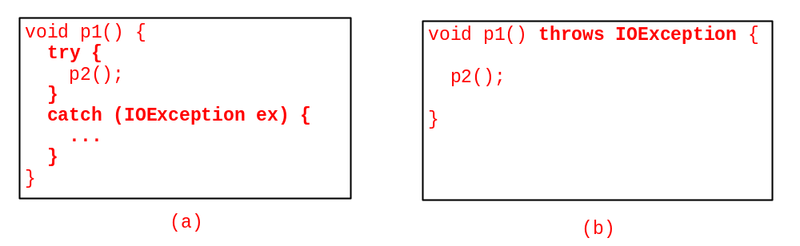
Catch or Declare Checked Exceptions
Java forces you to deal with checked exceptions. If a method declares a checked exception (i.e., an exception other than Error or RuntimeException), you must invoke it in a try-catch block or declare to throw the exception in the calling method. For example, suppose that method p1 invokes method p2 and p2 may throw a checked exception (e.g., IOException), you have to write the code as shown in (a) or (b).

Slide 32
Defining Custom Exception Classes
Use the exception classes in the API whenever possible.
Define custom exception classes if the predefined classes are not sufficient.
Define custom exception classes by extending Exception or a subclass of Exception.

Slide 33
Inheritance

Slide 34
Are superclass’s Constructor Inherited?
No. They are not inherited.
They are invoked explicitly or implicitly.
Explicitly using the super keyword.
A constructor is used to construct an instance of a class. Unlike properties and methods, a superclass's constructors are not inherited in the subclass. They can only be invoked from the subclasses' constructors, using the keyword super. If the keyword super is not explicitly used, the superclass's no-arg constructor is automatically invoked.

Slide 35
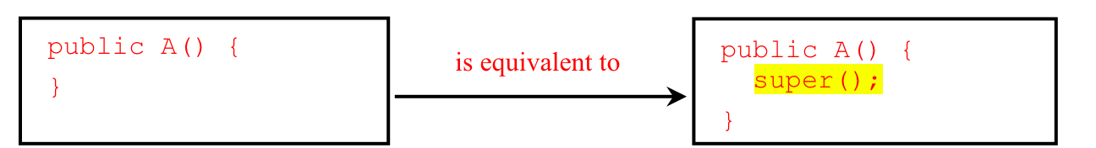
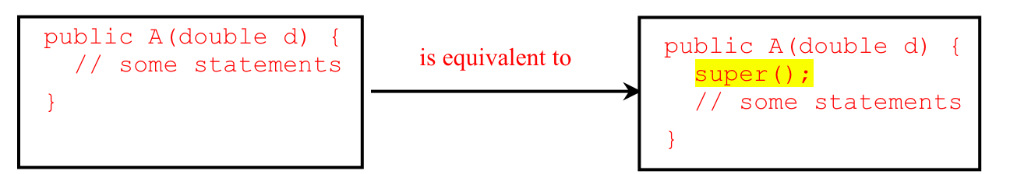
Superclass’s Constructor Is Always Invoked
A constructor may invoke an overloaded constructor or its superclass’s constructor. If none of them is invoked explicitly, the compiler puts super() as the first statement in the constructor. For example,

Slide 36
Using the Keyword super
The keyword super refers to the superclass of the class in which super appears. This keyword can be used in two ways:
To call a superclass constructor
To call a superclass method

Slide 37
CAUTION
You must use the keyword super to call the superclass constructor. Invoking a superclass constructor’s name in a subclass causes a syntax error. Java requires that the statement that uses the keyword super appear first in the constructor.

Slide 38
Overriding Methods in the Superclass
A subclass inherits methods from a superclass. Sometimes it is necessary for the subclass to modify the implementation of a method defined in the superclass. This is referred to as method overriding.
public class Circle extends GeometricObject {
// Other methods are omitted
/** Override the toString method defined in GeometricObject */
public String toString() {
return super.toString() + "\nradius is " + radius;
}
}

Slide 39
Polymorphism, Dynamic Binding and Generic Programming
public class PolymorphismDemo {
public static void main(String[] args) {
m(new GraduateStudent());
m(new Student());
m(new Person());
m(new Object());
}
public static void m(Object x) {
System.out.println(x.toString());
}
}
class GraduateStudent extends Student {
}
class Student extends Person {
public String toString() {
return "Student";
}
}
class Person extends Object {
public String toString() {
return "Person";
}
}
Method m takes a parameter of the Object type. You can invoke it with any object.
An object of a subtype can be used wherever its supertype value is required. This feature is known as polymorphism.
When the method m(Object x) is executed, the argument x’s toString method is invoked. x may be an instance of GraduateStudent, Student, Person, or Object. Classes GraduateStudent, Student, Person, and Object have their own implementation of the toString method. Which implementation is used will be determined dynamically by the Java Virtual Machine at runtime. This capability is known as dynamic binding.

Slide 40
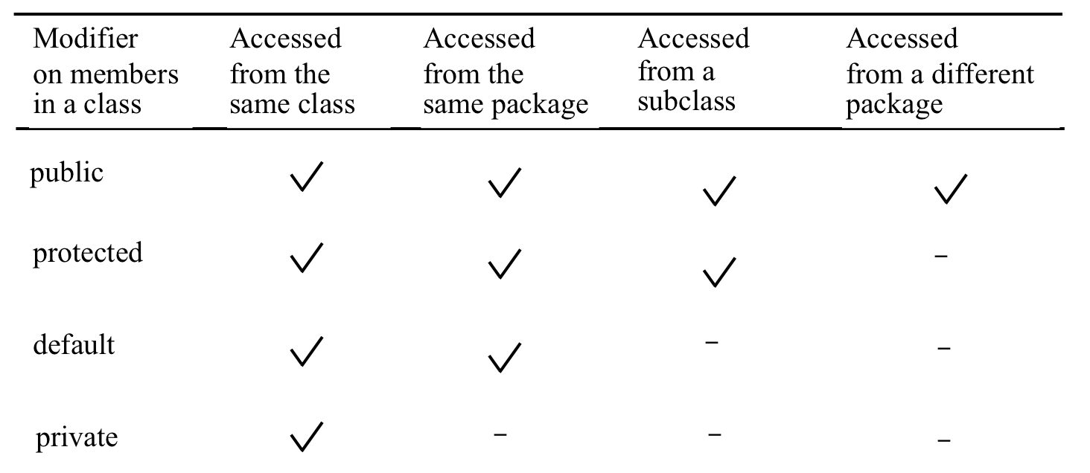
Accessibility Summary

Slide 41
A Subclass Cannot Weaken the Accessibility
A subclass may override a protected method in its superclass and change its visibility to public. However, a subclass cannot weaken the accessibility of a method defined in the superclass. For example, if a method is defined as public in the superclass, it must be defined as public in the subclass.

Slide 42
Abstract class and Interface

Slide 43

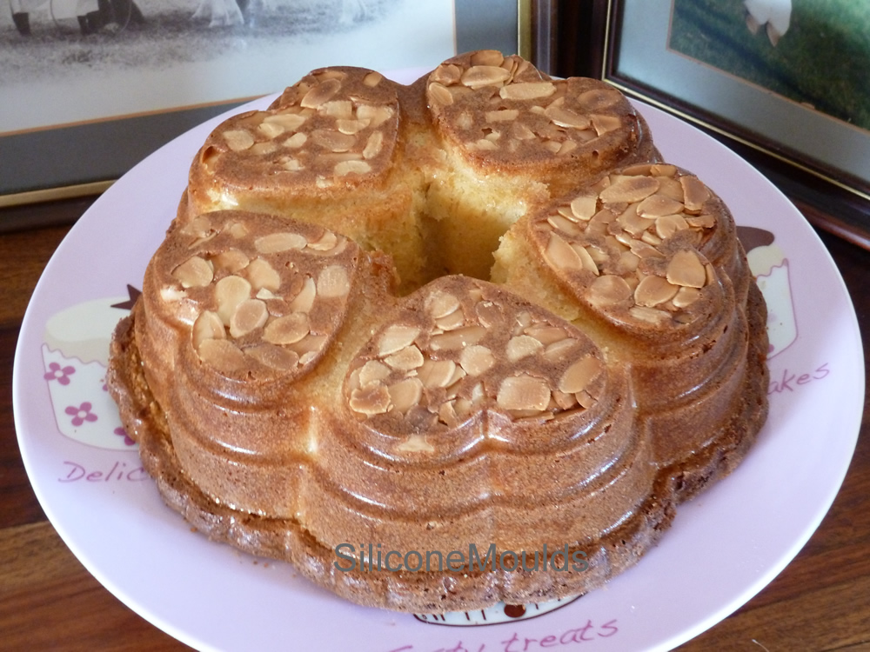
What’s an abstract class?
It is a special kind of class solely used for sharing/reusing data/behavior for subclasses
Difference from the classes you have seen so far
  Cannot be “newed”.
  Can own “abstract methods”.
Analogy:
  Special molds used to make other molds not to make cakes

Slide 44
What’s an abstract method?
We need “abstract classes” for reusing data/behavior for subclasses.
Often we only say what a method looks like and don’t provide any definition
  No need → subclass will override
  Impossible → depends on what subclass does
Such methods are “abstract” methods with the abstract modifier.

Slide 45
What’s an interface?
The single most important concept in the Java language
Think of interface as a special type of abstract class
  Add additional roles/personality to a class
  To satisfy the need of multiple inheritance but no black diamond.
  Key for building massive scale Java libraries

Slide 46
Define an Interface
To distinguish an interface from a class, Java uses the following syntax to declare an interface:
public interface InterfaceName {
constant declarations;
method signatures;
}
Example:
public interface Edible {
/** Describe how to eat */
public abstract String howToEat();
}

Slide 47

Interfaces vs. Abstract Classes
  In an interface, the data must be constants; an abstract class can have all types of data.
  Each method in an interface has only a signature without implementation; an abstract class can have concrete methods.
Notes:
Thursday class stops here.

Slide 48
GUI Basics
You will not need to remember APIs.
How to compose Swing widgets is not covered in the midterm.

Slide 49
Event-driven programming

Slide 50
Review points
Know how to handle events for Swing widgets, if APIs are given.
Understand the basic syntax and rules of inner classes
Understand the basic syntax of anonymous inner classes

Slide 51
Procedural vs. Event-Driven Programming
Procedural programming is executed in procedural order. （Also called imperative)
In event-driven programming, code is executed upon activation of events.

Slide 52
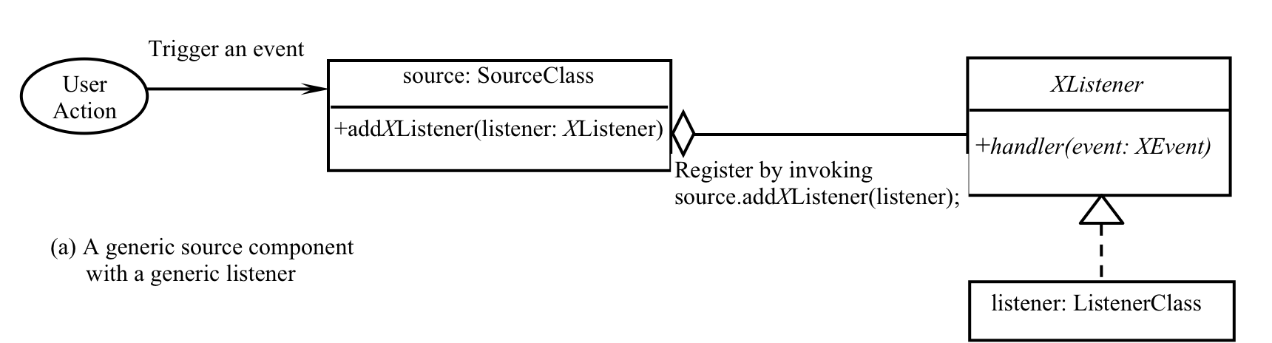
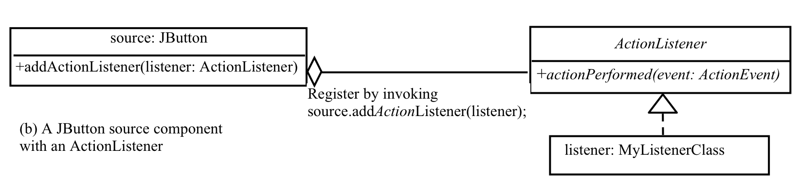
The Delegation Model

Slide 53
The Delegation Model: Example
JButton jbt = new JButton("OK");
ActionListener listener = new OKListener();
jbt.addActionListener(listener);

Slide 54
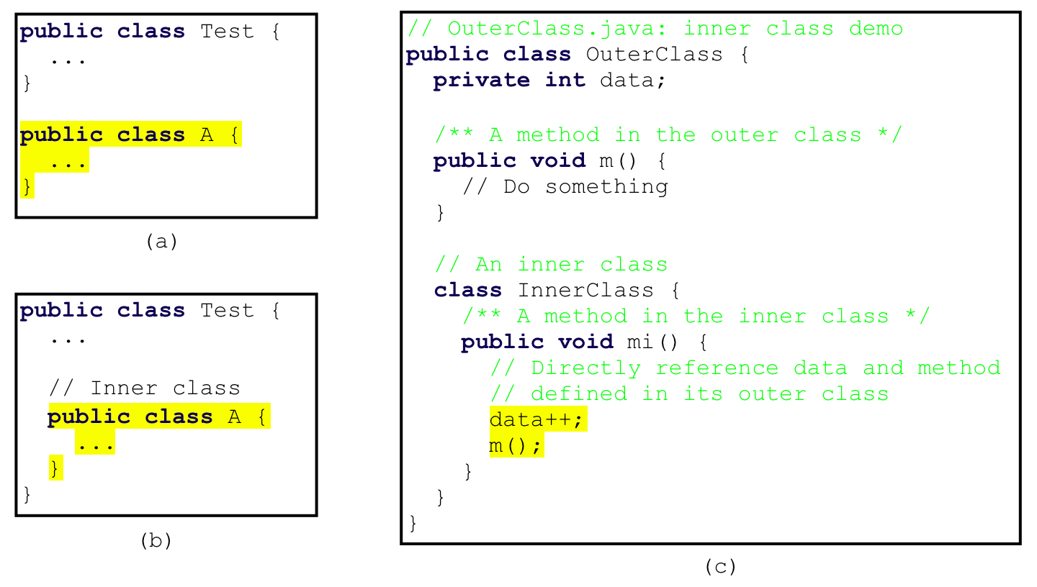
Inner Classes, cont.

Slide 55
Inner Classes (cont.)
Inner classes can make programs simple and concise.
An inner class supports the work of its containing outer class and is compiled into a class named OuterClassName$InnerClassName.class. For example, the inner class InnerClass in OuterClass is compiled into OuterClass$InnerClass.class.

Slide 56
Anonymous Inner Classes
Inner class listeners can be shortened using anonymous inner classes. An anonymous inner class is an inner class without a name. It combines declaring an inner class and creating an instance of the class in one step. An anonymous inner class is declared as follows:
new SuperClassName/InterfaceName() {
// Implement or override methods in superclass or interface
// Other methods if necessary
}

Slide 57
Good luck with your midterm

