Slide 1
Course Review

Slide 2
Final Exam
20/5/2016, Friday 8:30AM - 11:30AM, Tsang Shiu Tim Art Hall
Include all topics but with more emphasis on materials after the midterm.
Similar to midterm.
Closed book with a focus on concepts and principles.

Slide 3
Final Exam
Basic OOP (20%)
  Polymorphism
  Object initialization
  Abstract class, Interface, and Inner class
Exception Handling(10%)
Generics (25%)
Multithreading (25%)
Others (strings, networking, file I/O, GUI) (20%)

Slide 4
Java
Object oriented programming
  No explicit pointers but objects are references
  Extends one class but can implement multiple interfaces.
Exception handling is the norm: must handle all checked exceptions.
Generics.
Threads.
Comprehensive APIs for dealing with GUI, networking, …

Slide 5

Generics

Slide 6
Casting from
Superclass to Subclass
Explicit casting must be used when casting an object from a superclass to a subclass. This type of casting may not always succeed.
  Apple x = (Apple)fruit;
  Orange x = (Orange)fruit;
(From Inheritance Lecture)

Slide 7
Casting is bad
Remember the devil: void*?
If: Object o = new Object() and Apple a = (Apple)o, you get a runtime error.
It was mostly used when you use collection classes such as “LinkedList”.
No longer necessary with the use of Generics
(From Inheritance Lecture)

Slide 8
What is Generics?
Generics is the capability to parameterize types.
You can define a class or a method with generic types that can be substituted using concrete types by the compiler.
For example, you may define a generic stack class that stores the elements of a generic type. From this generic class, you may create a stack object for holding strings and a stack object for holding numbers. Here, strings and numbers are concrete types that replace the generic type.

Slide 9
Why Generics?
The key benefit of generics
  Enable errors to be detected at compile time rather than at runtime.
  A generic class or method permits you to specify allowable types of objects that the class or method may work with.
  If you attempt to use the class or method with an incompatible object, the compile error occurs.

Slide 10
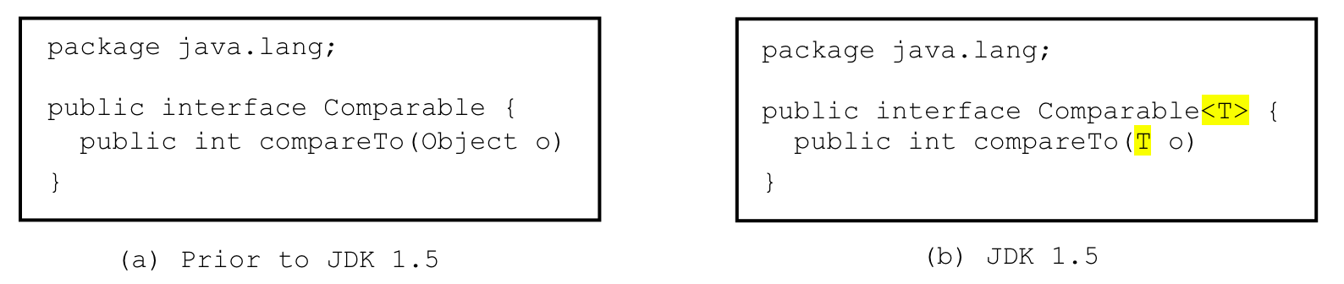
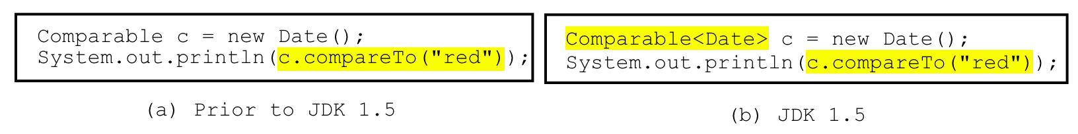
Generic Type
Generic Instantiation
Runtime error
Improves reliability
Compile error
GenericMotivation
_interfaces.ComparableRectangle, ComparableRectangleWithGeneric

Slide 11
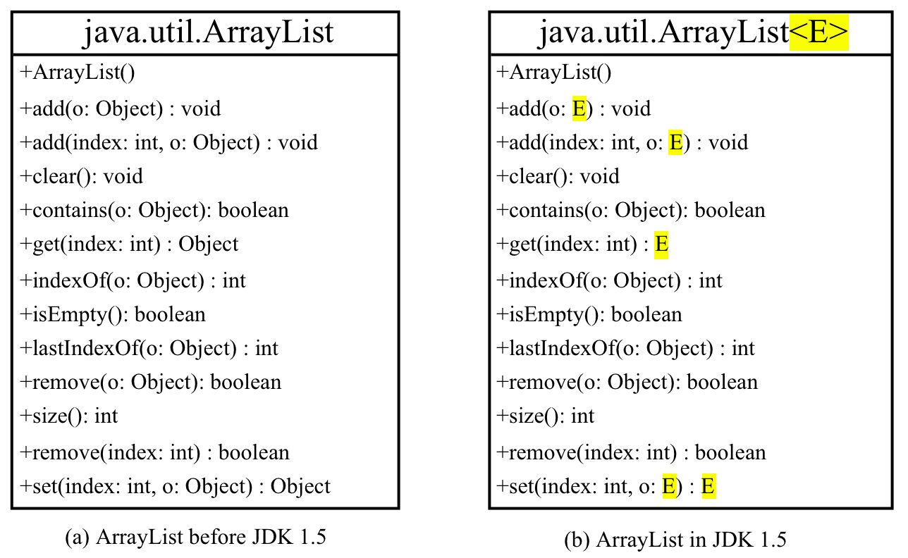
Generic ArrayList in JDK 1.5

Slide 12
No Casting Needed
ArrayList<Double> list = new ArrayList<Double>();
list.add(5.5); // 5.5 is automatically converted to new Double(5.5)
list.add(3.0); // 3.0 is automatically converted to new Double(3.0)
Double doubleObject = list.get(0); // No casting is needed
double d = list.get(1); // Automatically converted to double

Slide 13
Generic Types Restriction
Generic types must be reference types.
The following statement is wrong:
ArrayList<int> ints = new ArrayList<int>();
Use wrapper class types:
ArrayList<Integer> ints = …

Slide 14
Multiple Type Parameter
Our coffee shop lunch menu
  Meat + Starch + Soup
  (Pork/Beef/Chicken)+(Rice/Italy noodle/Fries)+(Cream/Vegetable soup)
class Lunch<M,St,S> {
M meat_;
St starch_;
S soup_;
public Lunch(M meat, St starch, S soup){
meat_ = meat;
starch_=starch;
soup_=soup;
}
}
Beef b = new Beef();
Rice r = new Rice();
MushroomSoup s = new MushroomSoup();
Lunch<Beef, Rice, MushroomSoup> l = new Lunch<Beef, Rice, MushroomSoup>(b,r,s);

Slide 15
Problem 1:
Incorrect Parameter Types
Node b = new Node();
TreeNode r = new TreeNode();
BTreeNode s = new BTreeNode();
Lunch<Node, TreeNode, BTreeNode> l = new Lunch<Node, TreeNode, BTreeNode>(b,r,s);
We want to more properly say the following:
Lunch<subtypes of Meat, subtypes of Starch, subtypes of Soup>

Slide 16
Bounded Generic Types
public class Meat { … }
public class Starch { … }
public class Soup { … }
public class Beef extends Meat { … }
public class CreamSoup extends Soup { … }
class Lunch <M extends Meat,St extends Starch,S extends Soup> {
M meat_;
St starch_;
S soup_;
public Lunch(M meat, St starch, S soup){
meat_ = meat;
starch_=starch;
soup_=soup;
}
}

Slide 17
Generic Methods
public static <E> void print(E[] list) {
for (int i = 0; i < list.length; i++)
System.out.print(list[i] + " ");
System.out.println();
}
public static void print(Object[] list) {
for (int i = 0; i < list.length; i++)
System.out.print(list[i] + " ");
System.out.println();
}
GenericMethodDemo
Notes:
We can use a type variable E in the place of Object. Show GenericMethodDemo.

Slide 18
public class Test {
public static void main(String[] args) {
Integer[] integers = {1,2,3,4,5};
String[] strings = {"London", "Paris", "New York", "Austin"};
Object[] objects = {"London", "Paris", "New York", "Austin", 1};
Test.<Integer>print(integers);
Test.<String>print(strings);
Test.print(objects);
Test.print1(integers);
Test.print1(strings);
Test.print1(objects);
}
public static <E> void print(E[] list) {
for (int i = 0; i < list.length; i++)
System.out.print(list[i] + " ");
System.out.println();
}
public static void print1(Object[] list) {
for (int i = 0; i < list.length; i++)
System.out.print(list[i] + " ");
System.out.println();
}
}
GenericTest
Notes:
Developers can flexibly refine the level of uniformity of an array. What if we re-implement the generic print method with print(E[] list, boolean ordered) or print(E[] list, boolean noDuplicate).

Slide 19
Problem 2:
Inheritance of Generic Types
Define Subclasses of Generic types not required!
ClassA extends ClassB
Subtype
  ClassA is a subtype of ClassB
  Stack<ClassA> is NOT a subtype of Stack<ClassB>
Are we losing polymorphism?
  This creates trouble for us
  Customer requests a refund because they want more flexibility

Slide 20


Are we losing polymorphism?
class Stack<T>{
public void pushAll(Stack<T> s){
for(//there is element in me)
s.push(pop());
}
public void popAll(Stack<T> s) {
for(//there is element in s)
push(s.pop());
}
}
//Let us say ClassB is a
//subclass of ClassA
Stack<ClassA> s1 = new Stack<ClassA>();
Stack<ClassB> s2 = new Stack<ClassB>();
s2.pushAll(s1);
//should be OK since ClassB is also a
//type of ClassA. s1 that handles the
//super type can handle subtypes
s1.popAll(s2);
//should be OK since ClassA is a super
//type of ClassB. Again, s1 should be
//able to take subtypes of ClassA.
It seems that parameter s should behave polymorphically

Slide 21
We need “wild card”
In defining a generic type
  “E extends ClassA” represents all subtypes of ClassA
In defining a container variable that behaves polymorphically
  “? extends” represent any sub types.
  “? super” represent any super types

Slide 22
Support Polymorphism
class Stack<T>{
public void pushAll(Stack<? super T> s){
for(//there is element in me)
s.push(pop());
}
public void popAll(Stack<? extends T> s) {
for(//there is element in s)
push(s.pop());
}
}
class Stack<T>{
public void pushAll(Stack<T> s){
for(//there is element in me)
s.push(pop());
}
public void popAll(Stack<T> s) {
for(//there is element in s)
push(s.pop());
}
}
Version 4
Stack<ClassA> s1 = new Stack<ClassA>();
Stack<ClassB> s2 = new Stack<ClassB>();
s2.pushAll(s1);
s1.popAll(s2);

Slide 23
Wildcards
Why wildcards are necessary? One more example.
WildCardDemo1
? unbounded wildcard
? extends T bounded wildcard
? super T lower bound wildcard:
WildCardDemo22
WildCardDemo3
Notes:
Although Integer is a subtype of Number. GenericStack<Integer> however is not a subtype of GenericStack<Number>. As such, WildCardDemo1 has a compilation error at max(intStack). Need to be fixed by:
public static double max(GenericStack<? extends Number> stack) { …
Similarly, GenericStack<Integer> is not a subtype of GenericStack<Object>
Can we replace <? super T> in WildCardDemo3 by <? extends T>?

Slide 24
Erasure on Generics
Generics are implemented using an approach called type erasure.
public static <T> int count(T[] anArray, T elem) {
int cnt = 0;
for (T e : anArray)
if (e.equals(elem))
++cnt;
return cnt;
}
public static int count(Object[] anArray, Object elem) {
int cnt = 0;
for (Object e : anArray)
if (e.equals(elem))
++cnt;
return cnt;
}

Slide 25
Erasure on Generics
Generics are a wrapper over java.lang.Object to ensure backwards compatibility
Generics are implemented using an approach called type erasure.
  Unbound variable replaced by “Object”
  Bounded variable “ T extends ClassA”, “? super ClassB” replaced by bound, “ClassA” or “ClassB”.
The types used to instantiate generics serve as “comments”.
What generics really is:
  Compile time checks
  Hints to generate the casting correctly.
  Enforcing the usage of the same type

Slide 26
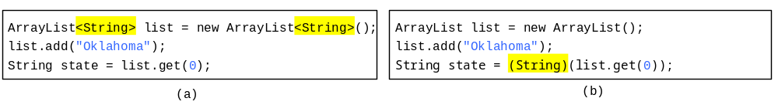
Compile Time Checking
For example, the compiler checks whether generics is used correctly for the following code in (a) and translates it into the equivalent code in (b) for runtime use. The code in (b) uses the raw type.

Slide 27
Checks and Hints
class Parent<T> {
T compute(T t){return t;}
}
p = new Parent<String>();
String s = p.compute(“s”);
String s = p.compute(circle);
class Parent{
Object compute(Object t){
return t; }
}
p = new Parent();
String s = (String) p.compute(“s”);
String s = (String) p.compute(circle);
Generics tells us p can only deal with Strings . This information is stored in the compiler not in the code

Slide 28
Type Enforcement
class Parent<T extends Geom> {
T compute(T t1, T t2){return t1.same(t2);}
}
p = new Parent<Circle>();
String s = p.compute(circle, triangle);
Generics tells us these two parameters have to be the same type, not just subclass of Geom. This information is stored in the compiler not in the code
class Parent{
Geom compute(Geom t1, Geom t2){
return t1.same(t2); }
}
p = new Parent();
Geom = (Circle) p.compute((Circle)circle, (Circle)triangle);

Slide 29
Important Facts
It is important to note that a generic class is shared by all its instances regardless of its actual generic type.
  GenericStack<String> stack1 = new GenericStack<String>();
  GenericStack<Integer> stack2 = new GenericStack<Integer>();
Although GenericStack<String> and GenericStack<Integer> are two types, but there is only one class GenericStack loaded into the JVM.
TestInstanceof
Notes:
Run TestInstanceof

Slide 30
Restrictions on Generics
Restriction 1: Cannot Create an Instance of a Generic Type. (i.e., new E()).
Restriction 2: Generic Array Creation is Not Allowed. (i.e., new E[100]).
Restriction 3: A Generic Type Parameter of a Class is Not Allowed in a Static Context.
Restriction 4: Exception Classes Cannot be Generic.
Notes:
1,2: cannot decide E dynamically
3,4: A generic class is shared by all its instances regardless of its actual generic types. There is only a single copy of static field.
4: catch cannot differentiate different generic types of the same exception after type erasure.

Slide 31
Not allowed in a static context
public class Test<E> {
public static void m (E o1) { // Illegal
}
public static E o1; // Illegal
static {
E o2; // Illegal
}
}
Notes:
What if Test<String>.o1 and Test<Date>.o1 after type erasure?

Slide 32
Not allowed in exception classes
public class MyException<T> extends Exception {}
try {
…
}
catch (MyException <Integer> ex) {
…
}
catch (MyException<Circle> ex) {
…
}
Notes:
Problems arise with the erasure of generic type.

Slide 33
Threads

Slide 34
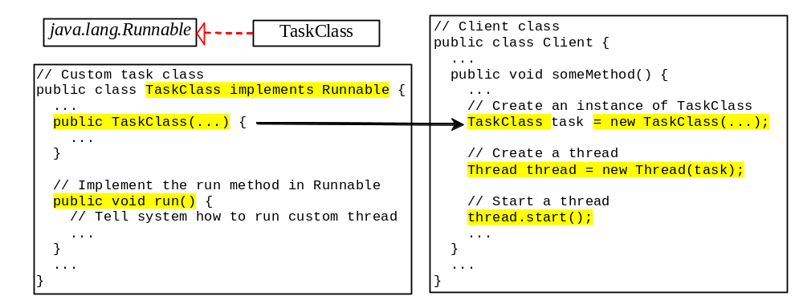
Creating Tasks and Threads

Slide 35
run()
The run() methods in a task class specifies how to perform the task. It’s automatically invoked by JVM when a thread is started.
You should not invoke it: doing so merely executes this method in the same thread; no new thread is started.

Slide 36
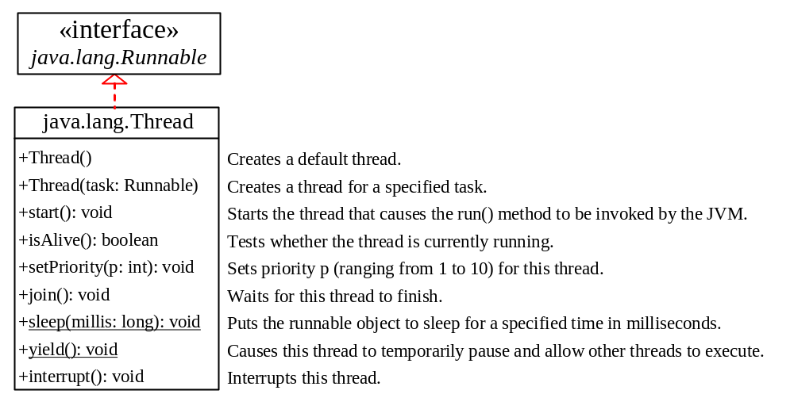
The Thread Class

Slide 37
The Static sleep(milliseconds) Method
The sleep(long mills) method puts the thread to sleep for the specified time in milliseconds. For example, suppose you modify the code in Lines 53-57 in TaskThreadDemo.java as follows:
  public void run() {
  for (int i = 1; i <= lastNum; i++) {
  System.out.print(" " + i);
  try {
  if (i >= 50) Thread.sleep(1);
  }
  catch (InterruptedException ex) {
  }
  }
  }
Every time a number (>= 50) is printed, the print100 thread is put to sleep for 1 millisecond.

Slide 38
The sleep() method may throw an InterruptedException, which is a checked exception.
This rarely occurs, but you have to catch it as it is a checked exception.
The same hold for the join() method.

Slide 39
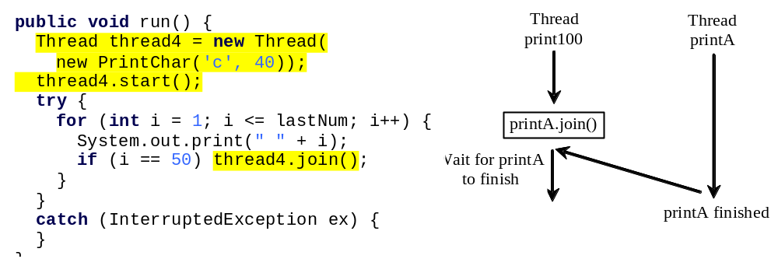
The join() Method
You can use the join() method to force one thread to wait for another thread to finish. For example, suppose you modify the code in Lines 53-57 in TaskThreadDemo.java as follows:
The numbers after 50 are printed after thread printA is finished.

Slide 40
Thread Priority
Each thread is assigned a default priority of Thread.NORM_PRIORITY. You can reset the priority using setPriority(int priority).
Some constants for priorities include Thread.MIN_PRIORITY Thread.MAX_PRIORITY Thread.NORM_PRIORITY

Slide 41
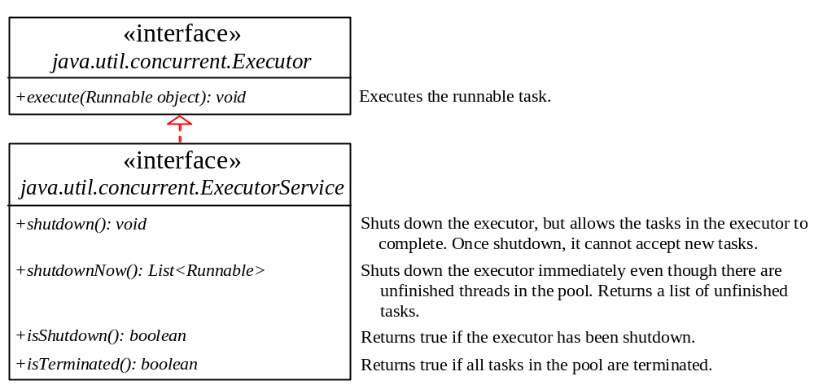
Thread Pools
Starting a new thread for each task could limit throughput and cause poor performance. A thread pool is ideal to manage the number of tasks executing concurrently. JDK 1.5 uses the Executor interface for executing tasks in a thread pool and the ExecutorService interface for managing and controlling tasks. ExecutorService is a subinterface of Executor.

Slide 42
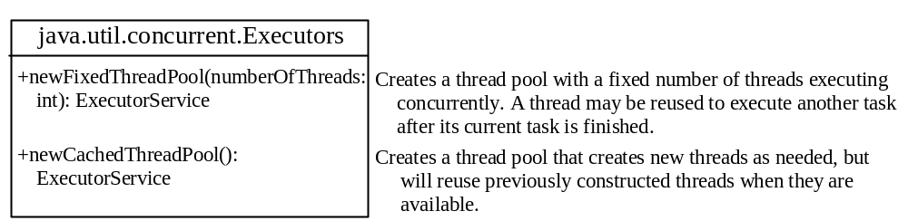
Creating Executors
To create an Executor object, use the static methods in the Executors class.
ExecutorDemo

Slide 43
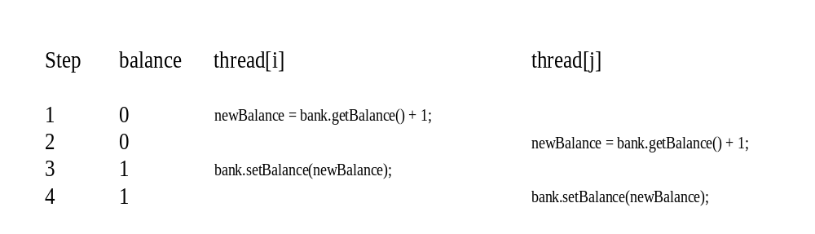
Thread Synchronization
A shared resource may be corrupted if it is accessed simultaneously by multiple threads. For example, two unsynchronized threads accessing the same bank account may cause conflict.

Slide 44
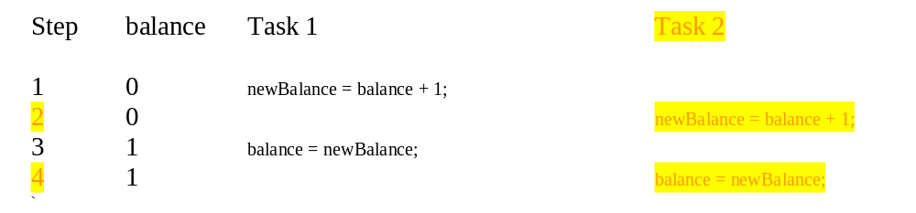
Race Condition
What, then, caused the error in the example? Here is a possible scenario:
The effect of this scenario is that Task 1 did nothing, because in Step 4 Task 2 overrides Task 1's result. Obviously, the problem is that Task 1 and Task 2 are accessing a common resource in a way that causes conflict. This is a common problem known as a race condition in multithreaded programs. A class is said to be thread-safe if an object of the class does not cause a race condition in the presence of multiple threads. As demonstrated in the preceding example, the Account class is not thread-safe.

Slide 45
The synchronized keyword
To avoid race conditions, more than one thread must be prevented from simultaneously entering certain part of the program, known as critical region. The critical region in the Listing 29.7 is the entire deposit method. You can use the synchronized keyword to synchronize the method so that only one thread can access the method at a time. There are several ways to correct the problem in Listing 29.7, one approach is to make Account thread-safe by adding the synchronized keyword in the deposit method in Line 45 as follows:
  public synchronized void deposit(double amount)

Slide 46
Synchronizing Instance Methods and Static Methods
A synchronized method acquires a lock before it executes. In the case of an instance method, the lock is on the object for which the method was invoked. In the case of a static method, the lock is on the class. If one thread invokes a synchronized instance method (respectively, static method) on an object, the lock of that object (respectively, class) is acquired first, then the method is executed, and finally the lock is released. Another thread invoking the same method of that object (respectively, class) is blocked until the lock is released.

Slide 47
Synchronizing Statements
Invoking a synchronized instance method of an object acquires a lock on the object, and invoking a synchronized static method of a class acquires a lock on the class. A synchronized statement can be used to acquire a lock on any object, not just this object, when executing a block of the code in a method. This block is referred to as a synchronized block. The general form of a synchronized statement is as follows:
  synchronized (expr) {
  statements;
  }
The expression expr must evaluate to an object reference. If the object is already locked by another thread, the thread is blocked until the lock is released. When a lock is obtained on the object, the statements in the synchronized block are executed, and then the lock is released.

Slide 48
Synchronizing Statements vs. Methods
Any synchronized instance method can be converted into a synchronized statement. Suppose that the following is a synchronized instance method:
  public synchronized void xMethod() {
  // method body
  }
This method is equivalent to
  public void xMethod() {
  synchronized (this) {
  // method body
  }
  }

Slide 49
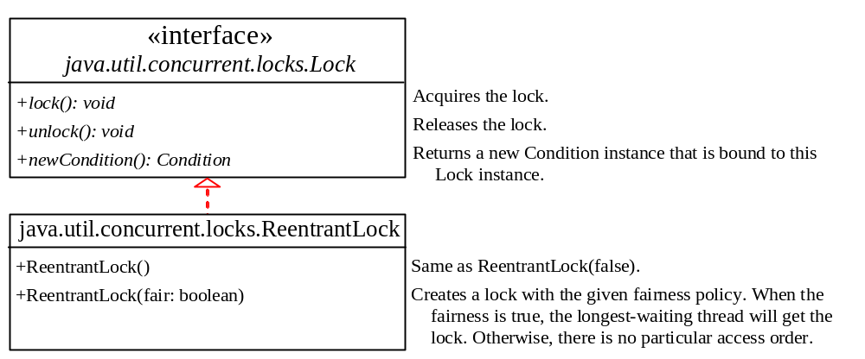
Synchronization Using Locks
A synchronized instance method implicitly acquires a lock on the instance before it executes the method.
JDK 1.5 enables you to use locks explicitly. The new locking features are flexible and give you more control for coordinating threads. A lock is an instance of the Lock interface, which declares the methods for acquiring and releasing locks, as shown in Figure 29.14. A lock may also use the newCondition() method to create any number of Condition objects, which can be used for thread communications.

Slide 50
Fairness Policy
ReentrantLock is a concrete implementation of Lock for creating mutual exclusive locks. You can create a lock with the specified fairness policy. True fairness policies guarantee the longest-wait thread to obtain the lock first. False fairness policies grant a lock to a waiting thread without any access order. Programs using fair locks accessed by many threads may have poor overall performance than those using the default setting, but have smaller variances in times to obtain locks and guarantee lack of starvation.

Slide 51
Example: Using Locks
This example revises AccountWithoutSync.java in Listing 29.7 to synchronize the account modification using explicit locks.
AccountWithSyncUsingLock

Slide 52
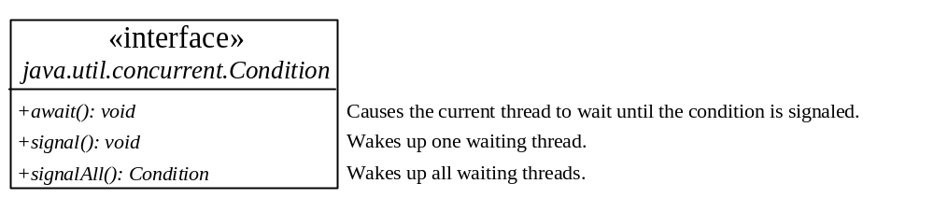
Cooperation Among Threads
The conditions can be used to facilitate communications among threads. A thread can specify what to do under a certain condition. Conditions are objects created by invoking the newCondition() method on a Lock object. Once a condition is created, you can use its await(), signal(), and signalAll() methods for thread communications, as shown in Figure 29.15. The await() method causes the current thread to wait until the condition is signaled. The signal() method wakes up one waiting thread, and the signalAll() method wakes all waiting threads.

Slide 53
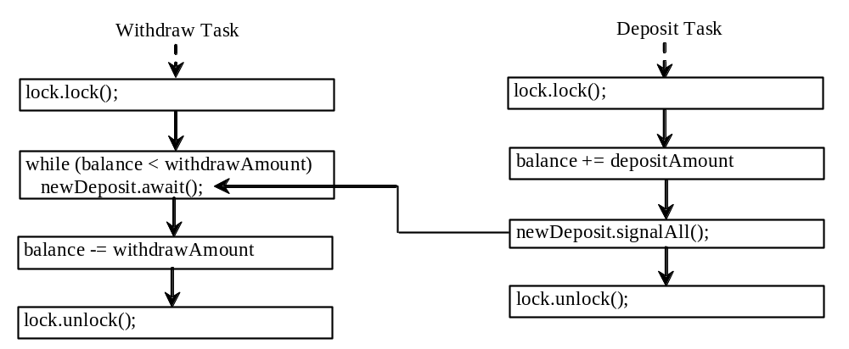
Cooperation Among Threads
To synchronize the operations, use a lock with a condition: newDeposit (i.e., new deposit added to the account). If the balance is less than the amount to be withdrawn, the withdraw task will wait for the newDeposit condition. When the deposit task adds money to the account, the task signals the waiting withdraw task to try again. The interaction between the two tasks is shown in Figure 29.16.

Slide 54
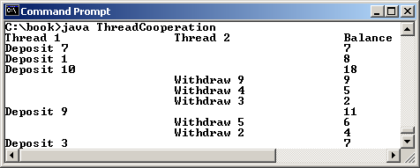
Example: Thread Cooperation
Write a program that demonstrates thread cooperation. Suppose that you create and launch two threads, one deposits to an account, and the other withdraws from the same account. The second thread has to wait if the amount to be withdrawn is more than the current balance in the account. Whenever new fund is deposited to the account, the first thread notifies the second thread to resume. If the amount is still not enough for a withdrawal, the second thread has to continue to wait for more fund in the account. Assume the initial balance is 0 and the amount to deposit and to withdraw is randomly generated.
ThreadCooperation

Slide 55
Java’s Built-in Monitors
Locks and conditions are new in Java 5. Prior to Java 5, thread communications are programmed using object’s built-in monitors. Locks and conditions are more powerful and flexible than the built-in monitor. However, it is easier to understand and use.
A monitor is an object with mutual exclusion and synchronization capabilities. Only one thread can execute a method at a time in the monitor. A thread enters the monitor by acquiring a lock on the monitor and exits by releasing the lock. Any object can be a monitor. An object becomes a monitor once a thread locks it. Locking is implemented using the synchronized keyword on a method or a block. A thread must acquire a lock before executing a synchronized method or block. A thread can wait in a monitor if the condition is not right for it to continue executing in the monitor.

Slide 56
wait(), notify(), and notifyAll()
Use the wait(), notify(), and notifyAll() methods to facilitate communication among threads.
The wait(), notify(), and notifyAll() methods must be called in a synchronized method or a synchronized block on the calling object of these methods. Otherwise, an IllegalMonitorStateException would occur.
The wait() method lets the thread wait until some condition occurs. When it occurs, you can use the notify() or notifyAll() methods to notify the waiting threads to resume normal execution. The notifyAll() method wakes up all waiting threads, while notify() picks up only one thread from a waiting queue.

Slide 57
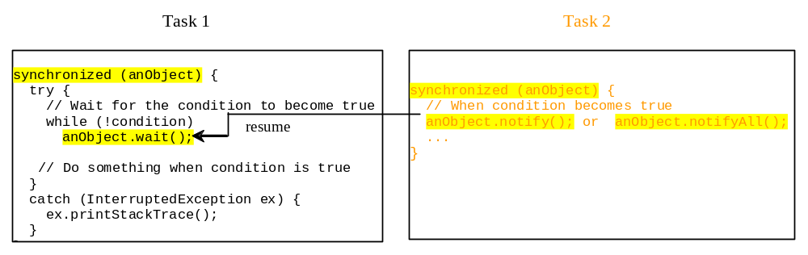
Example: Using Monitor
The wait(), notify(), and notifyAll() methods must be called in a synchronized method or a synchronized block on the receiving object of these methods. Otherwise, an IllegalMonitorStateException will occur.
When wait() is invoked, it pauses the thread and simultaneously releases the lock on the object. When the thread is restarted after being notified, the lock is automatically reacquired.
The wait(), notify(), and notifyAll() methods on an object are analogous to the await(), signal(), and signalAll() methods on a condition.

Slide 58
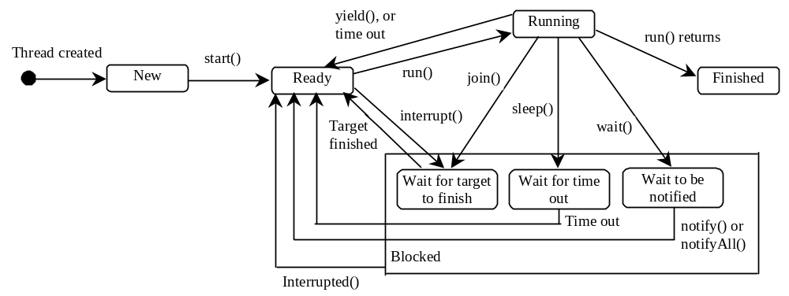
Thread States
A thread can be in one of five states: New, Ready, Running, Blocked, or Finished.

Slide 59
Networking (TCP)

Slide 60
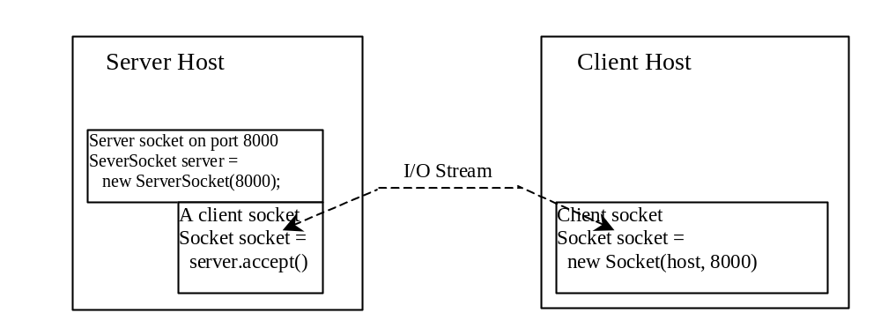
Client/Server Communications
The server must be running when a client starts. The server waits for a connection request from a client. To establish a server, you need to create a server socket and attach it to a port, which is where the server listens for connections.
After the server accepts the connection, communication between server and client is conducted the same as for I/O streams.
After a server socket is created, the server can use this statement to listen for connections.
The client issues this statement to request a connection to a server.

Slide 61
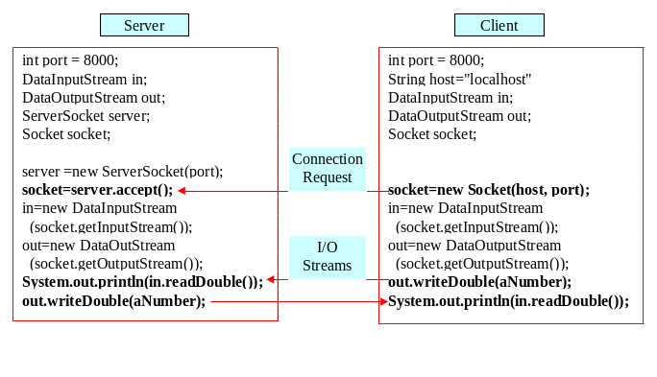
Data Transmission through Sockets
InputStream input = socket.getInputStream();
OutputStream output = socket.getOutputStream();

Slide 62
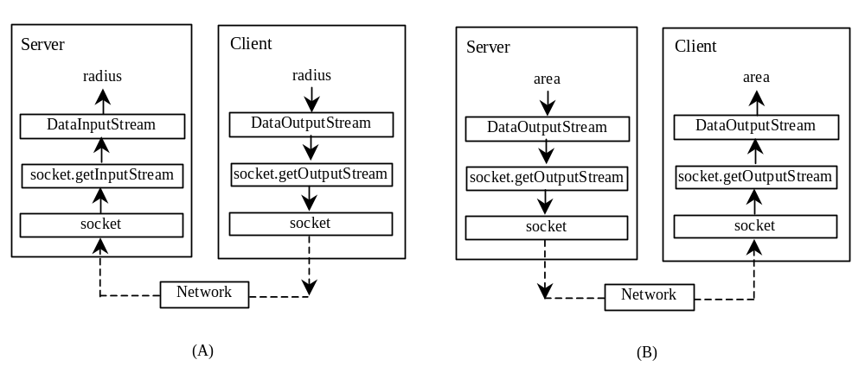
A Client/Server Example

Slide 63
The InetAddress Class
Occasionally, you would like to know who is connecting to the server. You can use the InetAddress class to find the client's host name and IP address. The InetAddress class models an IP address. You can use the statement shown below to create an instance of InetAddress for the client on a socket.
  InetAddress inetAddress = socket.getInetAddress();
Next, you can display the client's host name and IP address, as follows:
  System.out.println("Client's host name is " +
  inetAddress.getHostName());
  System.out.println("Client's IP Address is " +
  inetAddress.getHostAddress());

Slide 64
Serving Multiple Clients
Multiple clients are quite often connected to a single server at the same time. Typically, a server runs constantly on a server computer, and clients from all over the Internet may want to connect to it. You can use threads to handle the server's multiple clients simultaneously. Simply create a thread for each connection. Here is how the server handles the establishment of a connection:
    while (true) {
    Socket socket = serverSocket.accept();
    Thread thread = new ThreadClass(socket);
    thread.start();
    }
The server socket can have many connections. Each iteration of the while loop creates a new connection. Whenever a connection is established, a new thread is created to handle communication between the server and the new client; and this allows multiple connections to run at the same time.

Slide 65
Good lucks in final!

