Slide 1
Setting up Eclipse and Emacs Programming Environment

Slide 2
Preparation for Eclipse
Install MinGW GCC or Cygwin GCC
basic compiler for Eclipse
Install Eclipse C/C++ Development Tool (CDT)
Eclipse ⇒ Help ⇒ Install New Software...
⇒ In "Work with", enter the CDT update site http://download.eclipse.org/tools/cdt/releases/juno (for Eclipse Juno only)
⇒ Add ⇒ Enter a name (e.g., CDT 8.1.0)
⇒ You should select all the "CDT main features". You may select optional features ⇒ Finish

Slide 3
Take MinGW as an example
MinGW---- “Minimalist GNU for Windows”
Install MinGW on your computer
Set up the Environment Variable:
MINGW_HOME=D:/MinGW
LIBRARY_PATH=%MINGW_HOME%/lib
C_INCLUDE_PATH=%MINGW_HOME%/include
CPLUS_INCLUDE_PATH=%MINGW_HOME%/include/c++/3.4.5;%MINGW_HOME/include/c++/3.4.5/mingw32;%MINGW_HOME/include/c++/3.4.5/backward;%MINGW_HOME%/include
path=%path%;%MINGW_HOME%/bin
(the version may be higher than 3.4.5)

Slide 4
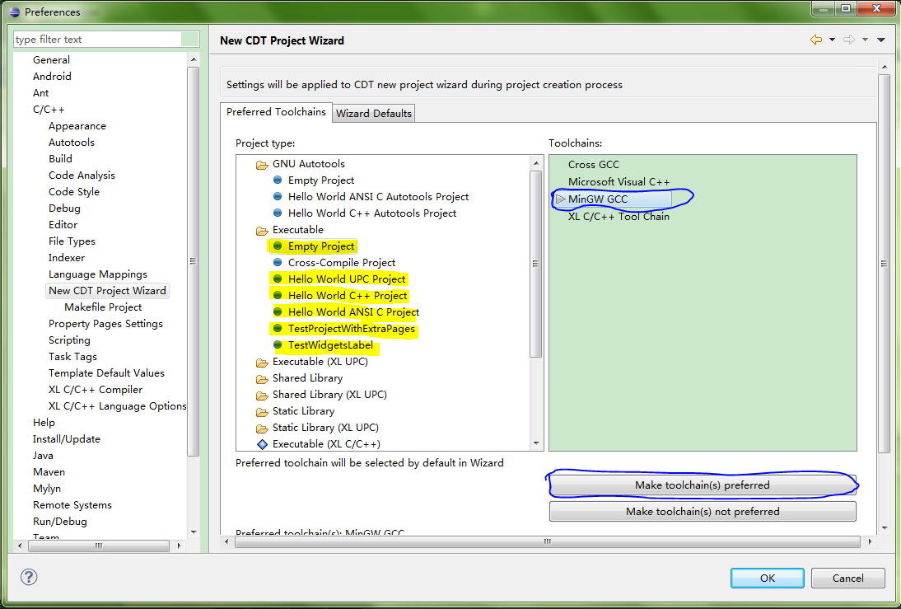
CDT Project Wizard

Slide 5
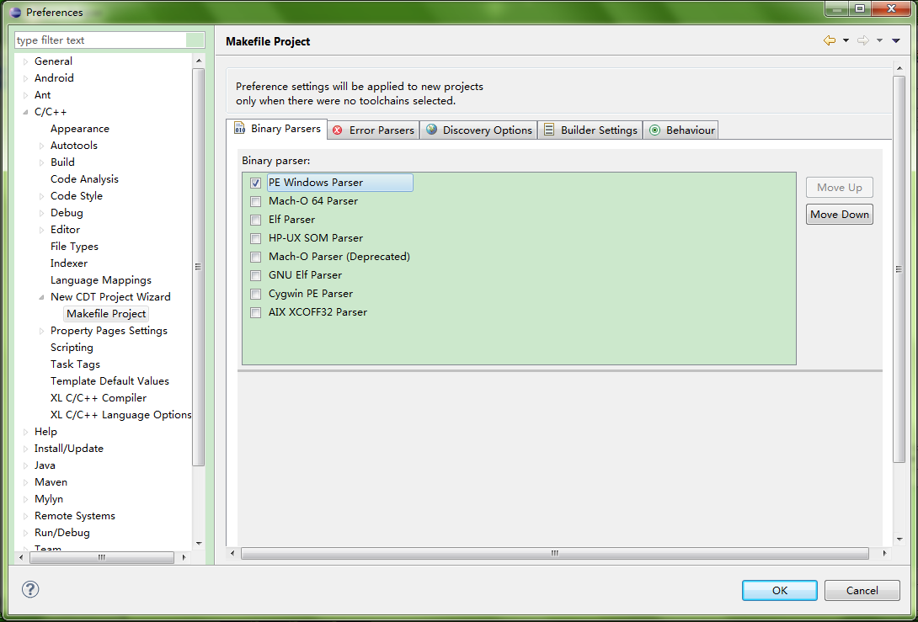
Makefile Project

Slide 6
More Detail Could be Found
http://www3.ntu.edu.sg/home/ehchua/programming/howto/EclipseCpp_HowTo.html

Slide 7
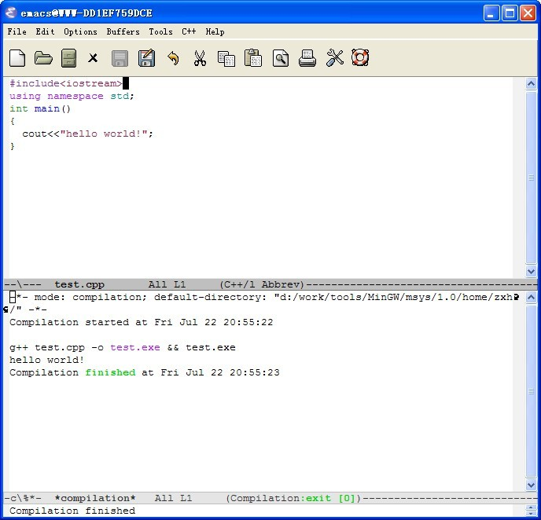
Starting Emacs on Windows

Slide 8
Environment Setup for Emacs
Download the following link:
1、mingw-get-inst：http://sourceforge.net/projects/mingw/files/
2、emacs：http://www.gnu.org/software/emacs/
Environment Variables Setting:
Variable Name: Path
Append Variable Value:
D:\work\tools\emacs-23.2\bin;
D:\work\tools\MinGW\bin

