Slide 1
Lecture 4: Integer and Matrix Multiplication
More complicated examples of divide-and-conquer

Slide 2



Integer Arithmetic
Add. Given two $n$-bit integers $a$ and $b$, compute $a+b$.
$O(n)$ time
Multiply. Given two $n$-digit integers $a$ and $b$, compute $a⋅b$.
Primary school method: $O(n^{2})$ time.
1
1
0
1
0
1
0
1
$$×$$
0
1
1
1
1
1
0
1
1
1
0
1
0
1
0
1
1
1
0
1
0
1
0
1
0
0
0
0
0
0
0
0
$$+$$
0
1
1
1
1
1
0
1
1
1
0
1
0
1
0
1
1
0
1
0
1
0
0
1
0
1
1
0
1
0
1
0
1
1
1
0
1
0
1
0
1
1
1
0
1
0
1
0
1
1
1
0
1
0
1
0
1
0
0
0
0
0
0
0
0
1
1
0
1
0
0
0
0
0
0
0
0
0
0
1

Slide 3
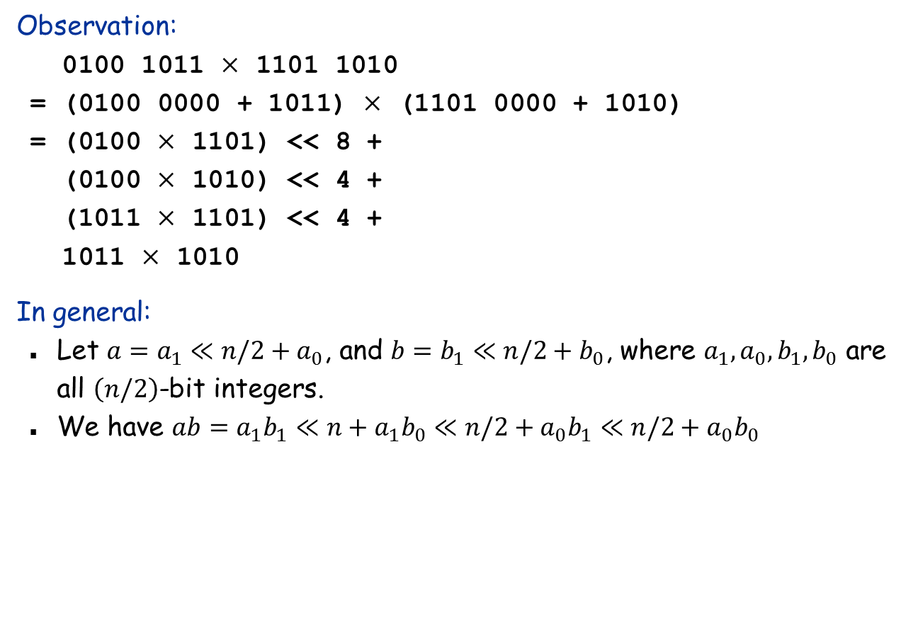
Divide-and-Conquer Multiplication: First Attempt
Observation:
0100 1011 $×$ 1101 1010
= (0100 0000 + 1011) $×$ (1101 0000 + 1010)
= (0100 $×$ 1101) << 8 +
(0100 $×$ 1010) << 4 +
(1011 $×$ 1101) << 4 +
1011 $×$ 1010
In general:
Let $a=a_{1}≪n/2+a_{0}$, and $b=b_{1}≪n/2+b_{0}$, where $a_{1},a_{0},b_{1},b_{0}$ are all $\left(n/2\right)$-bit integers.
We have $ab=a_{1}b_{1}≪n+a_{1}b_{0}≪n/2+a_{0}b_{1}≪n/2+a_{0}b_{0}$

Slide 4
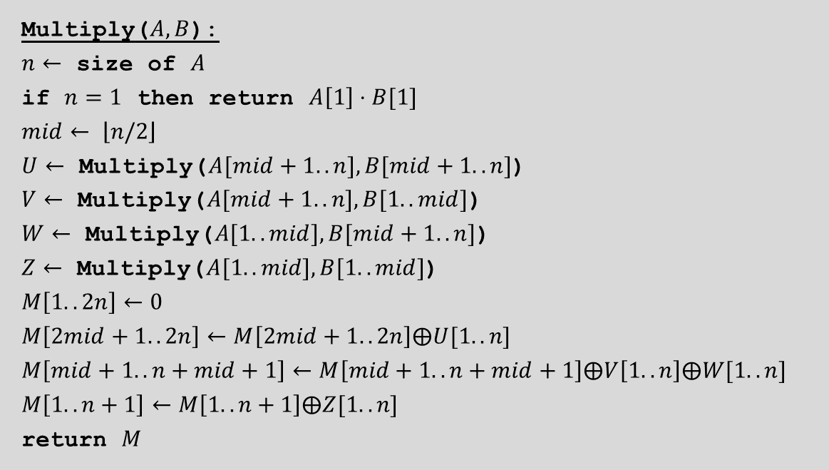
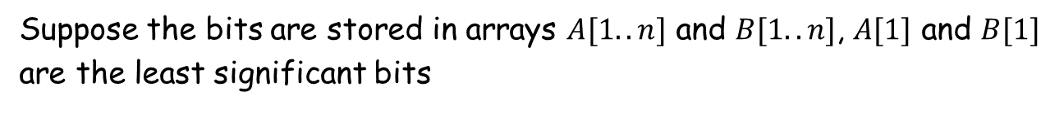

The first divide-and-conquer algorithm for integer multiplication
Suppose the bits are stored in arrays $A[1..n]$ and $B[1..n]$, $A[1]$ and $B[1]$ are the least significant bits
Multiply($A, B$):
$n←$ size of $A$
if $n=1$ then return $A\left[1\right]⋅B[1]$
$$mid← \left\lfloor n/2\right\rfloor$$
$U←$ Multiply($A[mid+1..n], B[mid+1..n]$)
$V←$ Multiply($A[mid+1..n], B[1..mid]$)
$W←$ Multiply($A[1..mid], B[mid+1..n]$)
$Z←$ Multiply($A[1..mid], B[1..mid]$)
$$M\left[1..2n\right]←0$$
$$M\left[2mid+1..2n\right]←M\left[2mid+1..2n\right]⨁U[1..n]$$
$$M\left[mid+1..n+mid+1\right]←M\left[mid+1..n+mid+1\right]⨁V\left[1..n\right]⨁W[1..n]$$
$$M\left[1..n+1\right]←M\left[1..n+1\right]⨁Z[1..n]$$
return $M$
$⨁$: denotes the integer addition algorithm

Slide 5








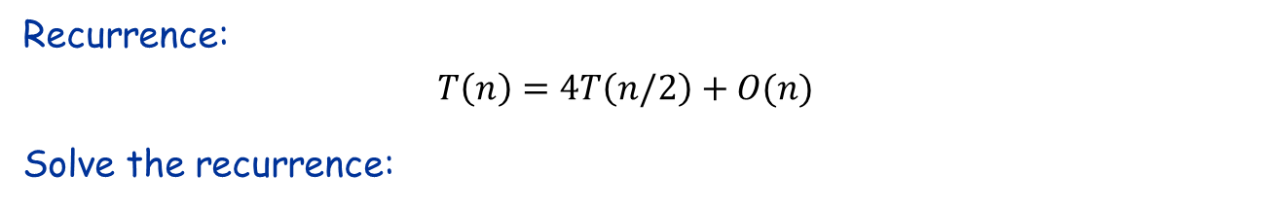











Analysis
Recurrence:
$$T\left(n\right)=4T\left(n/2\right)+O(n)$$
Solve the recurrence:
$T(n)$
$$n$$
$$T(n/2)$$
$$T(n/2)$$
$$T(n/2)$$
$$T(n/2)$$
$$4⋅n/2$$
$$T(n/4)$$
$$T(n/4)$$
$$T(n/4)$$
$$T(n/4)$$
$$T(n/4)$$
$$T(n/4)$$
$$T(n/4)$$
$$T(n/4)$$
$$T(n/4)$$
$$T(n/4)$$
$$T(n/4)$$
$$T(n/4)$$
$$4^{2}⋅n/2^{2}$$
. . .
. . .
$$T(n/2k)$$
$$4k⋅n/2k$$
. . .
. . .
$$T(1)$$
$$T(1)$$
$$T(1)$$
$$T(1)$$
$$T(1)$$
$$T(1)$$
$$T(1)$$
$$T(1)$$
$$4^{\log{n}}⋅1$$

Slide 6
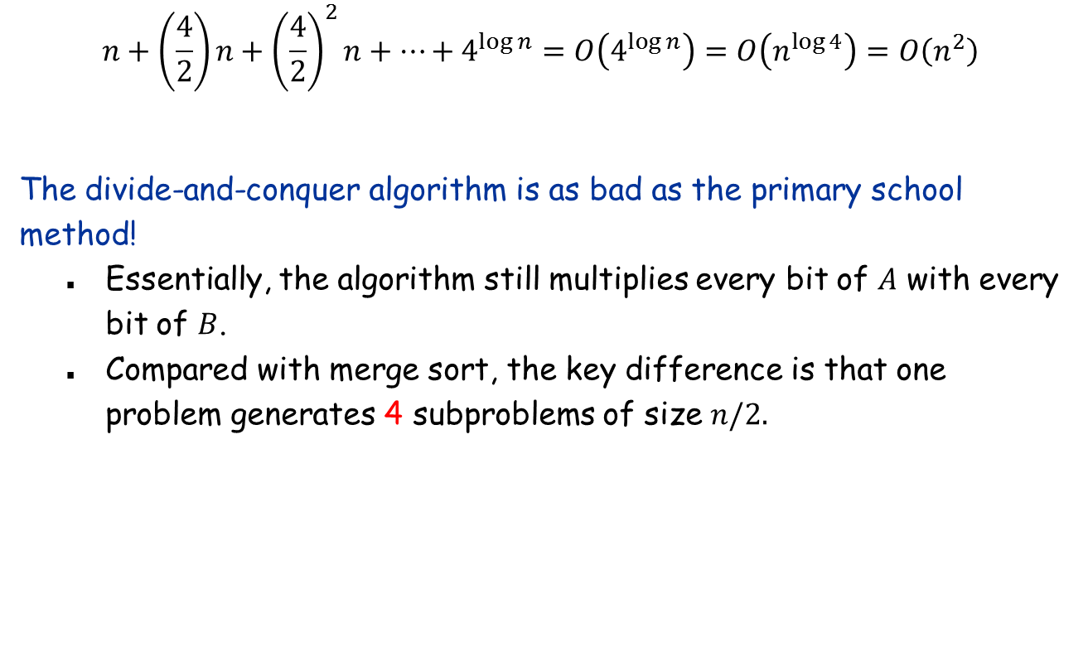
Analysis (continued)
$$n+\left(\frac{4}{2}\right)n+{\left(\frac{4}{2}\right)}^{2}n+…+4^{\log{n}}=O\left(4^{\log{n}}\right)=O\left(n^{\log{4}}\right)=O\left(n^{2}\right)$$
The divide-and-conquer algorithm is as bad as the primary school method!
Essentially, the algorithm still multiplies every bit of $A$ with every bit of $B$.
Compared with merge sort, the key difference is that one problem generates 4 subproblems of size $n/2.$

Slide 7
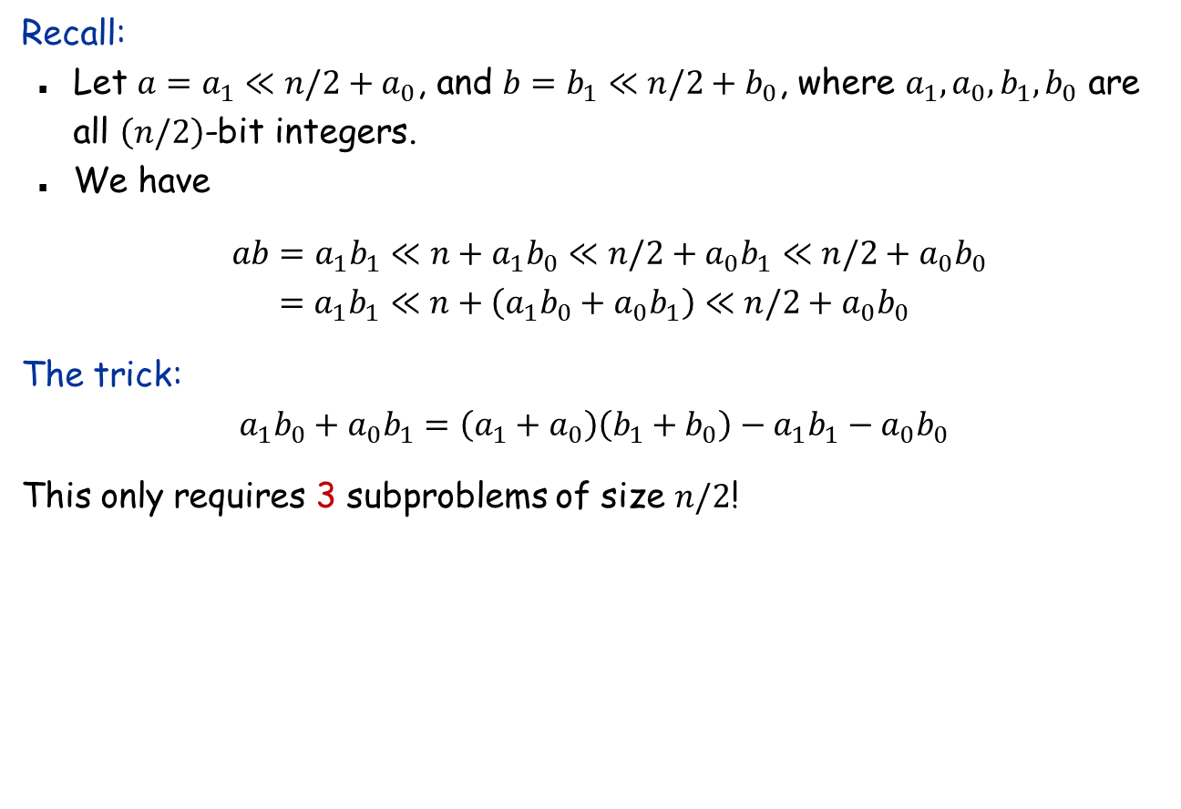
Karatsuba Multiplication
Recall:
Let $a=a_{1}≪n/2+a_{0}$, and $b=b_{1}≪n/2+b_{0}$, where $a_{1},a_{0},b_{1},b_{0}$ are all $\left(n/2\right)$-bit integers.
We have
$ab=a_{1}b_{1}≪n+a_{1}b_{0}≪n/2+a_{0}b_{1}≪n/2+a_{0}b_{0}$
$$=a_{1}b_{1}≪n+\left(a_{1}b_{0}+a_{0}b_{1}\right)≪n/2+a_{0}b_{0}$$ The trick:
$$a_{1}b_{0}+a_{0}b_{1}=\left(a_{1}+a_{0}\right)\left(b_{1}+b_{0}\right)−a_{1}b_{1}−a_{0}b_{0}$$
This only requires 3 subproblems of size $n/2$!

Slide 8
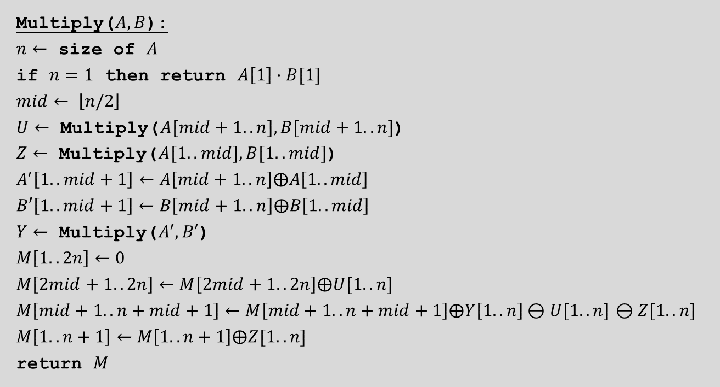
Karatsuba’s multiplication algorithm
Multiply($A, B$):
$n←$ size of $A$
if $n=1$ then return $A\left[1\right]⋅B[1]$
$$mid← \left\lfloor n/2\right\rfloor$$
$U←$ Multiply($A[mid+1..n], B[mid+1..n]$)
$Z←$ Multiply($A[1..mid], B[1..mid]$)
$$A^{′}\left[1..mid+1\right]←A\left[mid+1..n\right]⨁A\left[1..mid\right]$$
$$B′\left[1..mid+1\right]←B\left[mid+1..n\right]⨁B\left[1..mid\right]$$
$Y←$ Multiply($A^{′},B′$)
$$M\left[1..2n\right]←0$$
$$M\left[2mid+1..2n\right]←M\left[2mid+1..2n\right]⨁U[1..n]$$
$M\left[mid+1..n+mid+1\right]←M\left[mid+1..n+mid+1\right]⨁Y\left[1..n\right]⊖U[1..n]$ $⊖Z[1..n]$
$$M\left[1..n+1\right]←M\left[1..n+1\right]⨁Z[1..n]$$
return $M$
$⨁$ $⊖$: denotes the integer addition/subtraction algorithm

Slide 9










Analysis
Recurrence:
$$T\left(n\right)=3T\left(n/2\right)+O(n)$$
Solve the recurrence:
$$T(n)$$
$$n$$
$$T(n/2)$$
$$T(n/2)$$
$$T(n/2)$$
$$3⋅n/2$$
$$T(n/4)$$
$$T(n/4)$$
$$T(n/4)$$
$$T(n/4)$$
$$T(n/4)$$
$$T(n/4)$$
$$T(n/4)$$
$$T(n/4)$$
$$T(n/4)$$
$$3^{2}⋅n/2^{2}$$
. . .
. . .
$$T(n/2k)$$
$$3k⋅n/2k$$
. . .
. . .
$$T(1)$$
$$T(1)$$
$$T(1)$$
$$T(1)$$
$$T(1)$$
$$T(1)$$
$$T(1)$$
$$T(1)$$
$$3^{\log{n}}⋅1$$

Slide 10
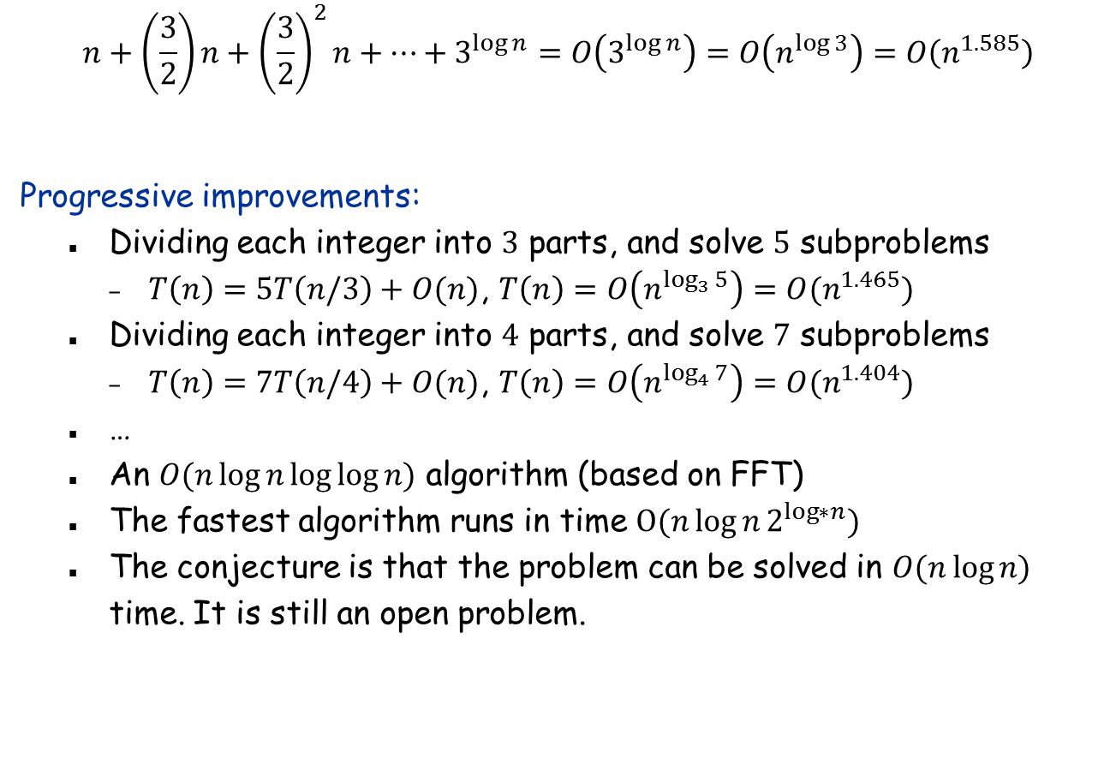
Analysis (continued)
$$n+\left(\frac{3}{2}\right)n+{\left(\frac{3}{2}\right)}^{2}n+…+3^{\log{n}}=O\left(3^{\log{n}}\right)=O\left(n^{\log{3}}\right)=O\left(n^{1.585}\right)$$
Progressive improvements:
Dividing each integer into $3$ parts, and solve $5$ subproblems
$T\left(n\right)=5T\left(n/3\right)+O(n)$, $T\left(n\right)=O\left(n^{\log_{3}{5}}\right)=O(n^{1.465})$
Dividing each integer into $4$ parts, and solve $7$ subproblems
$T\left(n\right)=7T\left(n/4\right)+O(n)$, $T\left(n\right)=O\left(n^{\log_{4}{7}}\right)=O(n^{1.404})$
…
An $O(n\log{n\log{\log{n)}}}$ algorithm (based on FFT)
The fastest algorithm runs in time $O(n\log{n}2^{\log{∗n}})$
The conjecture is that the problem can be solved in $O(n\log{n)}$ time. It is still an open problem.

Slide 11










The Master Theorem
Theorem: Let $a≥1, b>1,c≥0$ be constants. The recurrence $T\left(n\right)=aT(n/b)+n^{c}$ have the following solutions.
Case 1: $c<\log_{b}a: T\left(n\right)=O\left(n^{\log_{b}a}\right)$.
Case 2: $c=\log_{b}a: T\left(n\right)=O(n^{c}\log{n}).$
Case 3: $c>\log_{b}a: T\left(n\right)=O\left(n^{c}\right).$
Proof:
$$T(n)$$
$$n^{c}$$
$$T(n/b)$$
$$T(n/b)$$
$$T(n/b)$$
$$a⋅{\left(\frac{n}{b}\right)}^{c}$$
$$a^{2}⋅{\left(\frac{n}{b^{2}}\right)}^{c}$$
$$T(n/b^{2})$$
$$T(n/b^{2})$$
$$T(n/b^{2})$$
$$T(n/b^{2})$$
$$T(n/b^{2})$$
$$T(n/b^{2})$$
$$a^{k}⋅{\left(\frac{n}{b^{k}}\right)}^{c}$$
$$T(n/bk)$$
$$T(1)$$
$$T(1)$$
$$T(1)$$
$$T(1)$$
$$T(1)$$
$$T(1)$$
$$T(1)$$
$$T(1)$$
$$a^{\log_{b}{n}}⋅1$$

Slide 12
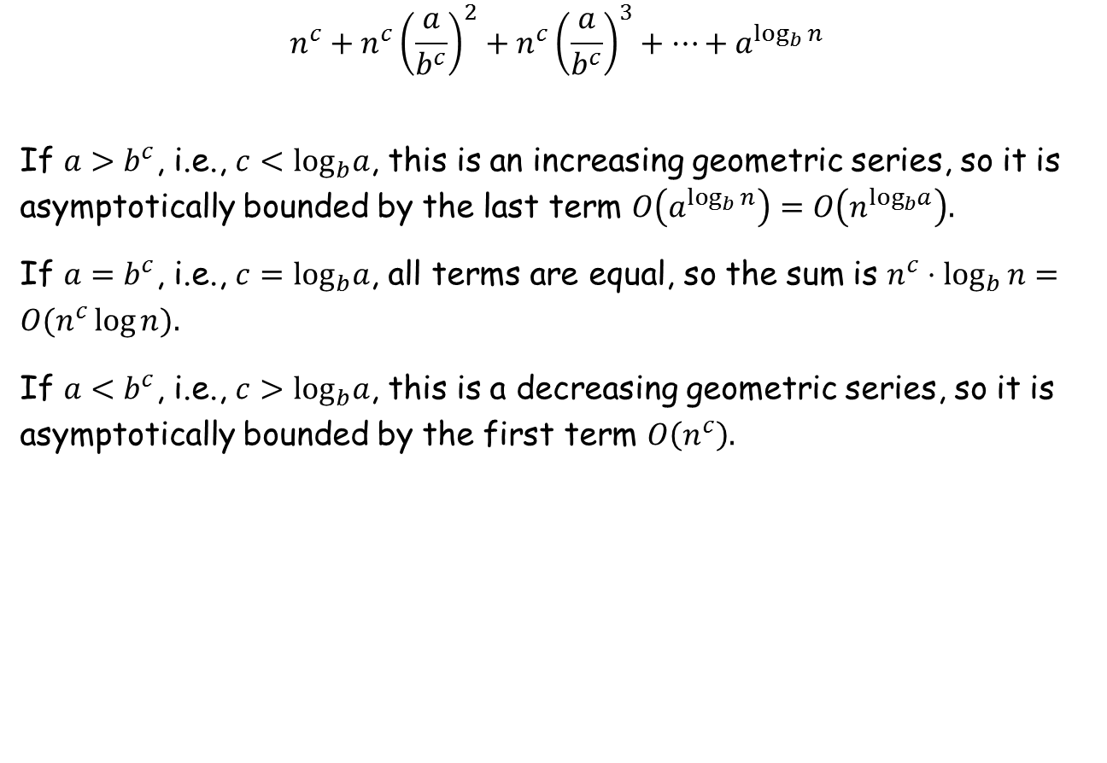
Proof of the Master Theorem (continued)
$$n^{c}+n^{c}{\left(\frac{a}{b^{c}}\right)}^{2}+n^{c}{\left(\frac{a}{b^{c}}\right)}^{3}+…+a^{\log_{b}{n}}$$
If $a>b^{c}$, i.e., $c<\log_{b}a$, this is an increasing geometric series, so it is asymptotically bounded by the last term $O\left(a^{\log_{b}{n}}\right)=O\left(n^{\log_{b}a}\right).$
If $a=b^{c}$, i.e., $c=\log_{b}a$, all terms are equal, so the sum is $n^{c}⋅\log_{b}{n}=O(n^{c}\log{n}).$
If $a<b^{c}$, i.e., $c>\log_{b}a$, this is a decreasing geometric series, so it is asymptotically bounded by the first term $O\left(n^{c}\right).$

Slide 13

Matrix Multiplication
Matrix multiplication. Given two $n$-by-$n$ matrices $A$ and $B$, compute $C=AB$.
Brute force. $(n3)$time.
Fundamental question. Can we improve upon brute force?

Slide 14

Matrix Multiplication: First Attempt
Divide-and-conquer.
Divide: partition $A$ and $B$ into ½$n$-by-½$n$ blocks.
Conquer: multiply 8 ½$n$-by-½$n$ submatrices recursively.
Combine: add appropriate products using 4 matrix additions.

Slide 15

Strassen’s Matrix Multiplication Algorithm
Key idea. multiply 2-by-2 block matrices with only 7 multiplications.
7 multiplications of ½$n$-by-½$n$ submatrices.
$O(n^{2})$ additions and subtractions.
$T\left(n\right)=7T\left(n/2\right)+O(n^{2})$, $T\left(n\right)=O\left(n^{\log_{2}{7}}\right)=O(n^{2.807})$

Slide 16
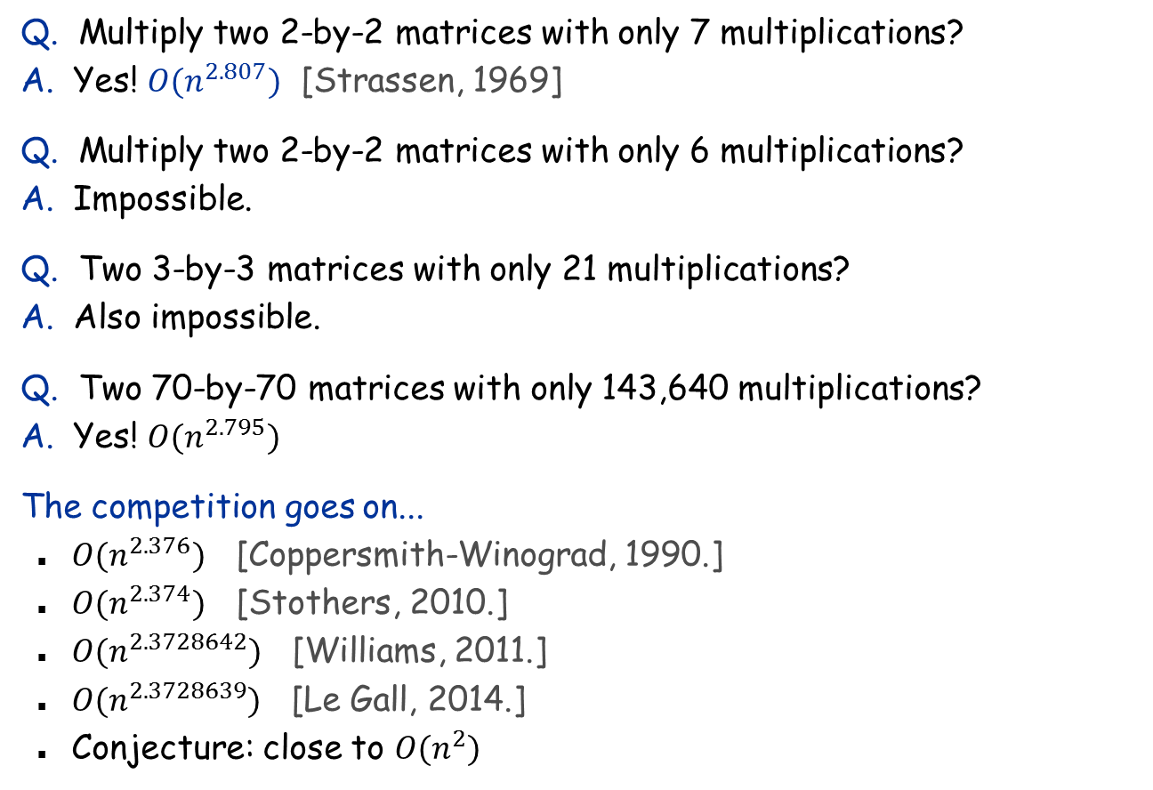
Fast Matrix Multiplication in Theory
Q. Multiply two 2-by-2 matrices with only 7 multiplications? A. Yes! $O(n^{2.807})$ [Strassen, 1969]
Q. Multiply two 2-by-2 matrices with only 6 multiplications? A. Impossible.
Q. Two 3-by-3 matrices with only 21 multiplications? A. Also impossible.
Q. Two 70-by-70 matrices with only 143,640 multiplications? A. Yes! $O(n^{2.795})$
The competition goes on...
$O(n^{2.376})$ [Coppersmith-Winograd, 1990.]
$O(n^{2.374})$ [Stothers, 2010.]
$O(n^{2.3728642})$ [Williams, 2011.]
$O(n^{2.3728639})$ [Le Gall, 2014.]
Conjecture: close to $O(n^{2})$

