Slide 1
Lecture 7: Heaps and Heapsort
A truly in-place sorting algorithm

Slide 2
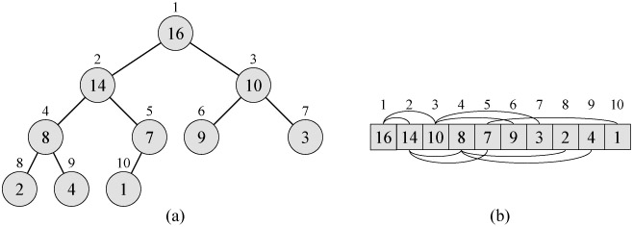
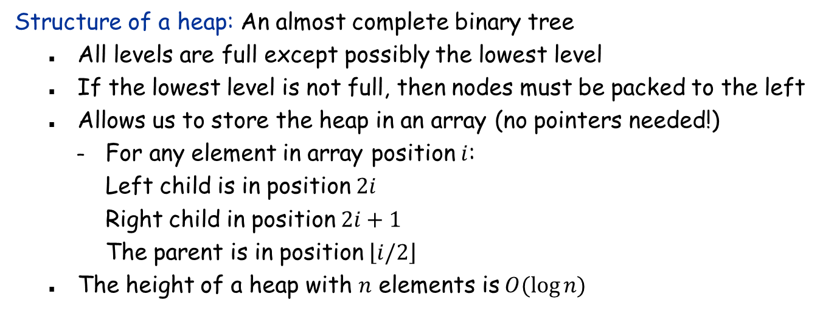
(Binary) Heap
Structure of a heap: An almost complete binary tree
All levels are full except possibly the lowest level
If the lowest level is not full, then nodes must be packed to the left
Allows us to store the heap in an array (no pointers needed!)
For any element in array position $i$: Left child is in position $2i$ Right child in position $2i+1$ The parent is in position $\left\lfloor i/2\right\rfloor$
The height of a heap with $n$ elements is $O(\log{n)}$

Slide 3
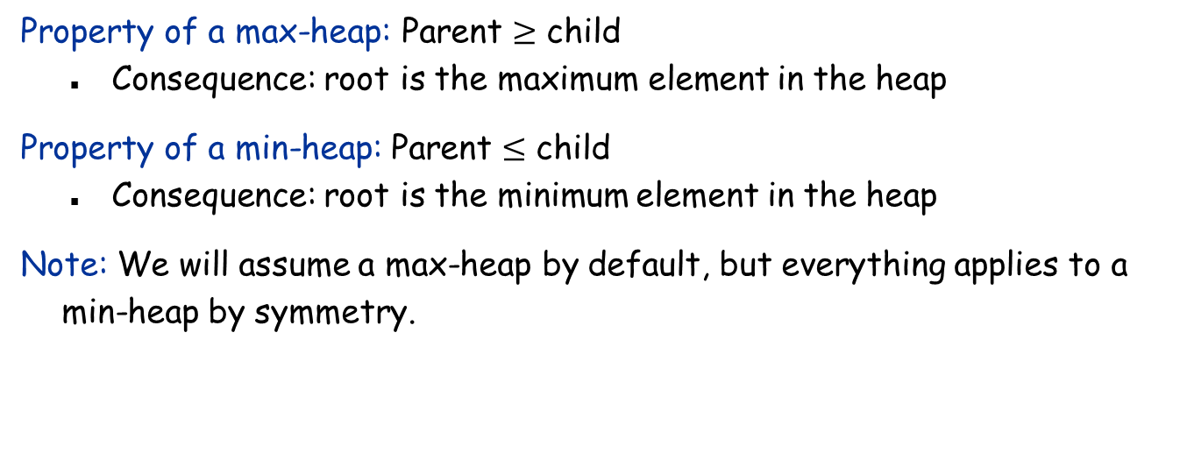
(Binary) Heap
Property of a max-heap: Parent $≥$ child
Consequence: root is the maximum element in the heap
Property of a min-heap: Parent $≤$ child
Consequence: root is the minimum element in the heap
Note: We will assume a max-heap by default, but everything applies to a min-heap by symmetry.

Slide 4
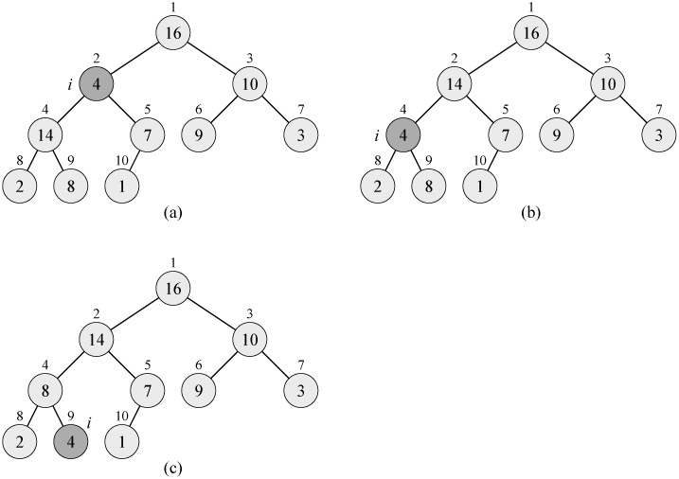

Maintaining the heap property
Given: A node $i$ in a heap such that
The binary trees under Left($i$) and Right($i$) are max-heaps
$A[i]$ might be smaller than Left($i$) or Right($i$)
Goal: Make the binary tree under $i$ a max-heap

Slide 5


Maintaining the heap property
Running time: $O(\log{n)}$
Max-Heapify($A, i$):
$l←$Left(i), $r←$Right($i$)
if $l≤A.heapsize$ and $A[l] > A[i]$ then
$largest←l$
else $largest←i$
if $r≤A.heapsize$ and $A[r]>A[largest]$ then
$largest←r$
if $largest≠i$ then
exchange $A[i]$ with $A[largest]$
Max-Heapify($A, largest$)

Slide 6
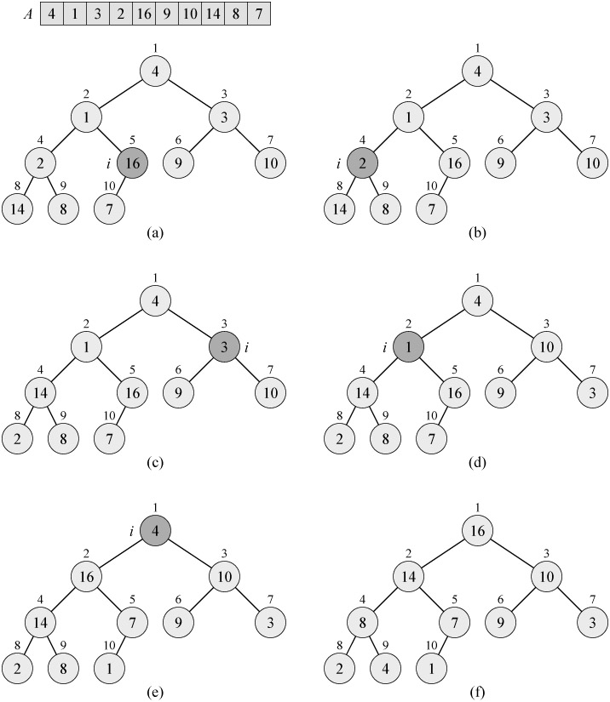
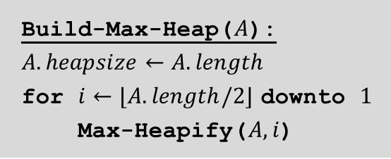
Building a heap
Build-Max-Heap($A$):
$A.heapsize←A.length$
for $i←⌊A.length/2⌋$ downto $1$
Max-Heapify($A, i$)

Slide 7
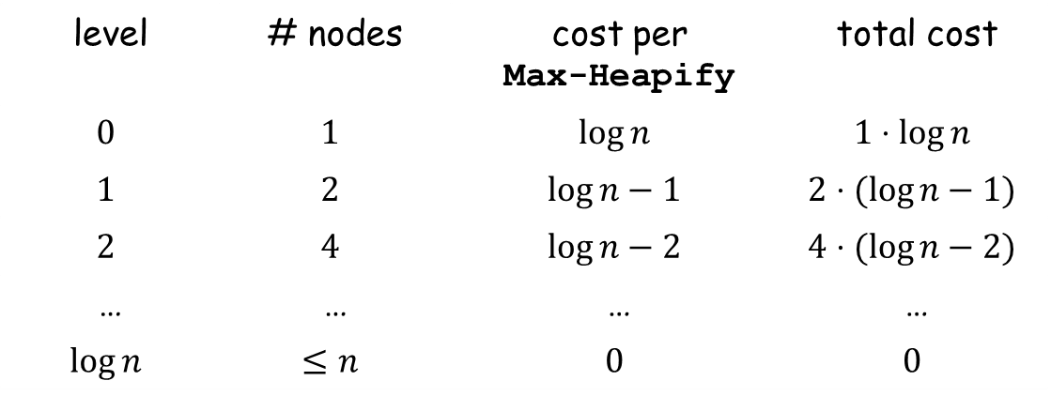
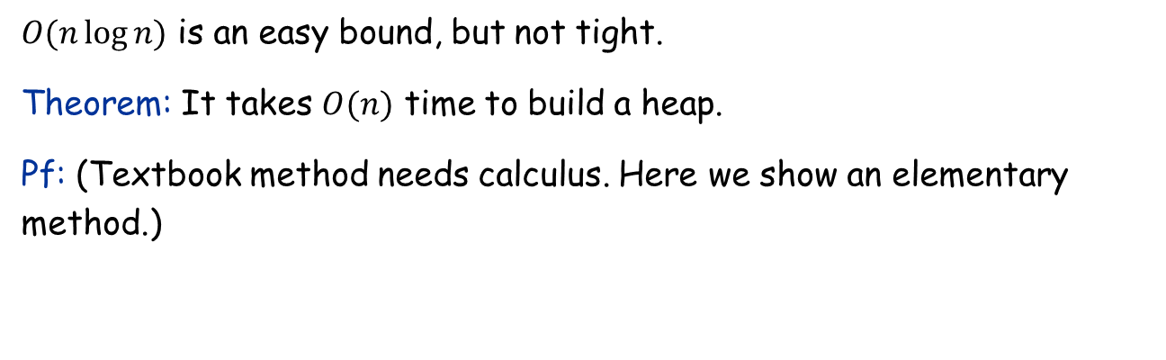
Analysis of heap-building
level | # nodes | cost per Max-Heapify | total cost
$$0$$ | $$1$$ | $$\log{n}$$ | $$1⋅log{n}$$
$$1$$ | $$2$$ | $$\log{n}−1$$ | $$2⋅(log{n}−1)$$
$$2$$ | $$4$$ | $$\log{n}−2$$ | $$4⋅(log{n}−2)$$
… | … | … | …
$$\log{n}$$ | $$≤n$$ | $$0$$ | $$0$$
$O(n\log{n)}$ is an easy bound, but not tight.
Theorem: It takes $O(n)$ time to build a heap.
Pf: (Textbook method needs calculus. Here we show an elementary method.)

Slide 8
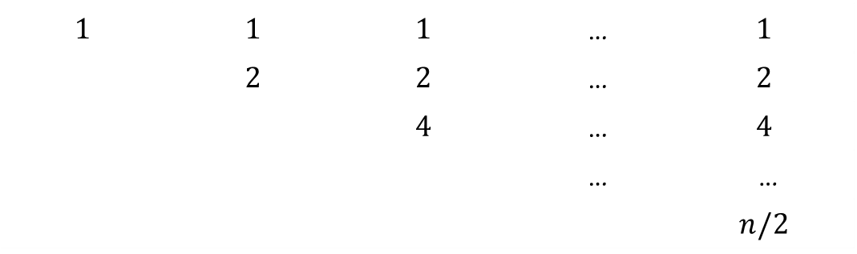

Analysis of heap-building (continued)
$$1$$ | $$1$$ | $$1$$ | … | $$1$$
 | $$2$$ | $$2$$ | … | $$2$$
 |  | $$4$$ | … | $$4$$
 |  |  | … | …
 |  |  |  | $$n/2$$
$$2⋅1$$ | $$2⋅2$$ | $$2⋅4$$ | … | $$2⋅n/2$$
$$=O(n)$$

Slide 9
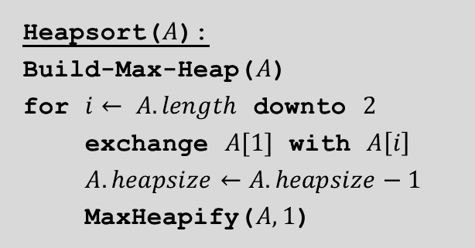

Heapsort
Heapsort($A$):
Build-Max-Heap($A$)
for $i← A.length$ downto $2$
exchange $A[1]$ with $A\left[i\right]$
$A.heapsize←A.heapsize−1$
MaxHeapify($A, 1$)
Running time: $O(n\log{n)}$, dominated by the $n$ MaxHeapify operations.
Working space: $O(1)$
Q: Can we use a min-heap to implement heapsort?

Slide 10
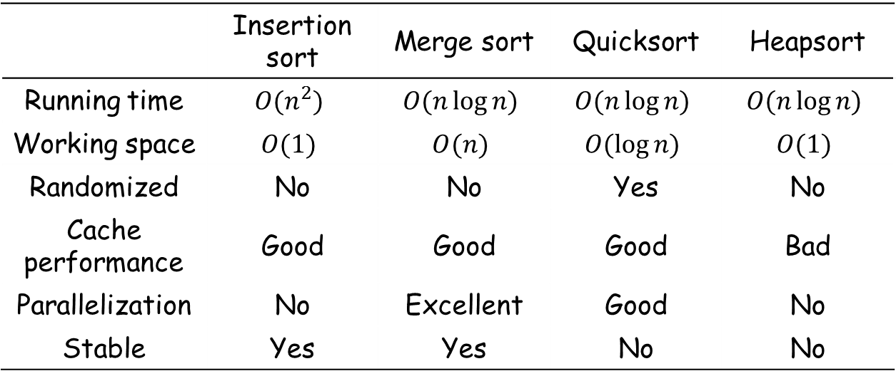
Summary of comparison-based sorting algorithms
 | Insertion sort | Merge sort | Quicksort | Heapsort
Running time | $$O(n^{2})$$ | $$O(n\log{n)}$$ | $$O(n\log{n)}$$ | $$O(n\log{n)}$$
Working space | $$O(1)$$ | $$O(n)$$ | $$O(\log{n)}$$ | $$O(1)$$
Randomized | No | No | Yes | No
Cache performance | Good | Good | Good | Bad
Parallelization | No | Excellent | Good | No
Stable | Yes | Yes | No | No
Stable: The ordering of equal elements are preserved after sorting.

Slide 11


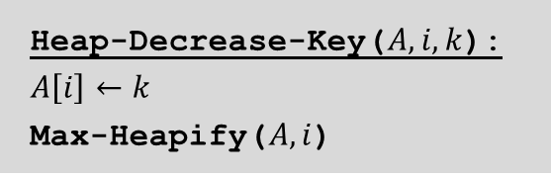
Priority queues
A priority queue is a data structure that supports the following operations:
Maximum($S$) returns the element of $S$ with the largest key.
Insert($S,x$) inserts the element $x$ into the set $S$.
Extract-Max($S$) removes and returns the element of S with the largest key.
Increase-Key($S,i,k$) increases $A\left[i\right]$ to the new value $k$.
Decrease-Key($S,i,k$) decreases $A[i]$ to the new value $k$.
Heap-Extract-Max($A$):
if $A.heapsize<1$ then return error
$$max←A[1]$$
$$A\left[1\right]←A[A.heapsize]$$
$$A.heapsize←A.heapsize−1$$
Max-Heapify($A,1$)
return $max$
Heap-Decrease-Key($A,i,k$):
$$A\left[i\right]←k$$
Max-Heapify($A,i$)

Slide 12
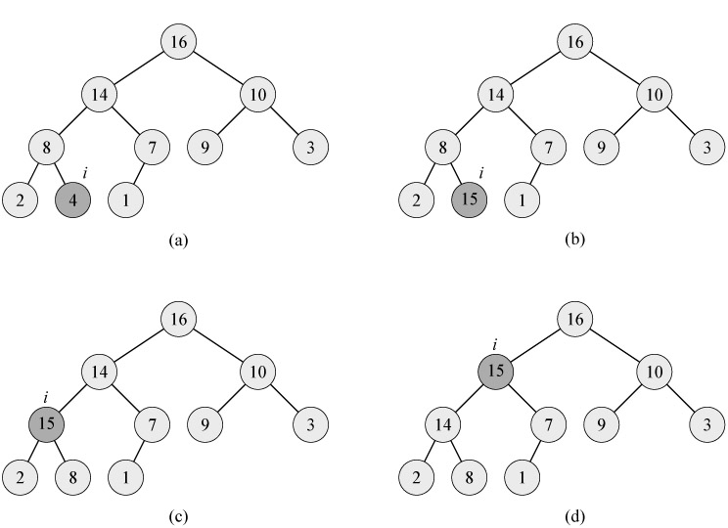
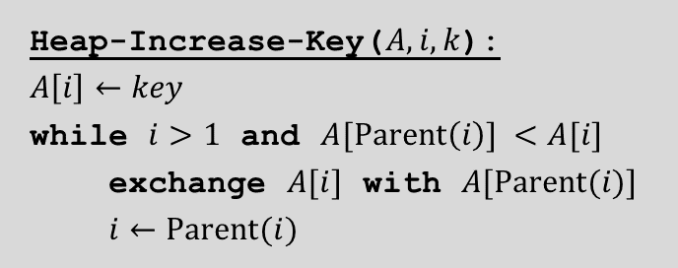
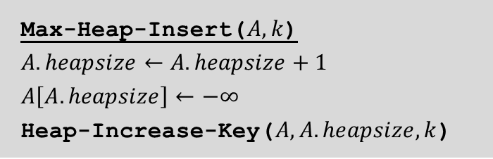

Heap: Increase-Key
Heap-Increase-Key($A, i, k$):
$$A\left[i\right]←key$$
while $i>1$ and $A[Parent\left(i\right)] <A[i]$
exchange $A[i]$ with $A[Parent(i)]$
$i←Parent(i)$
Running time: $O(\log{n)}$
Max-Heap-Insert($A, k$)
$$A.heapsize←A.heapsize+1$$
$$A\left[A.heapsize\right]←−∞$$
Heap-Increase-Key($A, A.heapsize, k$)

