Slide 1
Lecture 8: Sorting in Linear Time

Slide 2
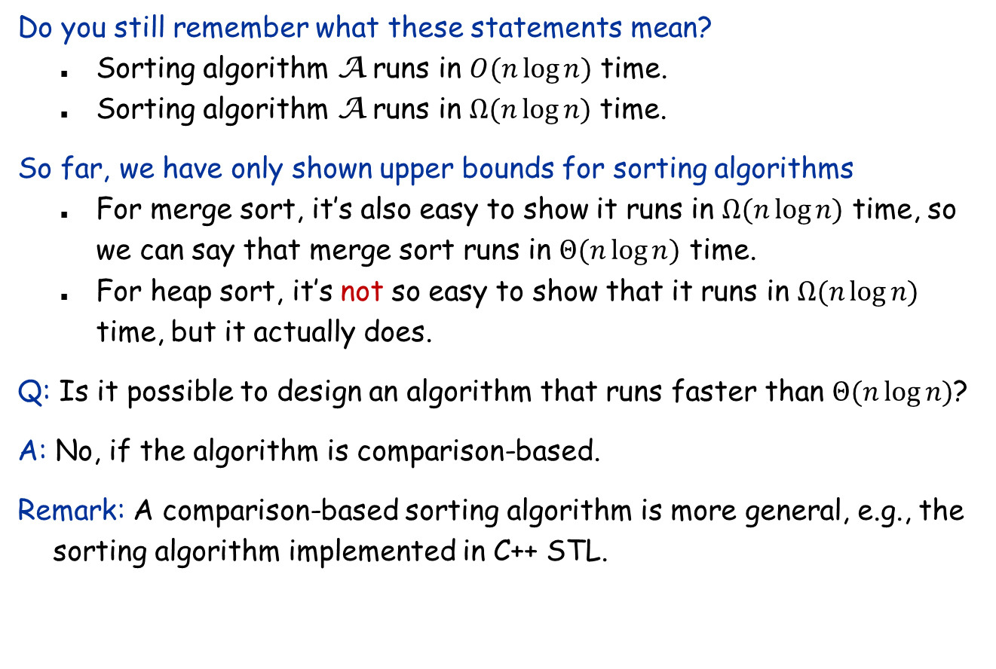
Running time of sorting algorithms
Do you still remember what these statements mean?
Sorting algorithm A runs in $O(n\log{n)}$ time.
Sorting algorithm A runs in $Ω(n\log{n)}$ time.
So far, we have only shown upper bounds for sorting algorithms
For merge sort, it’s also easy to show it runs in $Ω(n\log{n)}$ time, so we can say that merge sort runs in $Θ(n\log{n)}$ time.
For heap sort, it’s not so easy to show that it runs in $Ω(n\log{n)}$ time, but it actually does.
Q: Is it possible to design an algorithm that runs faster than $Θ(n\log{n)}$?
A: No, if the algorithm is comparison-based.
Remark: A comparison-based sorting algorithm is more general, e.g., the sorting algorithm implemented in C++ STL.

Slide 3
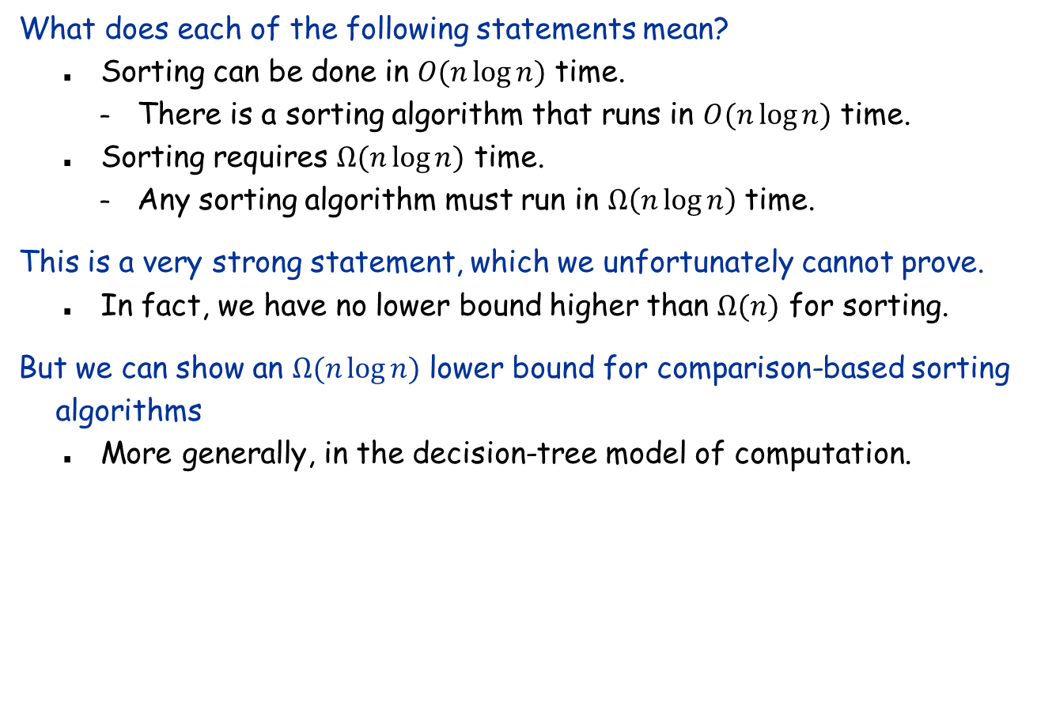
Lower bounds for problems
What does each of the following statements mean?
Sorting can be done in $O(n\log{n})$ time.
There is a sorting algorithm that runs in $O(n\log{n)}$ time.
Sorting requires $Ω(n\log{n})$ time.
Any sorting algorithm must run in $Ω\left(n\log{n}\right)$ time.
This is a very strong statement, which we unfortunately cannot prove.
In fact, we have no lower bound higher than $Ω(n)$ for sorting.
But we can show an $Ω(n\log{n})$ lower bound for comparison-based sorting algorithms
More generally, in the decision-tree model of computation.

Slide 4
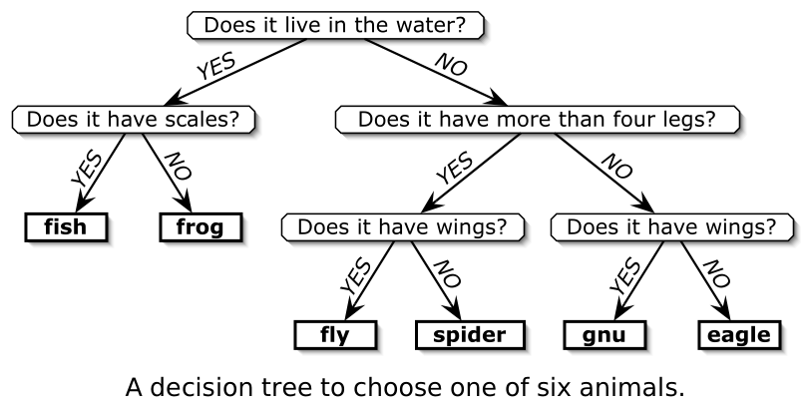
The decision-tree model
An algorithm in the decision-tree model
Solves the problem by asking questions with binary answers
Cannot ask questions like “how many legs does it have?”
The worst-case running time is the height of the decision tree.

Slide 5

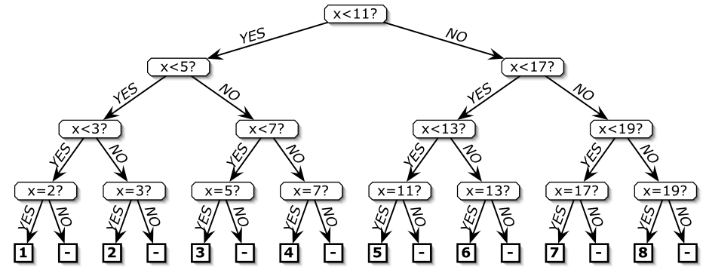
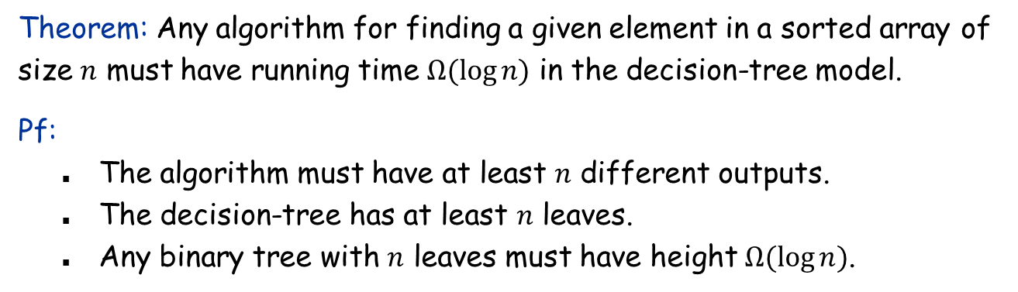
The decision-tree for binary search
Theorem: Any algorithm for finding a given element in a sorted array of size $n$ must have running time $Ω(\log{n)}$ in the decision-tree model.
Pf:
The algorithm must have at least $n$ different outputs.
The decision-tree has at least $n$ leaves.
Any binary tree with $n$ leaves must have height $Ω(\log{n})$.

Slide 6
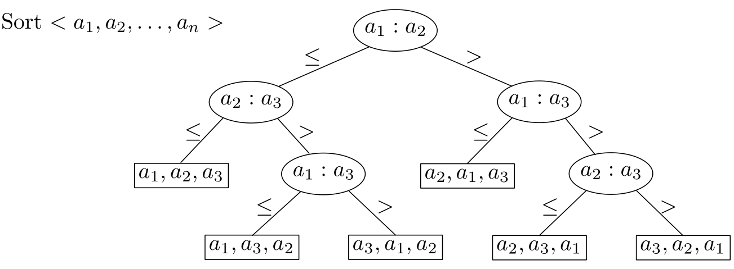
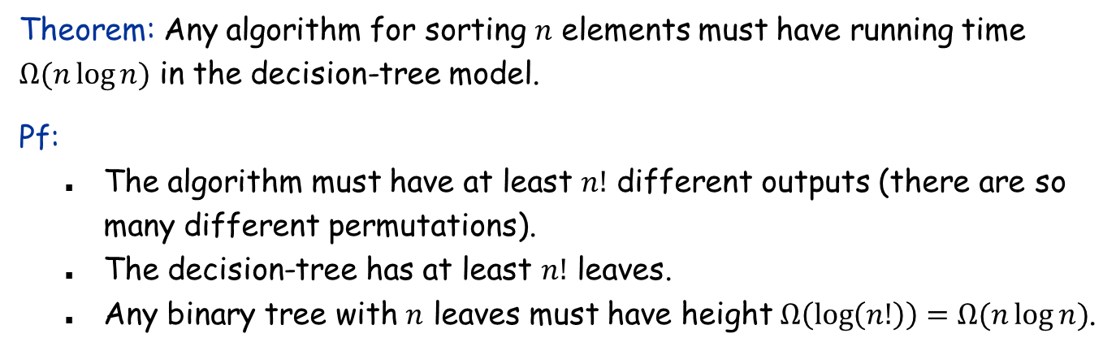
The decision-tree for sorting
Theorem: Any algorithm for sorting $n$ elements must have running time $Ω(n\log{n)}$ in the decision-tree model.
Pf:
The algorithm must have at least $n!$ different outputs (there are so many different permutations).
The decision-tree has at least $n!$ leaves.
Any binary tree with $n$ leaves must have height $Ω\left(\log\left(n!\right)\right)=Ω(n\log{n})$.

Slide 7
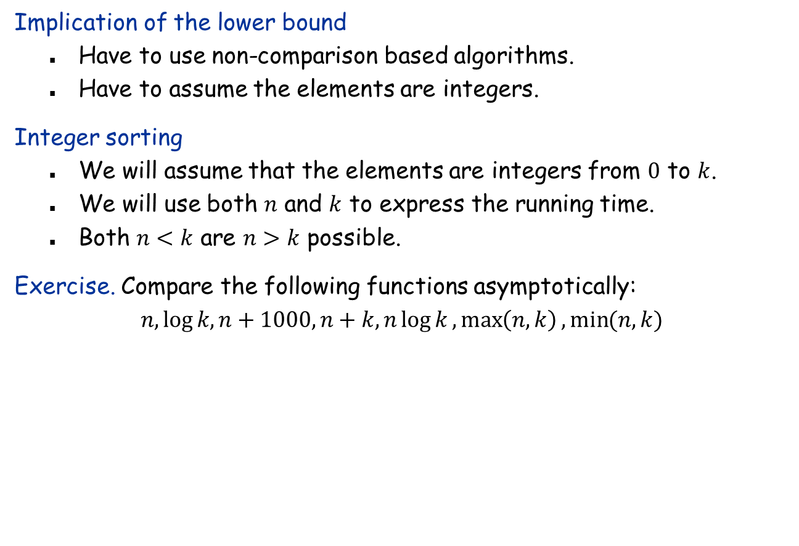
Can we do better?
Implication of the lower bound
Have to use non-comparison based algorithms.
Have to assume the elements are integers.
Integer sorting
We will assume that the elements are integers from $0$ to $k$.
We will use both $n$ and $k$ to express the running time.
Both $n<k$ are $n>k$ possible.
Exercise. Compare the following functions asymptotically:
$$n,\log{k, n+1000,n+k,}n\log{k},\max\left(n,k\right),\min{(n,k)}$$

Slide 8
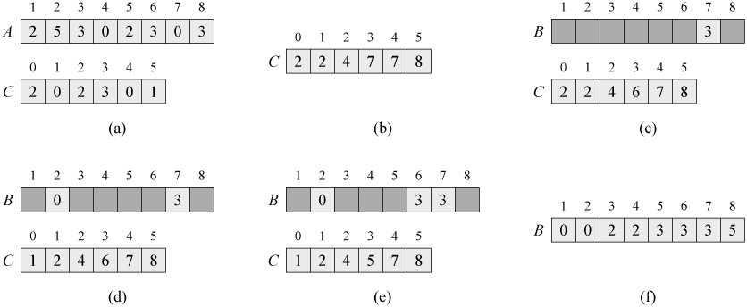
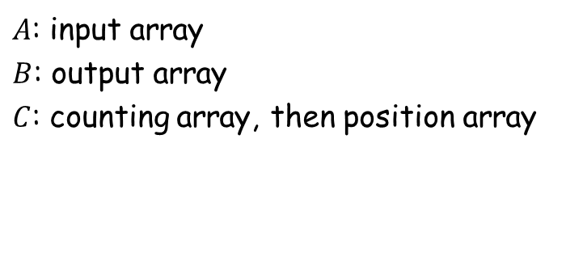
Counting sort
$A$: input array $B$: output array $C$: counting array, then position array

Slide 9
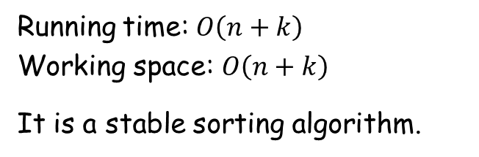
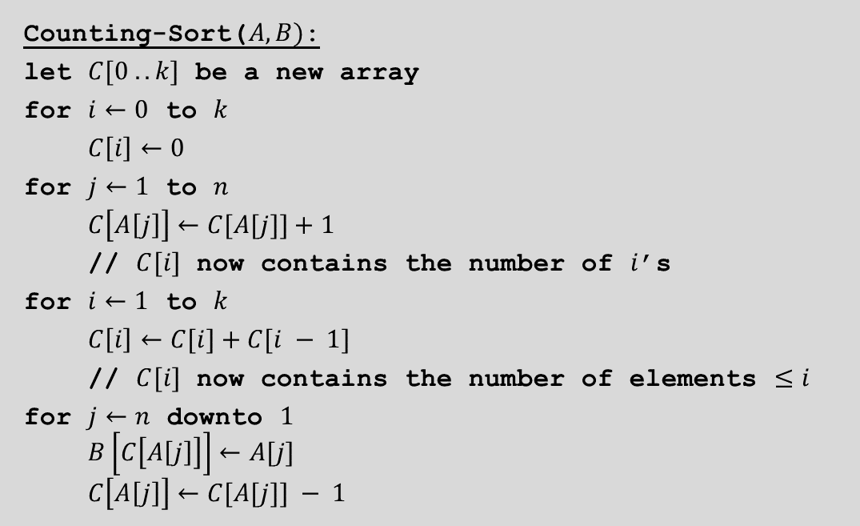
Counting sort
Counting-Sort($A, B)$:
let $C[0 .. k]$ be a new array
for $i←0$ to $k$
$C\left[i\right]←0$
for $j←1$ to $n$
$C\left[A\left[j\right]\right]←C[A[j]]+1$
// $C[i]$ now contains the number of $i$’s
for $i←1$ to $k$
$C\left[i\right]←C[i]+C[i − 1]$
// $C[i]$ now contains the number of elements $≤i$
for $j←n$ downto $1$
$B\left[C\left[A\left[j\right]\right]\right]←A[j]$
$C\left[A\left[j\right]\right]←C[A[j]] − 1$
Running time: $O\left(n+k\right)$ Working space: $O\left(n+k\right)$
It is a stable sorting algorithm.

Slide 10
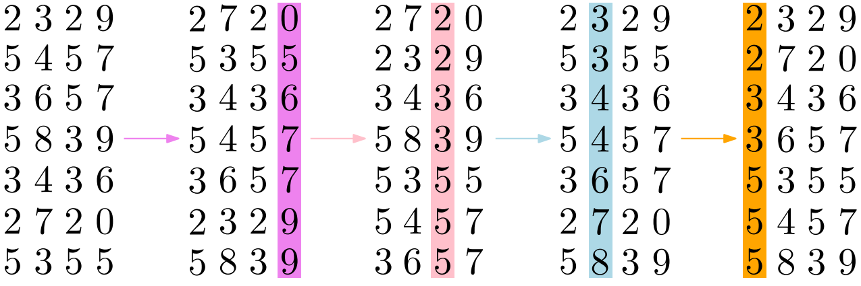
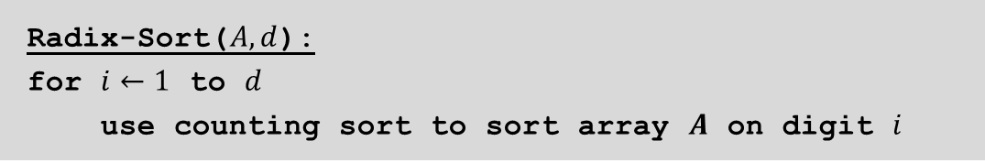
Radix sort
Radix-Sort($A, d$):
for $i←1$ to $d$
use counting sort to sort array $A$ on digit $i$

Slide 11
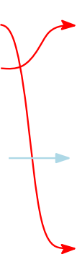
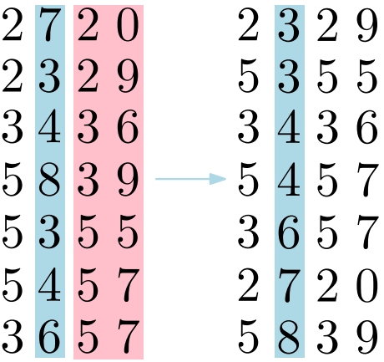
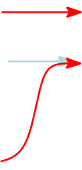
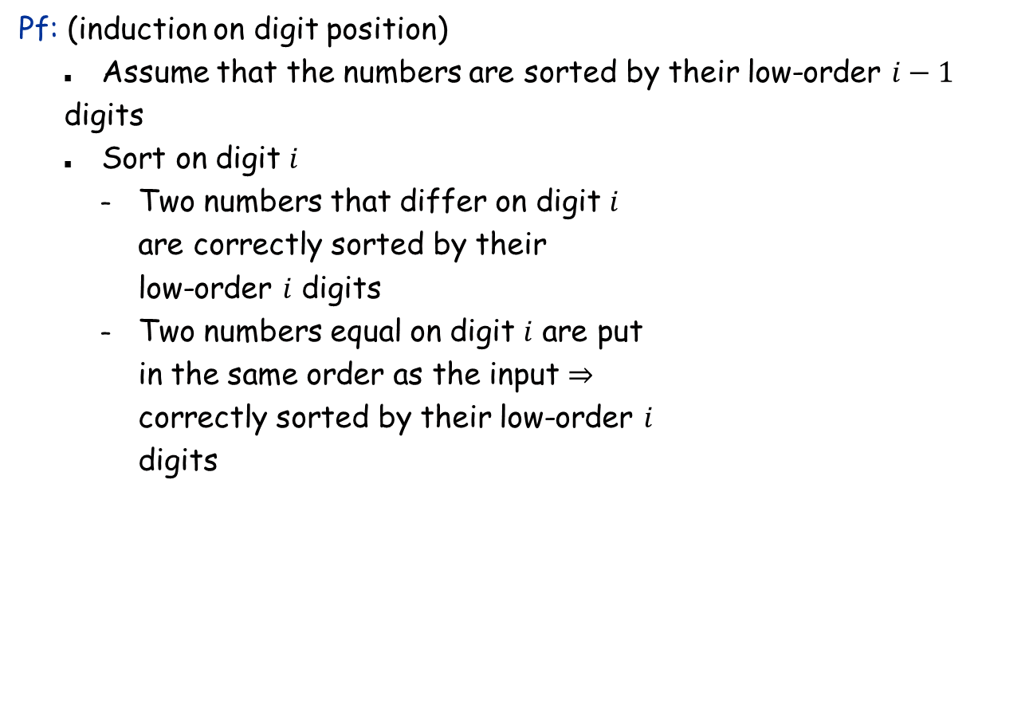
Radix sort: Correctness
Pf: (induction on digit position)
Assume that the numbers are sorted by their low-order $i−1$
digits
Sort on digit $i$
Two numbers that differ on digit $i$ are correctly sorted by their low-order $i$ digits
Two numbers equal on digit $i$ are put in the same order as the input ⇒ correctly sorted by their low-order $i$ digits

Slide 12
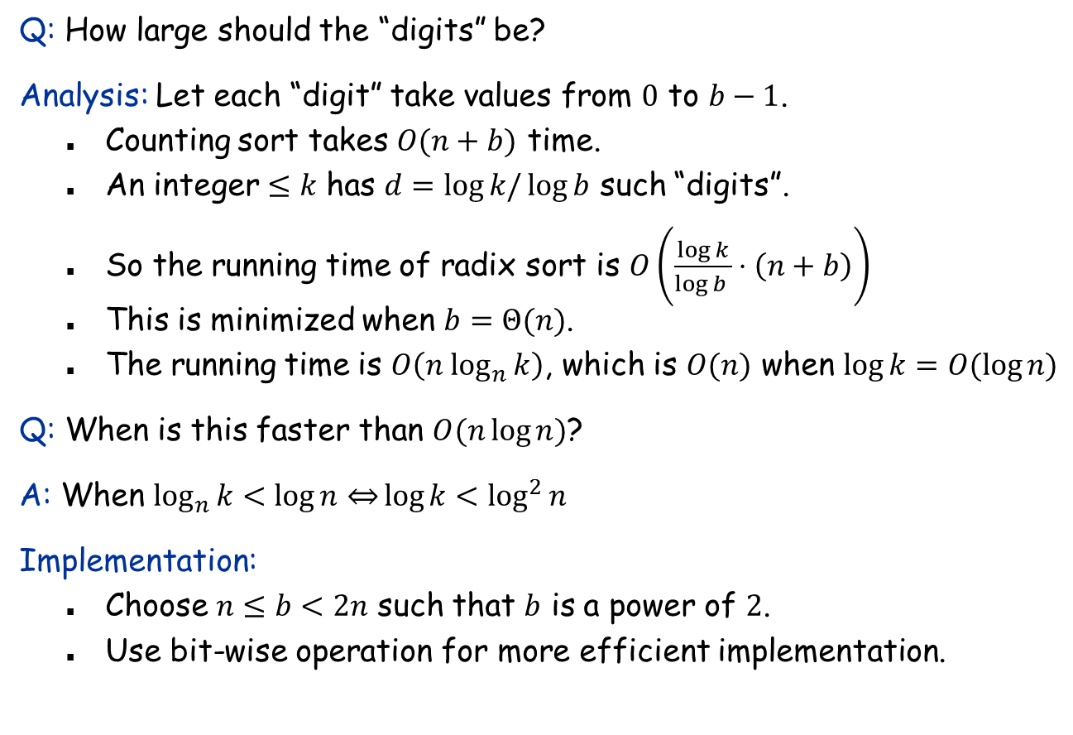
Radix sort: Running time analysis
Q: How large should the “digits” be?
Analysis: Let each “digit” take values from $0$ to $b−1$.
Counting sort takes $O(n+b)$ time.
An integer $≤k$ has $d=log{k/\log{b}}$ such “digits”.
So the running time of radix sort is $O\left(\frac{\log{k}}{\log{b }}⋅\left(n+b\right)\right)$
This is minimized when $b=Θ(n)$.
The running time is $O\left(n \log_{n}{k}\right)$, which is $O(n)$ when $\log{k=O(\log{n)}}$
Q: When is this faster than $O(n\log{n)}$?
A: When $\log_{n}{k<\log{n}⇔}\log{k}<\log^{2}{n}$
Implementation:
Choose $n≤b<2n$ such that $b$ is a power of $2$.
Use bit-wise operation for more efficient implementation.

Slide 13
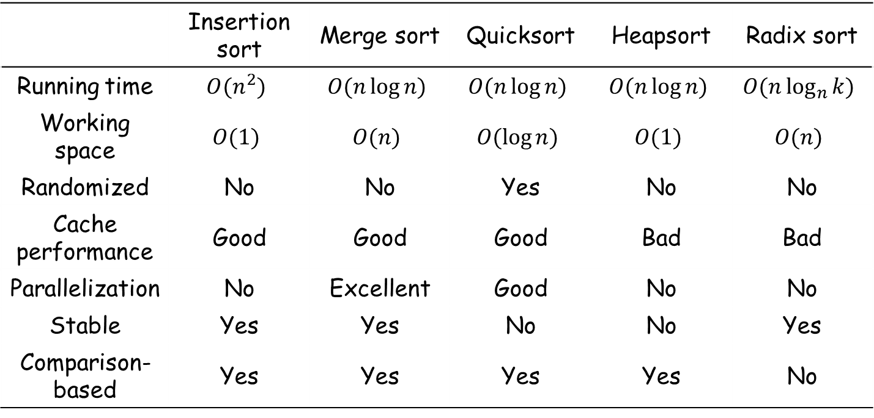
Summary of sorting algorithms
 | Insertion sort | Merge sort | Quicksort | Heapsort | Radix sort
Running time | $$O(n^{2})$$ | $$O(n\log{n)}$$ | $$O(n\log{n)}$$ | $$O(n\log{n)}$$ | $$O(n\log_{n}{k)}$$
Working space | $$O(1)$$ | $$O(n)$$ | $$O(\log{n)}$$ | $$O(1)$$ | $$O(n)$$
Randomized | No | No | Yes | No | No
Cache performance | Good | Good | Good | Bad | Bad
Parallelization | No | Excellent | Good | No | No
Stable | Yes | Yes | No | No | Yes
Comparison-based | Yes | Yes | Yes | Yes | No

Slide 14
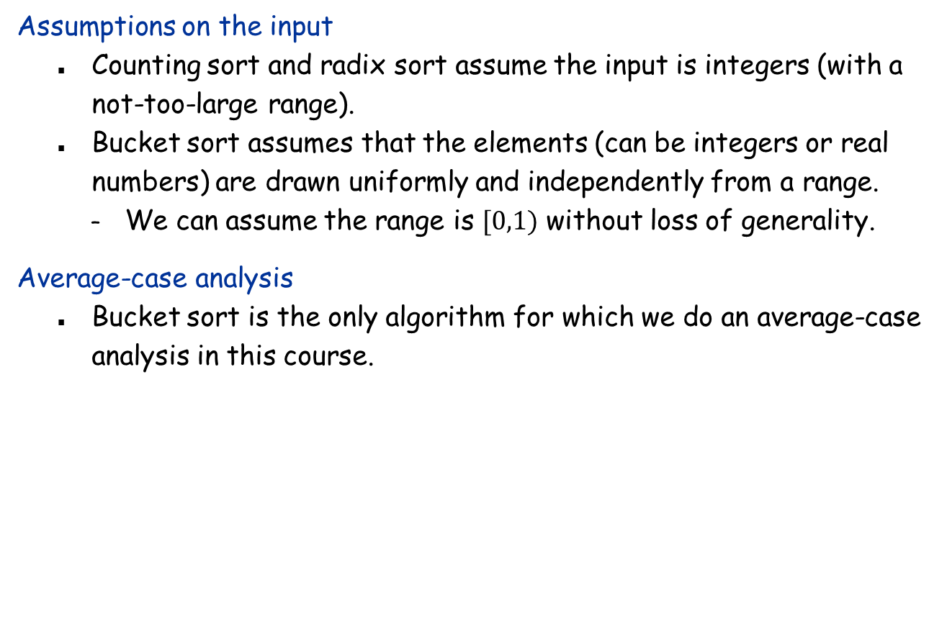
Bucket sort
Assumptions on the input
Counting sort and radix sort assume the input is integers (with a not-too-large range).
Bucket sort assumes that the elements (can be integers or real numbers) are drawn uniformly and independently from a range.
We can assume the range is $[0,1)$ without loss of generality.
Average-case analysis
Bucket sort is the only algorithm for which we do an average-case analysis in this course.

Slide 15
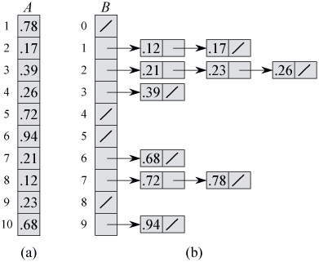
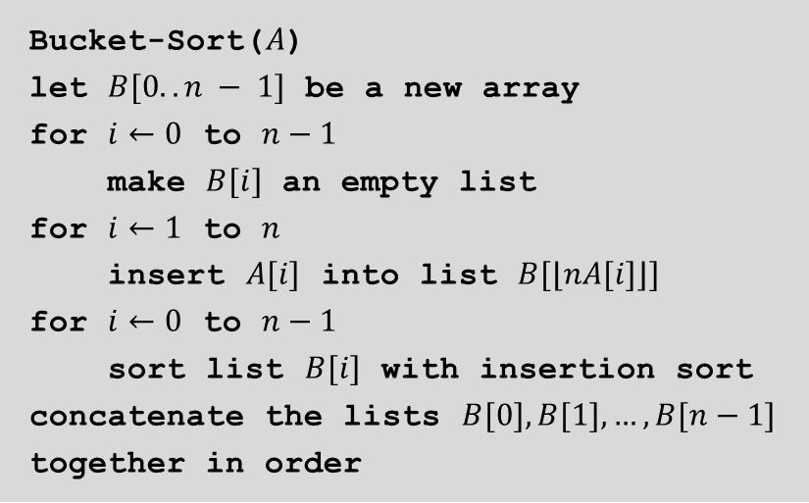

Bucket sort
Worst-case: $O(n^{2}$)
Bucket-Sort($A$)
let $B[0.. n − 1]$ be a new array
for $i←0$ to $n−1$
make $B[i]$ an empty list
for $i←1$ to $n$
insert $A[i]$ into list $B[⌊nA[i]⌋]$
for $i←0$ to $n−1$
sort list $B[i]$ with insertion sort
concatenate the lists $B[0], B[1], …, B[n−1]$ together in order

Slide 16
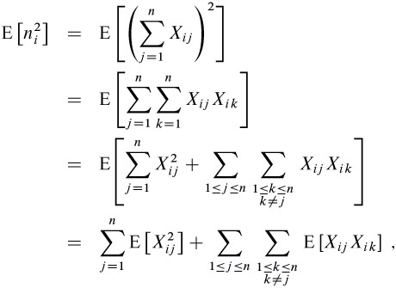
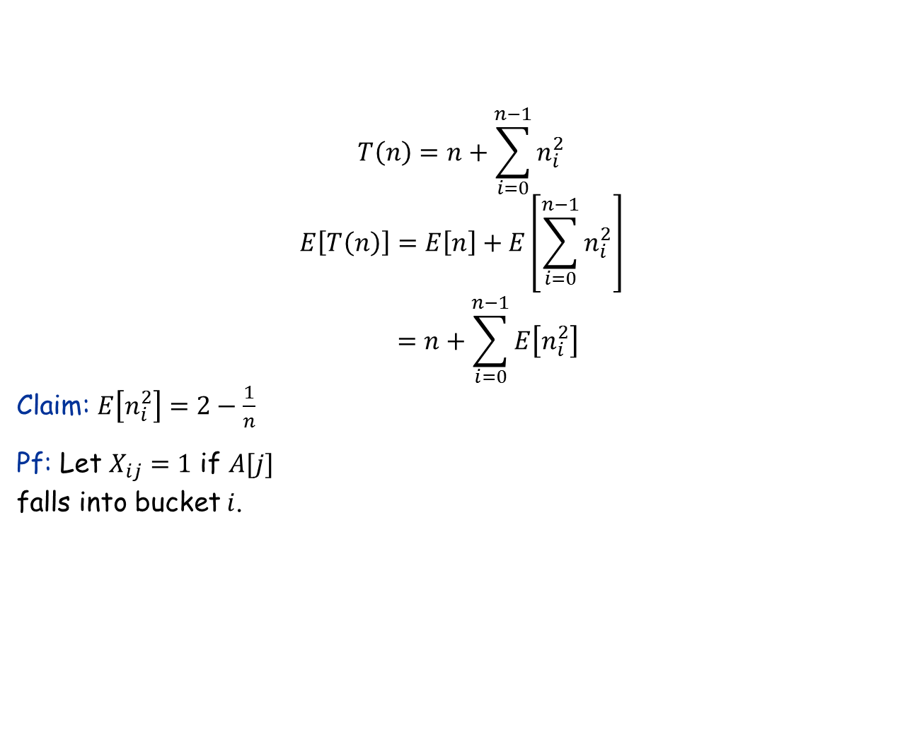
Average-case analysis of bucket sort
$$T\left(n\right)=n+\sum_{i=0}^{n−1}{n_{i}^{2}}$$
$$E\left[T\left(n\right)\right]=E\left[n\right]+E\left[\sum_{i=0}^{n−1}{n_{i}^{2}}\right]$$
$$=n+\sum_{i=0}^{n−1}{E\left[n_{i}^{2}\right]}$$ Claim: $E\left[n_{i}^{2}\right]=2−\frac{1}{n}$
Pf: Let $X_{ij}=1$ if $A[j]$ falls into bucket $i$.

Slide 17
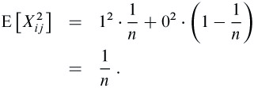
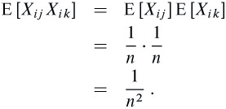
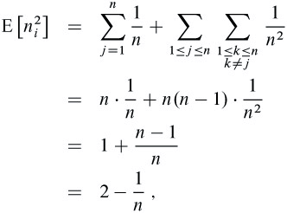
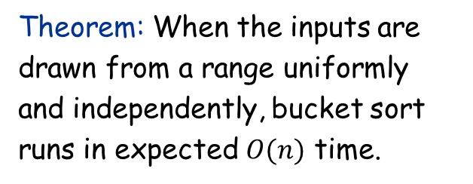
Average-case analysis of bucket sort
Theorem: When the inputs are drawn from a range uniformly and independently, bucket sort runs in expected $O(n)$ time.

