Slide 1
Lecture 9: Binary Search Trees

Slide 2
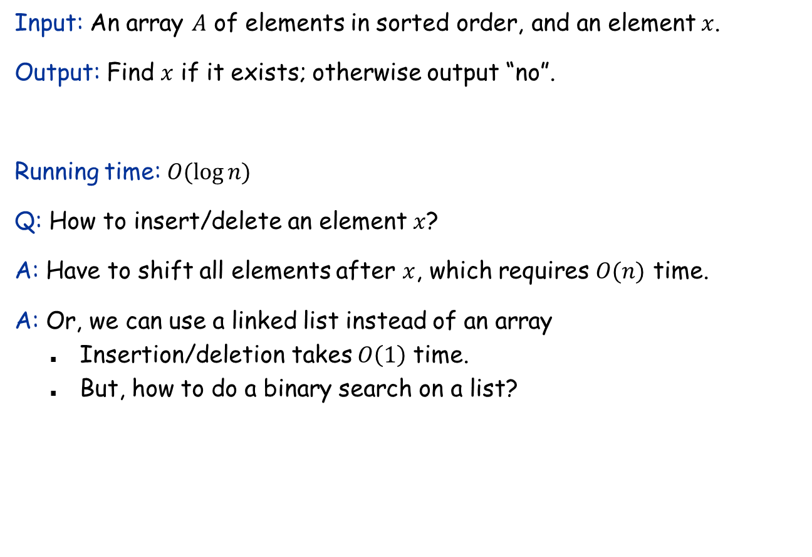
Recall the binary search algorithm
Input: An array $A$ of elements in sorted order, and an element $x$.
Output: Find $x$ if it exists; otherwise output “no”.
Running time: $O(\log{n)}$
Q: How to insert/delete an element $x$?
A: Have to shift all elements after $x$, which requires $O(n)$ time.
A: Or, we can use a linked list instead of an array
Insertion/deletion takes $O\left(1\right)$ time.
But, how to do a binary search on a list?
4
7
10
15
19
20
42
54
87
90

Slide 3
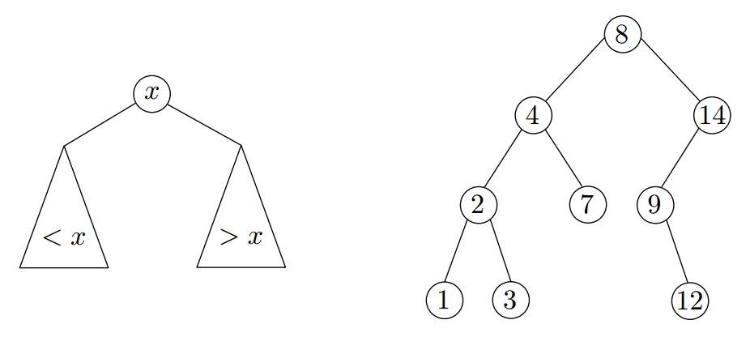
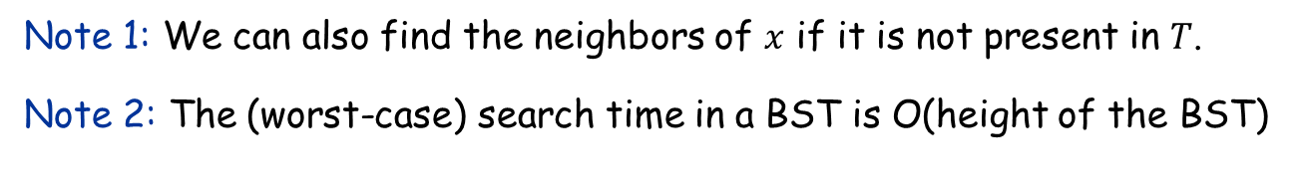
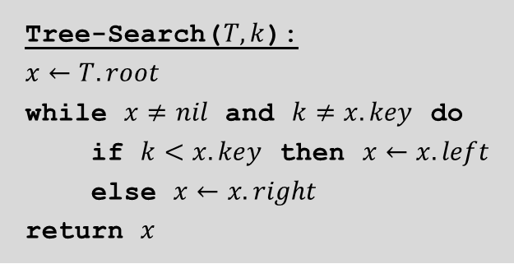
Binary search trees (BST)
Tree-Search($T,k$):
$$x←T.root$$
while $x≠nil$ and $k≠x.key$ do
if $k<x.key$ then $x←x.left$
else $x←x.right$
return $x$
Assumption: All keys are distinct
Note 1: We can also find the neighbors of $x$ if it is not present in $T$.
Note 2: The (worst-case) search time in a BST is O(height of the BST)

Slide 4
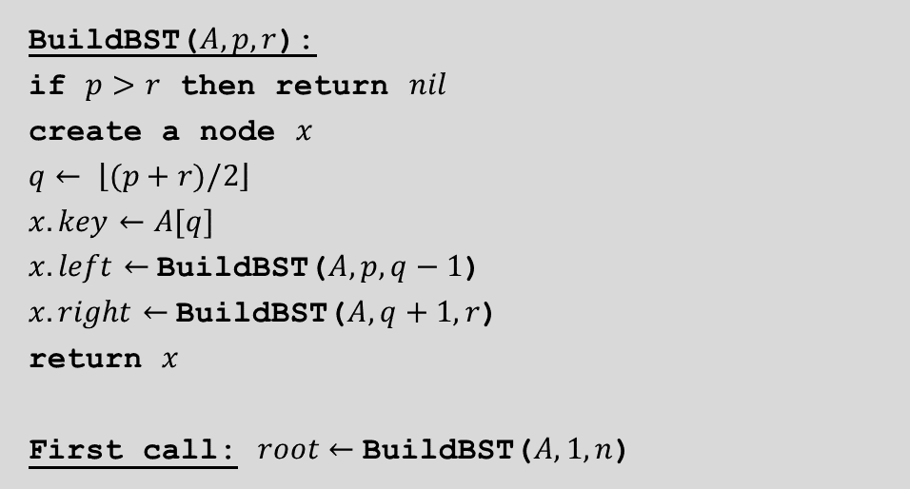
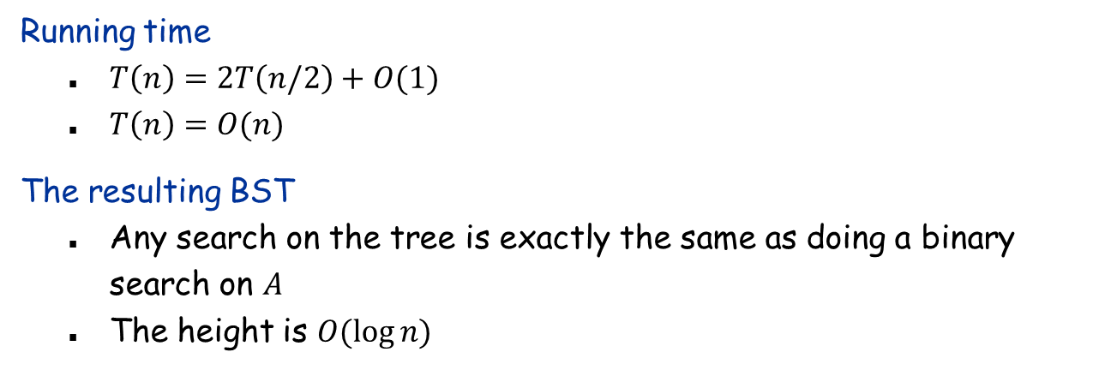
Building a BST from a sorted array
BuildBST($A, p, r$):
if $p>r$ then return $nil$
create a node $x$
$$q← \left\lfloor (p+r)/2\right\rfloor$$
$$x.key←A[q]$$
$x.left←$BuildBST($A,p,q−1$)
$x.right←$BuildBST($A,q+1,r$)
return $x$
First call: $root←$BuildBST($A,1,n$)
Running time
$T\left(n\right)=2T\left(n/2\right)+O(1)$
$T\left(n\right)=O(n)$
The resulting BST
Any search on the tree is exactly the same as doing a binary search on $A$
The height is $O(\log{n)}$

Slide 5
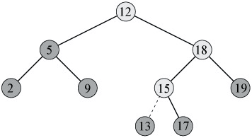
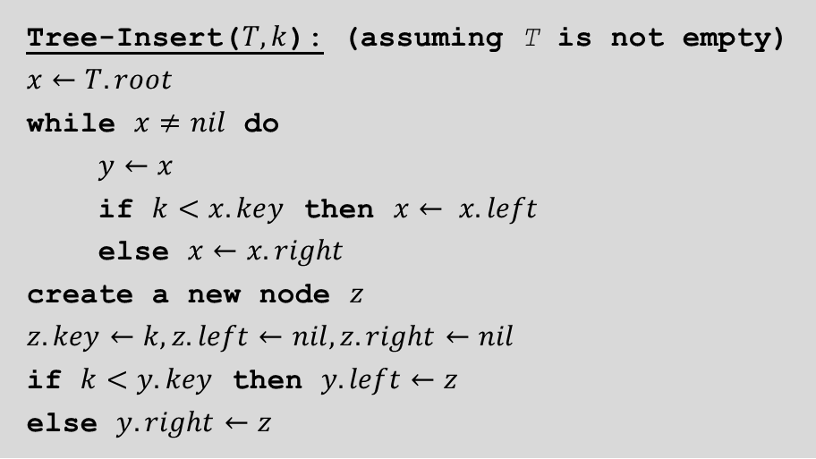
Insert into a BST
Tree-Insert($T, k$): (assuming T is not empty)
$$x←T.root$$
while $x≠nil$ do
$y←x$
if $k<x.key$ then $x← x.left$
else $x←x.right$
create a new node $z$
$$z.key←k,z.left←nil,z.right←nil$$
if $k<y.key$ then $y.left←z$
else $y.right←z$
The insertion time is O(height of the BST)
Deletion: See textbook (not required).

Slide 6

Problem with the insertion algorithm
If we insert all elements in sorted order…
Need a way to restore “balance” so that the height is always $O(\log{n)}$.
1
2
3
4
5

Slide 7
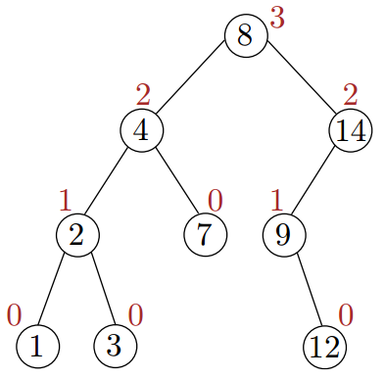
Height of a node
The height of a node in a tree is the number of edges on the longest downward path from the node to a leaf
Node height = max(children height) +1
Leaves: height = 0
Tree height = root height
Empty tree: height = −1

Slide 8
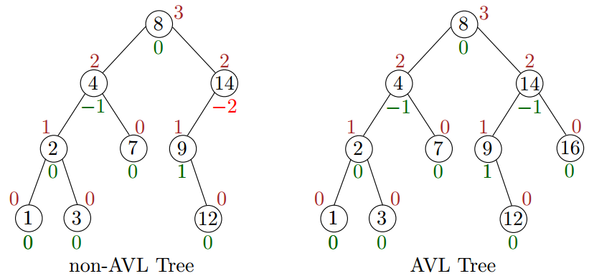

Balanced Binary Search Tree: AVL Tree
An AVL-tree is a binary search tree in which for every node in the tree, heights of its left and right subtrees differ by at most 1.
Q: Why is the height of an AVLtree $O(\log{n)}$?
Q: How to maintain the AVL property after an insertion/deletion?

Slide 9
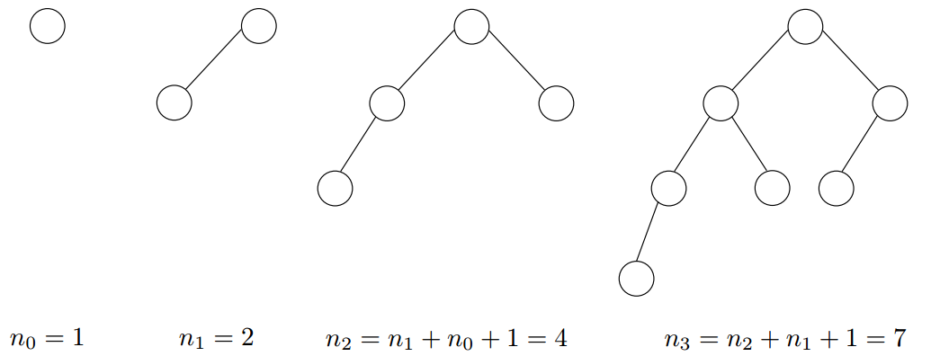

Height of an AVL-tree
Observation: Equivalent to show that # nodes $≥2^{ch}$ for an AVL-tree of height $h$ for some constant $c$.
Let $n_{h}$ be the minimum number of nodes in an AVL tree of height $h$.
${n≥n}_{h}≥2^{ch}⇔h≤\frac{1}{c}\log{n}=O(\log{n)}$

Slide 10

Height of an AVL-tree
Claim: $n_{h}≥2^{h/2}$
Pf: (by induction on $h$)
$n_{0}=1, n_{1}=2$ (base case)
Recurrence: $n_{h}= n_{h−1}+n_{h−2}+1$
$$nh=n_{h−1}+n_{h−2}+ 1$$ $≥2n_{h−2}$ ($n_{h−1}≥n_{h−2}+1$) $≥2⋅2^{(h−2)/2}$ (induction hypothesis) $=2^{h/2}$
Theorem: The height of an AVL-tree of $n$ nodes is $O(\log{n)}$.

Slide 11
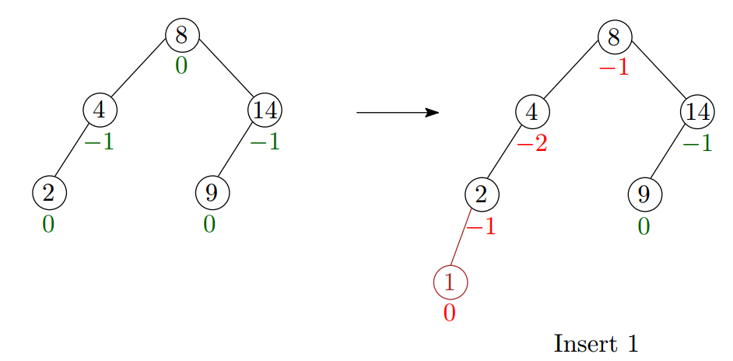

Restoring balance after an insertion
After an insertion, only nodes that are on the path from the insertion node to the root might have their balance altered
Because only those nodes have their subtrees altered
Idea:
Update the heights of these nodes from the insertion node
Stop when we find the lowest node $A$ violating AVL tree property
We will fix the tree at $A$.

Slide 12
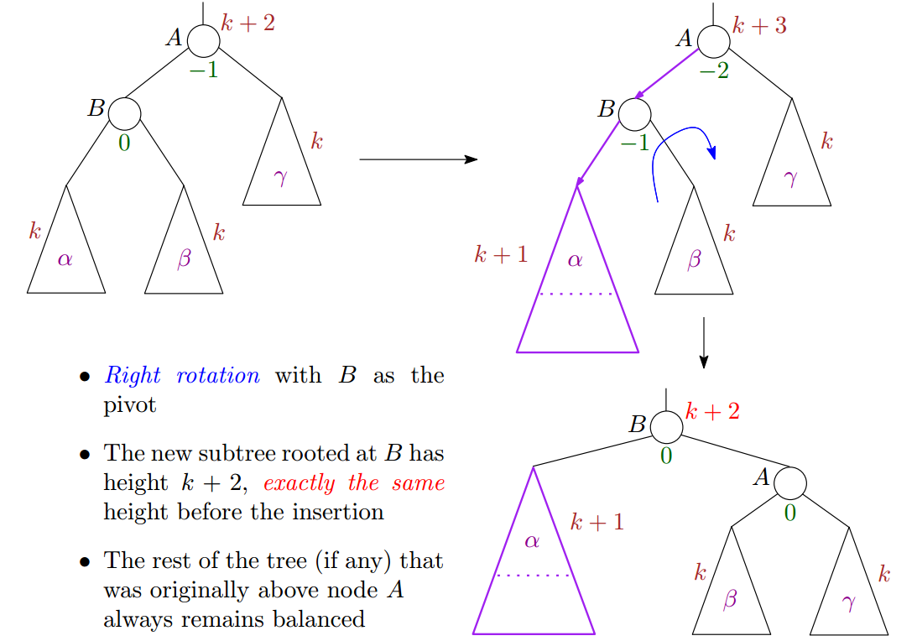

Left-left case
$P$: parent of $A$
$P.left←B$ (or $P.right←B$)
$$A.left←B.right$$
$$B.right←A$$

Slide 13
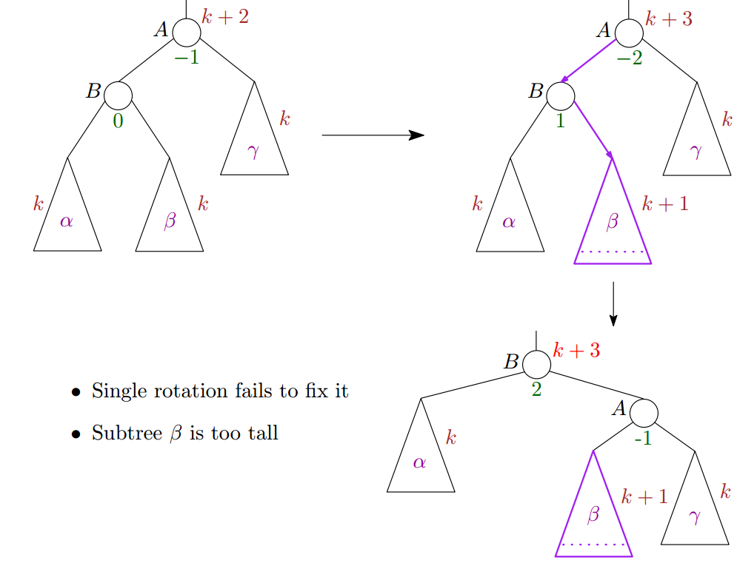
Left-right case

Slide 14
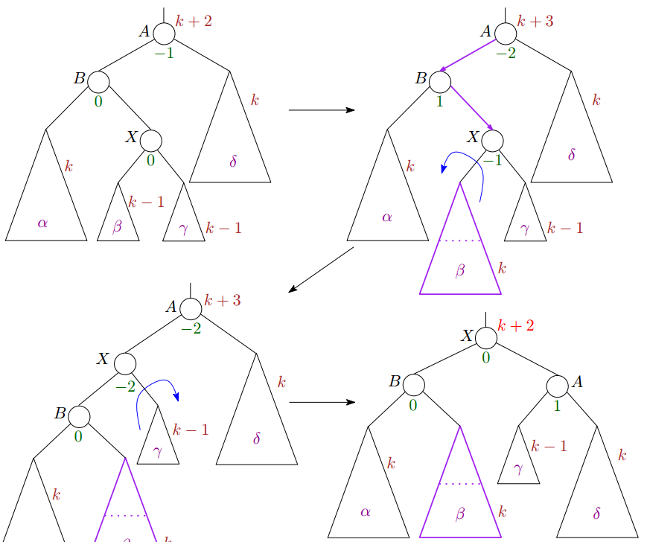

Left-right case
$P$: parent of $A$
$P.left←X$ (or $P.right←X$)
$$A.left←X.right$$
$$B.right←X.left$$
$$X.left←B$$
$$X.right←A$$

Slide 15
AVL-tree summary
Inserting into an AVL-tree
Insert the new element as a leaf
Update the height of every node above the inserted node, until we encounter the first node out of balance
Fix the balance (4 cases)
Left-left and right-right
Left-right and right-left
Deletion?
More complicated, when an internal node is deleted
Code is ugly
Not required for this course!
In practice:
map in C++ STL
Red-black tree (more complicated, but more efficient in terms of space; see textbook)

Slide 16
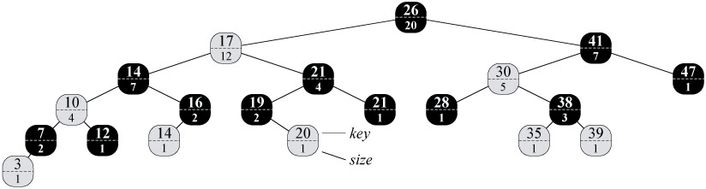
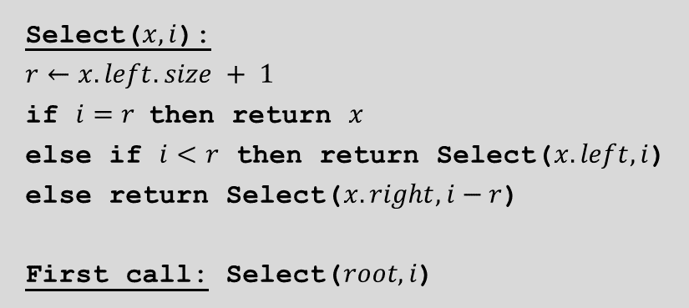

Augmenting BST with extra information
Select($x, i$):
$r←x.left.size + 1$
if $i=r$ then return $x$
else if $i<r$ then return Select($x.left, i$)
else return Select($x.right, i−r$)
First call: Select($root, i$)
Extra information: height
AVL-tree
Extra information: size of subtree
Retrieving the element with a given rank
Running time: $O(\log{n)}$
Note: This is a tail-recursion.

Slide 17
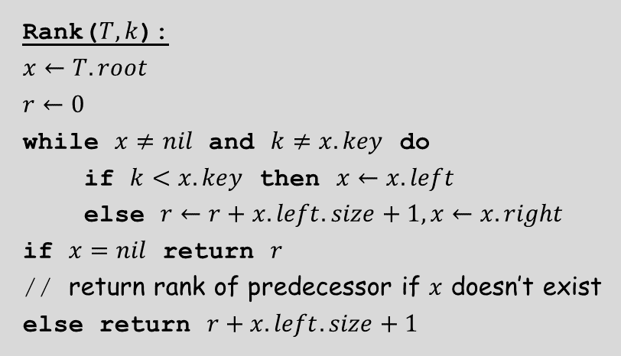

Augmenting BST with extra information
Rank($T, k$):
$$x←T.root$$
$$r←0$$
while $x≠nil$ and $k≠x.key$ do
if $k<x.key$ then $x←x.left$
else $r←r+x.left.size+1, x←x.right$
if $x=nil$ return $r$
// return rank of predecessor if $x$ doesn’t exist
else return $r+x.left.size+1$
Extra information: height
AVL-tree
Extra information: size of subtree
Retrieving the element with a given rank
Find the rank of any element
Running time: $O(\log{n)}$

Slide 18
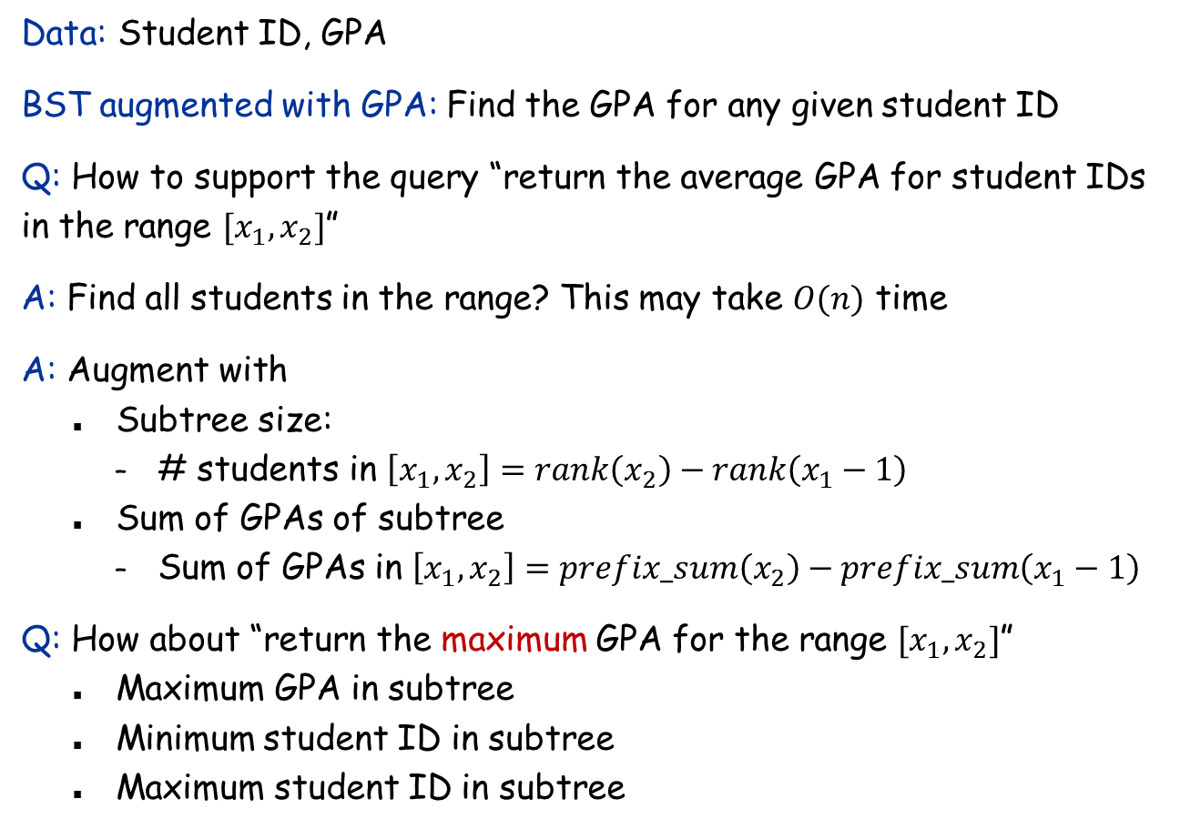
BST on 2-dimensional data
Data: Student ID, GPA
BST augmented with GPA: Find the GPA for any given student ID
Q: How to support the query “return the average GPA for student IDs in the range $[x_{1},x_{2}]$”
A: Find all students in the range? This may take $O(n)$ time
A: Augment with
Subtree size:
# students in $\left[x_{1},x_{2}\right]=rank\left(x_{2}\right)−rank\left(x_{1}−1\right)$
Sum of GPAs of subtree
Sum of GPAs in $\left[x_{1},x_{2}\right]=prefix_sum\left(x_{2}\right)−prefix_sum\left(x_{1}−1\right)$
Q: How about “return the maximum GPA for the range $[x_{1},x_{2}]$”
Maximum GPA in subtree
Minimum student ID in subtree
Maximum student ID in subtree

Slide 19
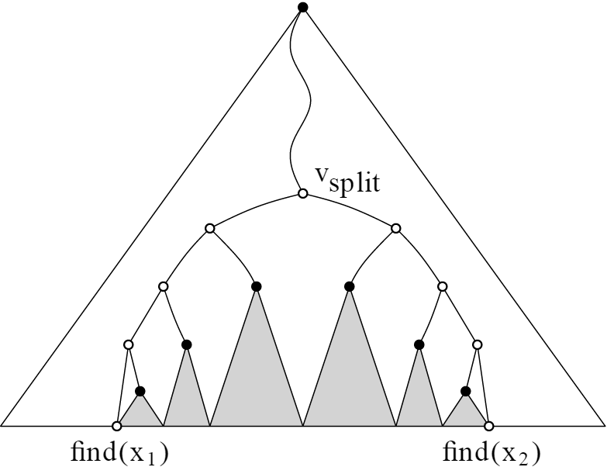
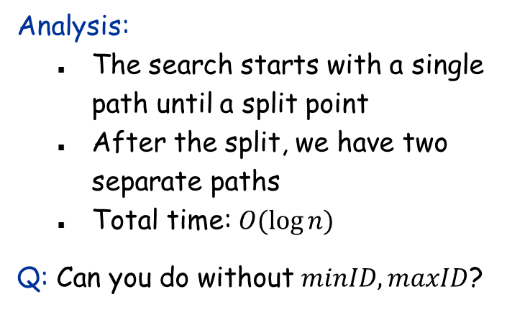
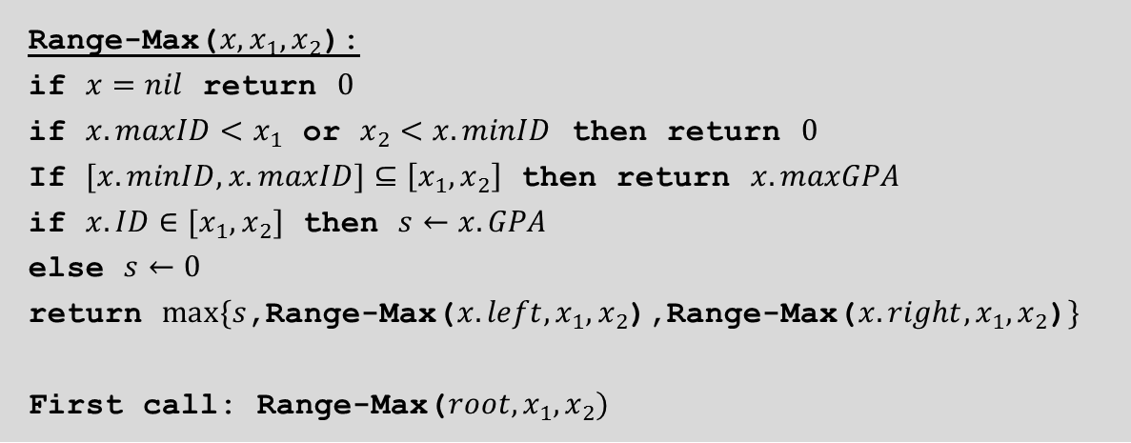
Range query
Range-Max($x, x_{1},x_{2}$):
if $x=nil$ return $0$
if $x.maxID<x_{1}$ or $x_{2}<x.minID$ then return $0$
If $[x.minID,x.maxID]⊆\left[x_{1},x_{2}\right]$ then return $x.maxGPA$
if $x.ID∈[x_{1},x_{2}]$ then $s←x.GPA$
else $s←0$
return $max\{s$,Range-Max($x.left,x_{1},x_{2}$),Range-Max($x.right,x_{1},x_{2}$)$\}$
First call: Range-Max($root,x_{1},x_{2})$
Analysis:
The search starts with a single path until a split point
After the split, we have two separate paths
Total time: $O(\log{n)}$
Q: Can you do without $minID,maxID$?

Slide 20


Maintaining extra information
How to maintain the extra information during an insertion?
Only need: $x.I=f(x,x.left.I,x.right.I)$
First update the extra information of all ancestors of the newly inserted node
During a rotation
Theorem: An augmented BST can be maintained in $O(\log{n)}$ time per insertion/deletion.
$P$: parent of $A$
$P.left←B$ (or $P.right←B$)
$$A.left←B.right$$
$$B.right←A$$
update extra info for $A$
update extra info for $B$

