Slide 1
Lecture 10: Hash Tables

Slide 2
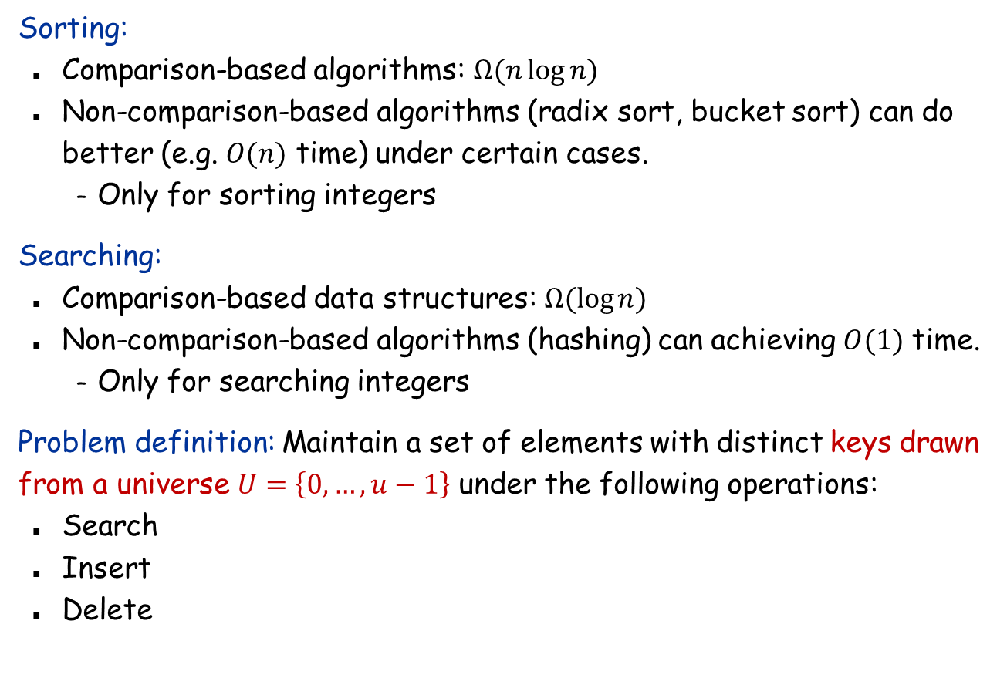
Breaking comparison-based lower bounds
Sorting:
Comparison-based algorithms: $Ω(n\log{n)}$
Non-comparison-based algorithms (radix sort, bucket sort) can do better (e.g. $O(n)$ time) under certain cases.
Only for sorting integers
Searching:
Comparison-based data structures: $Ω(\log{n)}$
Non-comparison-based algorithms (hashing) can achieving $O(1)$ time.
Only for searching integers
Problem definition: Maintain a set of elements with distinct keys drawn from a universe $U=\left\{0,…,u−1\right\}$ under the following operations:
Search
Insert
Delete

Slide 3
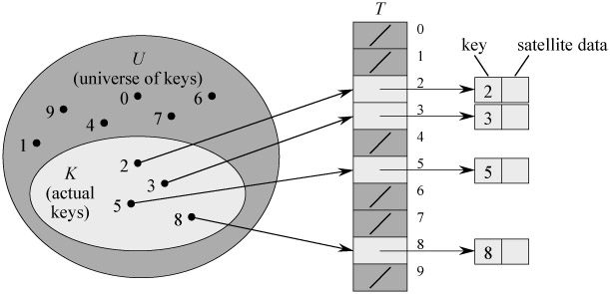

A trivial solution that achieves $O(1)$ time per operation
Solution:
Create an array $A[0..u−1]$.
Store the element with key $x$ at $A[x]$
Drawback: Huge space usage.
What if $U$ is the set of all IP addresses (think about IPv6)?

Slide 4
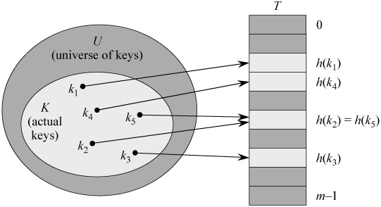
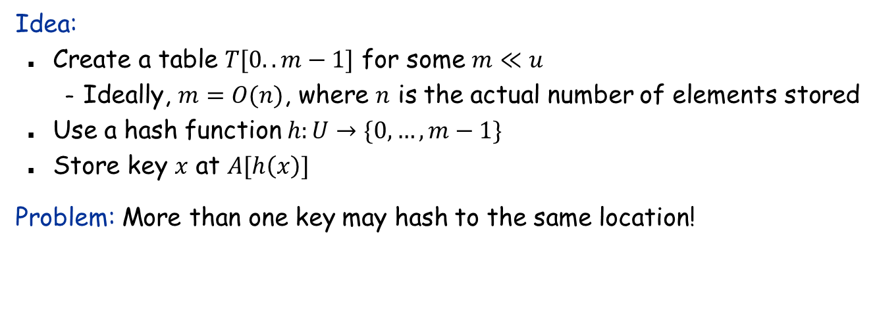
Reducing space
Idea:
Create a table $T[0..m−1]$ for some $m≪u$
Ideally, $m=O(n)$, where $n$ is the actual number of elements stored
Use a hash function $h:U→\{0,…,m−1\}$
Store key $x$ at $A[h\left(x\right)]$
Problem: More than one key may hash to the same location!

Slide 5
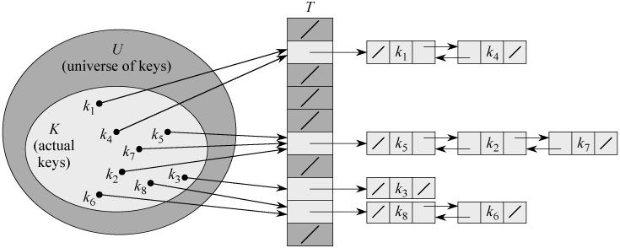
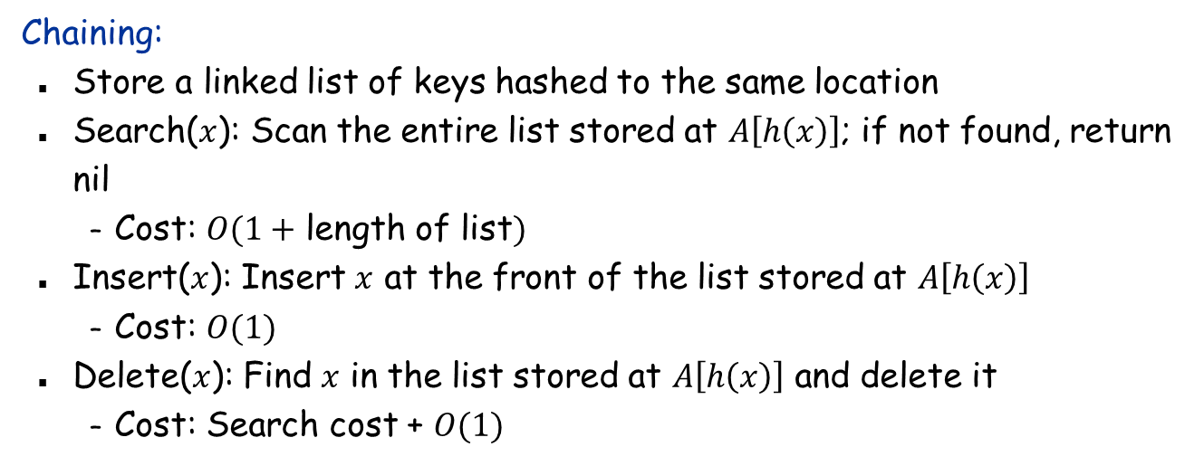
Collision Resolution by Chaining
Chaining:
Store a linked list of keys hashed to the same location
Search($x$): Scan the entire list stored at $A\left[h\left(x\right)\right]$; if not found, return nil
Cost: $O(1+$ length of list$)$
Insert($x$): Insert $x$ at the front of the list stored at $A\left[h\left(x\right)\right]$
Cost: $O(1)$
Delete($x$): Find $x$ in the list stored at $A\left[h\left(x\right)\right]$ and delete it
Cost: Search cost + $O(1)$

Slide 6
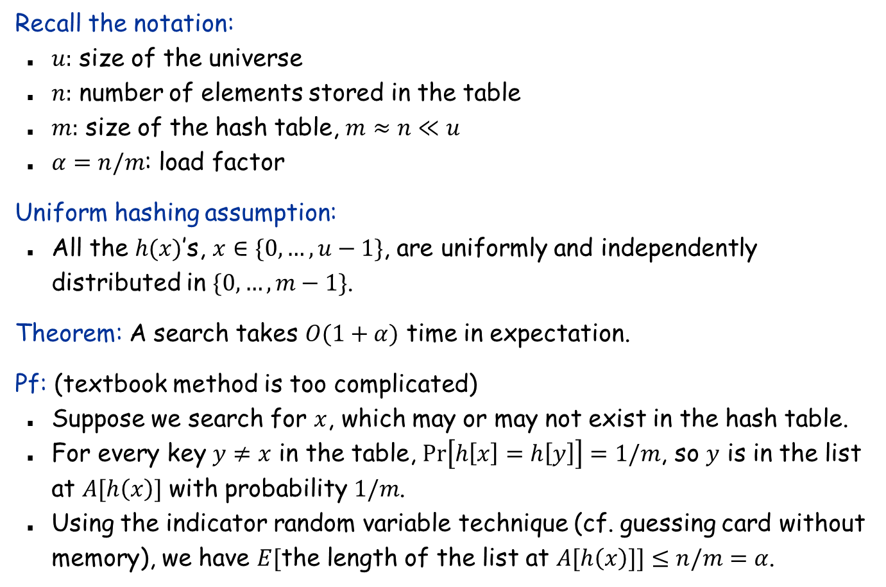
Analysis of Hashing with Chaining
Recall the notation:
$u:$ size of the universe
$n:$ number of elements stored in the table
$m:$ size of the hash table, $m≈n≪u$
$α=n/m$: load factor
Uniform hashing assumption:
All the $h(x)$’s, $x∈\{0,…,u−1\}$, are uniformly and independently distributed in $\{0,…,m−1\}$.
Theorem: A search takes $O(1+α)$ time in expectation.
Pf: (textbook method is too complicated)
Suppose we search for $x$, which may or may not exist in the hash table.
For every key $y≠x$ in the table, $Pr\left[h\left[x\right]=h\left[y\right]\right]=1/m$, so $y$ is in the list at $A[h\left(x\right)]$ with probability $1/m$.
Using the indicator random variable technique (cf. guessing card without memory), we have $E[$the length of the list at $A[h\left(x\right)]]≤n/m=α$.

Slide 7
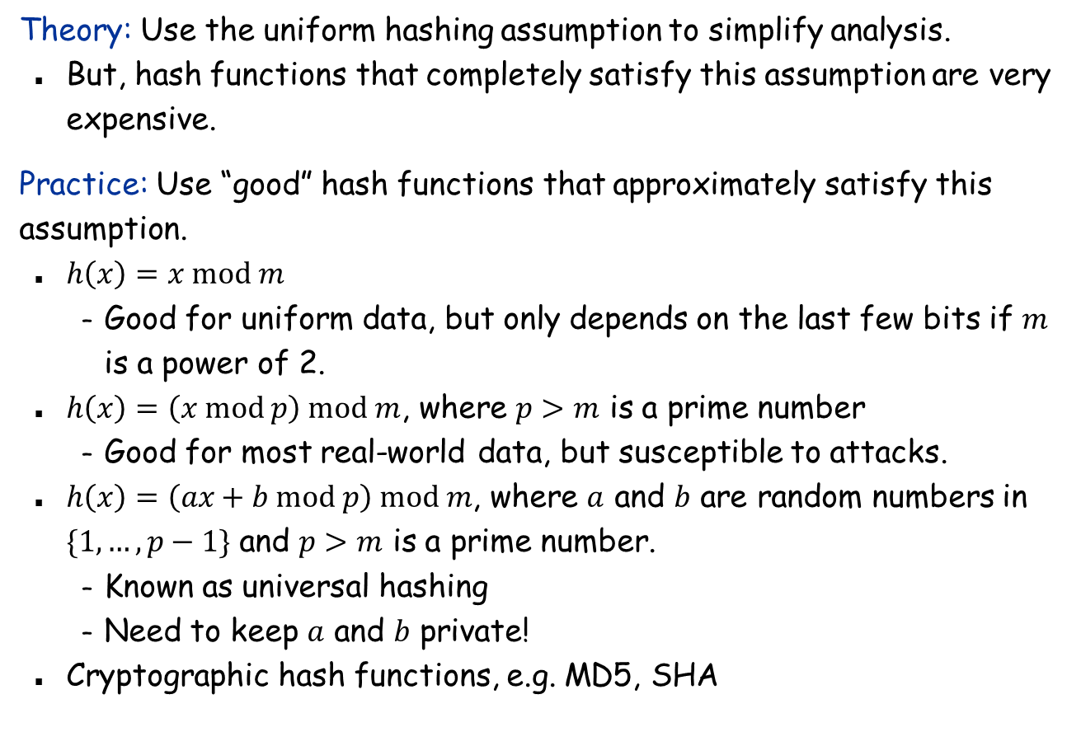
Hash Functions
Theory: Use the uniform hashing assumption to simplify analysis.
But, hash functions that completely satisfy this assumption are very expensive.
Practice: Use “good” hash functions that approximately satisfy this assumption.
$h\left(x\right)=x mod m$
Good for uniform data, but only depends on the last few bits if $m$ is a power of 2.
$h\left(x\right)=\left(x mod p\right) mod m$, where $p>m$ is a prime number
Good for most real-world data, but susceptible to attacks.
$h\left(x\right)=\left(ax+b mod p\right) mod m$, where $a$ and $b$ are random numbers in $\{1,…,p−1\}$ and $p>m$ is a prime number.
Known as universal hashing
Need to keep $a$ and $b$ private!
Cryptographic hash functions, e.g. MD5, SHA

Slide 8
Hashing non-integer data
int h(String s, int n) {
int hash = 0;
for (int i = 0; i < s.length(); i++)
hash = (31 * hash) + s[i];
return hash mod n;
}
hash function ala Java string library

Slide 9
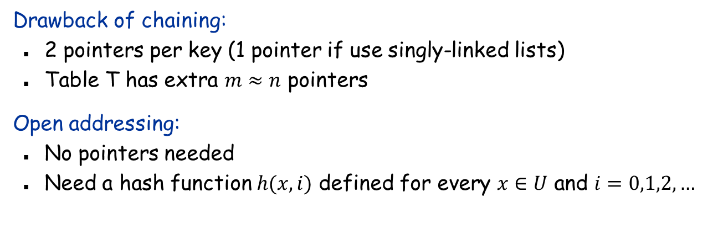
Open Addressing
Drawback of chaining:
2 pointers per key (1 pointer if use singly-linked lists)
Table T has extra $m≈n$ pointers
Open addressing:
No pointers needed
Need a hash function $h(x,i)$ defined for every $x∈U$ and $i=0,1,2,…$

Slide 10
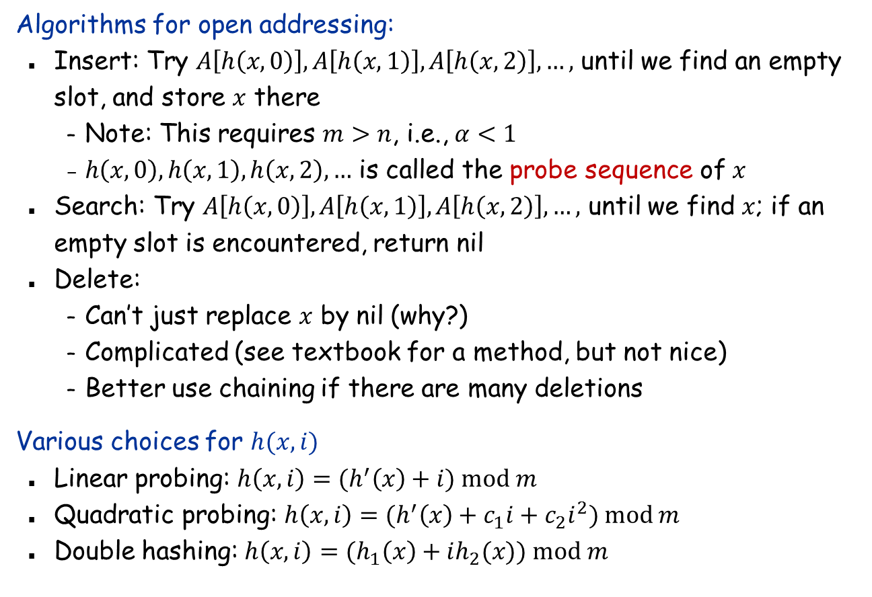
Open Addressing
Algorithms for open addressing:
Insert: Try $A\left[h\left(x,0\right)\right],A\left[h\left(x,1\right)\right],A\left[h\left(x,2\right)\right],…,$ until we find an empty slot, and store $x$ there
Note: This requires $m>n$, i.e., $α<1$
$h\left(x,0\right),h\left(x,1\right),h\left(x,2\right),…$ is called the probe sequence of $x$
Search: Try $A\left[h\left(x,0\right)\right],A\left[h\left(x,1\right)\right],A\left[h\left(x,2\right)\right],…,$ until we find $x$; if an empty slot is encountered, return nil
Delete:
Can’t just replace $x$ by nil (why?)
Complicated (see textbook for a method, but not nice)
Better use chaining if there are many deletions
Various choices for $h(x,i)$
Linear probing: $h\left(x,i\right)={(h}^{′}\left(x\right)+i) mod m$
Quadratic probing: $h\left(x,i\right)={(h}^{′}\left(x\right)+c_{1}i+c_{2}i^{2}) mod m$
Double hashing: $h\left(x,i\right)=(h_{1}\left(x\right)+ih_{2}(x)) mod m$

Slide 11
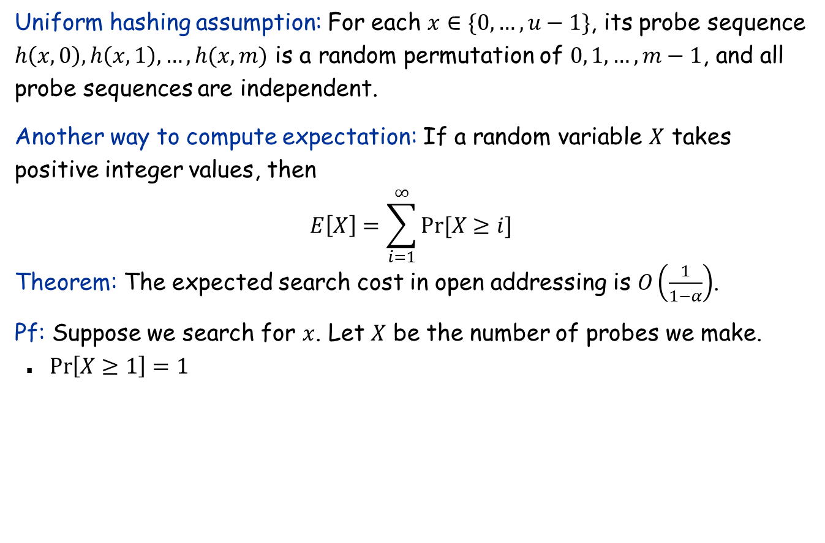
Analysis of Open Addressing
Uniform hashing assumption: For each $x∈\{0,…,u−1\}$, its probe sequence $h\left(x,0\right),h\left(x,1\right),…,h(x,m)$ is a random permutation of $0, 1,…, m−1$, and all probe sequences are independent.
Another way to compute expectation: If a random variable $X$ takes positive integer values, then
$$E\left[X\right]=\sum_{i=1}^{∞}{Pr⁡[X≥i]}$$
Theorem: The expected search cost in open addressing is $O\left(\frac{1}{1−α}\right)$.
Pf: Suppose we search for $x$. Let $X$ be the number of probes we make.
$\operatorname{Pr}\left[X≥1\right]=1$

Slide 12
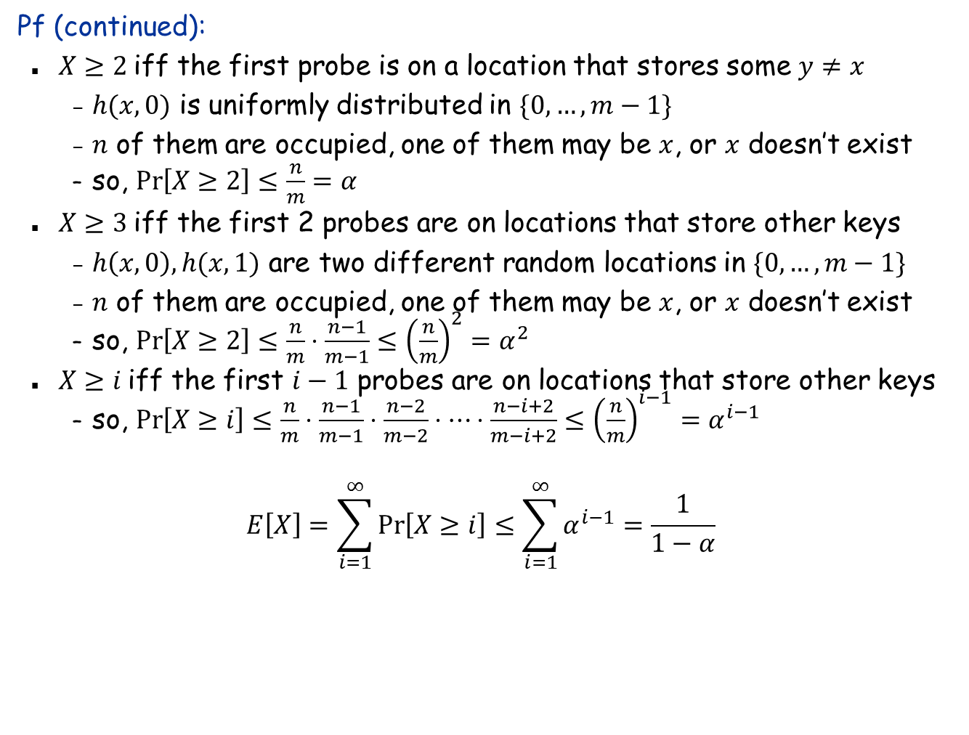
Analysis of Open Addressing
Pf (continued):
$X≥2$ iff the first probe is on a location that stores some $y≠x$
$h(x,0)$ is uniformly distributed in $\{0,…,m−1\}$
$n$ of them are occupied, one of them may be $x$, or $x$ doesn’t exist
so, $\operatorname{Pr}\left[X≥2\right]≤\frac{n}{m}=α$
$X≥3$ iff the first 2 probes are on locations that store other keys
$h\left(x,0\right),h(x,1)$ are two different random locations in $\{0,…,m−1\}$
$n$ of them are occupied, one of them may be $x$, or $x$ doesn’t exist
so, $\operatorname{Pr}\left[X≥2\right]≤\frac{n}{m}⋅\frac{n−1}{m−1}≤{\left(\frac{n}{m}\right)}^{2}=α^{2}$
$X≥i$ iff the first $i−1$ probes are on locations that store other keys
so, $\operatorname{Pr}\left[X≥i\right]≤\frac{n}{m}⋅\frac{n−1}{m−1}⋅\frac{n−2}{m−2}⋅⋯⋅\frac{n−i+2}{m−i+2}≤{\left(\frac{n}{m}\right)}^{i−1}=α^{i−1}$
$$E\left[X\right]=\sum_{i=1}^{∞}{\operatorname{Pr}\left[X≥i\right]}≤\sum_{i=1}^{∞}{α^{i−1}=\frac{1}{1−α}}$$

Slide 13

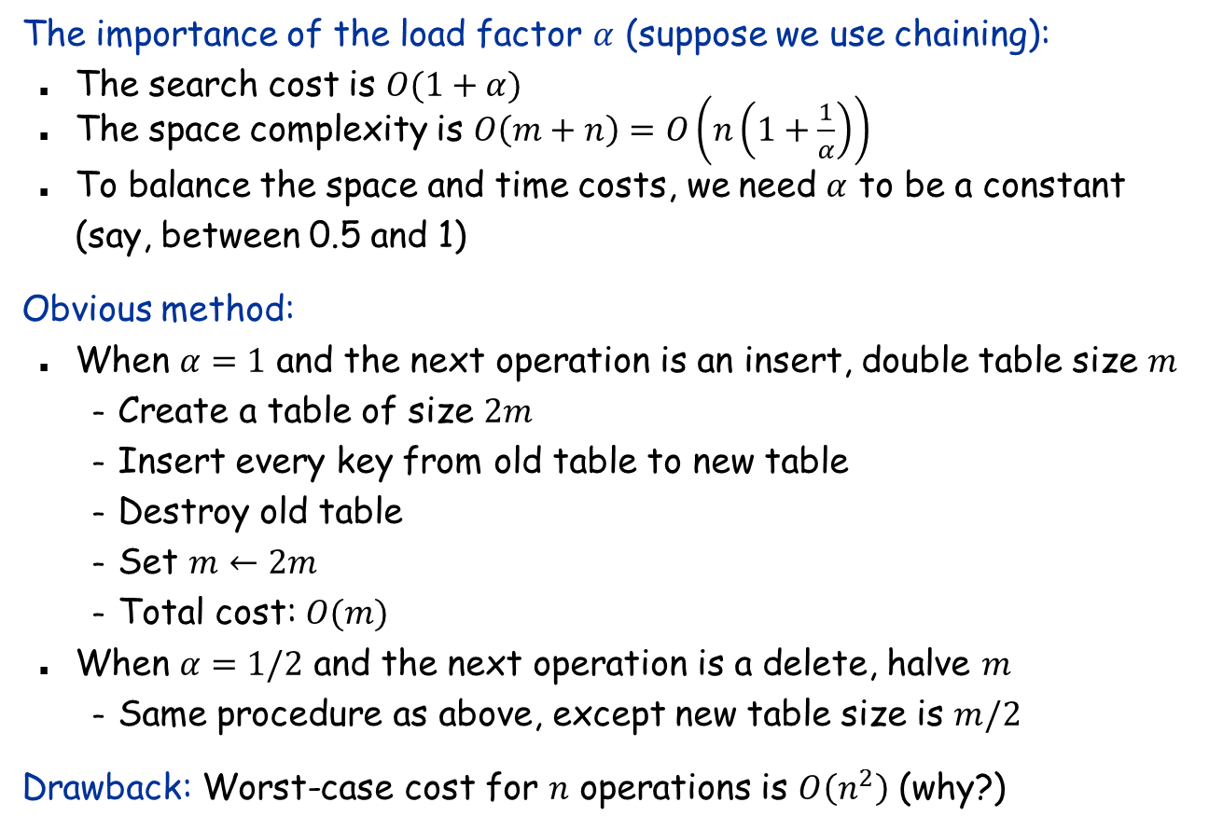
Dynamic Hash Tables
The importance of the load factor $α$ (suppose we use chaining):
The search cost is $O(1+α)$
The space complexity is $O\left(m+n\right)=O\left(n\left(1+\frac{1}{α}\right)\right)$
To balance the space and time costs, we need $α$ to be a constant (say, between 0.5 and 1)
Obvious method:
When $α=1$ and the next operation is an insert, double table size $m$
Create a table of size $2m$
Insert every key from old table to new table
Destroy old table
Set $m←2m$
Total cost: $O(m)$
When $α=1/2$ and the next operation is a delete, halve $m$
Same procedure as above, except new table size is $m/2$
Drawback: Worst-case cost for $n$ operations is $O\left(n^{2}\right)$ (why?)
$$1/4$$

Slide 14
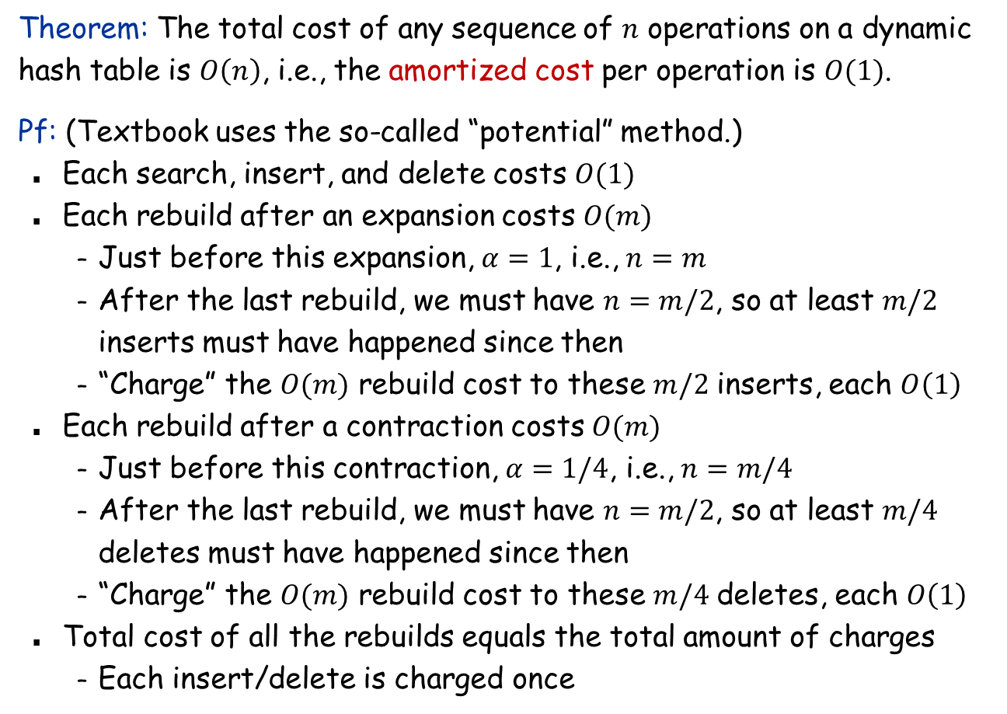
Analysis
Theorem: The total cost of any sequence of $n$ operations on a dynamic hash table is $O\left(n\right)$, i.e., the amortized cost per operation is $O(1)$.
Pf: (Textbook uses the so-called “potential” method.)
Each search, insert, and delete costs $O(1)$
Each rebuild after an expansion costs $O(m)$
Just before this expansion, $α=1$, i.e., $n=m$
After the last rebuild, we must have $n=m/2$, so at least $m/2$ inserts must have happened since then
“Charge” the $O(m)$ rebuild cost to these $m/2$ inserts, each $O\left(1\right)$
Each rebuild after a contraction costs $O(m)$
Just before this contraction, $α=1/4$, i.e., $n=m/4$
After the last rebuild, we must have $n=m/2$, so at least $m/4$ deletes must have happened since then
“Charge” the $O(m)$ rebuild cost to these $m/4$ deletes, each $O\left(1\right)$
Total cost of all the rebuilds equals the total amount of charges
Each insert/delete is charged once

Slide 15
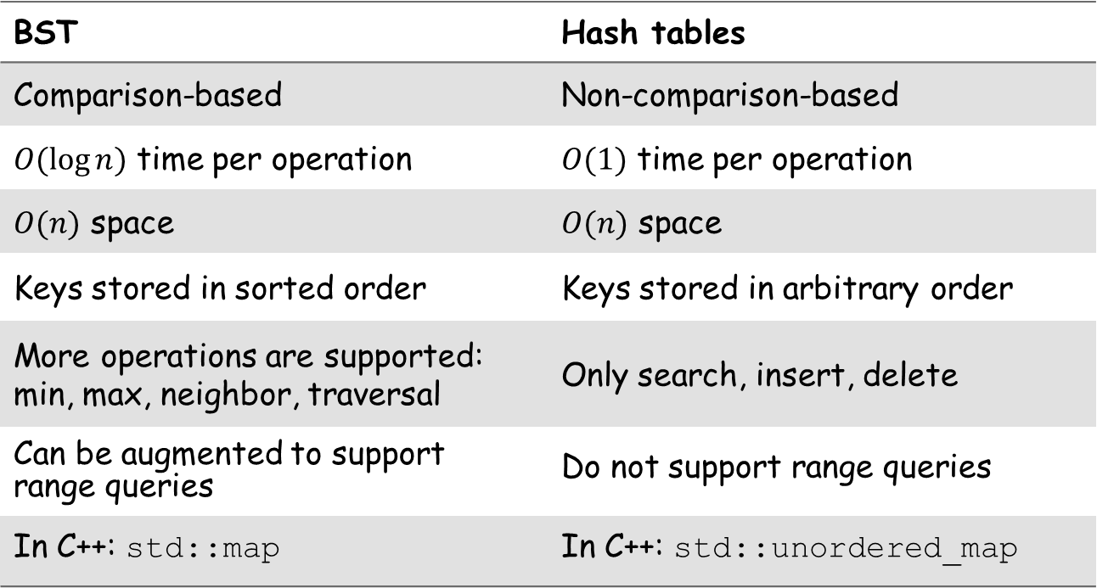
Comparison between BST and hash tables
BST | Hash tables
Comparison-based | Non-comparison-based
$O(\log{n})$ time per operation | $O(1)$ time per operation
$O(n)$ space | $O(n)$ space
Keys stored in sorted order | Keys stored in arbitrary order
More operations are supported: min, max, neighbor, traversal | Only search, insert, delete
Can be augmented to support range queries | Do not support range queries
In C++: std::map | In C++: std::unordered_map

